Slide 1
The Many Voices Publishing Platform
Group 61 — Progress Report — Fall 2016

Slide 2
Introduction

Slide 3

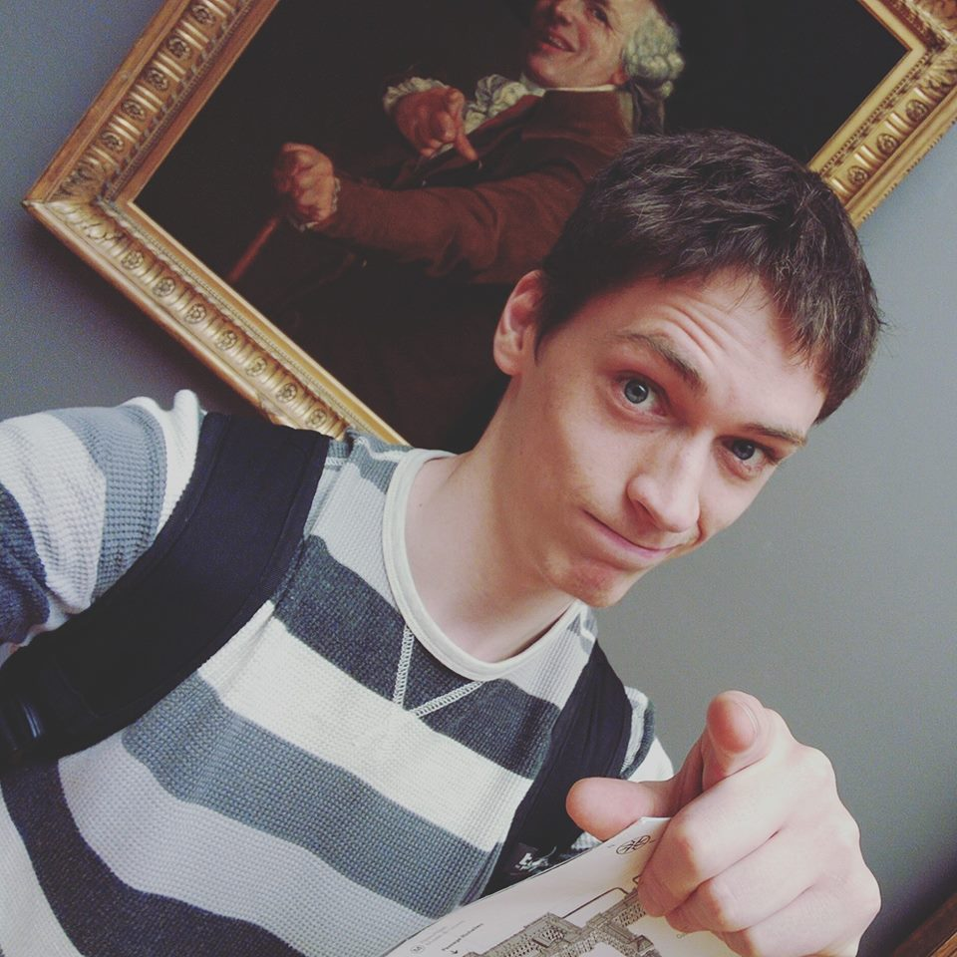
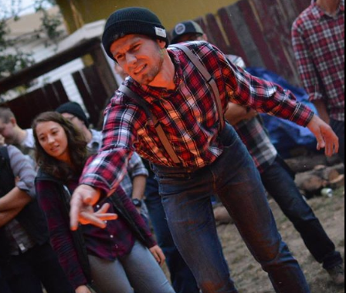
Team Remix
Steven Powers, DBA, UI/UX, Web, NWEP
Evan Tschuy, infrastructure, CoreOS
Josh Matteson, MECOP, Web

Slide 4

Our Teaching Assistant
Jon Dodge
PhD student, Computer Science
Used under fair use http://clipartsign.com/image/18721/

Slide 5
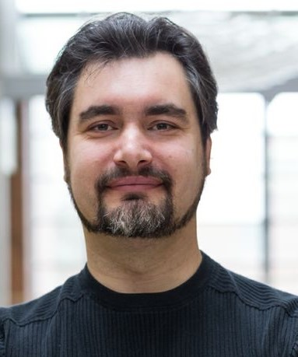
Our Client
Dr. Carlos Jensen
Director of CASS
Associate professor in the School of EECS at OSU
Areas of Interest
Teaches Social and Ethical Issues in CS

Slide 6
Our Client
Writing a textbook
Frustrated with current offerings in the textbook market
Interested in a better way to write textbooks for everyone

Slide 7
Problem Definition
Textbooks cost exorbitant amounts of money
Textbooks are often filled with poor or incorrect information
Additional resources

Slide 8
Proposed Solutions
Allow professors to create their own textbooks
Reducing costs for students
Increasing updates of information
Editing capabilities
Publishing
Searching for content

Slide 9
Definitions
Scrap - A section of a textbook, which can contain text or media
Section - An ordered collection of Scraps belonging to a chapter
Chapter - An ordered collection of Sections and Scraps

Slide 10
MVP Platform
What it does
What it will look like
Why we are developing it
Who will use it
Description & Purpose

Slide 11
What it does
A platform for creative textbook remixing using content from other experts in your field.
Create the perfect textbook by “remixing” exactly the texts you want
Search for new texts with easy-to-use discovery tools

Slide 12
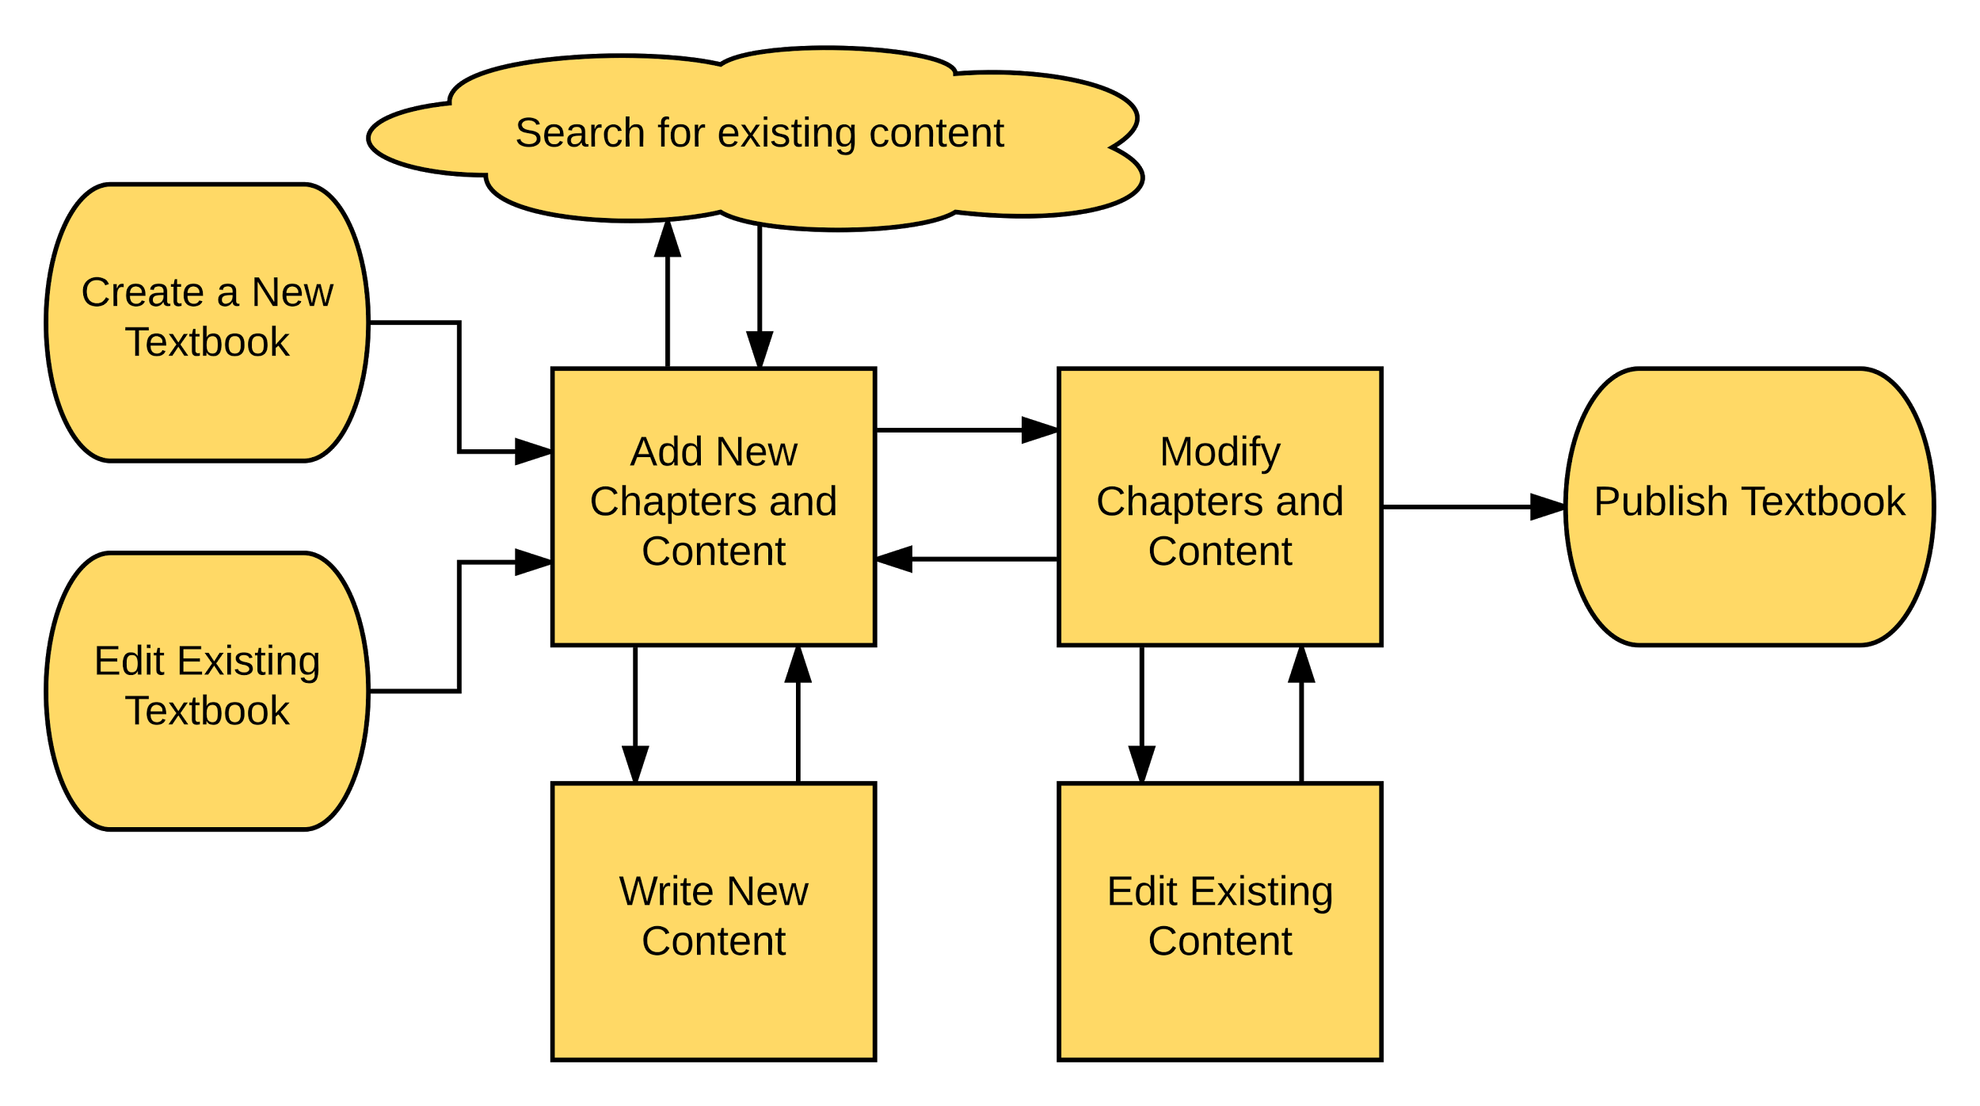
What it will look like

Slide 13
Why we are developing it
Customizing a textbook is currently not possible
Textbook writing should be like research — collaborative and open
A professor should not have to choose between having to spend years of time writing and not having the text they need to teach effectively

Slide 14
Who will use it
Professors that want to have a highly customized textbook without spending their life writing it
Those that want to “remix” existing textbooks to match their course focus area

Slide 15
MVP Platform
Frontend
Backend
Revision Control
Design

Slide 16
Frontend: Aurelia
A JavaScript framework in use since 2010
Similar to AngularJS
Compliant with W3C

Slide 17
Backend: NodeJS
Using the Express framework
NodeGit library for communication with Git

Slide 18
Git as Textbook Revision Control
Open Source
Individual scrap/section/chapter changes will be tracked on individual repositories to allow easy forking

Slide 19
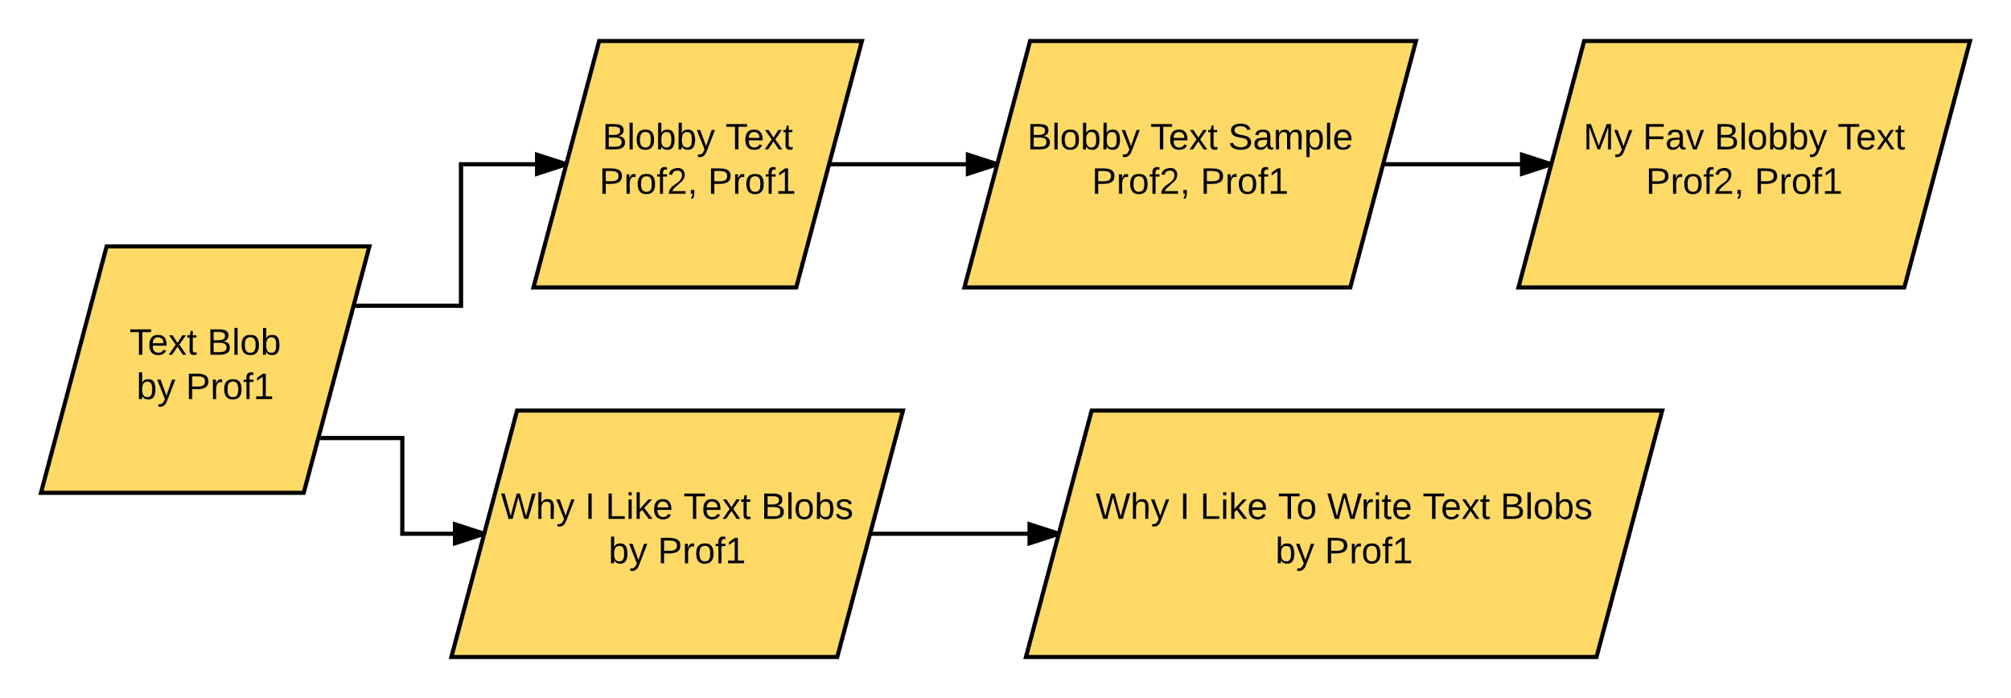
Textbook Revision Control
Textbooks can be forked and contributed to by users wanting to customize them

Slide 20
MVP Platform
Vision
Time Frame
Goals

Slide 21
Vision
An easy-to-use platform
A product that can revolutionize the textbook industry
Make it simple to have the book you want in your classroom, even if it doesn’t exist yet

Slide 22
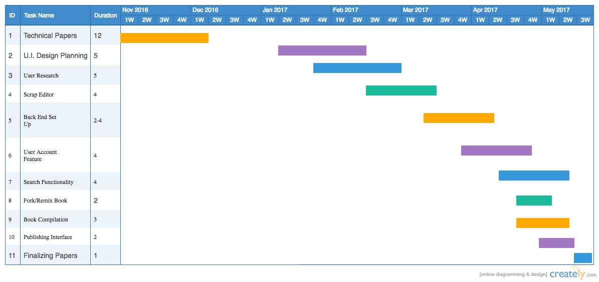
Time Frame
Time Frame

Slide 23
MVP Platform
Impediments
What’s Next
Other Details

Slide 24
Impediments
Client communication has proved more difficult than we expected.
We are addressing this by planning for weekly meetings, in addition to weekly emails with our client.

Slide 25
Impediments
Time availability has been a difficult balance between our various classes
Next term’s schedules have been arranged to have a set meeting time for the group once a week

Slide 26
What’s Next

Slide 27
Implementation
Moving from technology decisions into development the phase
Frontend functionality design
Backend API design and data storage

Slide 28
Conclusion

