Slide 1
CINEMATICS
Mobile Application Development
Submitted to:
Dr. Jake A. Qualls
Department of Computer Computer Science
May 2020
Submitted by:
Nishchit Pandey
50551164

Slide 2
OBJECTIVES
To provide a single system for different activities like viewing movies and their details, finding the ratings and reviews, searching, booking tickets, etc.
To provide an easier and faster arena for all movie lovers.

Slide 3
APPLCATION
It can be used by movie admirers to review and rate movies they like.
It can be used to help users to choose a movie based on their choices and type.
It can be used to know about the details and summary of the movies one is searching for.
. It can be used to gain information about the upcoming movies.

Slide 4
PROJECT FEATURES
Login feature.
Rating.
Writing reviews.
Categorizing movies.
Display upcoming movies.
Search option.

Slide 5
SYSTEM REQURIMENTS
Software Requirement
To run the program: To build the program:
i. Android 5.0 (Lollipop) or newer i. Java JDK 8
ii. Android Studio
iii. Windows 7 or above
iv. Linux
Hardware Requirement
To run this program : To build the program:
i. 4 GB of RAM
i. Integrated graphics ii. i3 processor or above, 5 GB of Hard
disk
Feasibility: Technical, economical ,etc.

Slide 6
Literature Review
TeeVee3
IMDb
Movies by Flixter

Slide 7
SYSTEM DESIGN
1. TMDb
2. Retrofit
3. Realm
4. Picasso

Slide 8
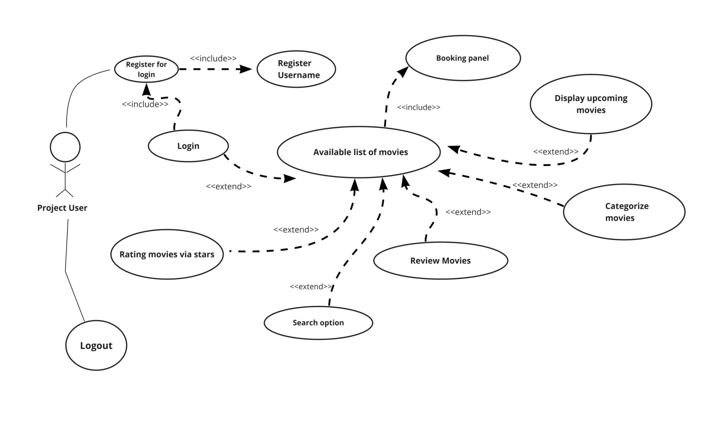
User Case Diagram

Slide 9
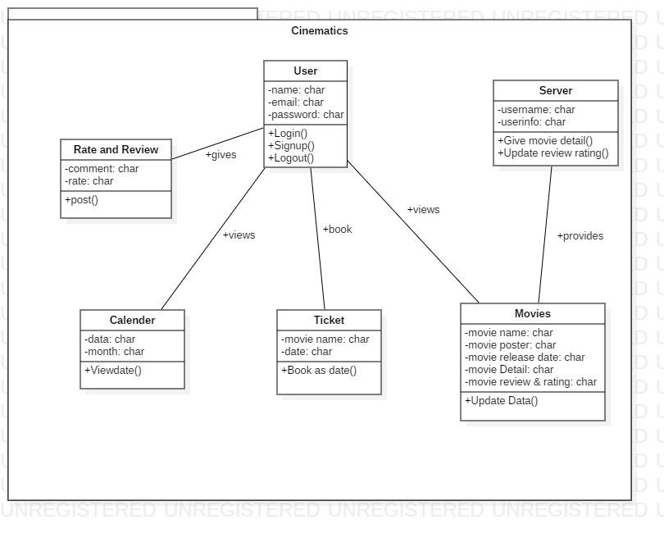
Class Diagram

Slide 10
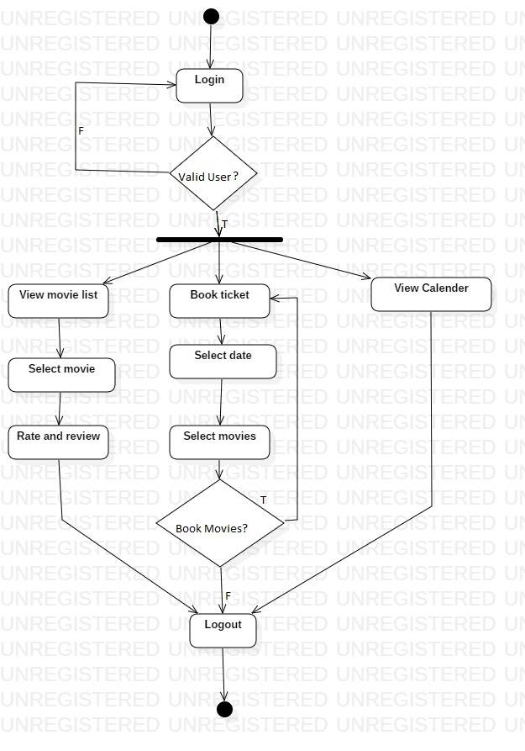
Activity Diagram

Slide 11
WHAT DOES THE SYSTEM DO?

Slide 12
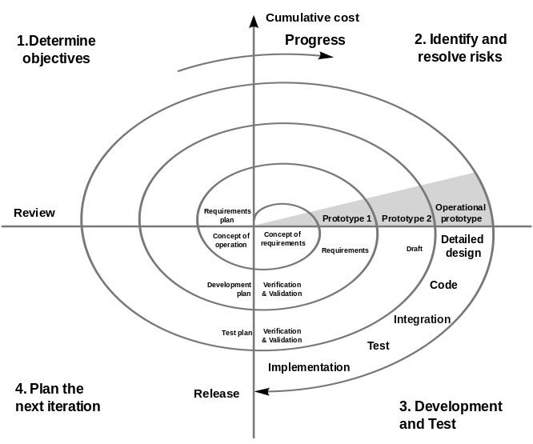
SOFTWARE DEVELOPMENT MODEL
Source: www.google.com

Slide 13
Limitations
The booking activity of our project does not provide the user with the option of selecting their desired seat or time for their movie.
The calendar feature does not display the upcoming movies like planned originally.

Slide 14
PROBLEM FACED

Slide 15
Working Schedule

Slide 16
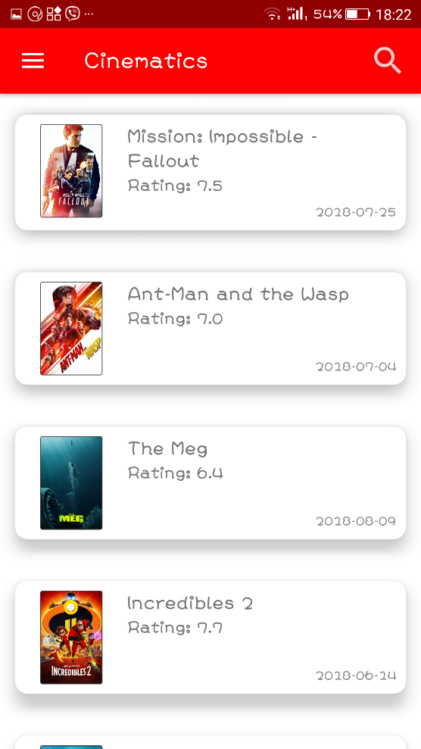
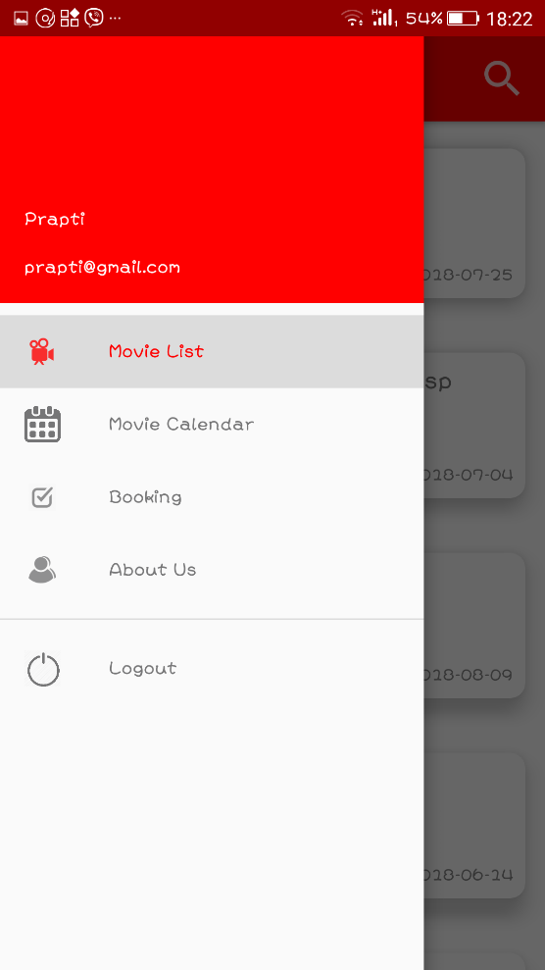
OUTPUT

Slide 17
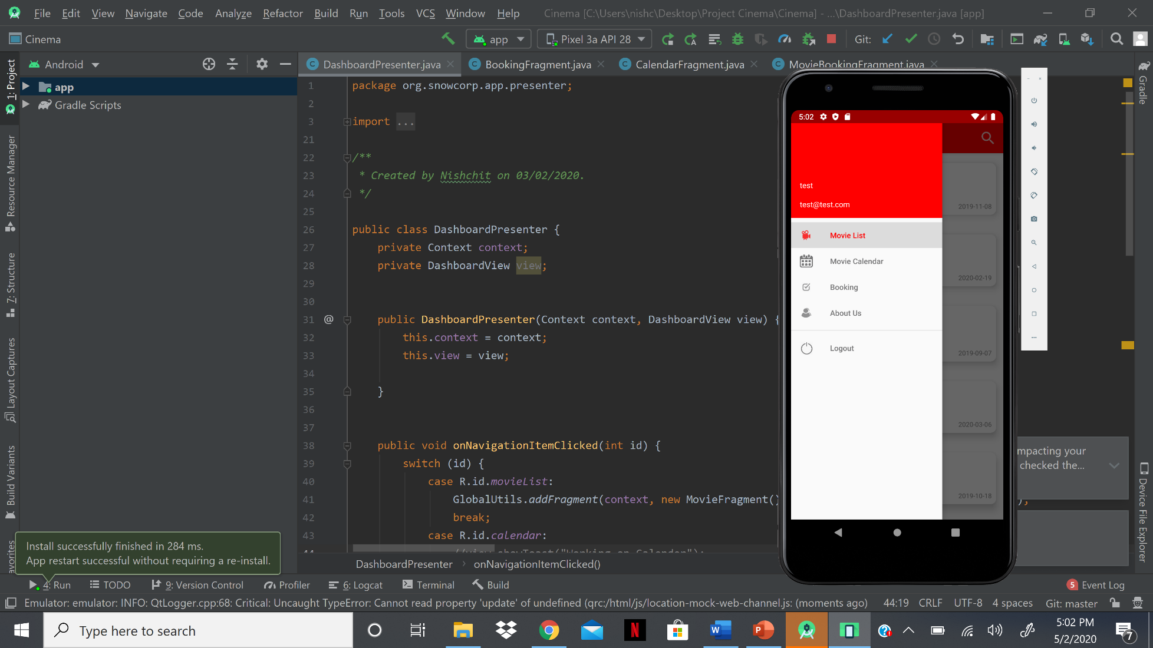
Output

Slide 18
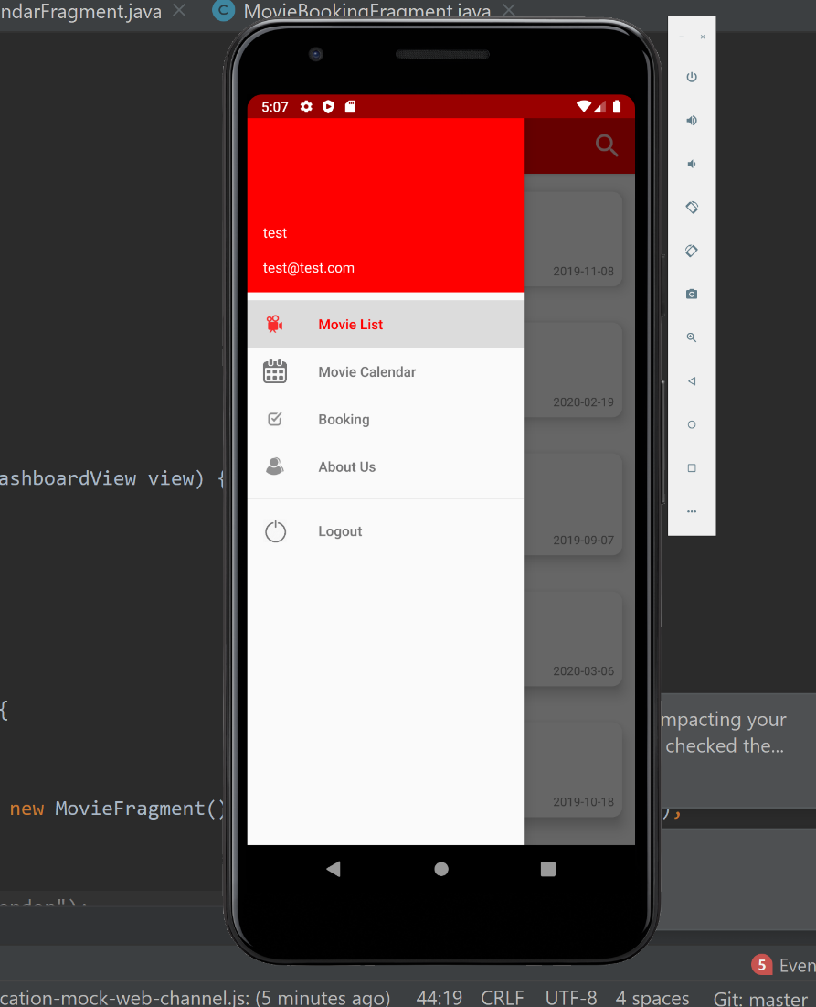
Output

Slide 19
CONCLUSION AND FUTURE ENHANCEMENTS

Slide 20
Conclusion
Watching movies gives us to reason to think, imagine, guess and even visualize other’s perspective as our own. Movies are made with proper screenplays succeed more than movies with intense stories, the way the cinematography create a small imaginary world within 3hours is a hidden art inside every films. Keeping this in mind, I have have created our app “Cinematics” in an attempt to provide movie lovers with a platform that will make their experience a lot more easier.
Lastly, I would like to conclude our project by expressing our sincere gratitude towards our university, Arkansas State University for giving us this wonderful opportunity to work on a project. I would also like to thank our respected teachers for their guidance throughout our project. It was due to their suggestions and support that I was able to complete this project.

Slide 21
THANK YOU

