Slide 1
MOBILE APPLICATION DEVELOPMENT -EduGain
Divakar Chowdary Kamma-50518740
Sai Sashank Sudunagunta-50568156

Slide 2
Introduction
EduGain is an android app which is useful for students as well as instructors and other academic staff. This app is based on course management system. In paper-based systems all the work is done manually, which is time consuming. Due to this we are developing an android application where time can be saved. Through our application, students can search their results using Android mobile. All information is stored in a backend server. The faculty member is authorized to log into EduGain through user id and password and they can enter the student’s information like attendance, grades, etc.

Slide 3
Key idea
The key idea is to implement an android project using Java with the help of backend database where entire data is stored.
The implementation of database is through Json file using Firebase where authentication is also done through firebase.
The Implementation is done through Android Studio Software.

Slide 4
Requirements For Implementation
Android Studio
Firebase
Json file support software like Visual Studio or Visual Studio Code
Java Programming Knowledge
Real Time database (Firebase is sufficient)
Android Phone

Slide 5
WORKING

Slide 6
HOW It WORKS?
This app has three modules:
Student: In this module can view their Grades, Attendance, Register and Unregister for courses , update their Personal Information like address, Mobile Number etc.,
Faculty: They enters Grades and Attendance for students, and they can view reports.
Admin: Handles all academic details like Updating Courses, Adding Student, Adding Instructors, Adding Departments, viewing reports etc.

Slide 7
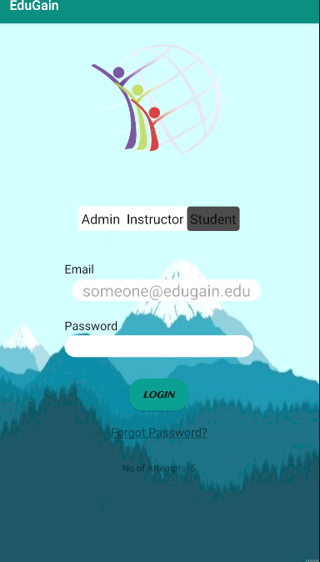
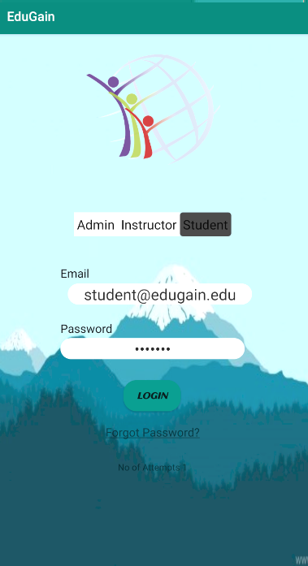

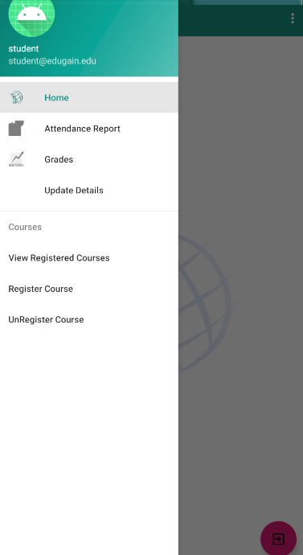
Student MODULE WORKING -STEPS
LOGOUT BUTTON
AUTHENTICATION
AFTER LOGGING
STUDENT ACTIVITIES
WELCOME SCREEN

Slide 8
Student Module Working
When App opens a welcome screen is displayed , the student must select student interface that shows on the screen.
Then the student is required to enter his Credentials for authentication , the entered credentials are checked with the database for providing access to student. If the student enters wrong credentials, he cannot enter the system.
Once the authentication is success , “Student welcome screen” is displayed then instructor is supposed to click “Menu” for displaying activities.

Slide 9
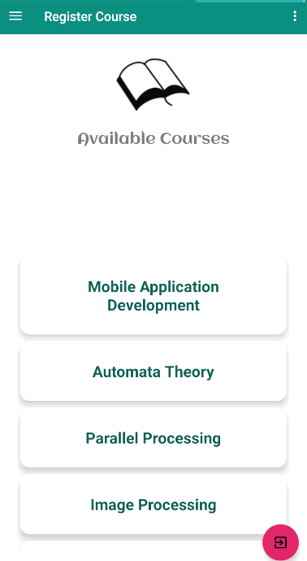
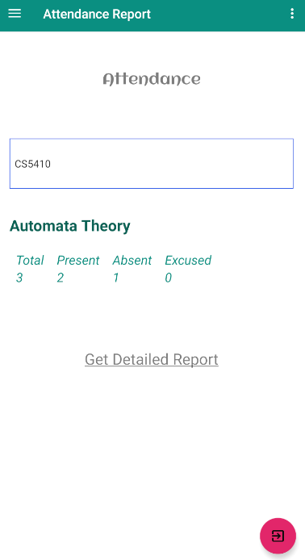
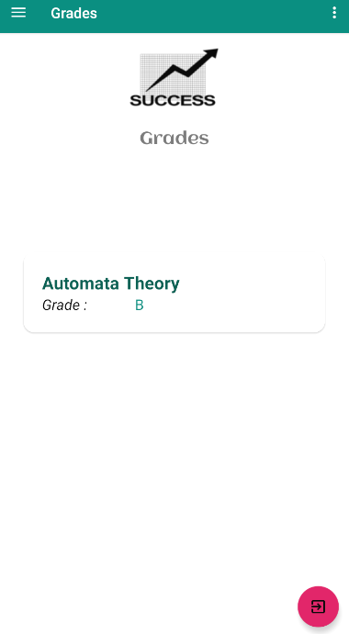
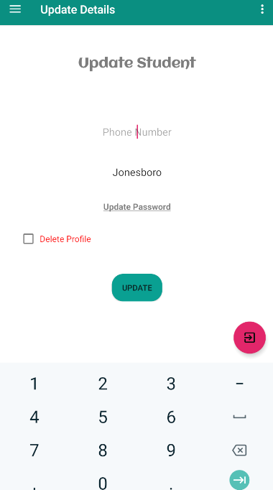
Student MODULE-ACTIVITIES

Slide 10
Student Module-ACTIVITIES
Activities that a student can Perform
Registering Courses
Unregistering Courses
Viewing Attendance
Viewing Grades
Updating Personal Information

Slide 11
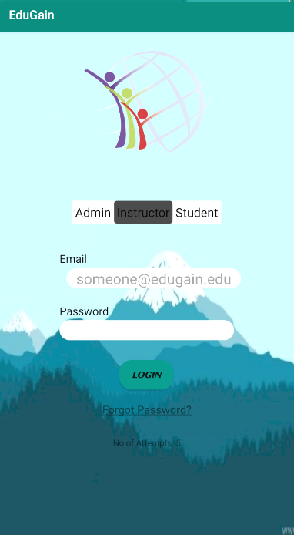


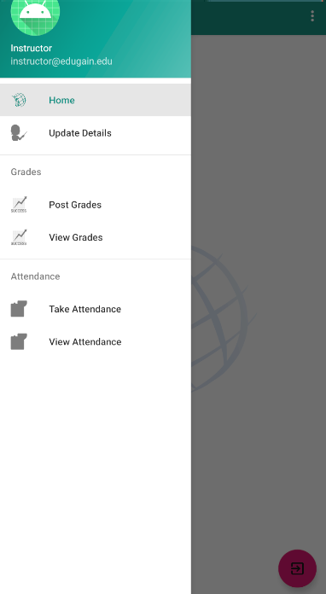
Instructor MODULE WORKING -STEPS
CLICK MENU
BUTTON FOR
VIEWING

Slide 12
Instructor Module Working
When App opens a welcome screen is displayed , the instructor must select Instructor Interface that shows on the screen.
Then the instructor is required to enter his Credentials for authentication , the entered credentials are checked with the database for providing access to instructor. If the instructor enters wrong credentials, he cannot enter the system.
Once the authentication is success , “Instructor welcome screen” is displayed then instructor is supposed to click “Menu” for displaying activities.

Slide 13
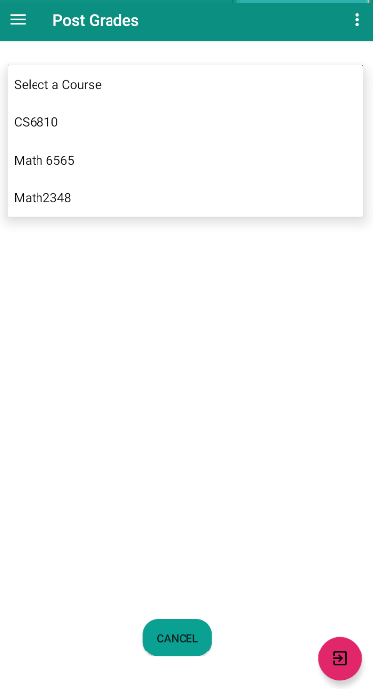
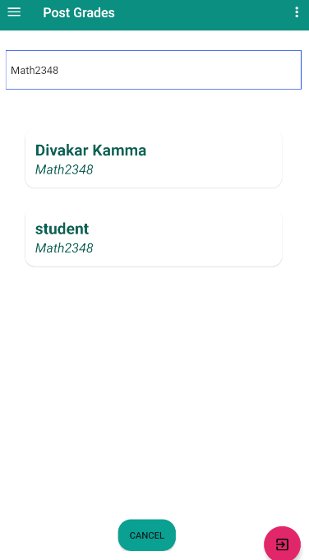
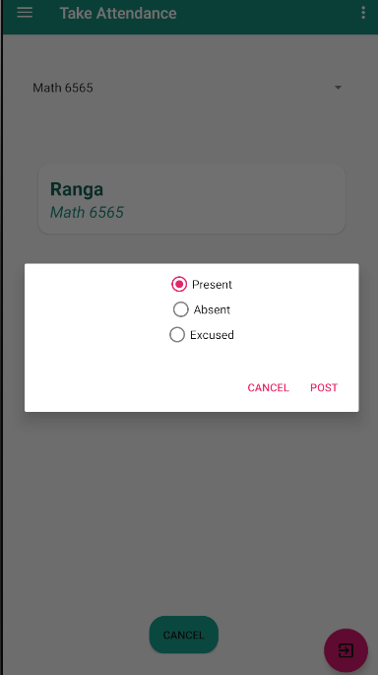
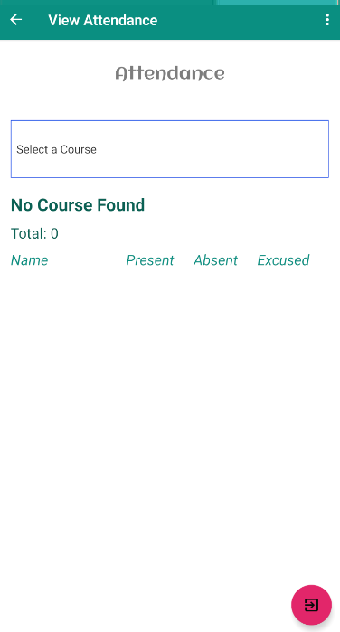
Instructor MODULE WORKING -ACTIVITIES

Slide 14
iNSTRUCTOR Module-ACTIVITIES
Activities that an instructor can Perform
Posting Grades
Taking Attendance
Viewing Attendance
Viewing Grades
Updating Personal Information

Slide 15
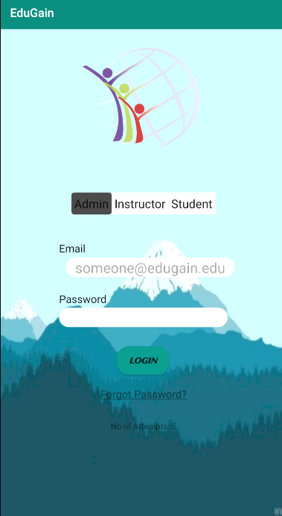

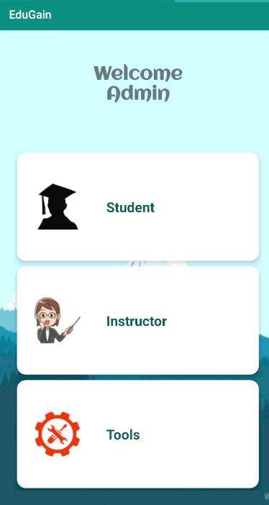
Admin MODULE WORKING -STEPS

Slide 16
Admin Module Working
When App opens a welcome screen is displayed , the admin must select Admin Interface that shows on the screen.
Then the admin is required to enter his Credentials for authentication , the entered credentials are checked with the database for providing access to admin. If the admin enters wrong credentials, he cannot enter the system.
Once the authentication is success , “Admin welcome screen” is displayed with a set of activities the admin has to select the required activity for operation.

Slide 17
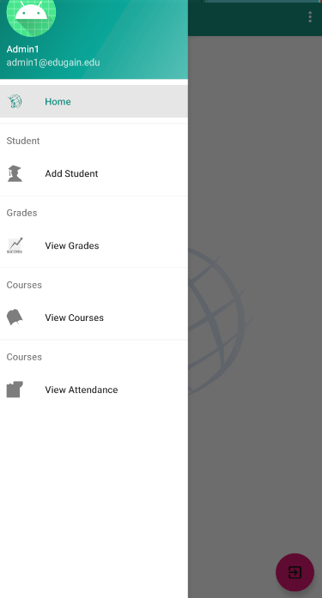
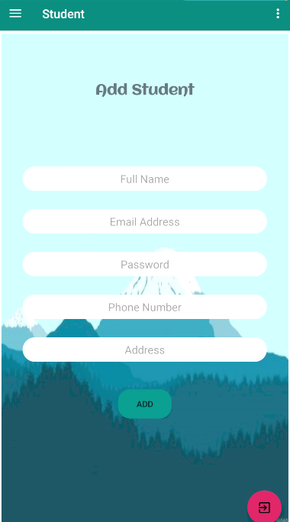
Admin’s Student Activities

Slide 18
Admin’s Student Activities
Activities that an admin can perform on admin’s student activities are:
Adding a Student and providing details like Email and Password to the added student.
Viewing Student Grades
Viewing Student Attendance
Viewing Student Courses

Slide 19
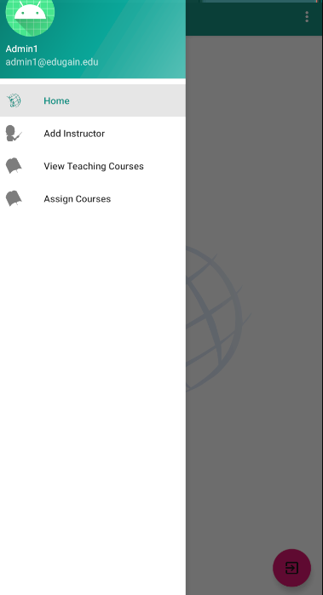
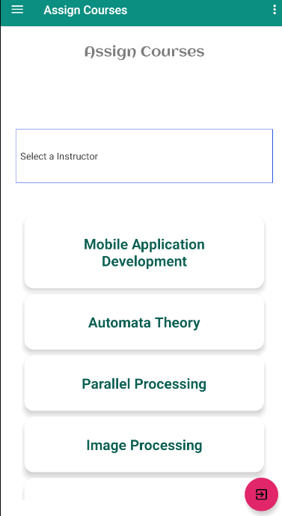
Admin’s Instructor Activities

Slide 20
Admin’s Instructor Activities
Activities that an admin can perform on admin’s instructor activities are:
Adding an Instructor and providing details like Email and Password to the added instructor.
Assigning courses to instructors.
Viewing Teaching courses

Slide 21
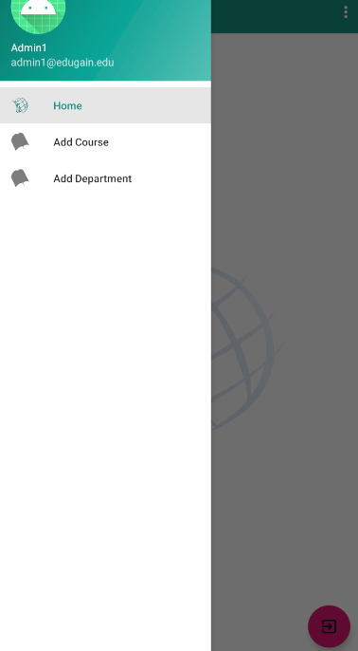
ADMIN’S TOOLS

Slide 22
ADMIN’S TOOLS-Activities
Activities that an admin can perform on admin’s tools activities are
Adding new Courses
Adding new Departments

Slide 23
Database

Slide 24

Firebase
It is a platform for building Android ,iOS and web apps .It provides services like
Authentication
Messaging
Cloud Storage
Real Time database

Slide 25
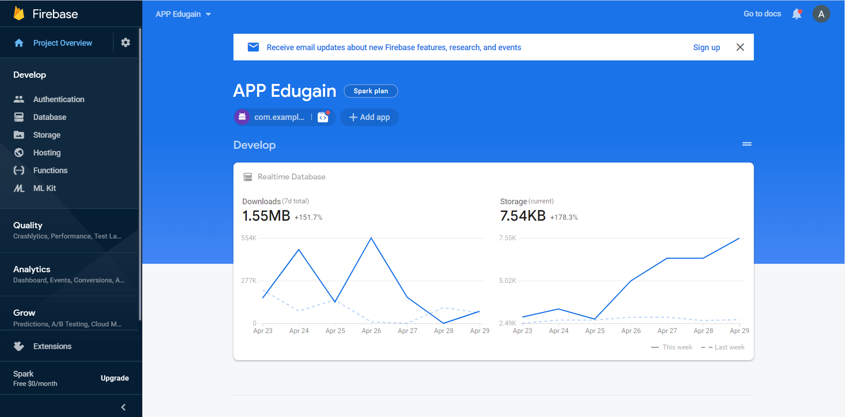
Firebase

Slide 26
Why Firebase
Creation of application can be done without any backend server.
It has libraries for JAVA, JavaScript, Android and iOS.
It automatically saves data to backend and can be used in any instances of application through synchronization.
It uses Json so it is faster than any other backend web services.
Without Server-side programming ,applications can be created
Only write front end code
Secured and Data monitoring is easy

Slide 27
Firebase-Database(Real-Time)
Whatever the data is entered in Android Phone it is added in the Realtime database therefore the effective changes can be seen in the Json file.
There is also a provision to add anything in Json file directly through Firebase .
The Added data through Firebase can be retrieved from android phone by refreshing the app.

Slide 28
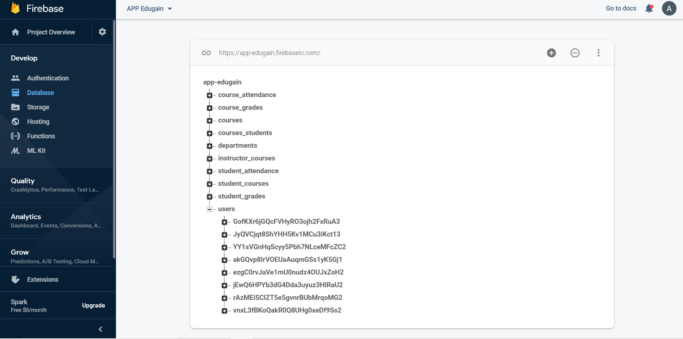
Firebase-Database(Real-Time)

Slide 29
JSON FILE
The entire Database is stored in a Json File
A JSON file is a file that stores simple data structures and objects in JavaScript Object Notation (JSON) format, which is a standard data interchange format. It is primarily used for transmitting data between a web application and a server.

Slide 30
Firebase-Authentication
In the Firebase Authentication when ever a user enters the Email and password in the user-interface it goes to the backend server which is firebase authentication and checks whether it is an authorized user or not.
If the Provided details are wrong the user cannot log into system and it shows the error message as “Invalid id or Password” in the Login page .

Slide 31
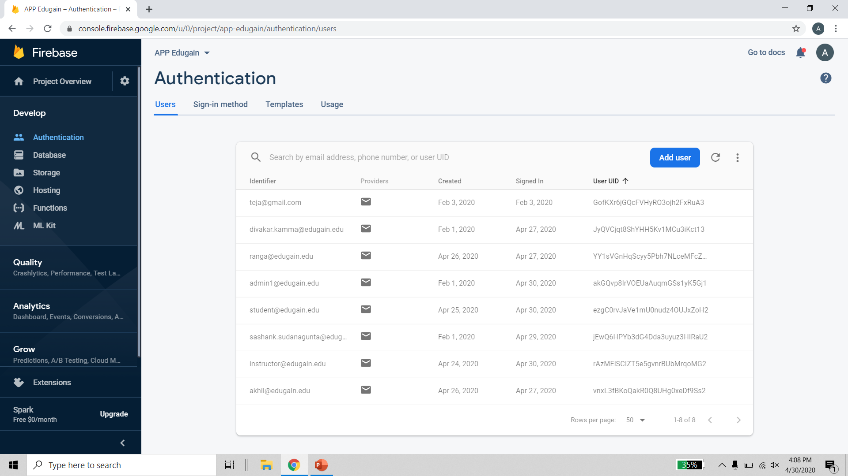
Firebase-Authentication
USERS

Slide 32
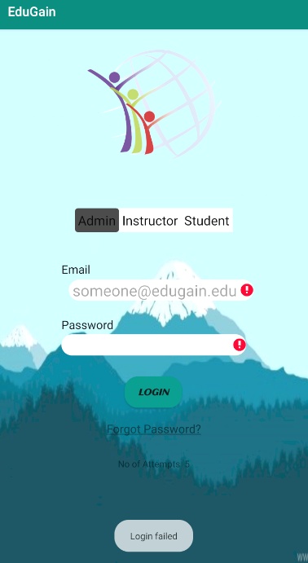
Security Features
Any user cannot login without providing required Details or Valid information.
Regular Monitoring is done through firebase and reports are send through Quality service.

Slide 33
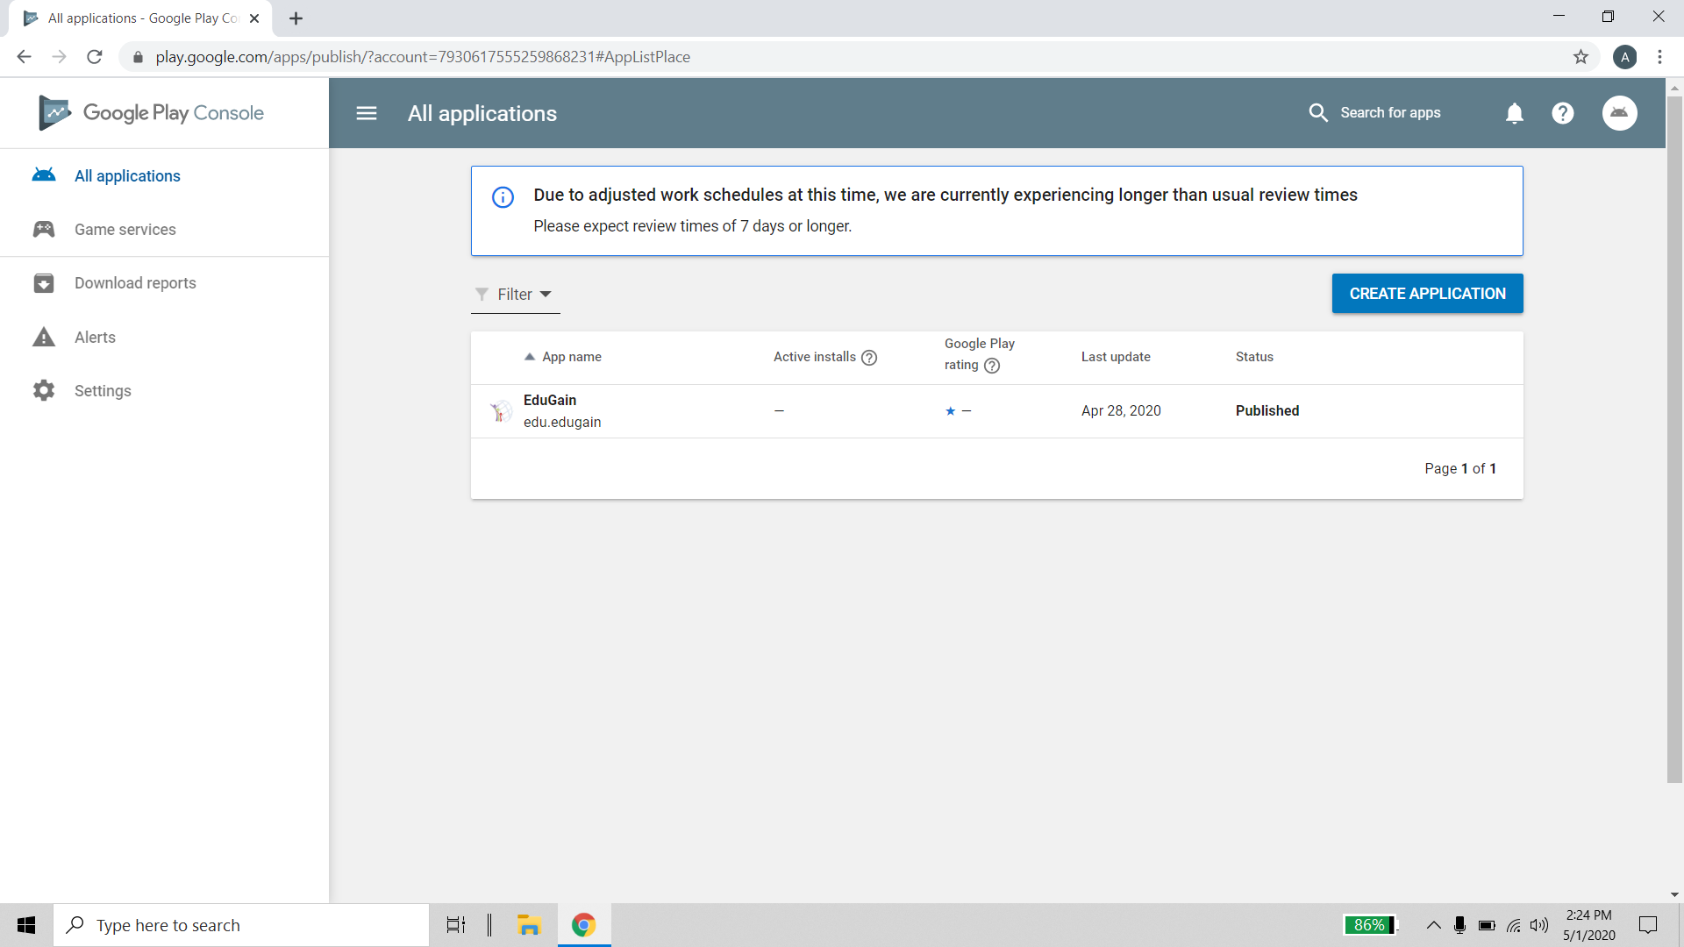
APK File and Play console Status
https://drive.google.com/file/d/1_DLeNVVG8M5FKRHIEaJAUObx9Tsst6wP/view?usp=sharing

Slide 34
Thankyou

