Slide 1

Naga Sai
Welcome
to
Foodie

Slide 2
CONTENTS
Signup / Login
Home page
Menu
Offers
Best Sellers

Slide 3
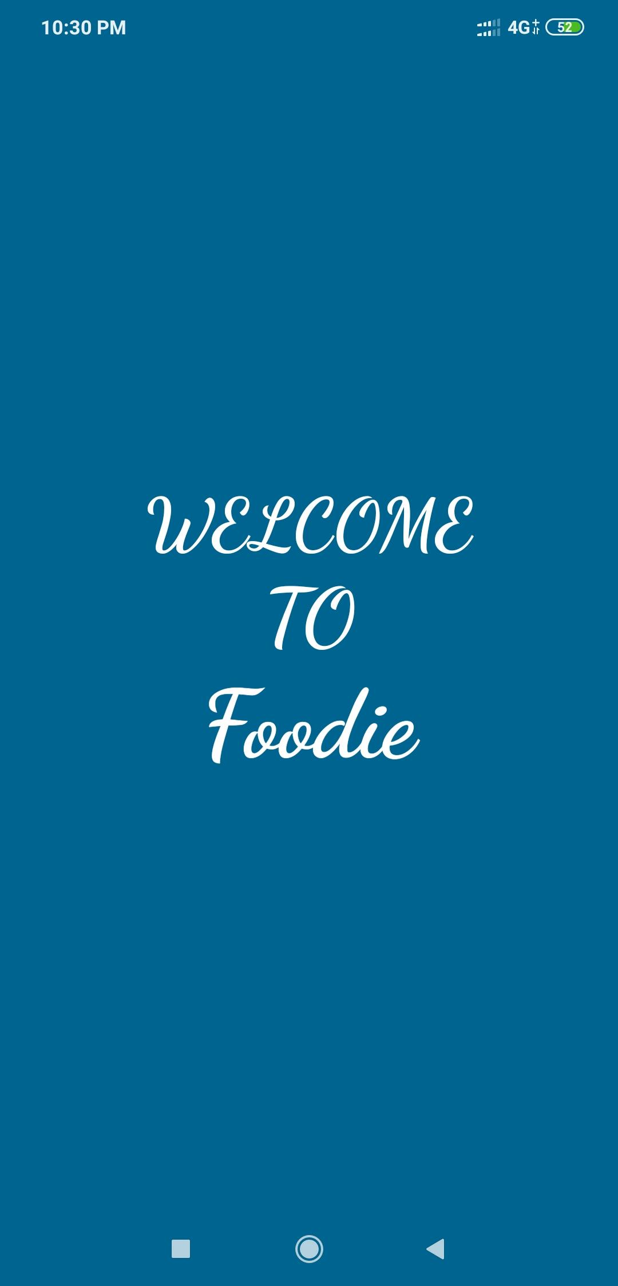
Foodie
The online pizza ordering system provides convenience for the customers. It overcomes the disadvantages of the traditional queuing system. This system increases the takeaway of foods than visitors. Therefore, this system enhances the speed and standardization of taking the order from the customer. It provides a better communication platform. the user’s details are noted electronically.

Slide 4
The online pizza ordering system set up menu online and the customers easily places the order with a simple button click. Also with a pizza menu online you can easily track the orders, maintain customer's database and improve your pizza delivery service. This system allows the user to select the desired pizza items from the displayed menu. The user orders the pizza items. The payment can be made online or pay-on-delivery system. The user’s details are maintained confidential because it maintains a separate account for each user. An id and password is provided for each user. Therefore it provides a more secured ordering.

Slide 5
Signup / Login
Signup and Signin using Firebase realtime database
Firebase:
Firebase helps mobile and web app team succeed
Firebase gives you functionality like analytics, databases, messaging and crash reporting so you can move quickly and focus on your users.
Firebase is built on Google infrastructure and scales automatically, for even the largest apps.
Firebase products work great individually but share data and insights, so they work even better together.

Slide 6
Signup / Login
Signup and Signin using Firebase realtime database
Firebase Authentication:
Firebase helps mobile and web app team succeed
Most apps need to know the identity of a user Knowing a user's identity allows an app to securely save user data in the cloud and provide the same personalized experience across all of the user's devices
Firebase Authentication provides backend services, easy-to-use SDKs, and ready-made UI libraries to authenticate users to your app. It supports authentication using passwords, phone numbers, popular federated identity providers like Google, Facebook and Twitter, and more.

Slide 7
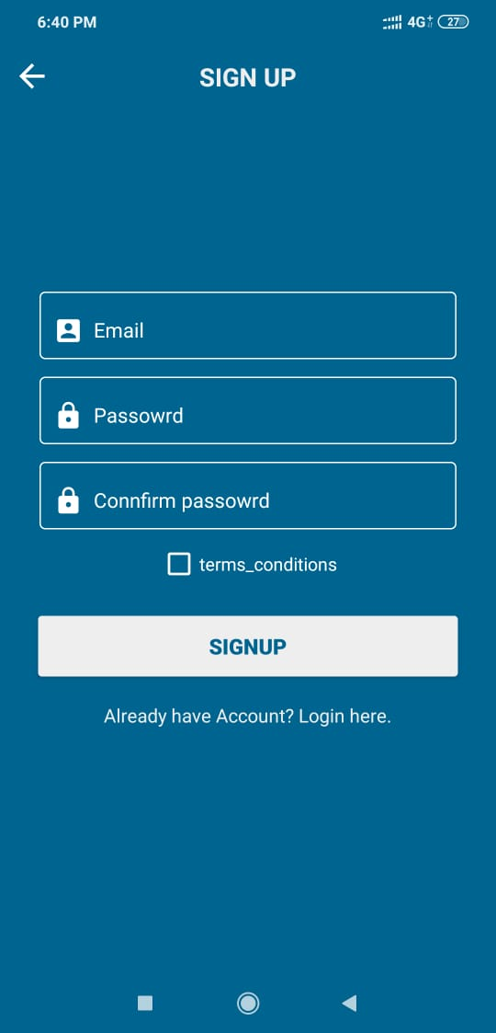
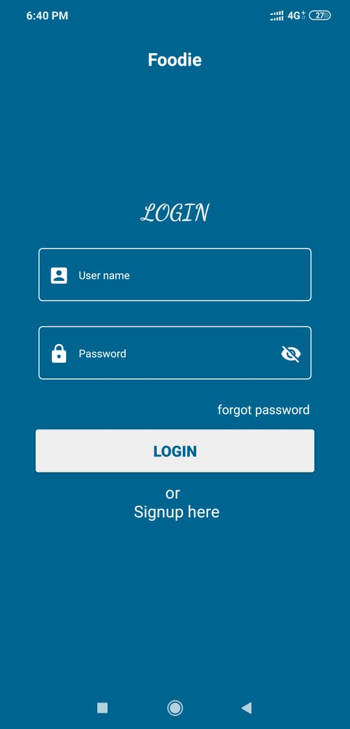
Signup / Login
Screens

Slide 8
Signup / Login
User has to register with simple basic details like email and password, this information will store in Firebase Authentication, after successful signup user can login through this details

Slide 9
Components used in this screen
Material UI Edit text
Button
Toolbar

Slide 10
Signup / Login
After successful registration, the user can login with the email and password, if login is user will redirected to the home screen inside the app

Slide 11
Components used in this screen
Material EditText
Button
Toolbar

Slide 12
Signup / Login
Signup and login look in one slide

Slide 13
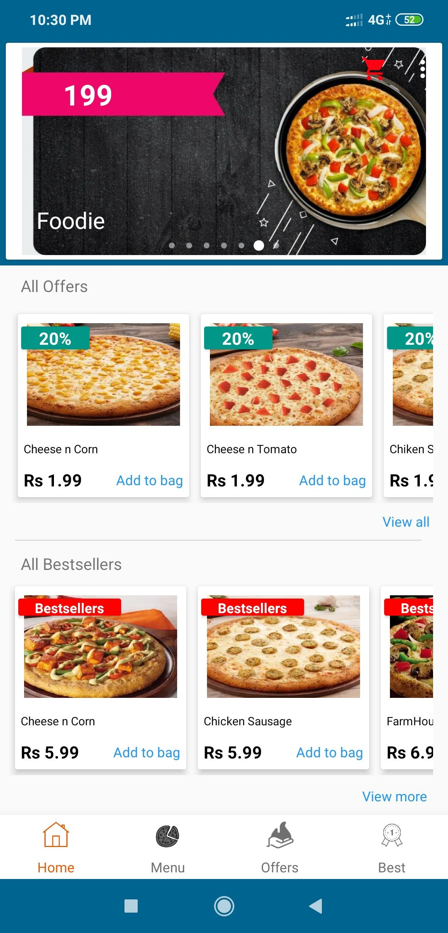
Home page
After successful login user will redirected to this home page

Slide 14
Home page
Home page that can shows all the categories present in the foodie application
1.All offers
2.All Best sellers
3.Menu

Slide 15
Components used in this screen
Appbar layout
Collapsing Toolbar Layout
Tab layout
RecyclerViews
Overflow menu

Slide 16
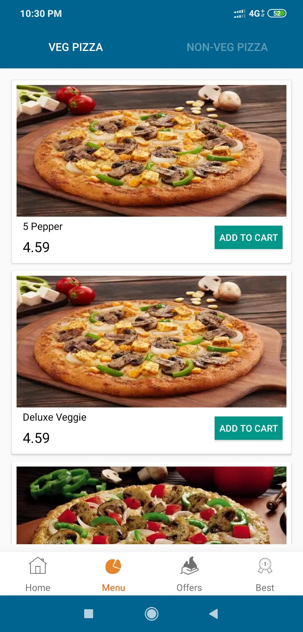
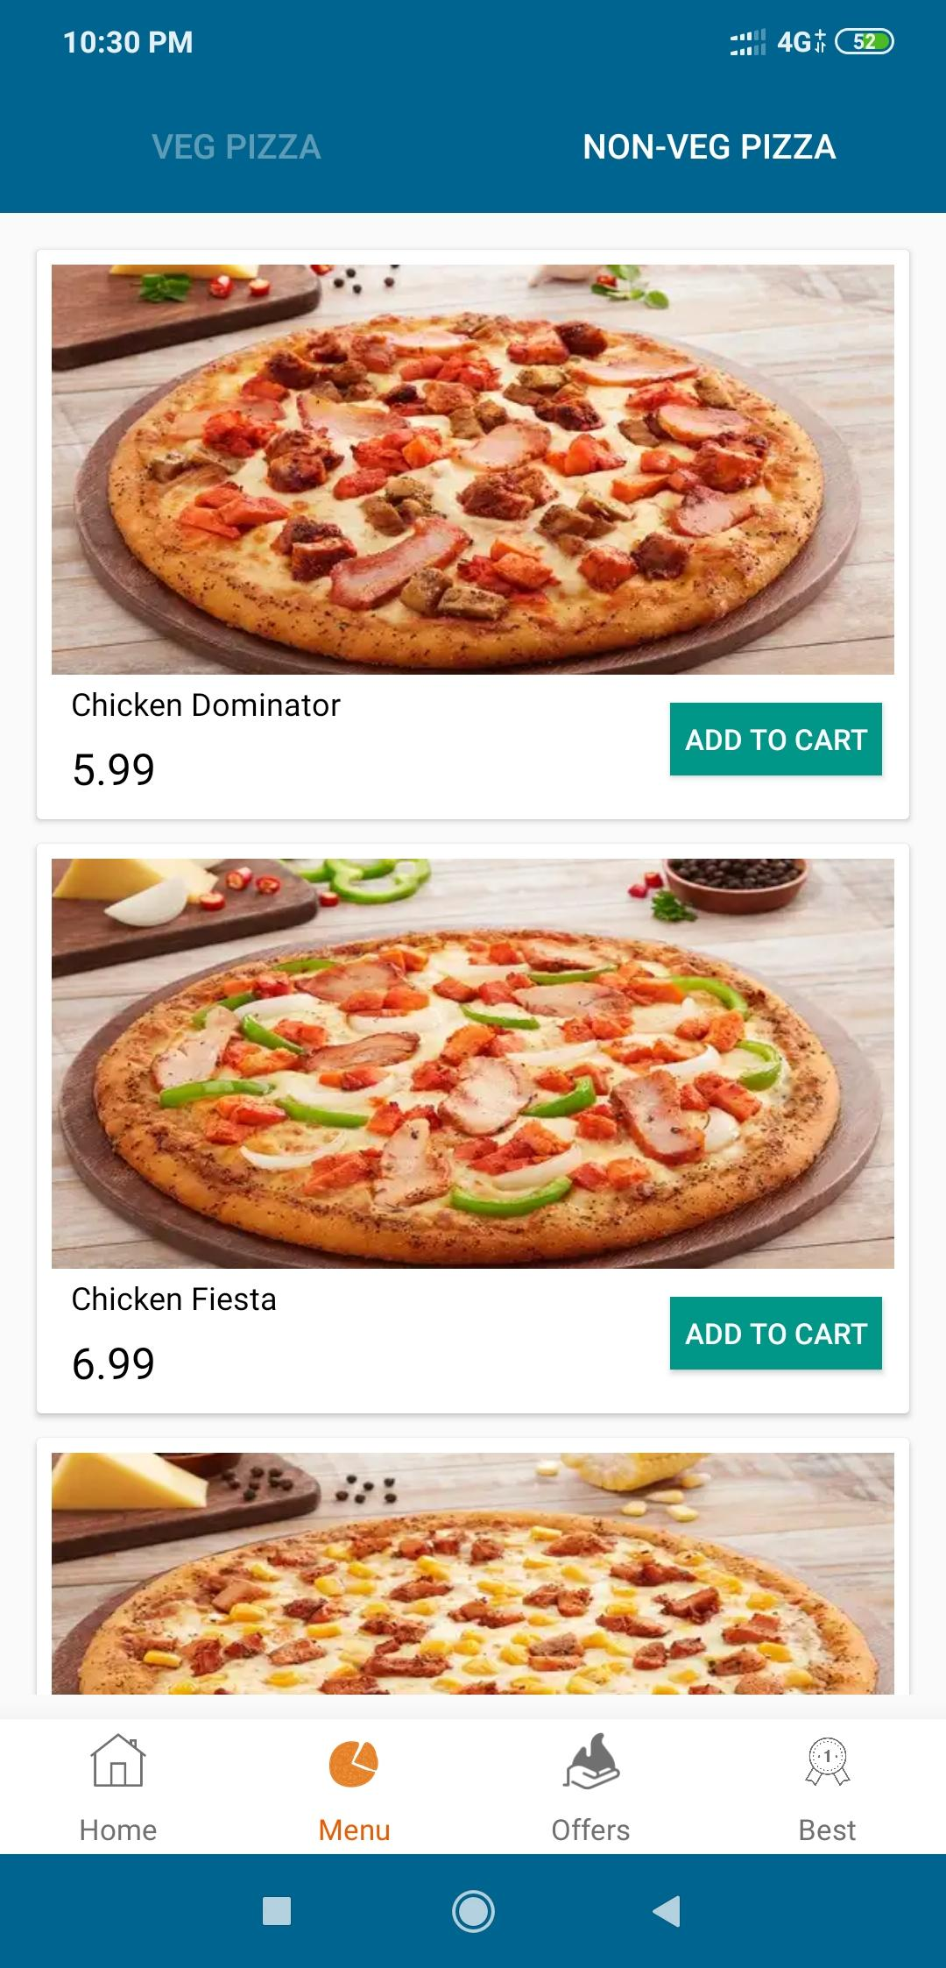
Menu
Its your wish to choose your dish

Slide 17
Menu
Its your wish to choose your menu from VEG, you can them by clicking on addtocart option

Slide 18
Menu
Its your wish to choose your menu from NON-VEG, you can them by clicking on add to cart option

Slide 19
Components used in this screen
Tab layout
RecyclerView
Button
Card View

Slide 20
Components used in this screen
Tab layout
RecyclerView
Button
Card View

Slide 21
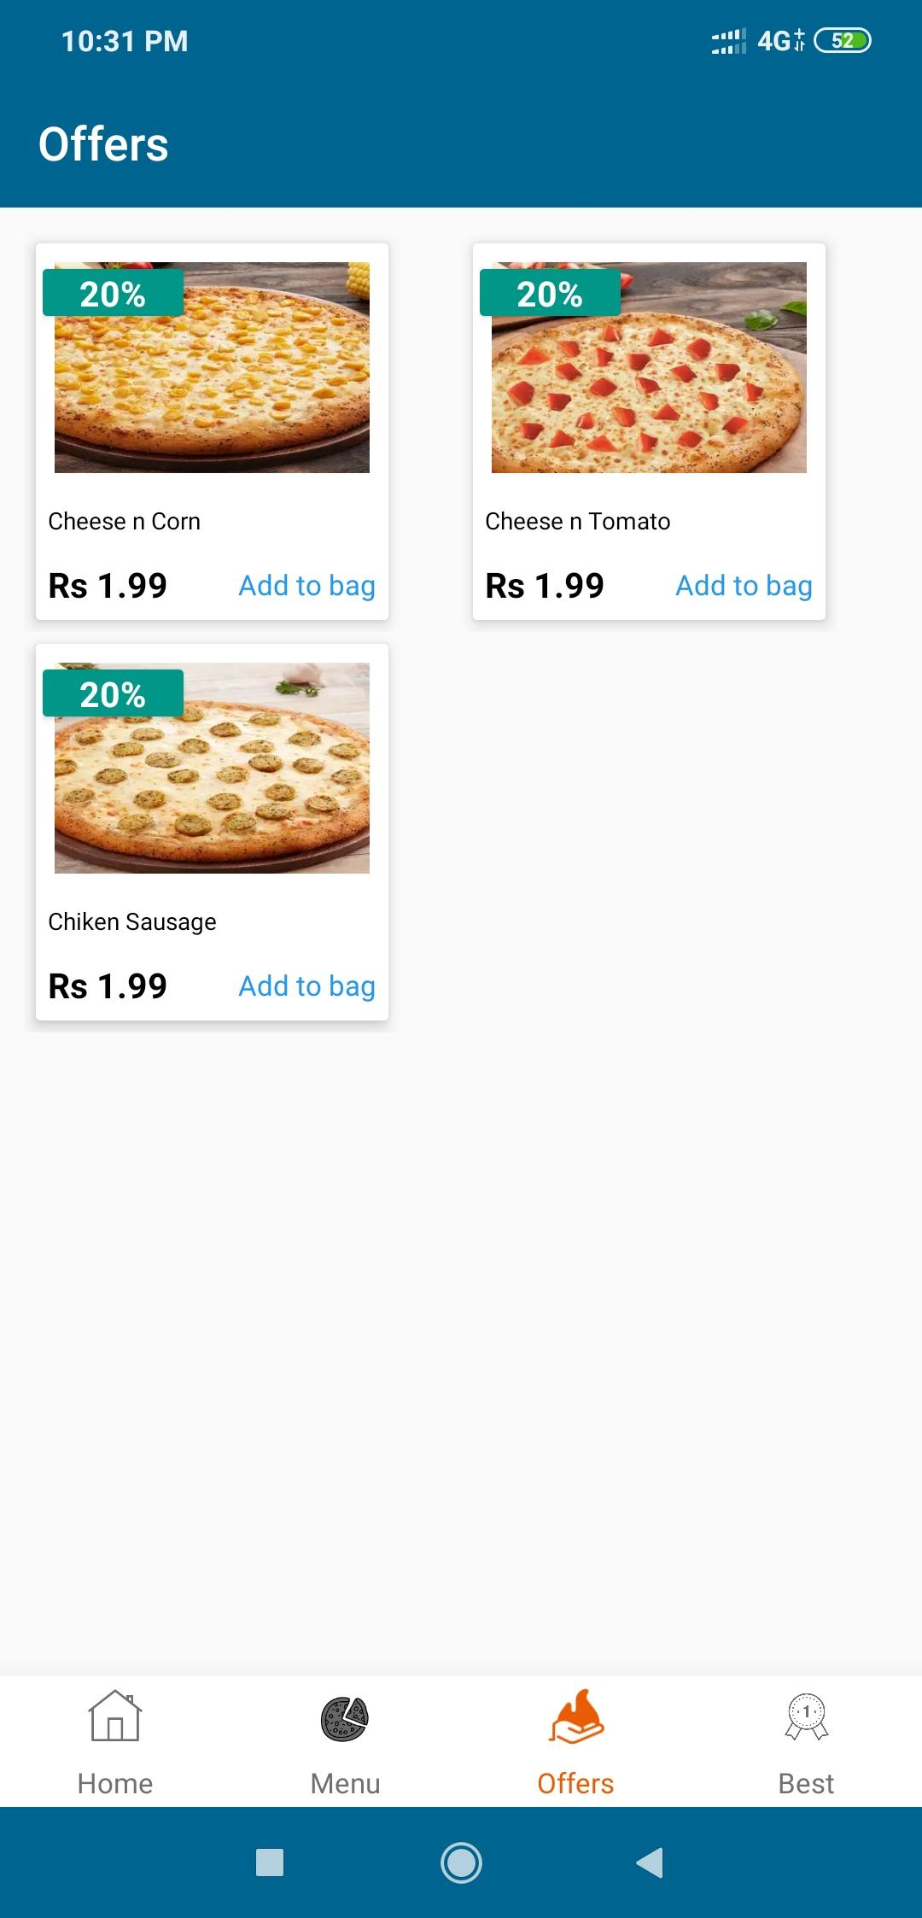
Offers
Shows all the offers available in foodie

Slide 22
Components used in this screen
Card View
RecyclerView

Slide 23
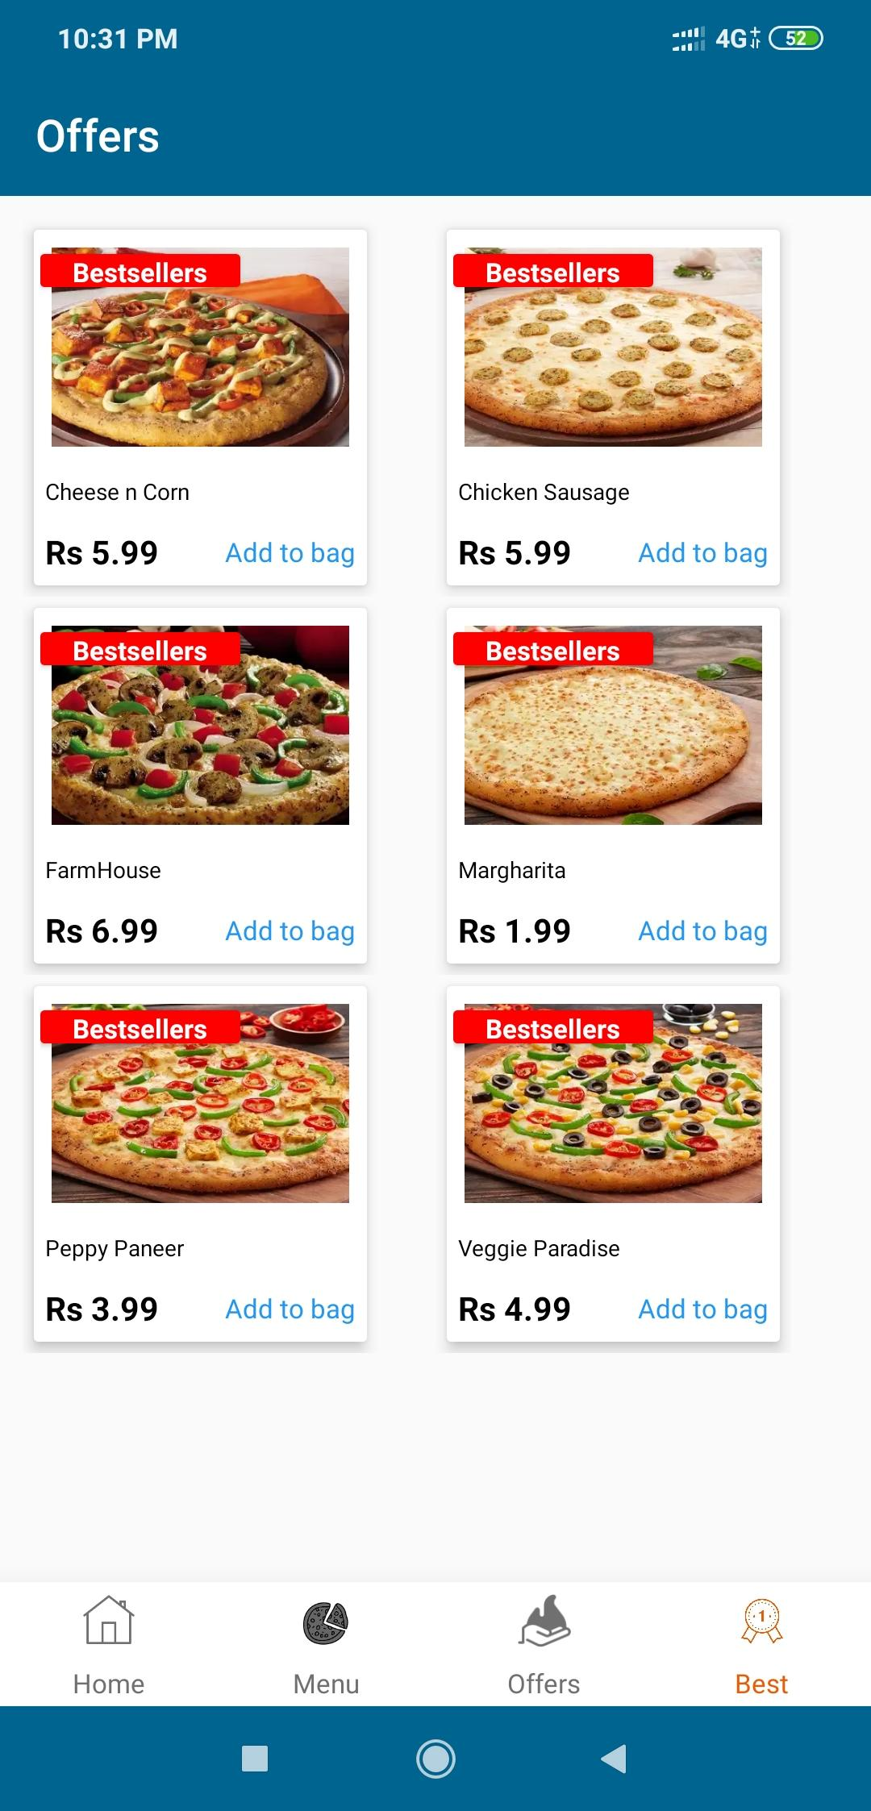
Best Sellers
Shows all the best sellers available in foodie

Slide 24
Components used in this screen
CardView
RecyclerView
TextView

Slide 25
_{Thank} you...

