Slide 1
Android Development

Slide 2
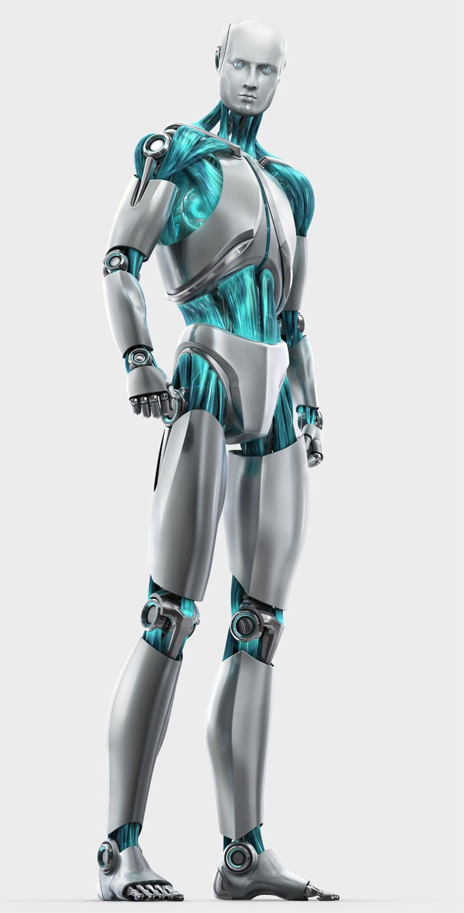

Android Development

Slide 3
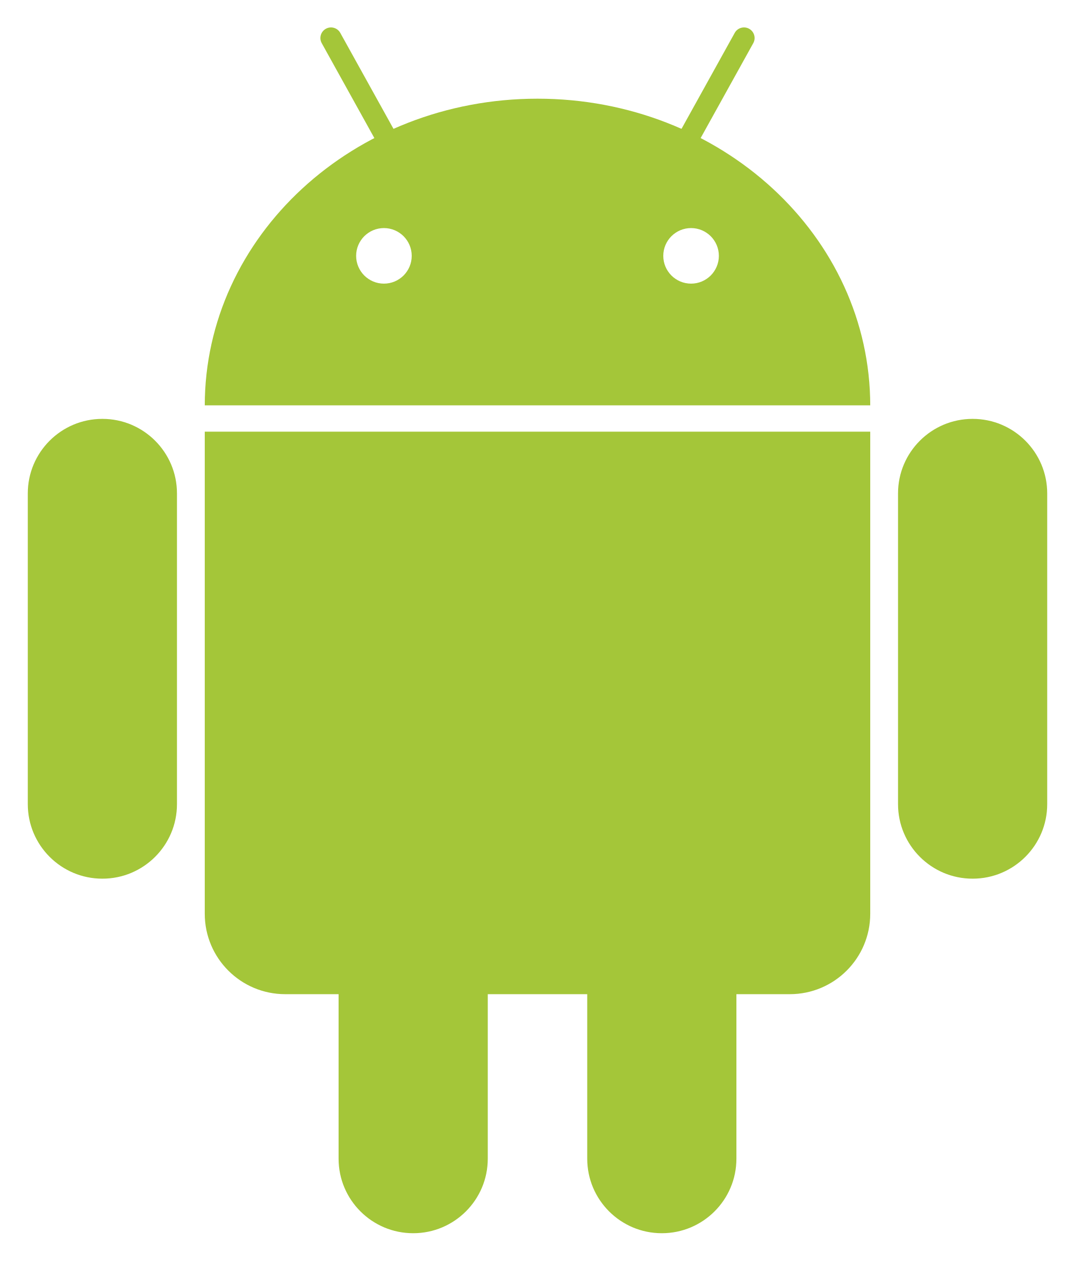
Android OS Application Development
Android is a mobile application operating system.
Applications for Android can be written in multiple languages.
Notes:
Android is a mobile operating system
Based on a modified kernel

Slide 4

Android OS Application Development
What languages should you use?
Notes:
JAVA -
SQL - used for database management with android apps
XML

Slide 5

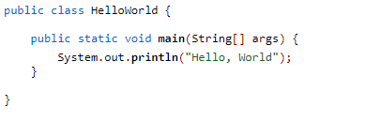
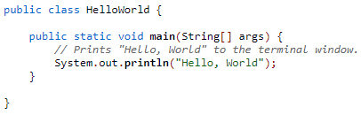
Java vs Kotlin
Java:
Kotlin:

Slide 6
Java
Object oriented
Statically typed
Can be used for Android application development

Slide 7
Kotlin
Object oriented
Statically typed
Can be used for Android and iOS application development
JVM version

Slide 8
Approaching Development
How should I develop?

Slide 9
MVC (Model-view-controller)
Break down your work
Model
View
Controller

Slide 10
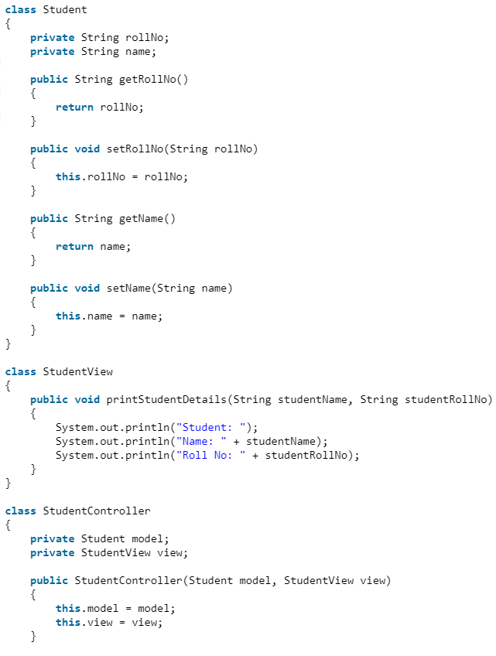
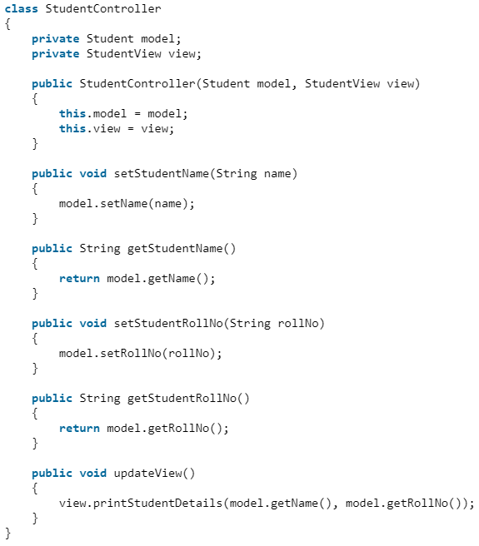
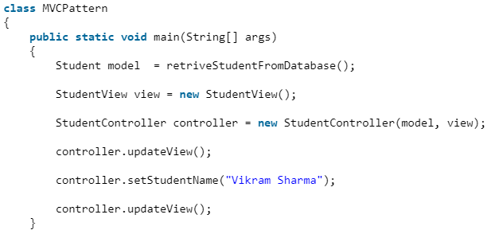
Design

Slide 11
Why MVC?
Work distribution
Separation
GUI

Slide 12
FIN

Slide 13
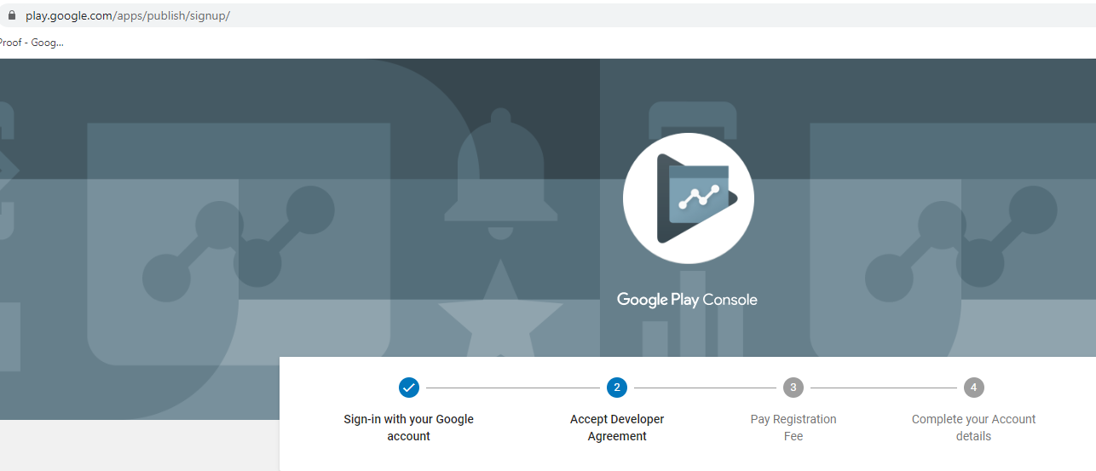
Publishing Your Application

