Slide 1
Introduction to Kotlin
Cody Mace

Slide 2
What is Kotlin?
Statically typed programming language that runs on the Java Virtual Machine
Compiles to Java byte code
Fully interoperable with Java
Created ~2011. Version 1.0 release in 2016
Google’s preferred language for Android app development since 2019

Slide 3
Why Use Kotlin?
Massively reduce amount of boilerplate code when compared to Java
Avoid common errors (Null Pointer Exception)
Interoperable with existing Java code

Slide 4
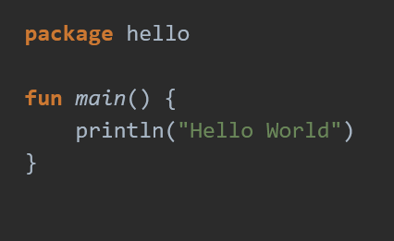
Hello Word

Slide 5

Functions
Some different ways to declare functions
Data type comes after variable name in parameter lists
Function sum accepts two Ints and returns an Int
Return type can often be inferred

Slide 6


Variables
Read only variables:
Variables that can be reassigned use var:

Slide 7
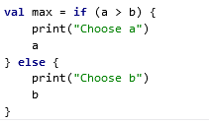
If Expressions
In Kotlin if is an expression
The last expression is the value of a block

Slide 8


Loops
For loops work on anything that provides an iterator
Similar to for each loop in other languages
Can loop over arrays or lists using index:
Can also loop over a range expression

Slide 9
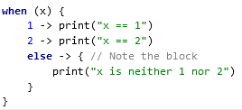

When expressions
Switch like statement except better

Slide 10
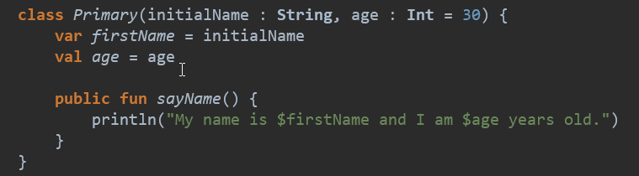

Classes
In Kotlin Classes are declared used the keyword ‘class’
To use a class:

Slide 11

Classes
Kotlin does not have a ‘new’ keyword like Java
Classes can be abstract but there is no need to mark as abstract

Slide 12
Classes
Classes are final by default
Classes must be marked ‘open’ before being used as a base class
Classes are public by default
Including Abstract classes (Pure Virtual)

Slide 13
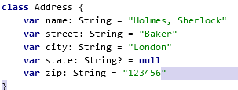
Properties
Like variables properties can be read only (val) or mutable (var)

Slide 14
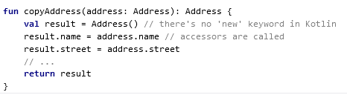
Using Properties
Default Getter/Setters are generated by compiler

Slide 15

Extensions
Kotlin provides the ability to extend a class with new functionality without having to inherit from the class
Allows programmer to write new functions for a class from a third party
Called like normal methods

Slide 16
Data Classes
Classes used to hold data
Use ‘data’ keyword before class definition
Automatically generates useful methods
Equals()/hashCode() pair
toString()
componentN() functions
copy() function (see next slide)
Pair and Triple

Slide 17

copy() function
Function generated for copying an object while changing some of the properties

Slide 18


Type System
Aimed at fixing the danger of null references
Kotlin has Nullable types and Non-Null Types
Non-Null reference
Nullable reference.

Slide 19
Type System
Guaranteed to work since A is non-nullable:
Will not work:

Slide 20

Null
Possible to check for null with normal if else chain
Safe call operator can also be used
Safe call operator can all be chained

Slide 21

Null
Use let to perform certain action only on non null values
A safe call can also be placed on the left side of an assignment.
If a null is encountered the assignment is skipped and the expression is not evaluated

Slide 22


Null
‘Elvis operator’
This:
Can be expressed:

Slide 23
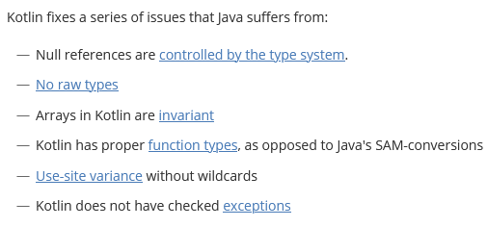
Kotlin vs Java

Slide 24
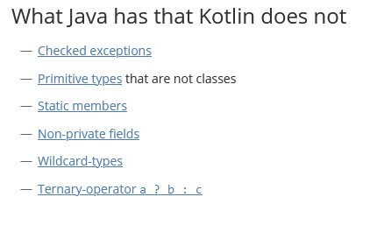
Kotlin vs Java

Slide 25
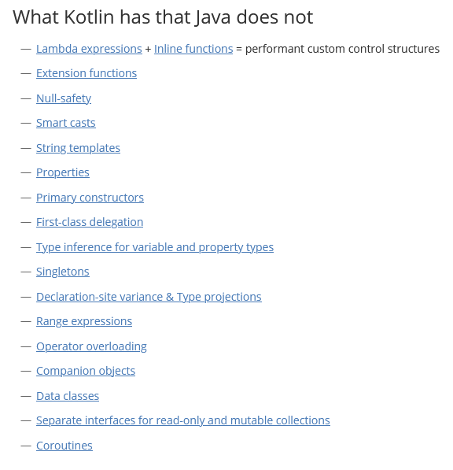

Slide 26
Somethings I missed/didn’t cover in depth
Secondary constructors
Lambda expressions/Higher-Order Functions
Interfaces
Inheritance
Coroutines/async
Collections

Slide 27
Kotlin Resources
https://kotlinlang.org/
https://developer.android.com/reference/kotlin/packages
https://play.kotlinlang.org/byExample/overview

