Slide 1

Different Perspective: Activity
Cade Powers

Slide 2
Multiplatform

Slide 3
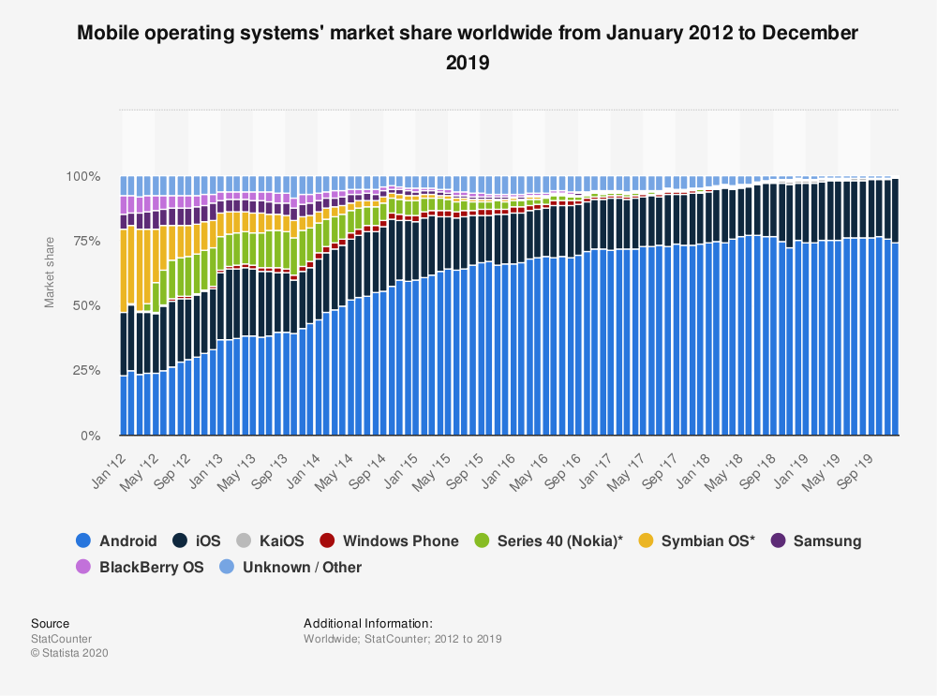
The Numbers
Android: 74.13%
IOS: 24.79%
Source:
https://www.statista.com/statistics/272698/global-market-share-held-by-mobile-operating-systems-since-2009/

Slide 4




Multiplatform: How?
Visual Studio
Xamarin
XAML
C#

Slide 5
Getting Started

Slide 6
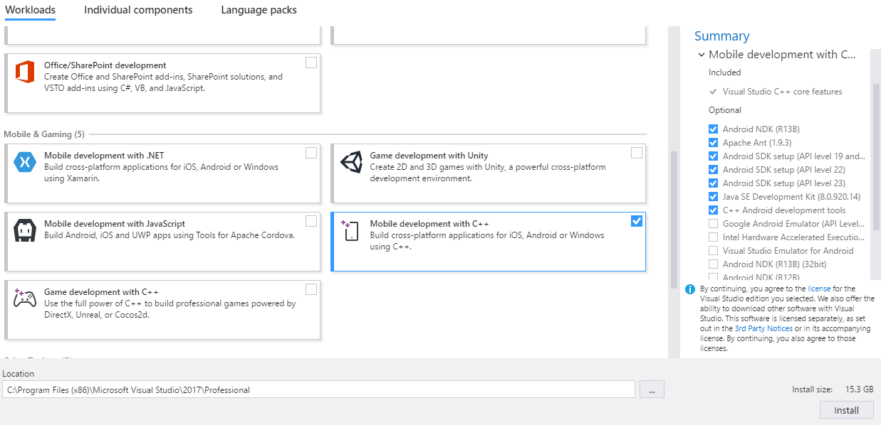
Getting Started: Visual Studio
Download:
https://visualstudio.microsoft.com/downloads/
Standard install
Install with mobile Development Package

Slide 7
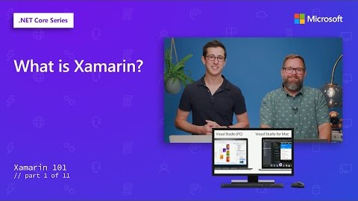
Getting Started: Xamarin
Create new solution
Select Xamarin Forms
3 Projects made for the one solution
Base code
Android app
IOS app
Learning Resource: https://dotnet.microsoft.com/learn/xamarin

Slide 8
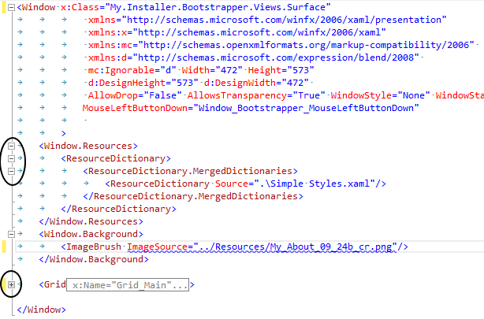
Getting Started: XAML
Mark up Language used in pairing with C#
Like HTML but made for mobile applications
Extension of XML

Slide 9
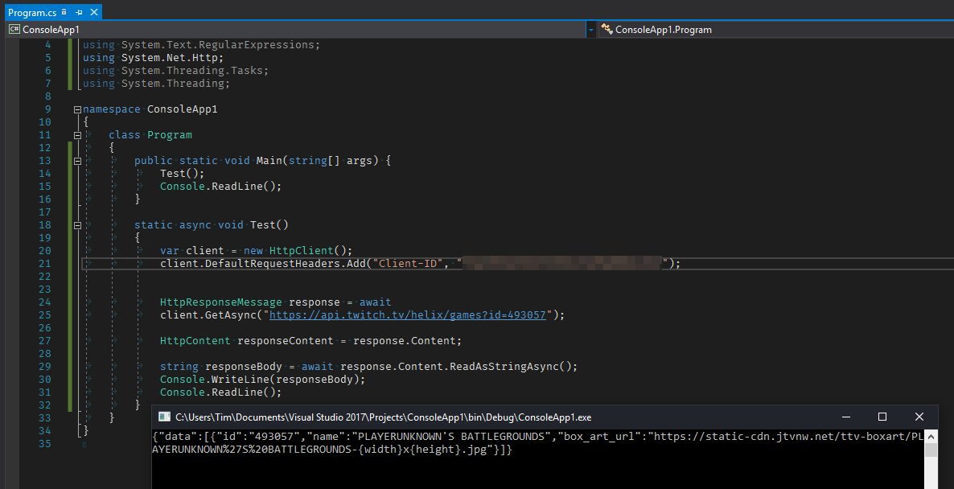
Getting Started: C#
Object-oriented C language
General application
Native on all platforms

Slide 10
Learn by Doing

Slide 11
Why Multiplatform?
Allows you to create one solution for all platforms
Saves time
Code is more easily maintained
Activities work the same in both OS

