Slide 1



Broadcast receiver services
Presented by
Sankalp Dekate

Slide 2
contents
Broadcast
Receiver
Services

Slide 3

BROADCAST
Broadcast Receiver
Registering a Receiver
Broadcast Intents
Type of Broadcasts

Slide 4
Broadcast receiver
A broadcast receiver is a dormant component of the Android system.
• Only an Intent (for which it is registered) can bring it into action.
Using a Broadcast Receiver, applications can register for a particular event. Once the event occurs, the system will notify all the registered applications.
• Examples: Boot completed, Time tick
The Broadcast Receiver’s job is to activate some software component, for example to notify the end user something occurred.

Slide 5
Broadcast receiver
An application listens for specific broadcast intents by registering a broadcast receiver.
• Broadcast receivers are implemented by extending the Android BroadcastReceiver class and
overriding the onReceive() method.
• The broadcast receiver may then be registered, either within code (for example within
an activity), or within a manifest file.

Slide 6
Broadcast receiver
Part of the registration implementation involves the creation of intent filters to indicate the specific broadcast intents the receiver is required to listen for.
This is achieved by referencing the action string of the broadcast intent.
When a matching broadcast is detected, the onReceive() method of the broadcast receiver is called, at which point the method has 5 seconds within which to perform any necessary tasks before returning.

Slide 7
Broadcast Receiver template
Package com.example.BroadcastDetector;
Import android.content.BroadcastReciver;
Import android.content.context;
Import android.content.Intent;
Public class MyReciever extends BroadcastReceiver{ @Override
Public void onReceive(Context context,Intent intent){ //Implement code here to be performed when broadcast is detected
}
}

Slide 8
Registering a broadcast receiver
<?Xml Versioin=“1.0” encoding=“utf-8”?>
<manifest Xmlns:android=http://schemas.android.com/apk/res/android
Package=“com.example.BroadcastDetector”
Android:Versioncode=“1”
Android:VersionName=“1.0”>
<uses-sdk android:minSdkVersion=“10” />
<application
android:icon=“@drawable/ic_launcher”
android.label=“@string/app_name”> <receiver android:name =”MyReceiver”> <intent-filter>
<action android:name=“com.example.Broadcast”>
</action> </intent-filter> </receiver> </application> </manifest>

Slide 9
Registering a receiver
There are two ways to register a Broadcast Receiver; one is Static and the other Dynamic.
Static:
Use tag in your Manifest file. (AndroidManifest.xml)
Not all events can be registered statically
Some events require permission
Dynamic:
Use Context.registerReceiver () method to dynamically register an instance.
Note: Unregister when pausing

Slide 10
Broadcast intents
Broadcast intents are Intent objects that are broadcast via a call to the sendBroadcast(), sendStickyBroadcast() or sendOrderedBroadcast() methods of the Activity class.
In addition to providing a messaging and event system between application components, broadcast intents are also used by the Android system to notify interested applications about key system events (such as the external power supply or headphones being connected or disconnected).
When a broadcast intent is created, it must include an action string in addition to optional data and a category string.

Slide 11
Broadcast intents
As with standard intents, data is added to a broadcast intent using key-value pairs in conjunction with the putExtra() method of the intent object.
The optional category string may be assigned to a broadcast intent via a call to the addCategory() method.
The action string, which identifies the broadcast event, must be unique and typically uses the application’s Java package name syntax.

Slide 12
Broadcast intent
Intent Intent = new Intent(); intent.setAction(“com.example.Broadcast”); intent.putExtra(“HIghScore”,1000); sendBroadcast(intent);
Intent Intent = new Intent(); intent.addFlags(Intent.FLAG_INCLUDE_STOPPED_PACKAGES); intent.setAction(“com.example.Broadcast”); intent.putExtra(“HIghScore”,1000); sendBroadcast(intent);

Slide 13
Types of broadcasts
Ordered Broadcasts:
These broadcasts are synchronous and follows the order specified using
android: priority attribute
The receivers with greater priority would receive the broadcast first.
Normal Broadcasts:
Normal broadcasts are not orderly.

Slide 14
ANDROID SERVICES
ANDROID SERVICES
INTENT SERVICES
STARTED SERVICES
SERVICES LIFE CYCLE
TYPES OF SERVICES
LOCAL SERVICES
BOUND SERVICES

Slide 15
Android services
The Android Service class is designed specifically to allow applications to initiate and perform background tasks.
Unlike broadcast receivers, which are intended to perform a task quickly and then exit, services are designed to perform tasks that take a long time to complete.
…such as downloading a file over an internet connection or streaming music to the user, but do not require a user interface.

Slide 16
Android services
Simplest form of service
Intent Service
Created to execute a task in a separate thread and then exit
Service
Started Service
Run until explicitly stopped (in the rare case android needs to kill it, the service will
be restarted as soon as possible)
Started with startCommandmethod
Bound Service
Allows the exchange data with the interacting software component through an interface
(set of methods) .
Bind to a service interface.

Slide 17
INTENT SERVICES
Services run by default within the same main thread as the component from which they are launched. As such, any CPU intensive tasks that need to be performed by the service should take place within a new thread, thereby avoiding affecting the performance of the calling application.
The IntentServiceclass is a convenience class (subclassed from the Service class) that sets up a worker thread for handling background tasks and handles each request in an asynchronous manner.
Once the service has handled all queued requests, it simply exits. All that is required when using the IntentServiceclass is that the onHandleIntent() method be implemented containing the code to be executed for each request.
For services that do not require synchronous processing of requests, IntentService is the recommended option. Services requiring synchronous handling of requests will, however, need to subclass from the Service class and manually implement and manage threading to handle any CPU intensive tasks efficiently

Slide 18
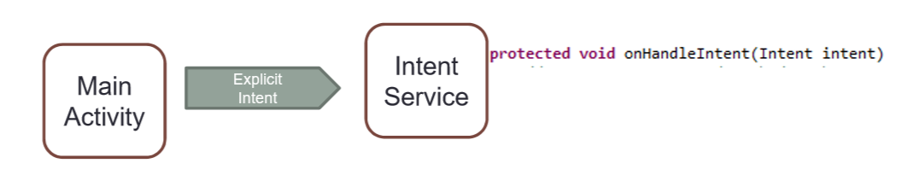
INTENT SERVICES:EXAMPLE
The service needs to be registered in the manifest file
The main activity creates an explicit intent pointing to the service
The service is started and the onHandleIntentmethod executed
Intents are queued and served serially

Slide 19
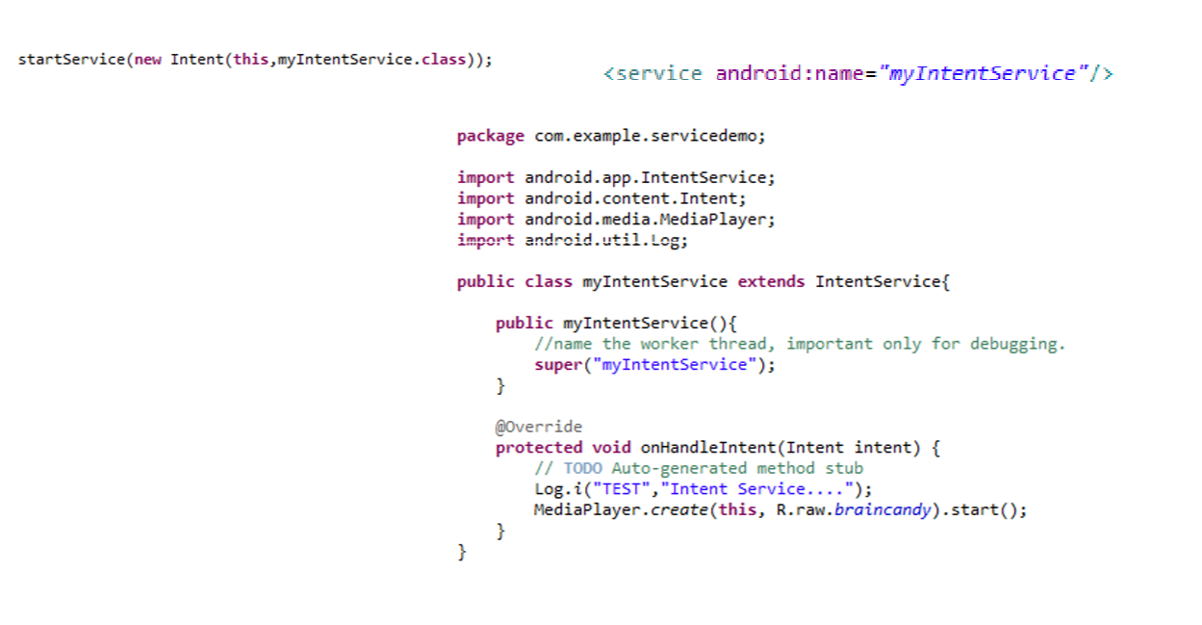
INTENT SERVICE :EXAMPLE

Slide 20
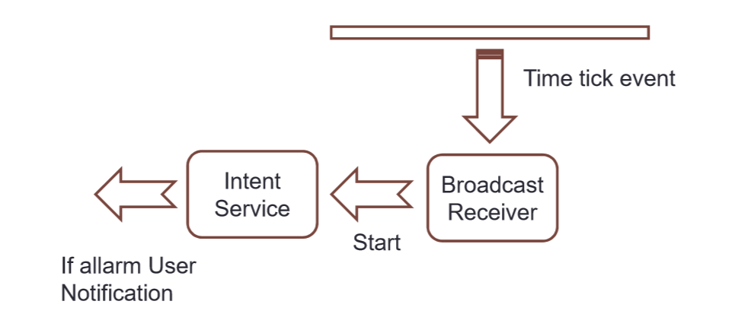
EXAMPLE:
Testing the weather condition periodically and send a notification if an alarm occurs

Slide 21
STARTED SERVICES
Started services are launched by other application components (such as an activity or even a broadcast receiver) and potentially run indefinitely in the background until the service is stopped, or is destroyed by the Android runtime system in order to free up resources.
A service will continue to run if the application that started it is no longer in the foreground, and even in the event that the component that originally started the service is destroyed.
By default, a service will run within the same main thread as the application process from which it was launched (referred to as a local service).
It is important, therefore, that any CPU intensive tasks be performed in a new thread within the service. Instructing a service to run within a separate process (and therefore known as a remote service) requires a configuration change within the manifest file.

Slide 22
STARTED SERVICES
Unless a service is specifically configured to be private (once again via a setting in the manifest file), that service can be started by other components on the same Android device.
This is achieved using the Intent mechanism in the same way that one activity can launch another as outlined in preceding slides.
Started services are launched via a call to the startService() method, passing through as an argument an Intent object identifying the service to be started.
When a started service has completed its tasks, it should stop itself via a call to stopSelf(). Alternatively, a running service may be stopped by another component via a call to the stopService() method, passing through as an argument the matching Intent for the service to be stopped.
Services are given a high priority by the Android system and are typically amongst the last to be terminated in order to free up resource

Slide 23
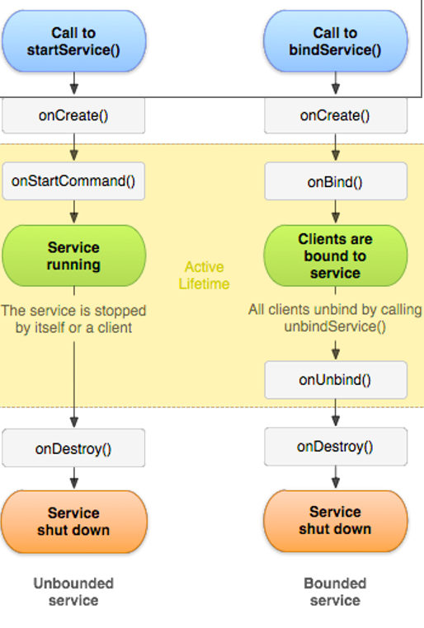
SERVICE
Services advertise one or more binder endpoints.
Clients choose to bind/unbind (or unbind when stopped).
A service with no bound clients may be shut down.

Slide 24
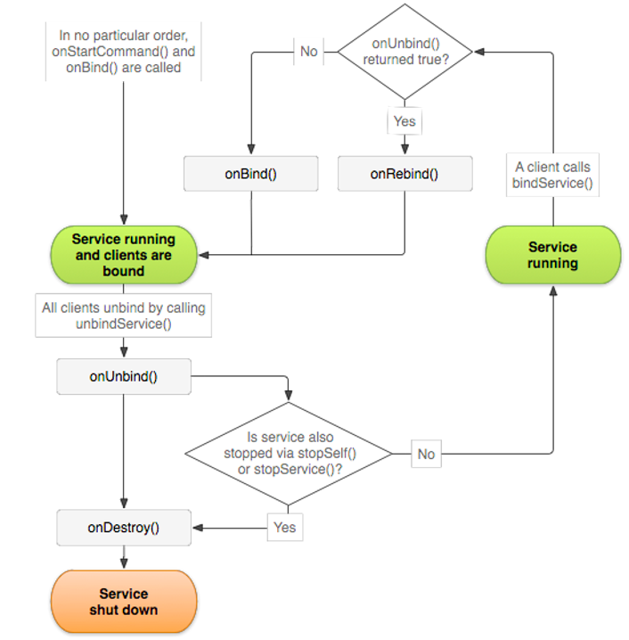
SERVICE

Slide 25
ANDROID SERVICES
A Service is an application that can perform long-running operations in background and does not provide a user interface.
Activity → UI, can be disposed when it loses visibility
Service → No UI, disposed when it terminates or when it is terminated by other components
A Service provides a robust environment for background tasks …

Slide 26
ANDROID SERVICE
A Service is started when an application component starts it by calling startService(Intent).
Once started, a Service runs in background indefinetely, even if the component that started it is destroyed.
Termination of a Service:
1. selfStop() → self-termination of the service
2. stopService(Intent) → terminated by others
3. System-decided termination (i.e. memory shortage)

Slide 27
SERVICE LIFE CYCLE
OnCreate() executed only once when the Service is created.
OnCreate()
startService()
OnStartCommand()
startService()
startService() might cause the execution of OnCreate+OnStartCommand, or only of OnStartCommand, depending whether the Service is already running …
RUNNING
onDestroy()
stopService()
selfStop()

Slide 28
SERVICE LIFE CYCLE
A Service’s lifecycle is a bit different from an Activity
– onCreate() –basically the same as Activity
– onStartCommand() –gets the service going
– onBind() –allows a Service to be a provider
– onDestroy() –basically the same as Activity
– stopSelf() –called by the Service to end it
– startService() and stopService() –Intent calls to start and stop a Service

Slide 29
Types of services
Local services: Start-Stop Lifecycle
Bound /Remote Services: Bound to application components. Allow to interact with them , send requests.

Slide 30
local services (Starting and stopping)
Works almost exactly the same as starting an Activity with an Intent
However, a Service will keep running after Activities close
You MUST manage your Services! Stopping them is necessary to not take up extra resources

Slide 31
Bound services
A Bound Service allows components (e.g. Activity) to bind to the services, send requests, receive response.
OnCreate()
OnBind()
onRebind()
Client interacts with the Service …
A Bound Service can serve components running on different processes (IPC).
onUnbind()
onDestroy()

Slide 32
Bound services
bindService(Intent, ServiceConnection, flags)
Component
(e.g. Activity)
Service
When the connection is established, the Service will call the onServiceConnected and pass a reference of the IBinder to the Component.
IBinder onBind()
IBinder
ServiceConnection
onServiceConnected(ComponentName, IBinder)

Slide 33
Bound services
When creating a Service, an IBinder must be created to provide an Interface that clients can use to interact with the Service … HOW?
Extending the Binder class (local Services only)
Extend the Binder class and return it from onBind()
Only for a Service used by the same application
Using the Android Interface Definition Language (AIDL)
- Allow to access a Service from different applications

Slide 34
Bound services
public class LocalService extends Service {
// Binder given to clients
private final IBinder sBinder=(IBinder) new SimpleBinder();
@Override
public IBinder onBind(Intent arg0) {
// TODO Auto-generated method stub
return sBinder;
}
class SimpleBinder extends Binder {
LocalService getService() {
return LocalService.this;
}
}
}

Slide 35
Bound service
public class MyActivity extends Activity {
LocalService lService;
private ServiceConnection mConnection=new ServiceConnection() {
@Override
public void onServiceConnected(ComponentName arg0, IBinder bind) {
SimpleBinder sBinder=(SimpleBinder) bind;
lService=sBinder.getService();
….
}
@Override
public void onServiceDisconnected(ComponentName arg0) {
}
};

Slide 36
THANK YOU

