Slide 1

ANDROID ARCHITECTURE
SAI SASHANK SUDUNAGUNTA
Date – 02 / 12 / 2020.

Slide 2
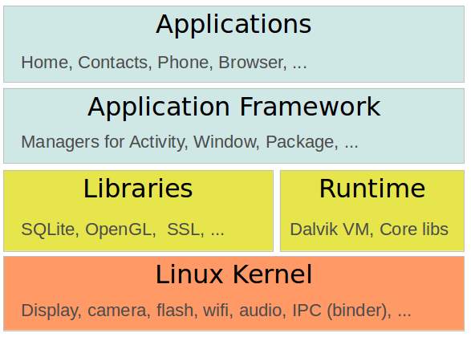
OVERVIEW
Five Layers
Linux Kernel
Android Runtime
Libraries
Application Framework
Applications.

Slide 3
LINUX KERNEL
Consists of Display Drivers.
Device Drivers.
Memory Managements.
Process Managements.
File and Network, I/O.

Slide 4
Android Runtime
Uses Dalvik Virtual Machine.
Core Java Libraries.
Application Specific Android Development.
Apple -> Swift ( Objective C).
Windows -> Visual C/C++ .
ART ( Android Runtime Virtual Machine)
Replaced Dalvik in Lollipop ( Android 5.0)
Ahead of Time Compilation ( AOT), Improved Garbage Collection.

Slide 5
Android Libraries
C/C++.
Internet Security.
User Interface Buildings.
Graphics.
Database Access.

Slide 6
Library Examples
WebKit
Web Browser Engine.
OpenGL
High Performance Graphics.
Render 2D or 3D graphic contents.
LibC
Generic C Library.
SQL-lite
A database management for authenticity and storing.

Slide 7
Examples Cont.
Surface Manager
Off Screen Buffering.
Apps that can’t directly draw onto screen
Reason behind window transparency.
An Off-Screen Buffer.
Media Framework
Uses StageFright engine.
Provides media codecs allowing recordings and playbacks of different types of media.

Slide 8
Application Framework
Higher Level Services to Applications.
Environment in which applications are run and managed.
Package Manager
Keeps track of installed Applications.
Apps can communicate with other apps on the Device
Windows Manager
Manages the windows that’s currently running and comprises the application.

Slide 9
Framework Cont.
Location Manager
Allows the application to receive location and movement info generated by GPS
Similar to getSystemService().
Activity Manager ------ android.app.ActivityManager().
Manages the life cycle of the Activities for the applications.
Telephone Manager
Manages the voice and RTL calls.

Slide 10
Framework Cont.
View System
Provides Common User Interface Elements.
Icons
Buttons
Text Entries.
Content Providers
Databases that allow the applications to store and share the info.

Slide 11
Framework Cont.
Resource Manager
Allows non-code embedded resources
Strings
Color Settings
UI layout
Notifications Manager
Allows all the applications to display banner alerts.

Slide 12
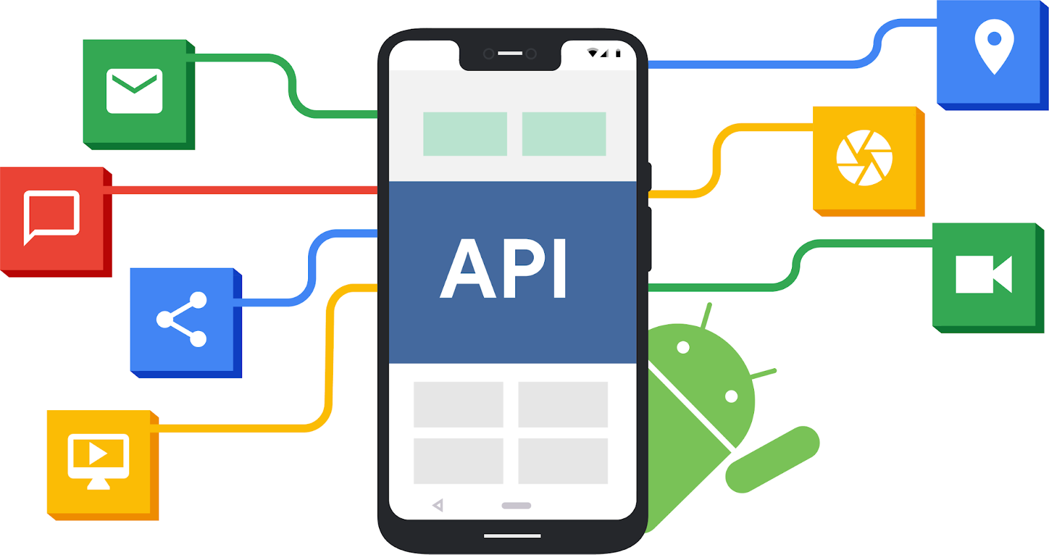
Applications
Responsible for Hosting the android application
Accessible to all Android APIs.
Executed in the VM ( Dalvik or ART)

Slide 13

Designed for Mobile and flexibility
Both in software and hardware.
5 Layers.
Application development
Simple
JAVA
Kotlin.
Access to all aspects of Kernel
Open Source.
APIS.

Slide 14
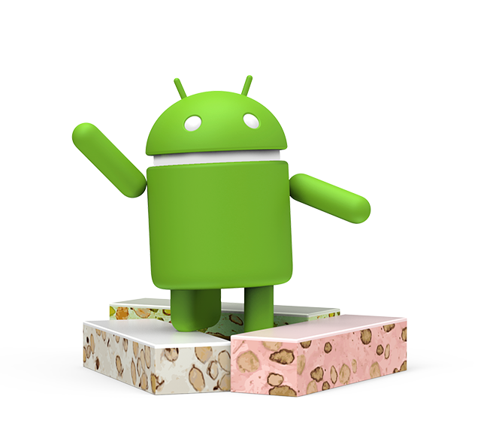
THANK YOU

