Slide 1
Web Scraping
&
Creating sqlite Database
By Joseph Hays

Slide 2
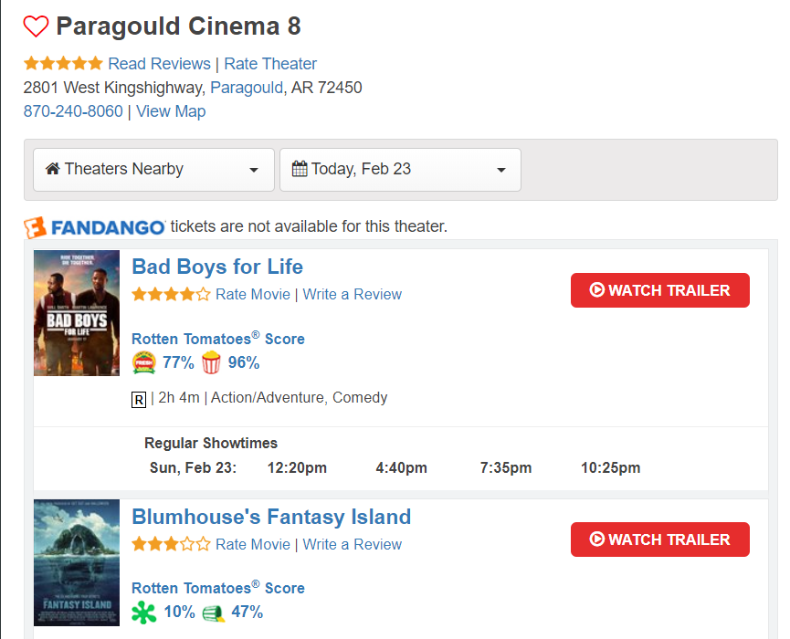
Find website
https://www.showtimes.com/

Slide 3
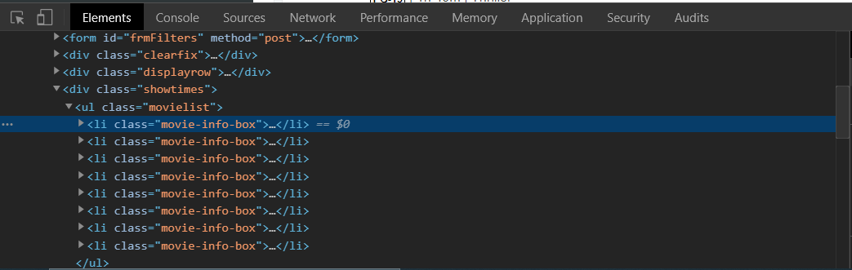
Look at source
Open console (ctrl+shift+i) in Chrome

Slide 4
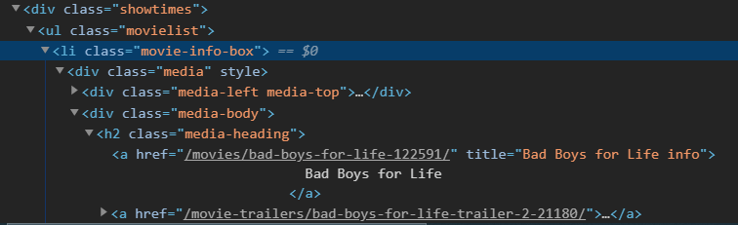
Find useful Tags
Each <li> tag contains a movie
The name is found in an <h2><a>Movie Title</a></h2>

Slide 5
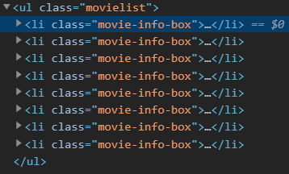

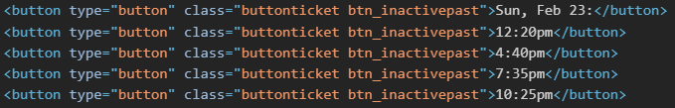
Here are the ones I chose
Tags:
li.movie-info-box | h2>a
span.mpaa | button.buttonticket

Slide 6
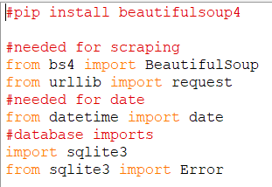
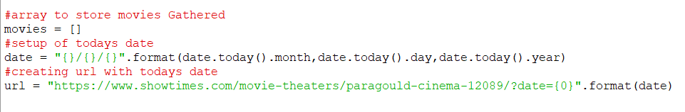
Writing Code (setup scraping)

Slide 7
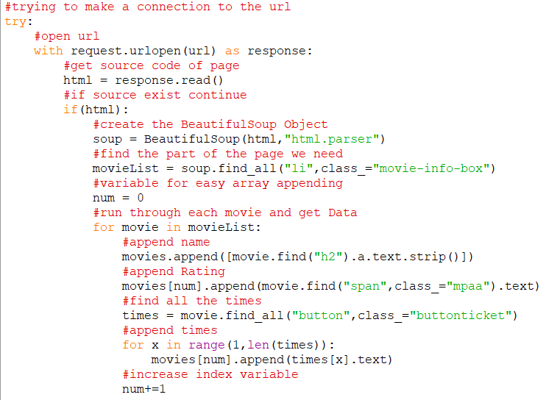
Scrap
Try to make
Connection
To url

Slide 8
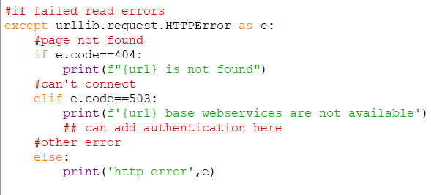
Failed (state error)

Slide 9
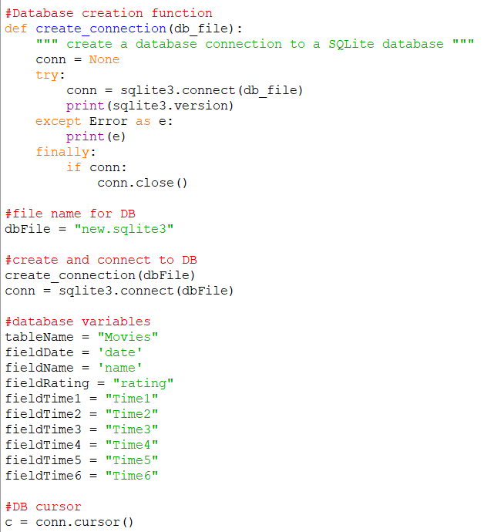
Setup Database
Make the database components
Open database
Setup table name
Setup column names

Slide 10
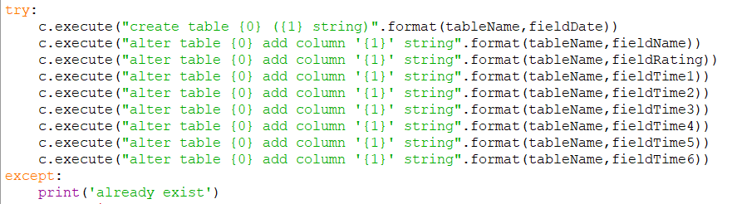
Create the table and columns

Slide 11
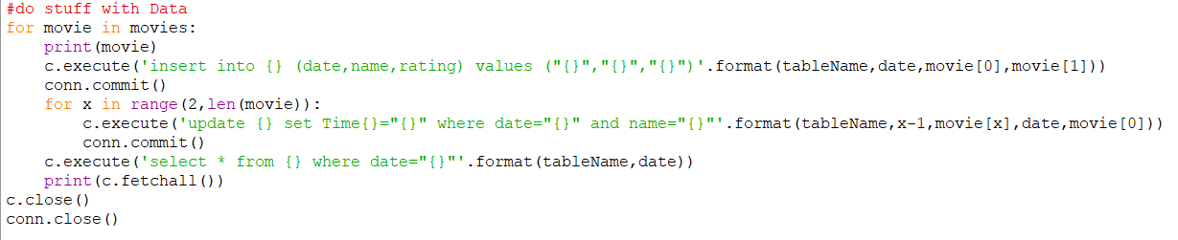
Save the Data to Database
Insert and update to the Database

Slide 12
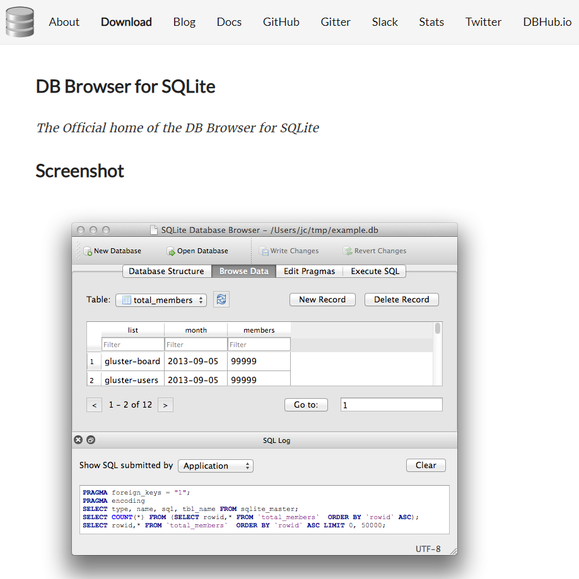
View Database
Get an sqlite database software

Slide 13
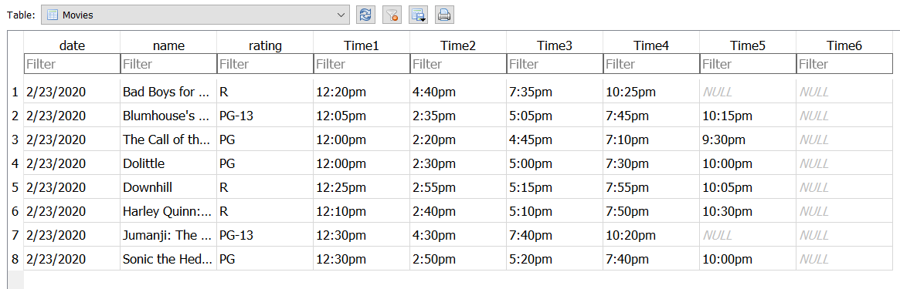
See if data matches the site

Slide 14
It’s easier than being a CS Major
Any Questions?

