Slide 1


FIREBASE
Divakar Chowdary kamma

Slide 2
What is Firebase?
It is a platform for building Android ,iOS and web apps .It provides services like
Authentication
Messaging
Cloud storage
Real time database and many more
Without Server-side programming ,applications can be created.
Can be used as Backend service.
Only write front end code
Secured and Data monitoring is easy

Slide 3
Developers
Founded by Andrew Lee and James Tamplin in 2011
In 2014 all its rights are purchased by Google.
Initially it is developed for database later it is further extended as a Full App development.

Slide 4
Why Firebase?
Creation of application can be done without any backend server.
It uses Json so it is faster than any other backend web services.
It has libraries for JAVA, JavaScript, Android and iOS.
It automatically saves data to backend and can be used in any instances of application through synchronization.

Slide 5
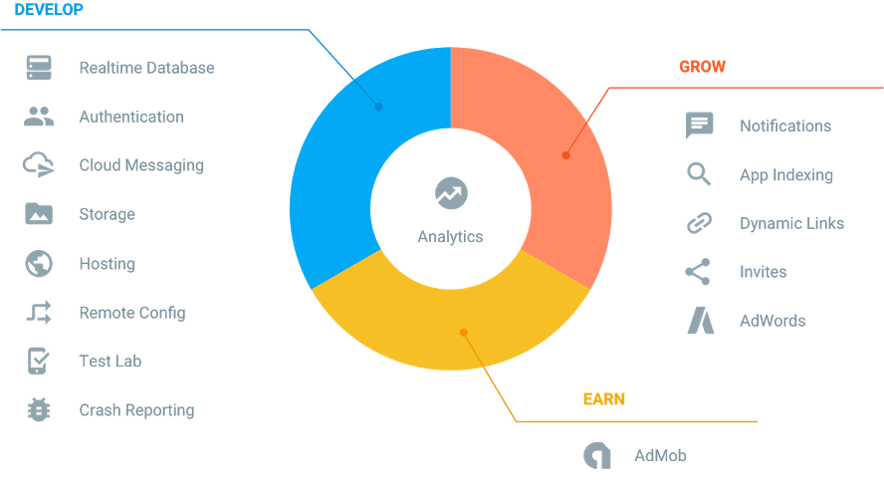
ANALYTICS OF FIREBASE

Slide 6
Analytics of Firebase
It is divided into three Modules
Develop
Grow
Earn

Slide 7
DEVELOP

Slide 8
AUTHENTICATION
Authentication and account management
Supports:
Email and Password
Supports Resetting password
Account Disable
Existing Auth systems
Provision for own custom Auth Tokens.
Provision for phone Authentication.

Slide 9
Realtime Database
It is totally cloud based, NoSQL, JSON.
Synchronization is done in real time
It stores data and Objects as JSON
It has Security Rules for data validation.
Even works in offline mode.

Slide 10
REQUIRED DATABASE FEATURES
Databases for mobile needs to be:
Lightweight since storage is limited in mobiles
No server requirement
Fast and secure
Included libraries
Low memory and power consumption

Slide 11
CLOUD MESSAGING
Firebase cloud messaging is a cross platform messaging solution that lets you to deliver messages at free cost.
It is a free service that helps Android and iOS developers to send data from servers to their applications, and upstream messages back to the cloud from the user's device.
If you need to integrate the Push Notification into your app, you need to use the Firebase Cloud Messaging Service.

Slide 12
FIREBASE STORAGE
Firebase storage can store files, photos, audio ,video etc.
It is a stand-alone solution for uploading user generated content like images and videos from an iOS and Android device, as well as the Web.
In typical Firebase fashion, there's no server required. Firebase Storage is designed specifically for scale, security, and network resiliency.

Slide 13
OFFLINE MODE
Offline Synchronization allows users to interact with a mobile app for viewing, adding, or modifying data even when there is no network connection.
Changes are stored in a local database. Once the device is back online, these changes are synced with the remote backend.
Offline mode is supported only in Android, iOS, and web apps. To use offline persistence there is no need of any changes to the code.

Slide 14
Other Functionalities
Firebase Crash Reports:
Firebase Crashlytics is a lightweight, Realtime crash reporter that helps you track, prioritize, and fix stability issues to improve your app quality
Test Lab:
Firebase Test Lab is a cloud-based app-testing infrastructure. With one operation, you can test your Android or iOS app across a wide variety of devices and device configurations, and see the results including logs, videos, and screenshots in the Firebase console.

Slide 15

Performance Monitoring
Keep app fast and responsive: Get information how your app works from users' point of view with automatic and customized tracking.
Users Traces to get Performance: using this traces you can understand in which context your app has performance issues.
Keep your eyes on Network: You can track response time, pay load, success rates.
Pinpoint the origin of issues: Break down both traces and network into required dimensions to break down issues.

Slide 16
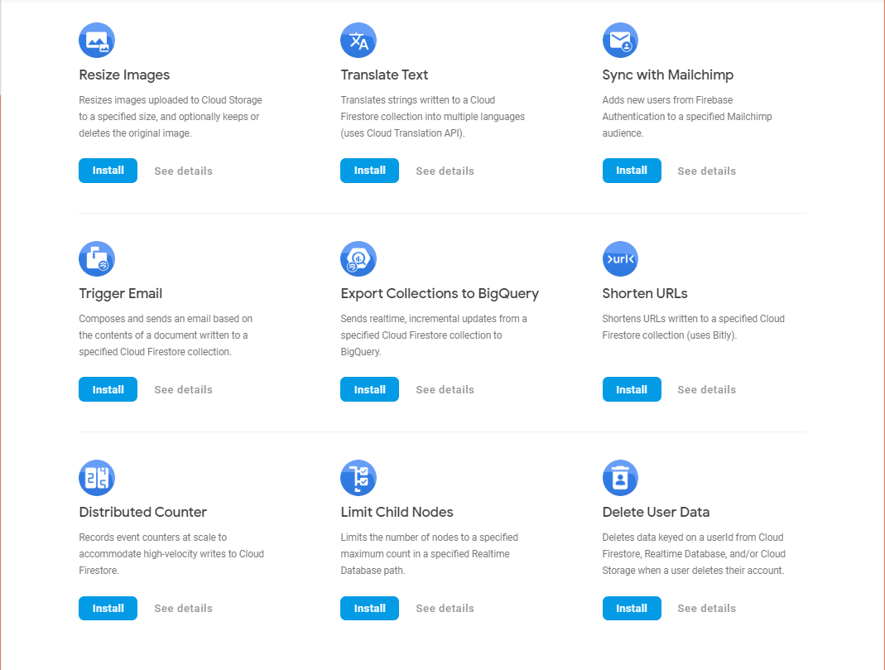
Firebase Extensions

Slide 17
Other features
There are other features that can be used in your app
Adding chat
Optimize ads
Add personalization welcome screen for users
Sharing photos
Can process payments without 3rd party server
Releasing beta versions for few users before releasing a main version

Slide 18
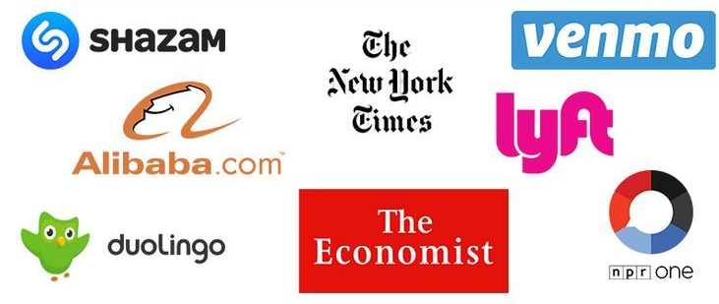
Popular companies Using Firebase

Slide 19
Other Databases
SQLite
Realm DB
ORMLite
Berkeley Db
Couchbase Lite
MySQL
Mongo DB
cassandra

Slide 20
HOW TO CONNECT FIREBASE?

Slide 21
Dependencies
Before running check the following:
Add the Firebase SDK for Google Analytics implementation 'com.google.firebase:firebase-analytics:17.2.2' // For example, to use Firebase Authentication and Cloud Fire store implementation 'com.google.firebase:firebase-auth:19.2.0’ implementation 'com.google.firebase:firebase-firestore:21.4.0’ Plugin:
classpath ‘com.google.gms: google-services:4.3.3

Slide 22
Thankyou!

