Slide 1

STORAGE IN ANDROID
Presented by
Pavan Kumar Reddy Sama

Slide 2
MAIN CONTENTS
DATA BASE
ANDROID DEBUGGING

Slide 3
SUBContents:
Android Shared Preferences
Android Session Management
Android Internal Storage
Android External Storage
Android SQLite Database

Slide 4
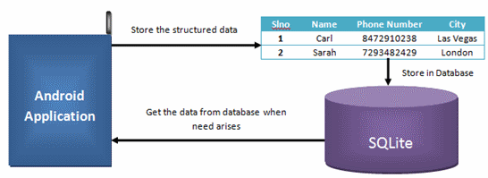
WHAT IS A DATABASE?
Database is organized collection of data so that it can be easily accessed, managed and updated.
DBMS is a software package designed to define, manipulate, retrieve and manage data in database.
Database Applications:
Banking : all transactions
Airlines : reservations, schedules
sales : customers, products
Manufacturing : Production,orders

Slide 5
Android Shared Preferences:
Useful for storing and retrieving private primitive data in key-value pairs.
Typical usage of Shared Preferences is for saving application such as username and password,auto login flag, remember-user flag etc.
Use the getSharedPreferences() method to get access to the preferences.

Slide 6
Android Shared Preferences
Example:
SharedPreferences prefs= this.getSharedPreferences(“myPrefs”,MODE_PRIVATE’);
If the preferences XML file exist, it is opened, otherwise it is created.
To Control access permission to the file:
MODE_PRIVATE : private only to the application
MODE_WORLD_READABLE : all application can read XML file
MODE_WORLD_WRITABLE : all application can write XML file

Slide 7
Android SHARED PREFERENCES
To add Shared preferences, first an editor object is needed
Editor prefsEditor = prefs.edit();
Then, use the put() method to store the data in the key-value pairs
prefsEditor.putString(“username”,”pavan”);
prefsEditor.putString(“password”,”1234”);
prefsEditor.putint(“times-login”,1);
prefsEditor.commit();

Slide 8
ANDROID SHARED PREFERENCES
To retrieve shared preferences data:
String username = prefsEditor.getString(“username”,” ”);
String password = prefsEditor.getString(“password”,” ”);
If you are using SharedPreferences for specific activity, we need to initialize the SharedPreferences object by using getPreferences() method like as shown below.
SharedPreferences sharedPref = getPreferences(Context.MODE_PRIVATE);
In case, if we are using multiple shared preference files, then we need to initialize the SharedPreferences object by using getSharedPreferences() method like as shown below.
SharedPreferences sharedPref = getSharedPreferences("filename1",Context.MODE_PRIVATE);
Here, the name “filename1” is the preference file, which want to read the values based on our requirements and the context mode MODE_PRIVATE, will make sure that the file can be accessed only within our application.

Slide 9
Write and read methods
Write to shared preference
Read to shared preference
SharedPreferences sharedPref = getPreferences(Context.MODE_PRIVATE); SharedPreferences.Editor editor = sharedPref.edit(); editor.putBoolean("keyname",true); editor.putString("keyname","string value"); editor.putInt("keyname","int value"); editor.putFloat("keyname","float value"); editor.putLong("keyname","long value"); editor.commit();
SharedPreferences pref = getPreferences(Context.MODE_PRIVATE); pref.getString("keyname",null); pref.getInt("keyname",0); pref.getFloat("keyname",0); pref.getBoolean("keyname",true); pref.getLong("keyname",0);

Slide 10
Deleting and clearing methods
Deleting from shared preferences
Clearing from shared preferences
SharedPreferences pref = getPreferences(Context.MODE_PRIVATE); SharedPreferences.Editor editor = pref.edit(); editor.remove("keyname"); editor.commit();
SharedPreferences pref = getPreferences(Context.MODE_PRIVATE); SharedPreferences.Editor editor = pref.edit(); editor.clear(); editor.commit();

Slide 11
How to save objects in shared preferences?
While developing a mobile application, you may want to save a custom object for later use.
For example, saving a user’s information when the application is closed and using it when the application is opened later.
Implementation:
Add Gson Library in Android Project
implementation ‘com.google.code.gson:gson::2.8.5’
Creating a shared Preferences
SharedPreferences mPrefs = getPreferences(MODE_PRIVATE);

Slide 12
How to save objects in shared preferences?
We will encode our object into a JSON string and save it in the shared preferences space.
Myobject myObject = new Myobject();
Editor prefsEditor = mPrefs.edit();
Gson gson= new Gson();
String json= gson. toJson(myObject);
prefsEditor.putString(“MyObject”,json);
prefsEditor.commit();
When we want to read the saved data we only have to decode from a JSON string back to our object.
Gson gson= new Gson();
String json=mPrefs.getString(“MyObject”,””);
MyObject obj = gson.fromJson(json,MyObject.class);

Slide 13
Android Session Management
In Android, Session Management is a process which is used to maintain the required values in a session to use it in a application.
Generally , in android we can manage the logged in user details in session either by storing it in global variables or in Shared Preferences .
In case , if we store the values in global variables ,those will be lost whenever the user closes the application but if we store the values in Shared Preferences , those will be persisted even if the application closed by user.

Slide 14
Android internal storage
Android can save files directly to the device internal storage.
These files are private to the application and will be removed if you uninstall the application.
We can create a file using openFileOutput() with parameter as file name and the operating mode.

Slide 15
Android Internal Storage
Similarly, we can open the file using openFileInput() passing the parameter as the filename with extension.
File are use to store large amount of data
Use I/O interfaces provided by java.io.* libraries to read/write files.
Only local files can be accessed

Slide 16
Read a File from Internal Storage
Use context.openFileInput(string name) to open a private input file stream related to a program.
Throw FileNotFoundException when file does not exist.
Syntax:-
String FILENAME = "user_details"; FileInputStream fstream = openFileInput(FILENAME); StringBuffer sbuffer = new StringBuffer(); int i; while ((i = fstream.read())!= -1){ sbuffer.append((char)i); } fstream.close();

Slide 17
Write a File to Internal Storage
Syntax:-
String mystring=“Hello World”;
FileOutputStream outfile = this.openFileOutput(“myfile.txt”,MODE_APPEND);
//Open and Write in”myfile.txt”,using append mode.
Outfile.write(mystring.getBytes());
Outfile.close(); //close output stream

Slide 18
EXTERNAL STORAGE
Every Android-compatible device supports a shared “external storage” that you can use to save files
Removable storage media (such as an SD card)
Internal (non-removable) storage
File saved to the external storage are world readable and can be modified by the user.
These files are private to the application and will be removed when the application is uninstalled.

Slide 19
Android external storage
Must check whether external storage is available first by calling getExternalStorageState()
Also check whether it allows read/write before reading/writing on it
getExternalFilesDir() takes a parameter such as
DIRECTORY_MUSIC,DIRECTORY_RINGTONE etc,to open specific type of subdirectories
For public shared directories,use getExternalStoragePublicDirectory()

Slide 20
Android external storage
For cache files,use getExternalCacheDir()
All these are applicable for API level 8 or above
For API level 7 or below ,use the method;
getExternalStorageDirectory()
Private files stored in //Android/data/<package_name>/files/
Cache files stored in //Android/data/<package_name>/cache/

Slide 21
Android sqLite database
Saving data to a database is ideal for repeating or structured data, such as contact information.
The APIs that you’ll need to use a database is available in the android.database.sqlite package
Android stores your database in your applications private folder.
Your data is secure , because by default this area is not accessible to other apps or the user

Slide 22
SQLITE DATABASE
android.database.sqlite contains the SQLite database management classes that an application would use to manage its own private database.
android.database.sqlite.SQLiteDatabase contains the methods for: creating, opening, closing, inserting, updating, deleting and quering an SQLite database.

Slide 23
SQLite database properties
Embedded RDBMS
ACID Compliant
Size – about 257 Kbytes
Not a client/server architecture
Accessed via function calls from the application
Writing (insert, update, delete) locks the database, queries can be done in parallel

Slide 24
Storage classes
NULL – null value
INTEGER - Signed integer, stored in 1, 2, 3, 4, 6, or 8 bytes depending on the magnitude of the value
REAL - A floating point value, 8-byte IEEE floating point number.
TEXT - Text string, stored using the database encoding (UTF-8, UTF-16BE or UTF-16LE).
BLOB - The value is a blob of data, stored exactly as it was input.

Slide 25
Classes in android sqlite
SQLiteCloseable - An object created from a SQLiteDatabase that can be closed.
SQLiteCursor - A Cursor implementation that exposes results from a query on a SQLiteDatabase.
SQLiteDatabase - Exposes methods to manage a SQLite database.
SQLiteProgram - A base class for compiled SQLite programs.
SQLiteQuery - A SQLite program that represents a query that reads the resulting rows into a CursorWindow.
SQLiteQueryBuilder - A convenience class that helps build SQL queries to be sent to SQLiteDatabase objects.
SQLiteStatement - A pre-compiled statement against a SQLiteDatabase that can be reused.

Slide 26
Create OPERATION
Create a static string containing the SQLite CREATE statement, use the execSQL( ) method to execute it.
String createAuthor = "CREATE TABLE authors (id INTEGER PRIMARY KEY AUTOINCREMENT,
fname TEXT, lname TEXT);
myDatabase.execSQL(createAuthor);

Slide 27
Update operation
int update(String table, ContentValues values, String whereClause, String[ ] whereArgs)
public void updateBookTitle(Integer bookId, String newTitle) {
ContentValues values = new ContentValues();
values.put("title" , newTitle);
myDatabase.update("tbl_books" , values ,
"id=?" , new String[ ] {bookId.toString() } );
}

Slide 28
Insert operation
long insert(String table, String nullColumnHack, ContentValues values)
import android.content.ContentValues;
ContentValues values = new ContentValues( );
values.put("firstname" , "J.K.");
values.put("lastname" , "Rowling");
long newAuthorID = myDatabase.insert("tbl_authors" , "" , values);

Slide 29
Delete oPERATION
int delete(String table, String whereClause, String[] whereArgs)
public void deleteBook(Integer bookId)
{
myDatabase.delete("tbl_books" , "id=?" , new String[ ] { bookId.toString( ) } ) ;
}

Slide 30
queriEs
Method of SQLiteDatabase class and performs queries on the DB and returns the results in a Cursor object
Cursor c = mdb.query(p1,p2,p3,p4,p5,p6,p7)
p1 ; Table name (String)
p2 ; Columns to return (String array)
p3 ; WHERE clause (use null for all, ?s for selection args)
p4 ; selection arg values for ?s of WHERE clause
p5 ; GROUP BY ( null for none) (String)
p6 ; HAVING (null unless GROUP BY requires one) (String)
p7 ; ORDER BY (null for default ordering)(String)
p8 ; LIMIT (null for no limit) (String)

Slide 31
ANDROID DEBUGGING
Android Studio provides a debugger that allows you to do the following and more:
Select a device to debug your app on.
Set breakpoints in your Java or Kotlin.
Examine variables and evaluate expressions at runtime.
Enable debugging on your device:
If you're using the emulator, this is enabled by default
But for a connected device, you need to enable debugging in the device developer options.
Settings > System > Developer Options > USB debugging

Slide 32
In build.gradle file
android {
buildTypes {
customDebugType {
debuggable true
...
}
}
}

Slide 33
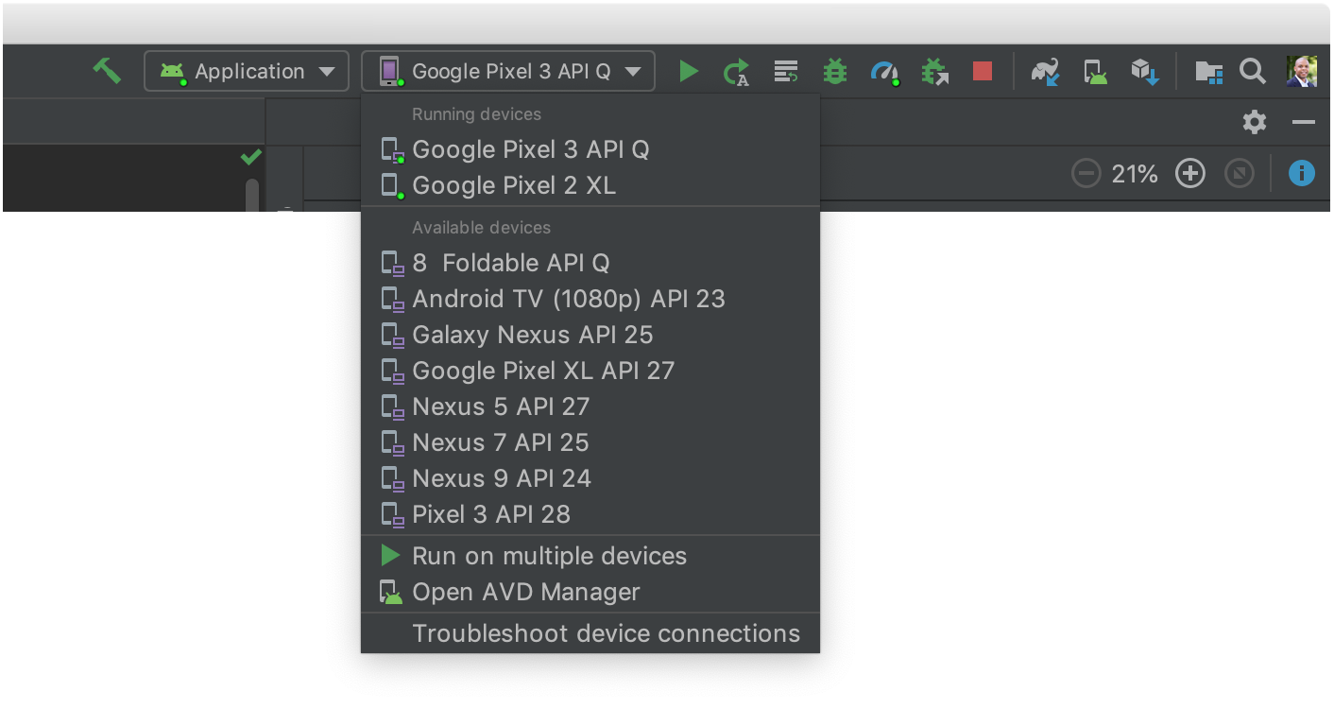

Start debugging
You can start a debugging session as follows:
Set some breakpoints in the app code.
In the toolbar, select a device to debug your app on from the target device drop-down menu.
If you don't have any devices configured, then you need to either connect a device via USB or create an AVD to use the Android Emulator.
In the toolbar, click Debug

Slide 34
THANK YOU

