Slide 1
How to Upload Your Mobile Application to Play Store
Jeffrey Ratton 2-17-20

Slide 2
Play Store (Android)
First, to upload an application you need to be a Google Play Developer
25$ fee

Slide 3
Step 1: Create Your Developer Account
Requirements: Google account
Google Play Console https://play.google.com/apps/publish/signup/
Accept Dev Agreement
Pay Fee
Complete Account Details

Slide 4
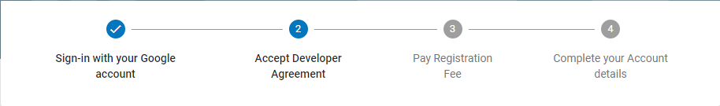

Slide 5
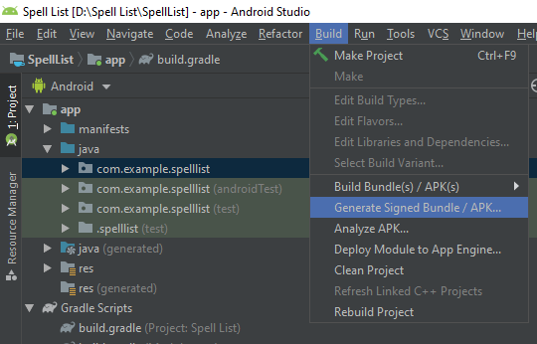
Getting APK or Signed Bundle

Slide 6
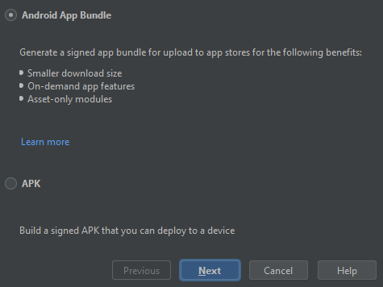
Getting APK or Signed Bundle
“An Android App Bundle is a new upload format that includes all your app’s compiled code and resources, but defers APK generation and signing to Google Play.”

Slide 7
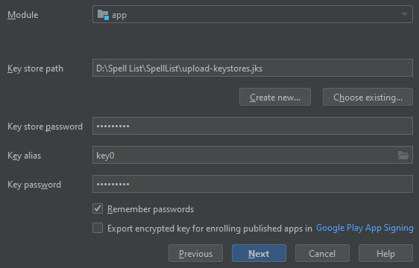
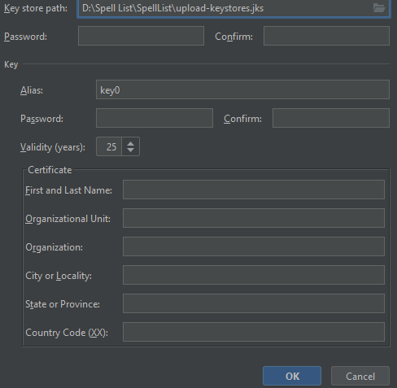
Getting Signed Bundle

Slide 8
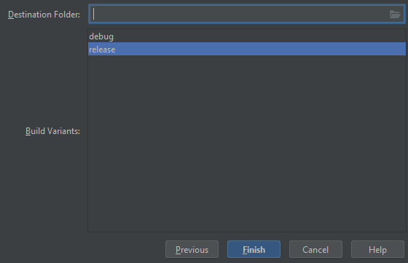
Getting Signed Bundle

Slide 9
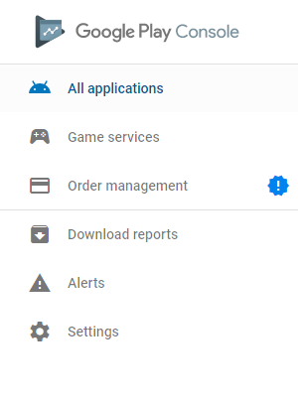
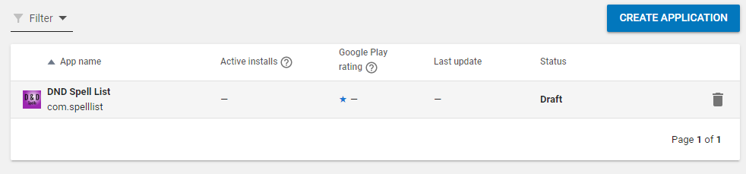
Uploading

Slide 10
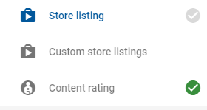
5 Sections
Store Listing
App Releases
Content Rating
App Content
Pricing & Distribution

Slide 11
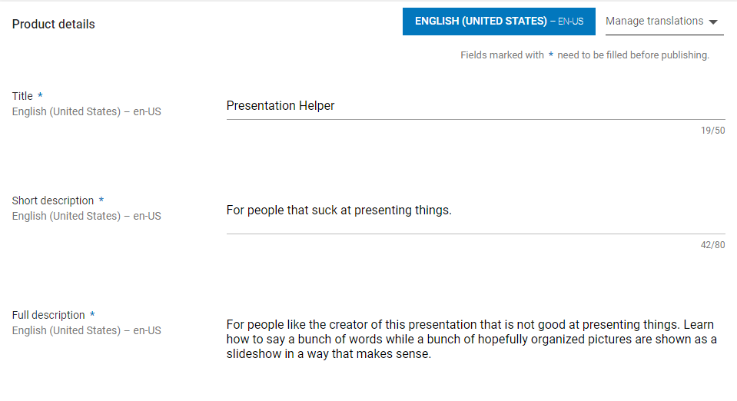
Uploading (Store Listing)

Slide 12
Uploading (Store Listing)
Along with Title, Short Description, and Full Description, more information is required
512 x 512 Image that will be the icon of the application
2 Screenshots of the application
Application Type(Application or Game) and Category
Content Rating (questionnaire)
Contact Email
*Privacy policy marked required, but there is a checkbox for not submitting a privacy policy at this time.

Slide 13
Uploading (App Releases)
Select between Release(Public Finished), Beta(Public Test), Alpha (Closed Test) and Internal(Closed Test)
Select the .apk or .aab depending on if you created an APK or Signed Bundle.

Slide 14
Uploading (Content Rating)
Quick questionnaire to determine rating of the app.

Slide 15
Uploading (App Content)
Similar to Content Rating
Basically determines if the app targets children

Slide 16
Uploading (Pricing & Distribution)
Free by default. Must have merchant account if app costs
Select countries the app is available
Ads?
Content Guidelines (checkbox)
US export laws (checkbox)

Slide 17
Resources
https://www.youtube.com/watch?v=8v0r_6mYgF8

