Slide 1
Word on the Street
By: Jagger Harness and Noah Whited

Slide 2
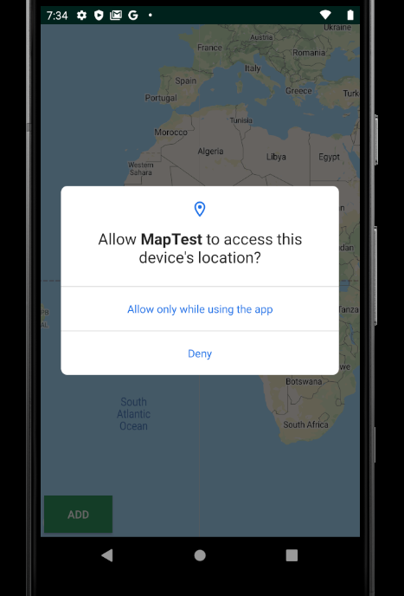
Location Services
The app starts with a permissions screen to ask users for access to their location data.

Slide 3
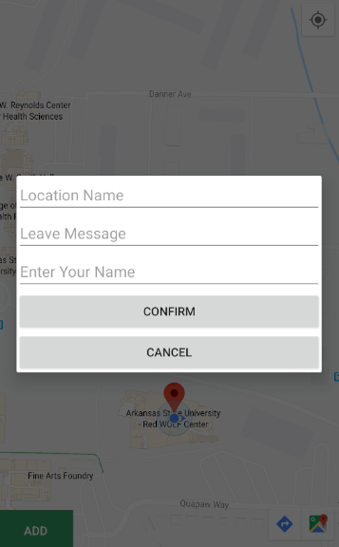
Drop messages
Users may drop messages that detail locations around them.

Slide 4
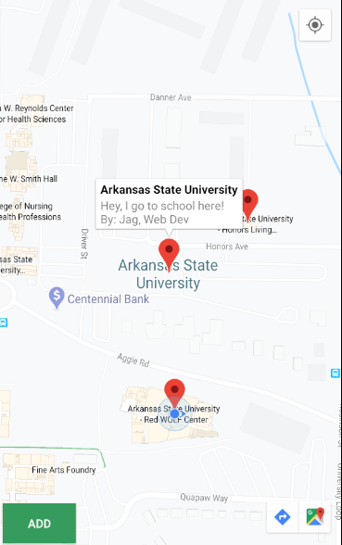
Read left messages
Users can access messages left by other users. The messages are stored on a server that I set up that contains server code and a database.

