Slide 1

Fantasy Football Recommendations using Machine Learning
Kartik Acharya, Andrew Beaton, Matthew LeGate
{kacharya3, abeaton7, legate}@gatech.edu
GitHub Page: https://cs4641-2021.github.io/sports-numbers-fans/

Slide 2
Introduction
Objective: Explore machine learning algorithms to derive fantasy football recommendations for wide-receivers (WR) on a seasonal basis.
Metrics:
Average game stats (total touchdowns scored, yards gained, etc), seasonal stats(total games played, snap share %, etc), advanced stats (Defender gap %, etc.)
~40 features total
Target feature - Average Points Per Game for Next Year
Challenges:
Limited data - We have a combined total of ~300 complete, labeled samples
The data spans from 2017-2020 seasons (the same player could appear 3 times in training data or never in the training data)
Account for lesser-known players or new players, injuries, etc.

Slide 3
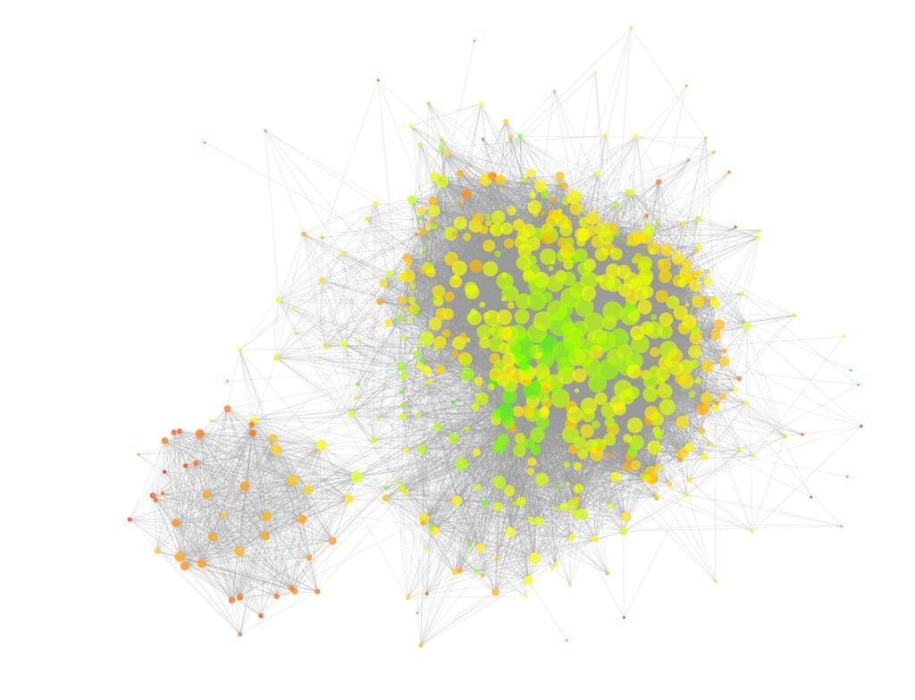




Machine Learning Workflow
Data Pre-Processing
Unsupervised Learning
Supervised
Learning
Prediction Model
Results
Training
Learning
Data cleaning and visualization
Collect and compile player stats and ranking, with historical game performance.
Clean up data for processing.
Visualize and analyze data.
Clustering and Classification
Cluster and classify data to understand similarities/dissimilarities.
Identify player features of importance.
Rank/Score Players by Projected Points
Use Random Forest, Decision Tree to learn/model projected points.
Prediction Model
Model to estimate projected player points.
Rank Player Points
Player with most points has the most value for the game.

Slide 4
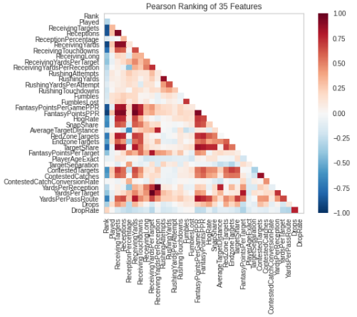
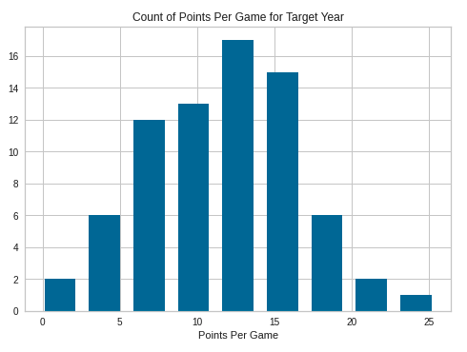
Data Visualization

Slide 5
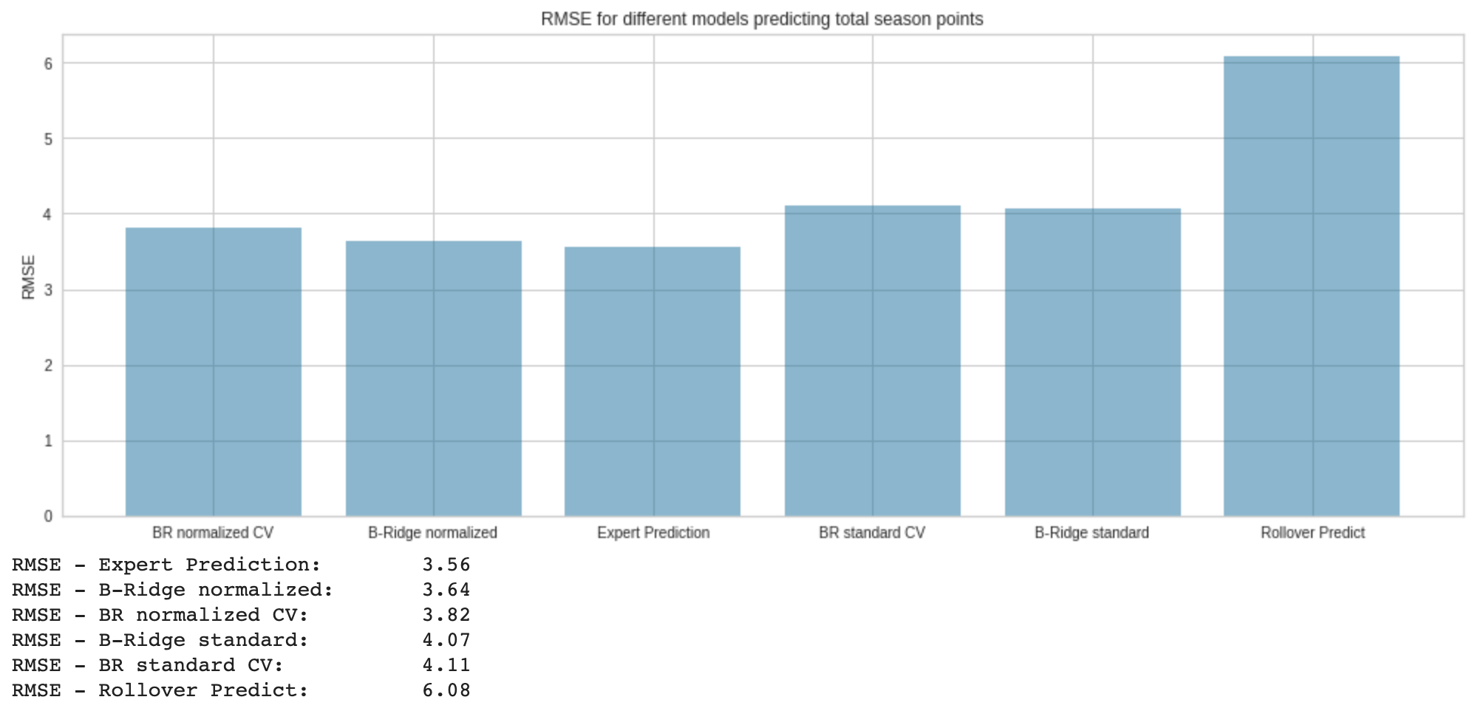
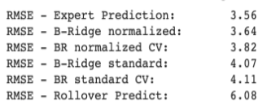
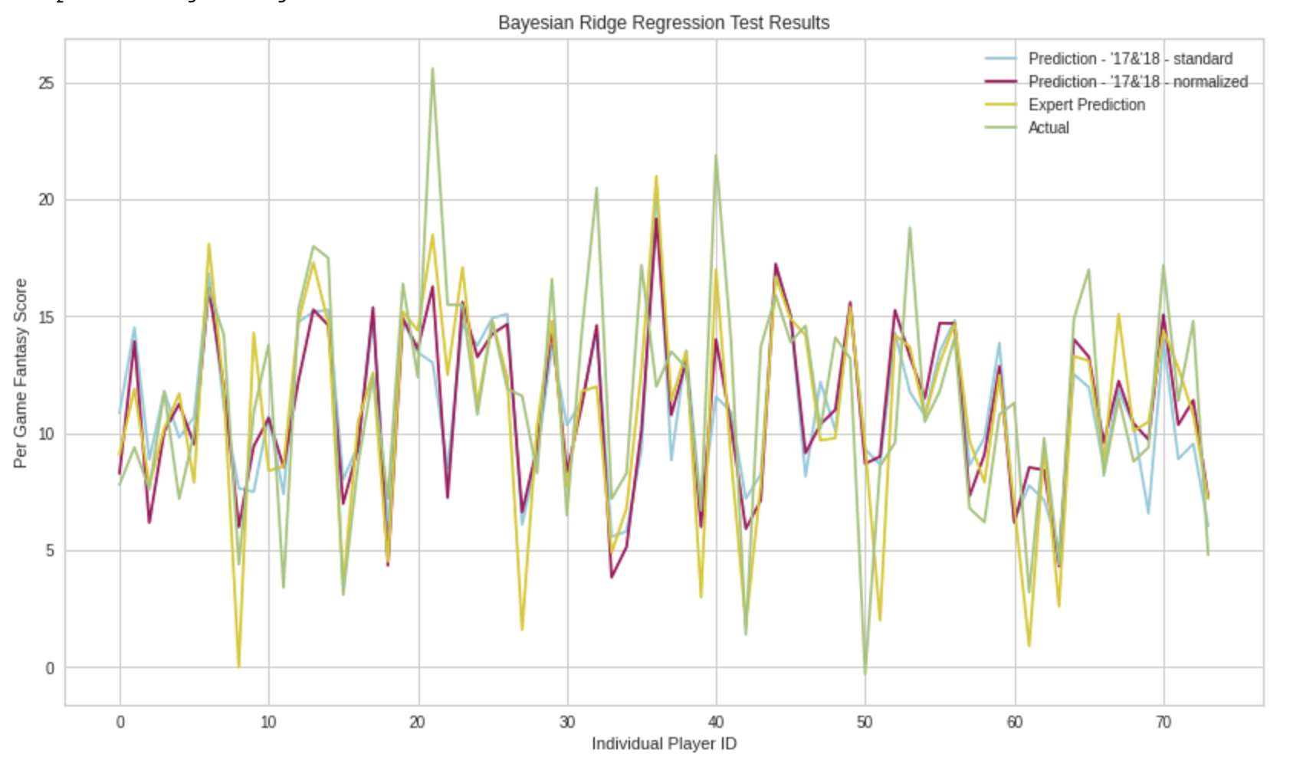
Initial Progress

Slide 6
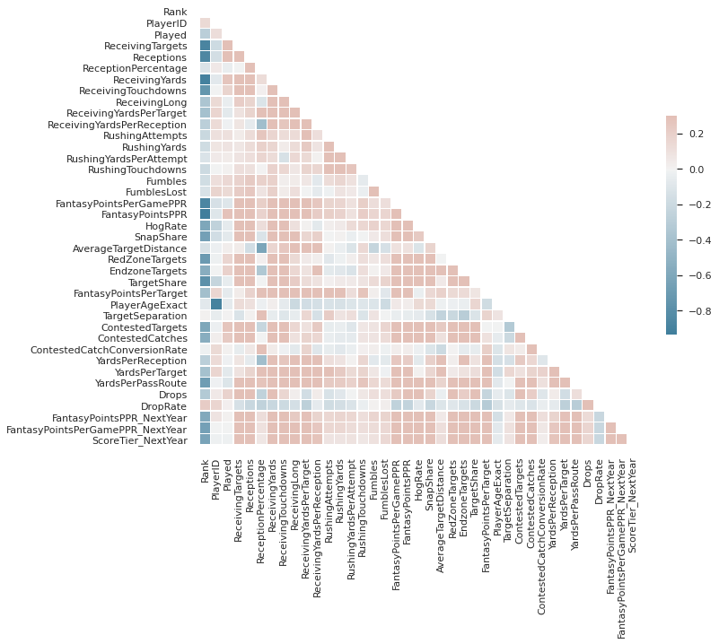
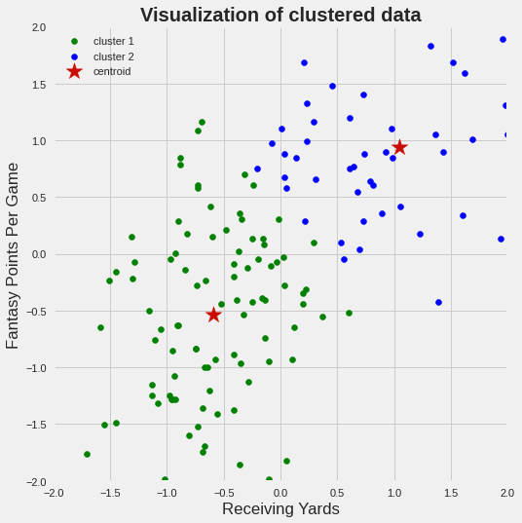
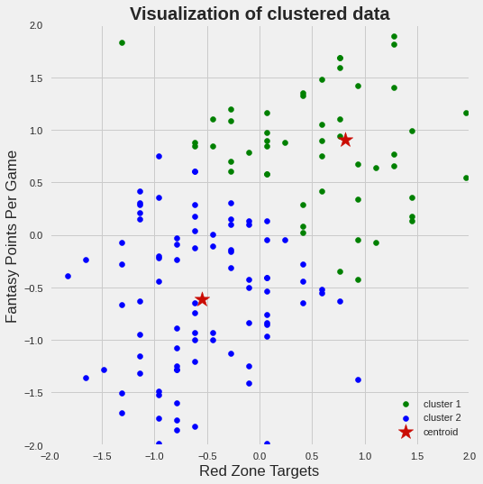
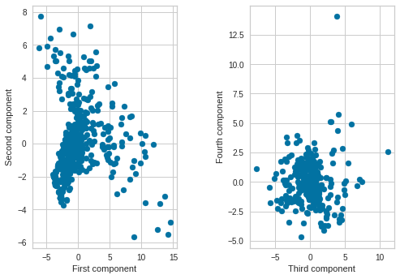
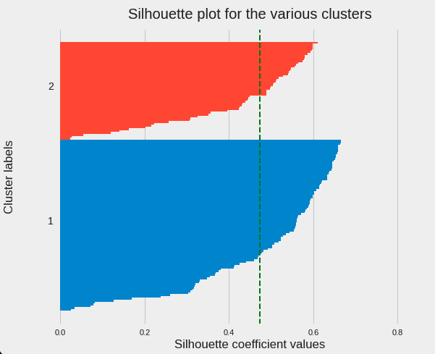
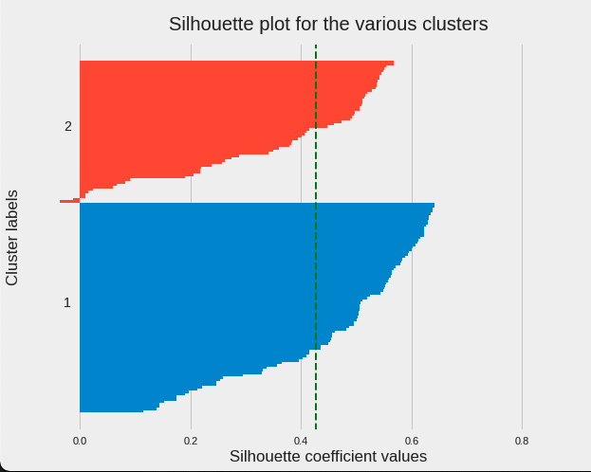
Feature Engineering
Unsupervised Learning
Supervised Learning
Used feature selection to select receiving yards and red zone targets
Using target value of fantasy points per game
Correlation Matrix (39 features) shows high correlation between Average Target Distance and Reception Percentage
K=2 Clusters for Receiving Yards and Red Zone Targets with Silhouette Plots
train feature shape: (109, 34)
test feature shape: (37, 34)
Shape of the scaled and PCA features: (146, 4)
First 2 principal components selected

Slide 7
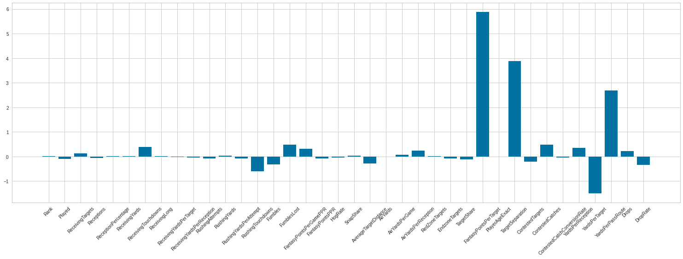
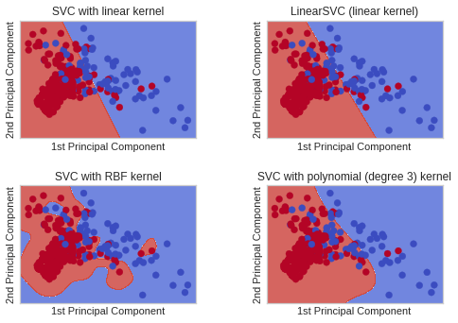
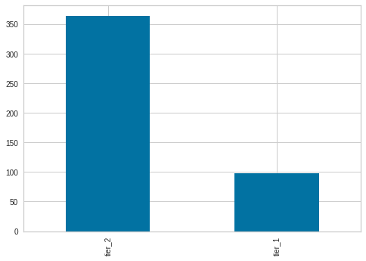
PCA and SVM Classifiers - 2D Decision Boundary
Feature Importance
Classify the players into 2 tiers
> 10 points Tier_1
<= 10 points Tier_2

Slide 8
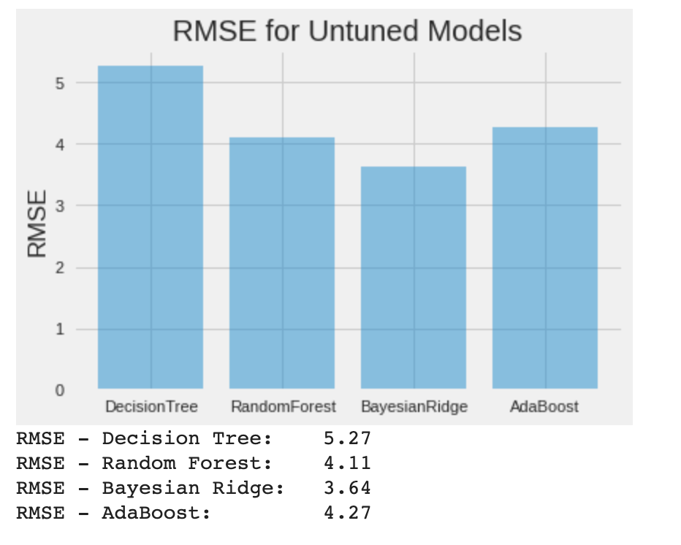
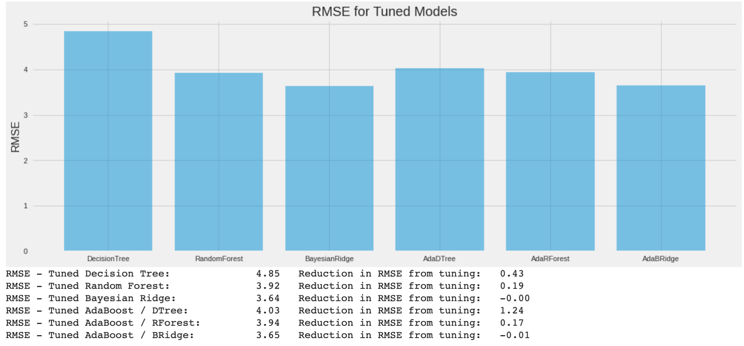
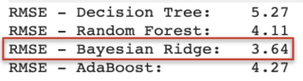
Model Exploration - Regression

Slide 9
Final Touchpoint
Missing values in original dataset (NaN values)
FantasyPointsPPR_NextYear
FantasyPointsPerGamePPR_NextYear
Used K-Nearest Neighbors to fill in missing values - total number of datapoints for 2017-2018 season went up to 462 vs 146
Underfitting against expert predictions

Slide 10
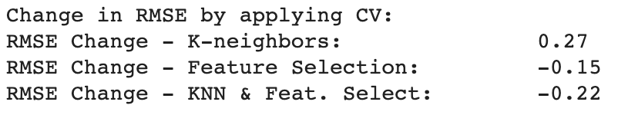
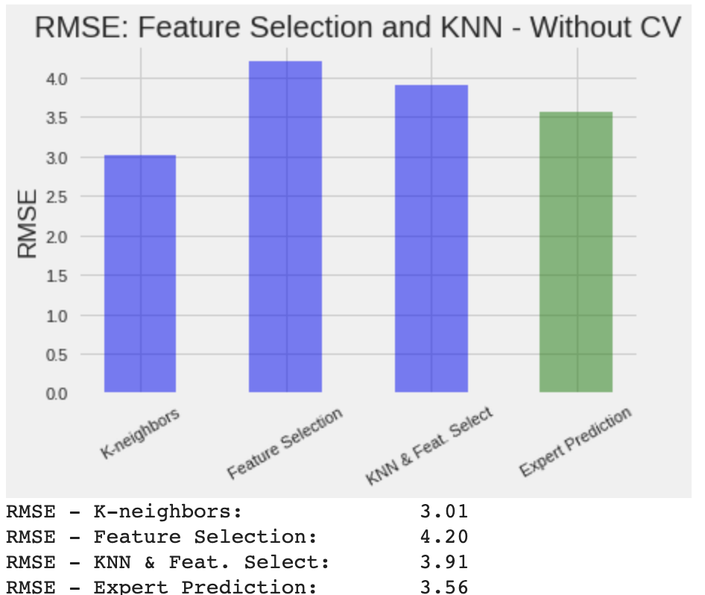
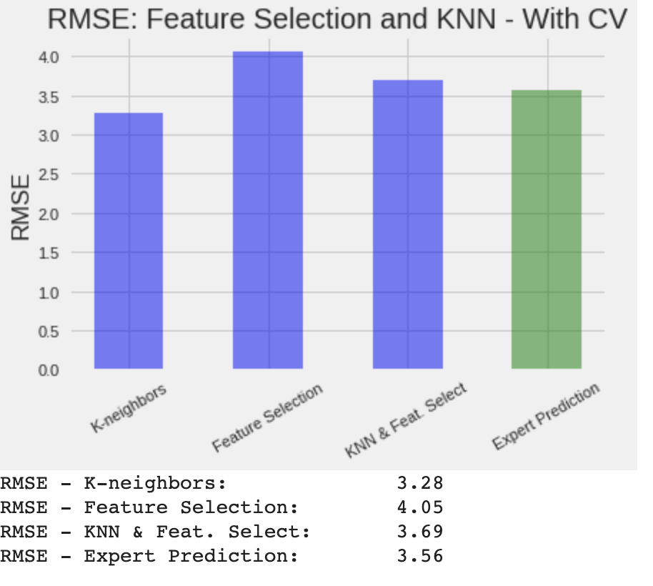
Results

Slide 11
Summary
Future Work
Unsupervised Learning
Data visualization
Feature Selection
K-Means Clustering with forward selection
Supervised Learning (scikit-learn)
Bayesian Ridge Regression
Decision Tree
Random Forest Regressors
PCA and SVM
Key steps with iterations
Data processing and analysis
Feature engineering
More data is better.
Classify players on different tiers for more accurate recommendations.
Evaluate different pipelines with the same scores for comparison.
Explore cross-validation and accuracy scores to tune hyperparameters.
Learning more relevant player features to beat expert predictions.

