Slide 1


CS-491
PRICEWISE

Slide 2

OUR TEAM
Tuğberk Dikmen
Deniz Hayri Özay
Mehmet Ali Öztürk
Furkan Yıldırım
Mete Arıkan

Slide 3

WHAT IS PRICEWISE ?
ULTIMATE SHOPPING ASSISTANT FOR WISE CUSTOMERS! PRICEWISE IS MORE THAN SIMPLY A PRICE COMPARISON SHOPPING LIST SOFTWARE; IT’S YOUR KEY TO SMART,BUDGET-FRIENDLY SHOPPING

Slide 4





PROBLEMS TO SOLVE
Decreasing Purchasing Power
Not Adequate Comparison Capacity
Time Spent on Price Search

Slide 5

OUR FEATURES
01
SHOPPING LIST COMPARISON
02
ONE BY ONE PRICE COMPARISON
03
SUGGESTING ALTERNATIVE AND SPLIT SHOPPING LIST
04
BEST PRICE ON CATAGORY
05
FINDING AND SUGGESTING SALES
06
SHOWING CLOSEST PATH FOR YOUR SHOPPING LIST

Slide 6
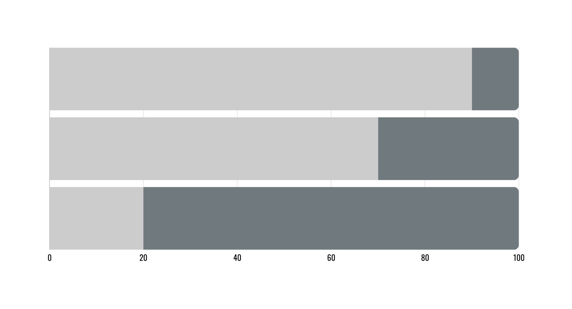
OUR PROGRESS
RESEARCH, ANALYSIS AND DESIGN
FRONT END DEVELOPMENT
BACK END DEVELOPMENT

Slide 7
PROJECT PLAN
SEP
OCT
NOV
DEC
MAY
JUN
JUL
AUG
JAN
FEB
MAR
APR
PLANING AND RESEARCH
FRONT END DEVELOPMENT
WEB SCRAPING BACK END DEVELOPMENT
PROJECT DEMO
USER AND LIST BACK END DEVELOPMENT
DATABASE IMPLEMENTATION
MACHINE LEARNING BACK END DEVELOPMENT
ADMIN FRONT END AND BACK END DEVELOPMENT
TESTING
APP LAUNCH

Slide 8
THANK YOU FOR YOUR ATTENTION

