Slide 1
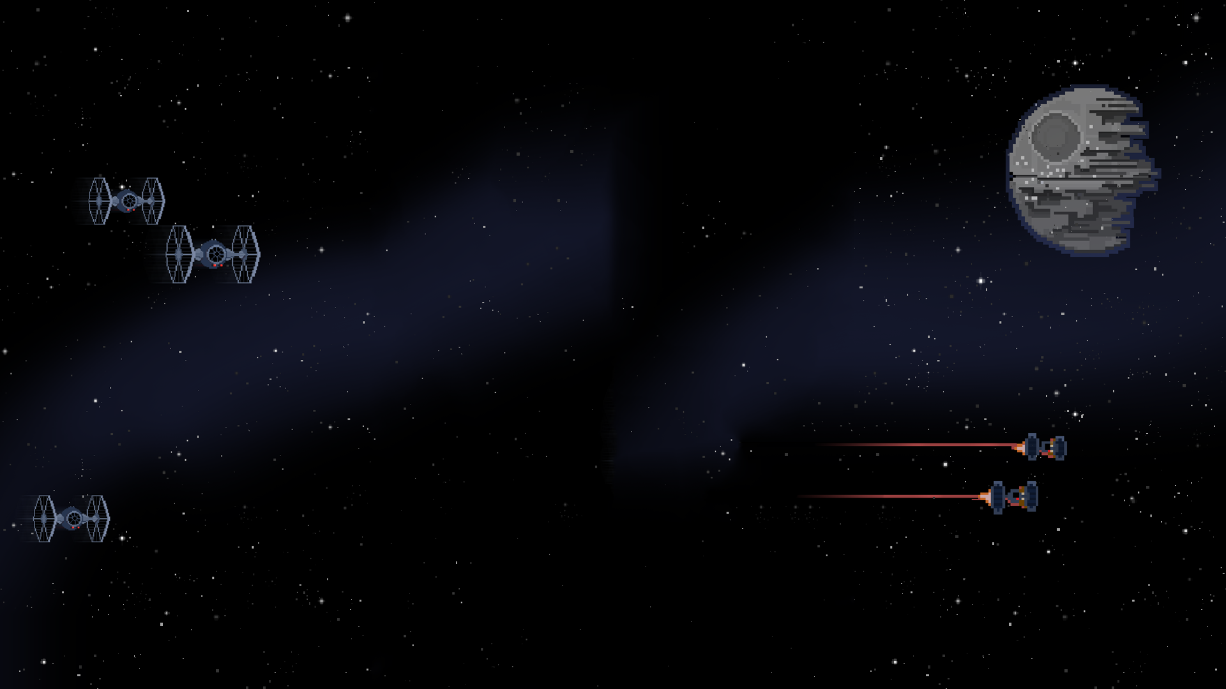
SkyMap
Team Deathstar
(Team 3)
Emma Batchelor, Lindsey Harris,
Joseph Noyes, Zein Sleiman

Slide 2
Project Overview
To calculate the position of stars, planets, and other space objects
Generate a map as a JPEG image of the sky
Shows position of various space objects relative to user location
Named stars and planets will have labels
Constellations will be labeled and be drawn with lines connecting each star
Implemented in Java

Slide 3
Project Schedule
Sprint 1
Setting up tools
Getting to know the project
CSV Reader
Software Development Plan
Sprint 2
Math formulas to Java
Data Parser
Basic GUI implementation
Sprint 3
JPEG Generator
Drawing Functions
Architectural Design
Sprint 4
Demo Presentation
Advanced GUI Implementation
Sprint 5
Final Testing and Debugging
Presentation Preparations

Slide 4
List of Deliverables
Software Development Plan - January 27, 2016
First Version of Backlog - February 15, 2016
Architecture Design and Updated Backlog - March 2, 2016
Presentation of Preliminary GUI - March 28, 2016
Product Delivery - April 20, 2016

Slide 5
Personnel
Everyone is assigned the role of Developer. The Developer role encompasess the following tasks:
Customer Liaison
Designer
Programmer
Analyst
Software Lead
Software Tester
Zein: TrelloMaster, Joseph: GITMaster, Emma: GUI Expert, Lindsey: Lead Editor
The meeting moderator and recorder roles will be rotated
Scrum Master and Product Owner roles will also be rotated

Slide 6
Risk Management Plan
Astronomical Mathematics
Drawing Functions
Excessive Ambition
Cross-platform Difficulties
Lack of Instructor Approval
Scheduling Conflicts
Weather Conflicts
Team Member Leaving
Losing Tools
Apocalypse

Slide 7
Milestones
Documents:
Software Dev Plan
Requirements Definition Doc
Software Design Doc
Software Test Plan
Presentations:
Presentation of Software Dev Plan (1/27)
Presentation of first version of Backlog (2/15)
Presentation of Architectural Design and updates to Backlog (3/2)
Presentation of Preliminary GUI Design (3/28)
Presentation of Final Product Delivery (4/18)

Slide 8
Milestones cont’d
Software:
Setting up dev tools: Trello, GIT, Google Calendar, IDEs
Learning Java
Preliminary GUI
Writing astronomy formulas into Java
JPEG Generator
Drawing functions
Final version of GUI

Slide 9
Any Questions?
Questions you have, answer them we will.

