Slide 1
Architectural Design
By: Jennifer Paulsen, Ina Carter, Maxwell Twente, Brandon Kibler

Slide 2
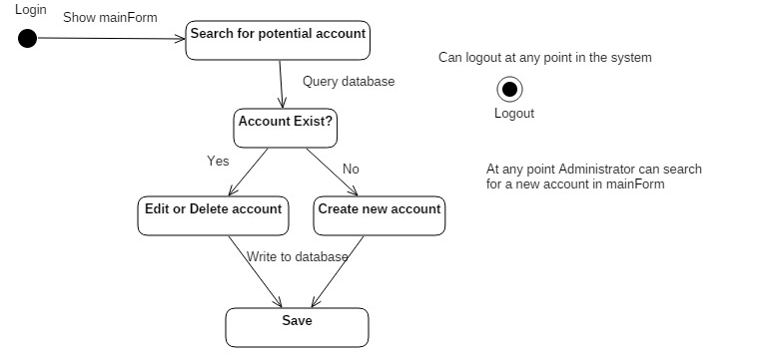
STATE DIAGRAM - ADMINISTRATOR

Slide 3
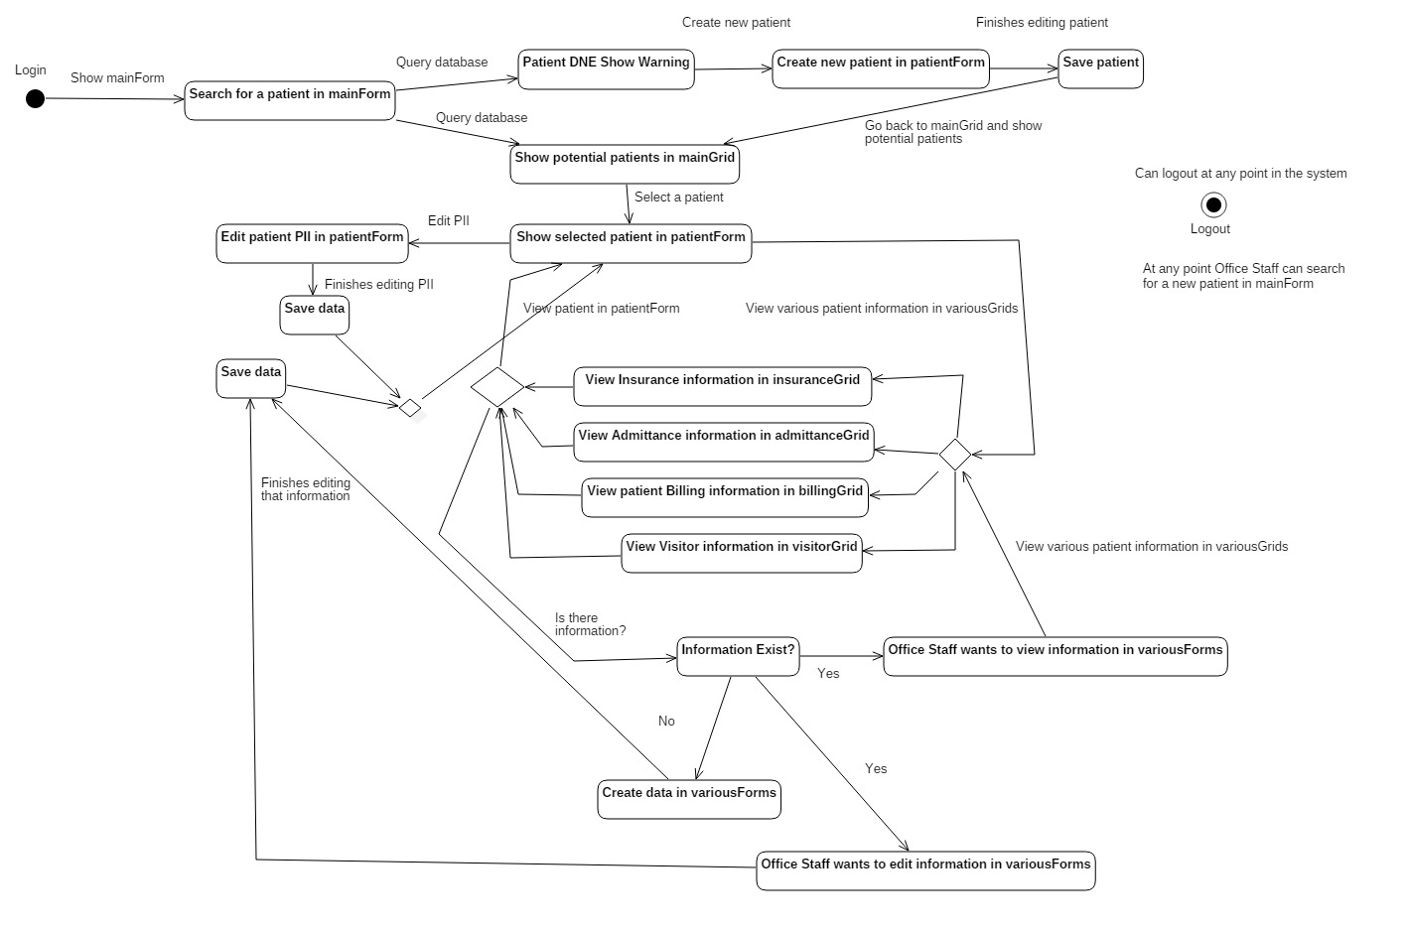
STATE DIAGRAM—OFFICE STAFF

Slide 4
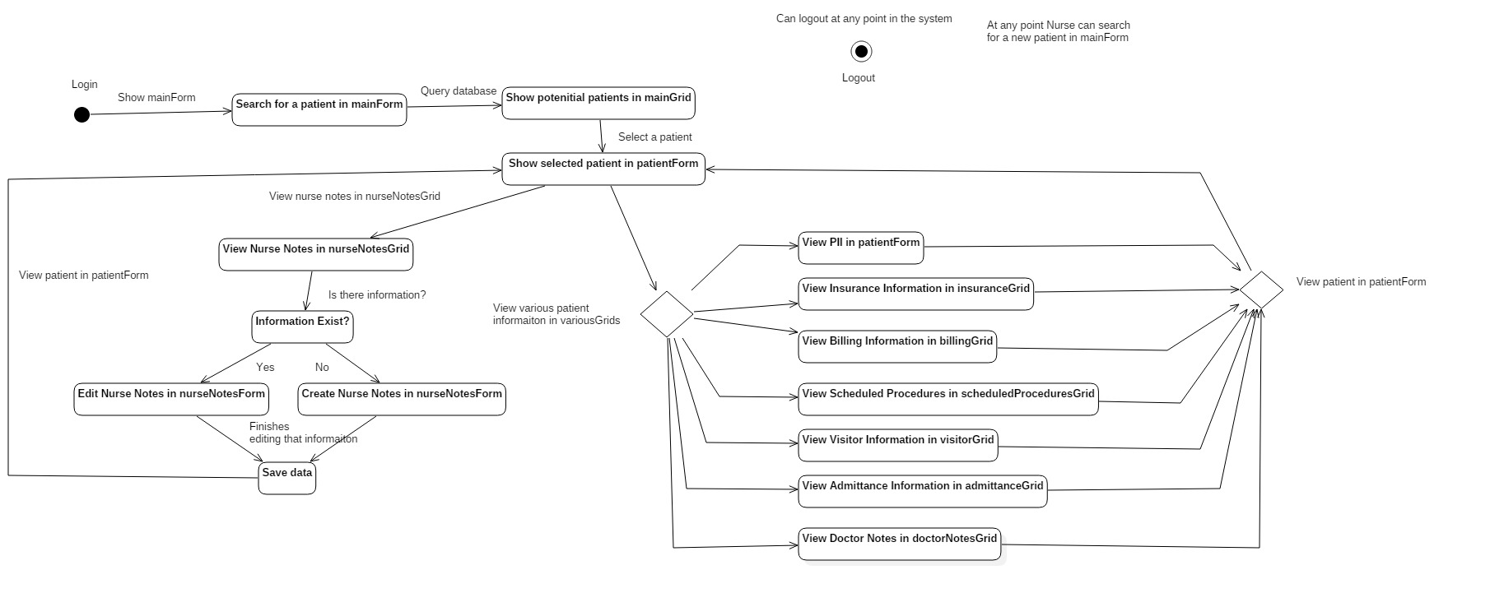
STATE DIAGRAM—NURSE

Slide 5
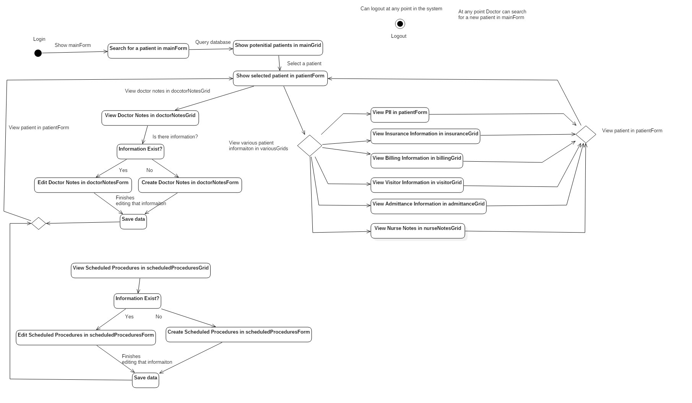
STATE DIAGRAM—DOCTOR

Slide 6
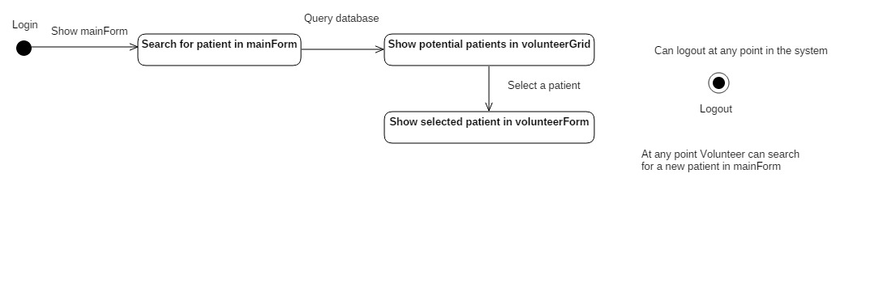
STATE DIAGRAM - VOLUNTEER

Slide 7
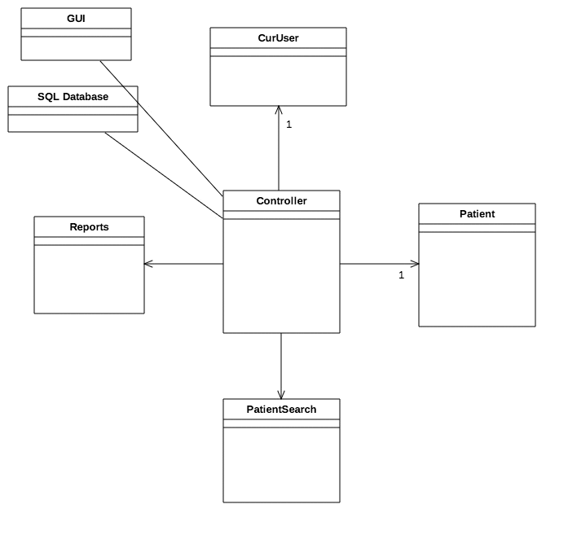
CONTROLLER

Slide 8
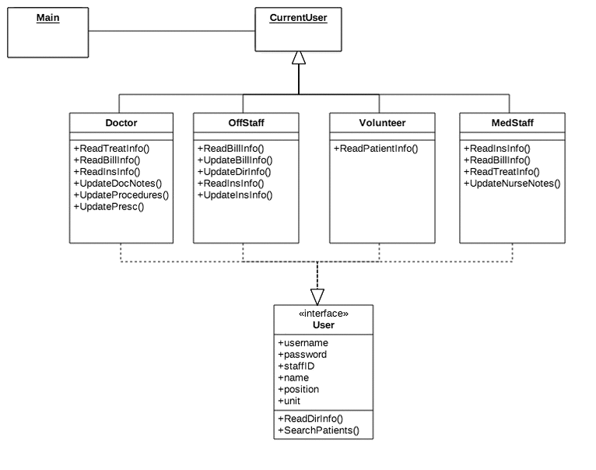
CONTROLLER—CURRENT USER

Slide 9
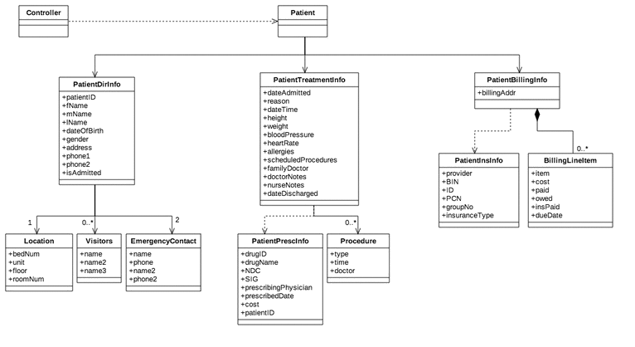
CONTROLLER—PATIENT

Slide 10
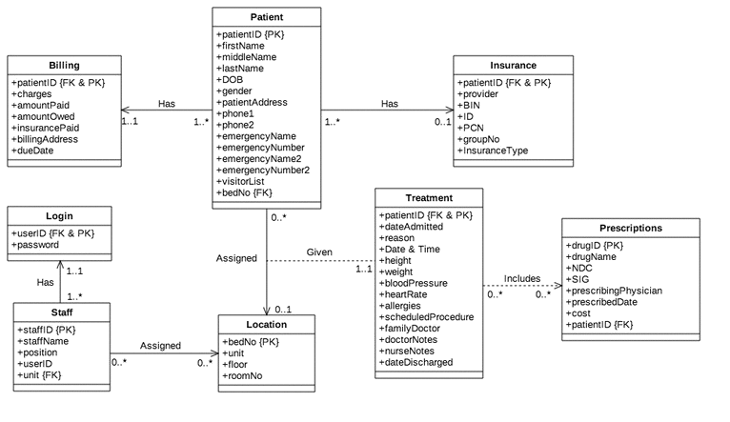
DATABASE

Slide 11
Backlog Updates
Moved creating the Database to be concurrent with Controller in sprint 4
Allows us to fully test each piece as we develop
Added creation of UML diagrams
State diagrams
Controller
Database

