Slide 1
Architectural Design
By: Jennifer Paulsen, Ina Carter, Maxwell Twente, Brandon Kibler

Slide 2
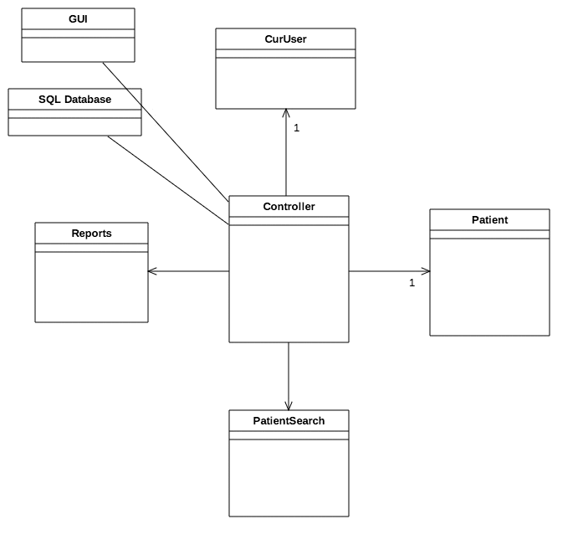
CONTROLLER

Slide 3
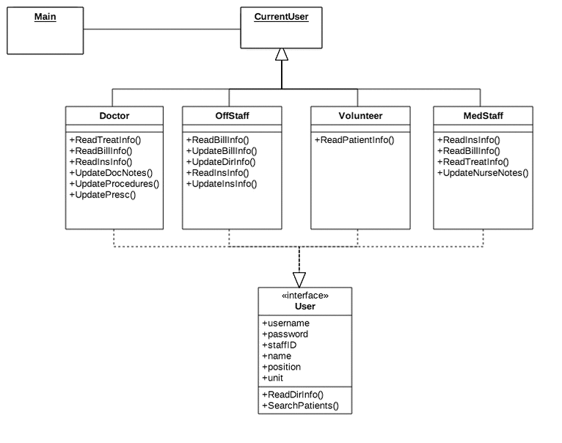
CONTROLLER—GUI

Slide 4
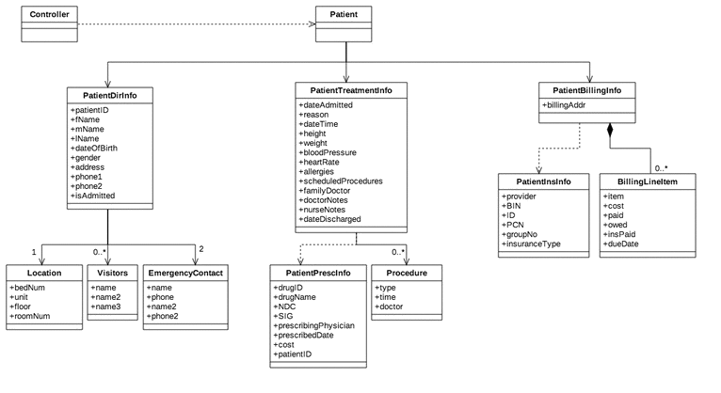
CONTROLLER—DATABASE

Slide 5
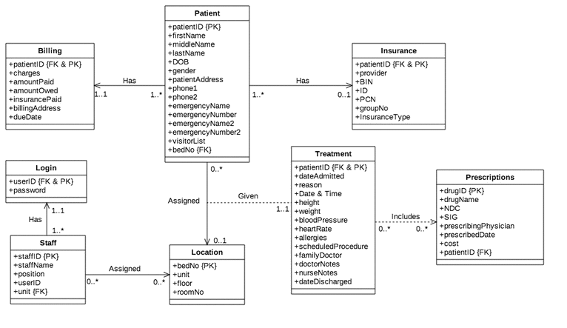
DATABASE

Slide 6
STATE DIAGRAM

