Slide 1
Patient Information management system
Team 6: Jennifer PaUlsEn, Max Twente, Brandon Kibler, Ina Carter

Slide 2

Purpose of project
Maintain current patient information
Available to doctors, nurses, office staff, and volunteers
Server accessible from multiple machines
Usable Graphical User Interface (GUI)

Slide 3
Objectives
Maintained detailed information on patients in or out of the hospital
Records must be maintained for five years
Grant access to patient information on a "need-to-know" basis

Slide 4
Personnel
Jennifer Paulsen: Software lead and requirements analyst
Max Twente: GUI designer and programmer
Ina Carter: Database designer and programmer
Brandon Kibler: Customer liaison and testing lead

Slide 5
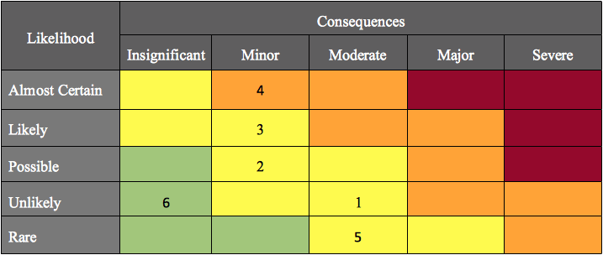
Risk management
1. Losing a member
2. Missed a requirement
3. Illness
4. Snowdays
5. Electrical Blackouts
6. Github site goes down

