Slide 1
Patient Information Management System: Backlog
By: Jennifer Paulsen, Brandon Kibler, Maxwell Twente, Ina Carter

Slide 2
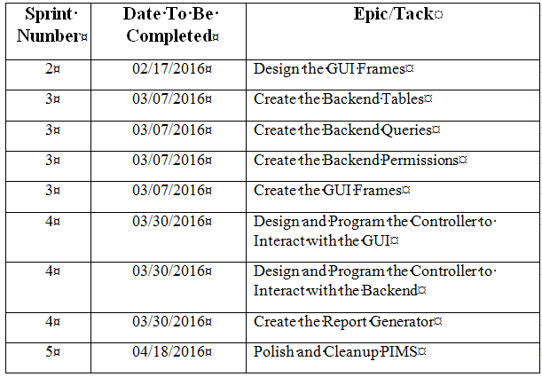
Sprint Breakdown

Slide 3
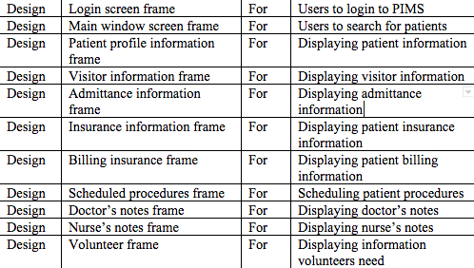
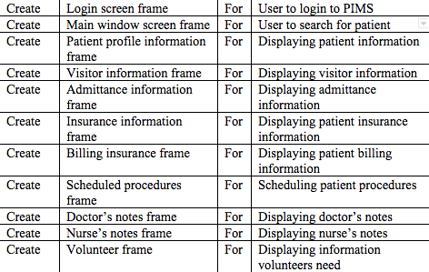
GUI Design and Creation
Design
Create

Slide 4
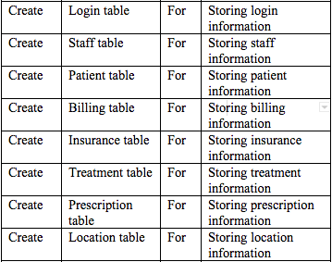
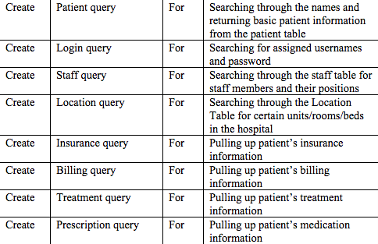
Backend : Create Tables and Queries
Tables
Queries

Slide 5
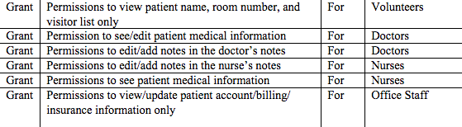
Backend : Grant Permissions
Permissions

Slide 6
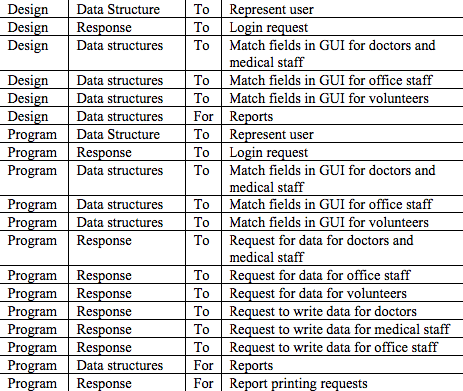
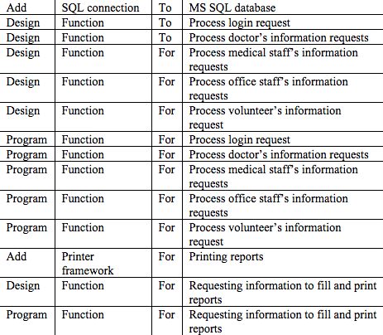
Controller Interface
GUI
Backend

Slide 7
Last 2 Epics
Report Generator Created
We do not know what user stories will be implemented for these 2 epics at this time
Polish and Cleanup PIMS

Slide 8
Model-View-Controller
User Action
Updates
View
Controller
Model
Updates
Notifies

