Slide 1

CS4HS: Introduction to Artificial Intelligence & Machine Learning
M. Allen, 09 Dec. 17

Slide 2
What is Artificial Intelligence?
Historical definition (Dartmouth Workshop on AI, 1956):
“The study of the conjecture that every aspect of learning or any other feature of intelligence can in principle be so precisely described that a machine can be made to simulate it.”

Slide 3
Modern AI: An Engineering Enterprise
Building (partially) autonomous machines for a variety of tasks
Construction, transportation, search-and-rescue, exploration…
Automating intelligence and formalizing knowledge
Internet search, expert systems, data mining, …
Using computational models to understand complex behavior
Automated planning, large-scale crowd simulation, traffic analysis, …
Using computers to discover new information
Medical image analysis, intrusion detection, stock market trading, …
Allowing computers to work better with people
Reactive tutoring, automated assistants, “sensitive” GPS systems, …

Slide 4
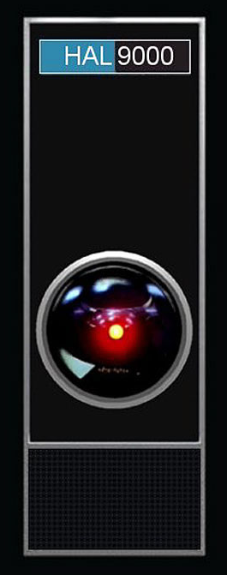
Why is AI So Difficult?
Originally, the desire was for a single system that would be “fully intelligent” on some human-approximate level
It turns out, however, that many of the basic capacities that go into “being human” are themselves very difficult
Highly complex
Involving various distinct capacities
Not well understood how we actually do them!

Slide 6
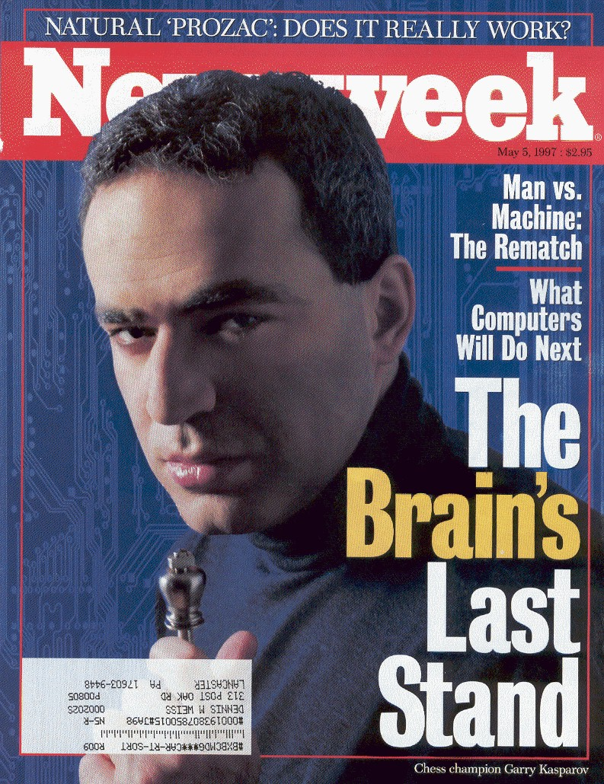
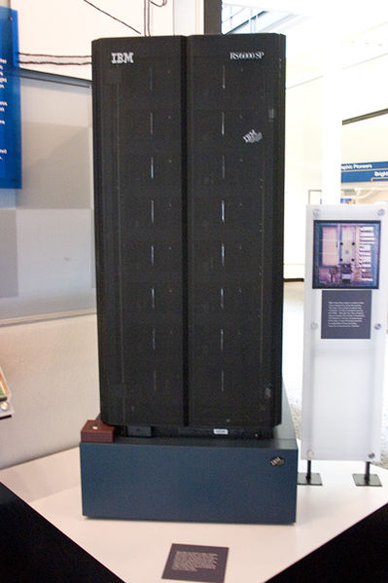
Some Success: Computer Chess
1996: World Chess Champion Garry Kasparov beat IBM computer Deep Blue in a match, 4–2
A year later, an improved Deep Blue beat Kasparov in the follow-up, 3½–2½
The first time ever that a computer had bested a reigning world champion in match play

Slide 7
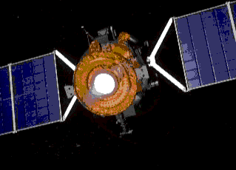
A Bit More Success: Space Exploration
1999: NASA allowed the Deep Space I vehicle to be piloted for two days by Remote Agent AI program
Completely controlled craft operations, over 60 Million miles from Earth
http://ti.arc.nasa.gov/tech/asr/planning-and-scheduling/remote-agent/

Slide 8
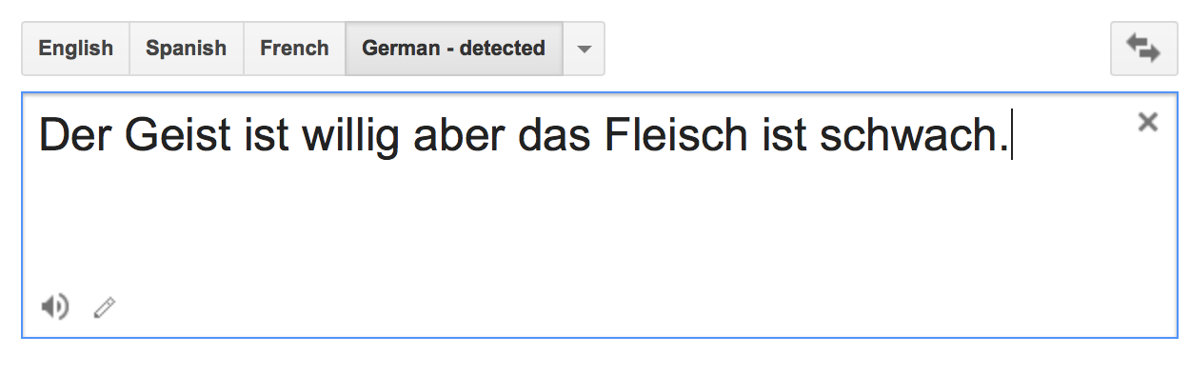
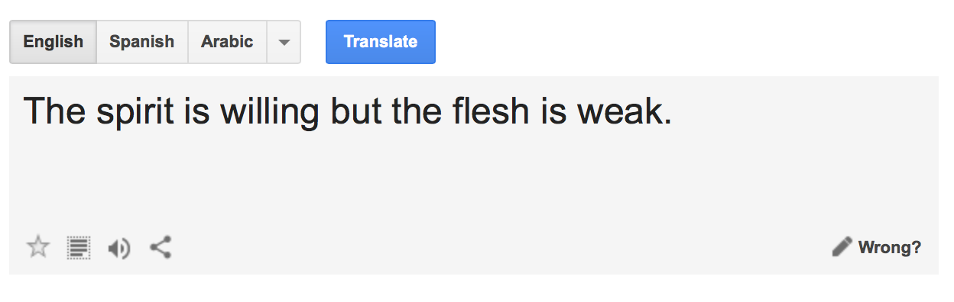
More Success: Natural Language Processing
Modern tools have made lots of progress; free commercial software can now translate many highly ambiguous and complex phrases easily
http://translate.google.com

Slide 9
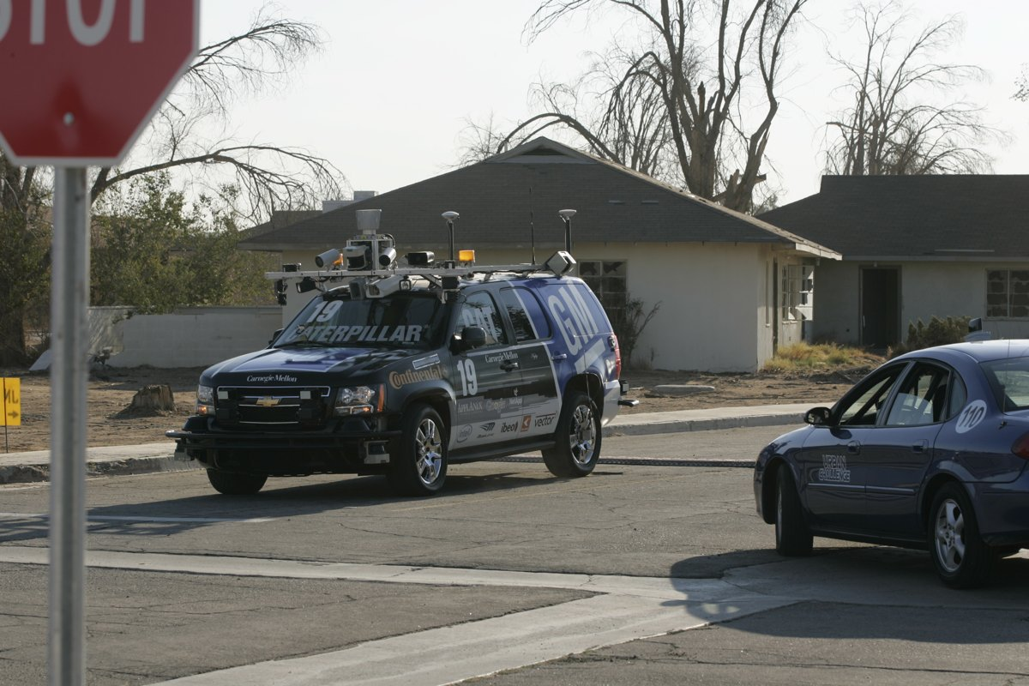
Even More Success: Robotic Vehicles
In the mid-2000’s the CMU ALVINN system drove on its own from Washington, DC to San Diego, CA
Managed all but 52 of the over-2800 miles
Averaged 63 Miles per hour in day, night, bad weather
In 2007, CMU’s Boss system won the DARPA Urban Challenge
60 Miles of urban driving
Merging with human traffic
Need to obey all traffic laws and posted signs
Much of this work is now part of the Google self-driving car system

Slide 10
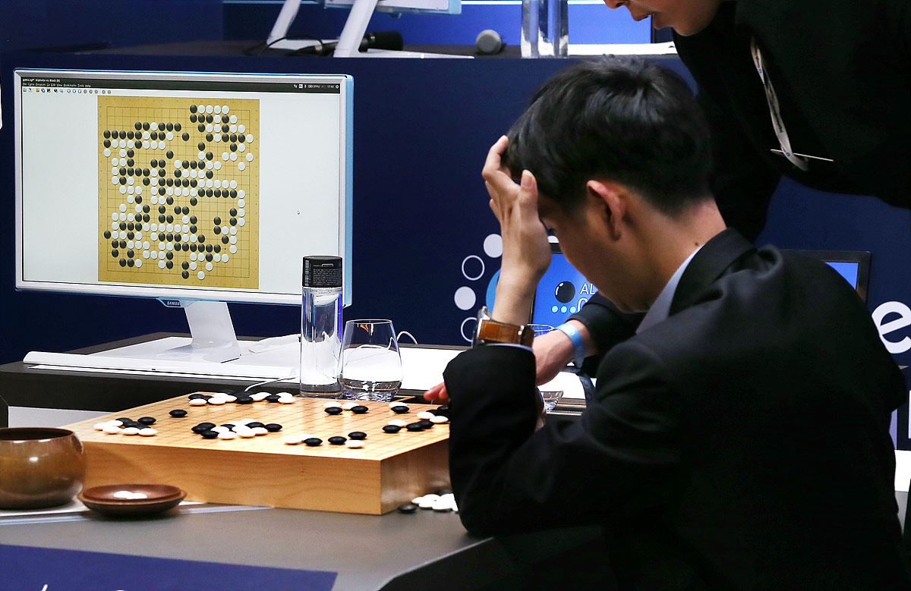
Recent Success
2015: Google DeepMind project’s AlphaGo is the first program to beat a professional human player in a non-handicap match
2016: first program to beat a 9-dan (master) level player
2017: first to beat the top-ranked player in the world
Using neural network technology, the program quickly learned to do something that hadn’t been expected possible for at least another 5–10 years

Slide 11
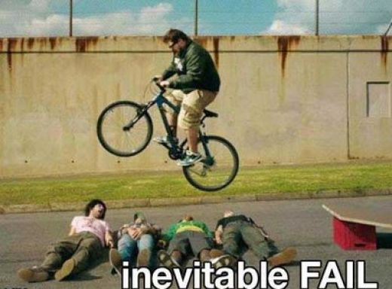
How Do We Define Intelligence?
It is not clear how “intelligence” should be understood (let alone how to get a machine to behave that way)
How a human being might act?
Or is it some sort of ideal rationality?

Slide 12
The Agent-Based Approach to AI

Slide 13

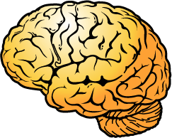

Possible Components of an AI Agent
Perception Systems
Memory Systems &
Background Knowledge
Environment
Reasoning Systems
Action Systems
Goals & Desires

Slide 14
What Should an Intelligent Agent Do?
We can take an operational approach:
An intelligent agent is one that optimizes some measure
How much it changes things so that it gets closer to the goals that have been set for it
The word-count of error-free text translated
Customer satisfaction for automated dialogue systems
Hours of accident free, real-time driving
Amount of data collected by an autonomous space-vehicle
…
Intelligence is defined by some means of measuring performance in a set task.

Slide 15
Judging the Best Agent
Suppose we have been given the common elements:
A precise performance measure
A sequence of world-information states (perceptions)
A starting knowledge-base for the agent
A fixed set of actions the agent can perform
The best agent is then the one that: maximizes the performance measure (1), when compared to all agents that experience the same world (2), and have access to the same knowledge (3) and can do the same things (4)

Slide 16
Planning vs. Learning
Many AI approaches can be put into two categories:
“Top-Down” (Planning/Reasoning):
Look at all the logical and mathematical details of a problem
Calculate an intelligent solution (a plan of action)
Put that solution to work
“Bottom-Up” (Learning/Reacting):
Try something (It probably doesn’t work!)
Improve the solution a bit
Keep this up until things are going well

Slide 17
Reinforcement Learning (RL)

Slide 18
A Reactive Model of Learning
The agent observes the state of the environment
The agent takes an action
The environment changes, and the agent:
Observes the new state
Receives some reward
Observe
Act
“Reward” is simply a positive or negative number.
(A negative reward is a cost.)
Observe
Reward

Slide 19
Learning = Exploration + Exploitation
The key to reinforcement learning (RL) is to keep track of the rewards we get as we try different things
A lot of the time we exploit our experience: do the things that have worked best in the past
Sometimes we explore: try out things even if our current best guess is that it isn’t such a good idea
An “epsilon-greedy” (ε-greedy) policy sets some probability threshold, ε, and chooses actions by:
Picking a random number R ∈ [0,1]
If R ≤ ε, choosing the action at random
If R > ε, acting in a greedy fashion (as before)
Over time, make ε smaller and smaller, and settle on the best policy of action we have learned

Slide 20
The Math that Makes It All Work
A popular algorithm for doing RL is Q-learning
For every state of the world, s, and every action, a, the agent stores a number, Q(s,a)
These numbers all start at zero (0)
The agent learns by repeating over and over:
Observe the world-state s₁ and:
With probability ε choose action a₁ at random
With probability (1 – ε ) choose a₁ with highest Q-value
Observe next world-state s₂ and obtain reward r
Update the Q-value for s₁ and a₁ :

Slide 21
Neural Networks for Learning

Slide 22

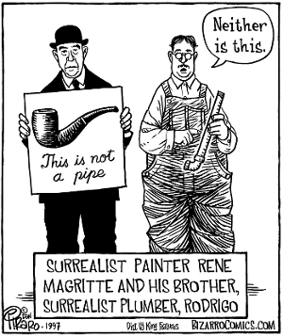
Learning for Classification
In a reinforcement learning problem, the solution is a policy: a function that takes in state-data as input and produces an action as output
There are many other such input/output functions we might want to learn
A classification function takes in data and tells us what kind of thing it is

Slide 23
Neural Learning Methods
Reinforcement Learning was inspired by the ways in which animals learn behaviors over time
Another obvious source of biological inspiration for learning research: the brain
Since the work of McCulloch and Pitts (1943), research has looked at ways to precisely model the neuron and the network of connections that allow animals to learn
These networks are used as classifiers: given an input, they label that input with a classification, or a distribution over possible classifications

Slide 24
The Basic Neuron Model
Neuron gets input from a set of other neurons, or from the problem input, and computes the function g
Output a_{j} is either passed along to another set of neurons, or is used as final output for learning problem itself

Slide 25
Input Bias Weights
Each input a_{i} to neuron j is given a weight w_{i,j}
Each neuron may have a fixed dummy input, a₀ = 1
The input function is then the weighted linear sum:

Slide 26
Neuron Output Functions
While the inputs to any neuron are treated in a linear fashion, the output function g need not be linear
The power of neural nets comes from fact that we can combine large numbers of neurons together to compute any function (linear or not) that we choose

Slide 27
The Perceptron Threshold Function
One possible function is the binary threshold, which is suitable for “firm” classification problems, and causes the neuron to activate based on a simple binary function:

Slide 28
The Sigmoid Activation Function
A function that is more often used in neural networks is the logistic (also known as the Sigmoid)
This gives us a “soft” value, which we can often interpret as the probability of belonging to some output class

Slide 29
Other Popular Activation Functions
The rectifier (or “ramp”) function is popular for many modern applications
A network using the rectifier is known as a rectifier linear unit (RELU)
The Softplus function is a smooth approximation to the rectifier
The derivative of Softplus is the Sigmoid function

Slide 30
Multi-Layer Feed-Forward Neural Networks
It was known from the beginning that a single-layer network could not represent all possible functions
For more complex functions, we will add one or more hidden layers of neurons between input and output layers
In a feed-forward network, each layer is connected only to next layer in the order (inputs → outputs)

Slide 31
Training a Neural Network
These sorts of networks are trained in a supervised manner, based upon pre-selected data
Training Set: inputs for which we know the correct output
For example, a set of images of different types of objects
Each image is hand-labeled by human beings to identify objects
We train the network so that it gets the correct answer

Slide 32
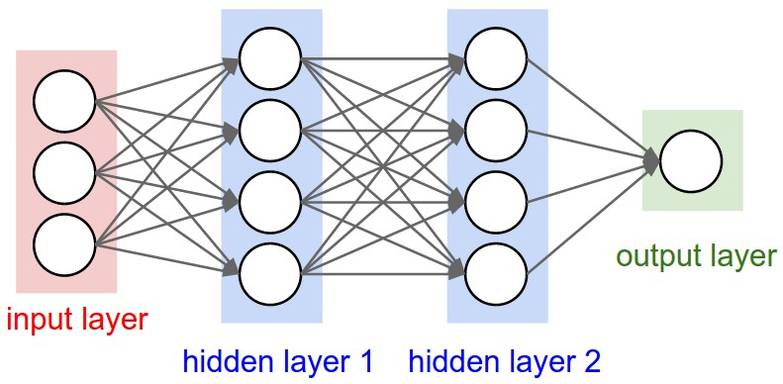
The Backpropagation Training Method
To start, we create our network structure
All weights are set randomly and meaninglessly

Slide 33
The Backpropagation Training Method
We then feed data from one example in the training set into the network, using whatever features make sense
The network calculates an answer: it is wrong.

Slide 34
The Backpropagation Training Method
At the output end, we compare the answer given to the correct answer, and figure out how wrong we are
Based on that error, we backpropagate, using the error to adjust all of the weights up or down

Slide 35
The Backpropagation Training Method
We repeat this process over and over until the error overall (averaged over the entire data-set) is reduced to a minimum, and then stop
Our network is ready to start looking at data for which we don’t already know the answer
With large, diverse data-sets to train upon, we hopefully have a neural net that can do some real work for us

