Slide 1
State | A₁: Higher | A₂: Lower
Ace
King
Queen
Jack

Slide 2
BLUE
RED
GREEN
ORANGE

Slide 3
BLUE
RED
GREEN
ORANGE

Slide 4
BLUE
RED
GREEN
ORANGE

Slide 5
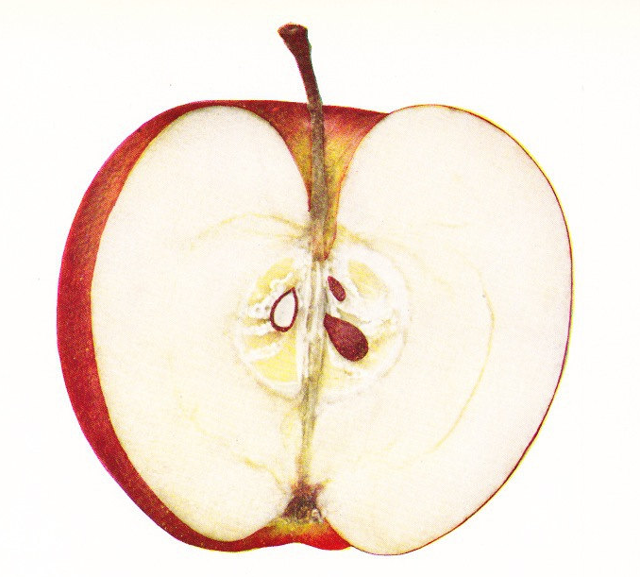

APPLE
NOT-APPLE
NOT-APPLE
APPLE

Slide 6
APPLE
NOT-APPLE

Slide 7
Input Layer
In1
In2
In3
In4
Hidden
Layer
H1
H2
Output Layer
O1
O2

