Slide 1
Problem Solving

Slide 2
Problem Solving
Before we can explore programming, we need to first explore the methods of problem solving used by computer scientists
Problem solving techniques help us go from an idea for an application or a problem to solve, to a plan for how to solve it that can be translated into a computer program.
A plan for solving a problem is called an algorithm.

Slide 3
Problem Solving Using Computers
There are many problem solving strategies used by computational thinkers. The following strategies are central and common.
Problem definition
identify the tasks, data, and properties of the solution
Decomposition
break up the solution into smaller chunks
Abstraction
only look at the relevant details

Slide 4
Abstraction and Algorithms
Algorithms are precise sequences of instructions for processes that can be executed by a computer and are implemented using programming languages.
Often you don’t start with an algorithm, you start with a problem. How do you develop an algorithm? How do you represent the algorithm?
One way to represent the algorithm is to use a diagram. Diagrams are an example of abstraction, a representation that allows us to focus on the important details.

Slide 5
Software Engineering
Software engineering is the study of designing and implementing software. A good deal of time is spent on the analysis or the problem and design of software architecture.
Step #1
Analyze the problem.
Step #2
Design the architecture of a solution.
Step #3
Implement the design as a computer program.
Notes:
The work of software design is much like the work of an architect.

Slide 6
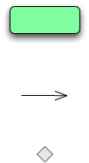
Activity Diagrams
The purpose:
a notation for depicting algorithms
captures the flow of an algorithm
activity diagrams are a kind of flow diagram / flowchart
part of the Unified Modeling Language (UML)
Real Computer Scientists use these diagrams to create official documents and diagrams of their software!
The notation
an action to be performed
a flow that determines the order of actions
a point at which flows merge or split (a choice)
starting and ending points (vertices)
Notes:
Flow can be thought of as the steps of an algorithm along with the order in which those steps are performed.

Slide 7
Setting the time of a Wristwatch
Pull crown out
Turn crown counterclockwise to desired time
Push crown in

Slide 8
Conditional Actions
Some actions are conditional. How would you say that you need to study if you have an exam tomorrow otherwise you would waste time on Facebook?
What are the actions?
What is the condition?
A diamond indicates points at which a flows split (a condition) or merge
[exam tomorrow]
[no exam tomorrow]
Study
Spend time on Facebook

Slide 9
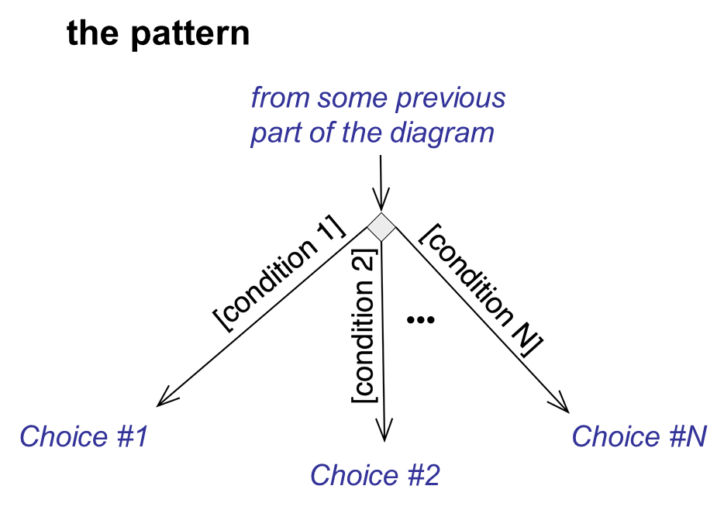
Can have more than two splits

Slide 10
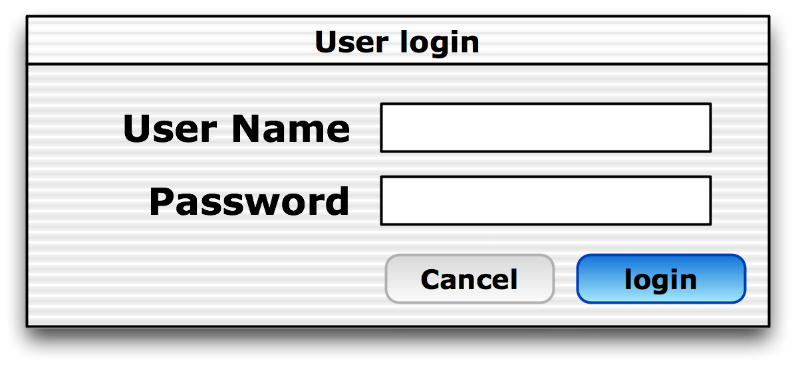
Logging In
enter user name
enter user password
[Cancel is clicked]
[Login is clicked]
cancel login
Check name/password
[name/password is valid]
Show desktop
Show Error msg
[name/password is invalid]

Slide 11
Repetition
Sometimes you would like to repeat some action. This doesn't require new diagram elements but can be expressed via actions, arcs, and conditionals.
[ending condition]
repeated action
[continue condition]
[continue condition]
repeated action
[ending condition]

Slide 12
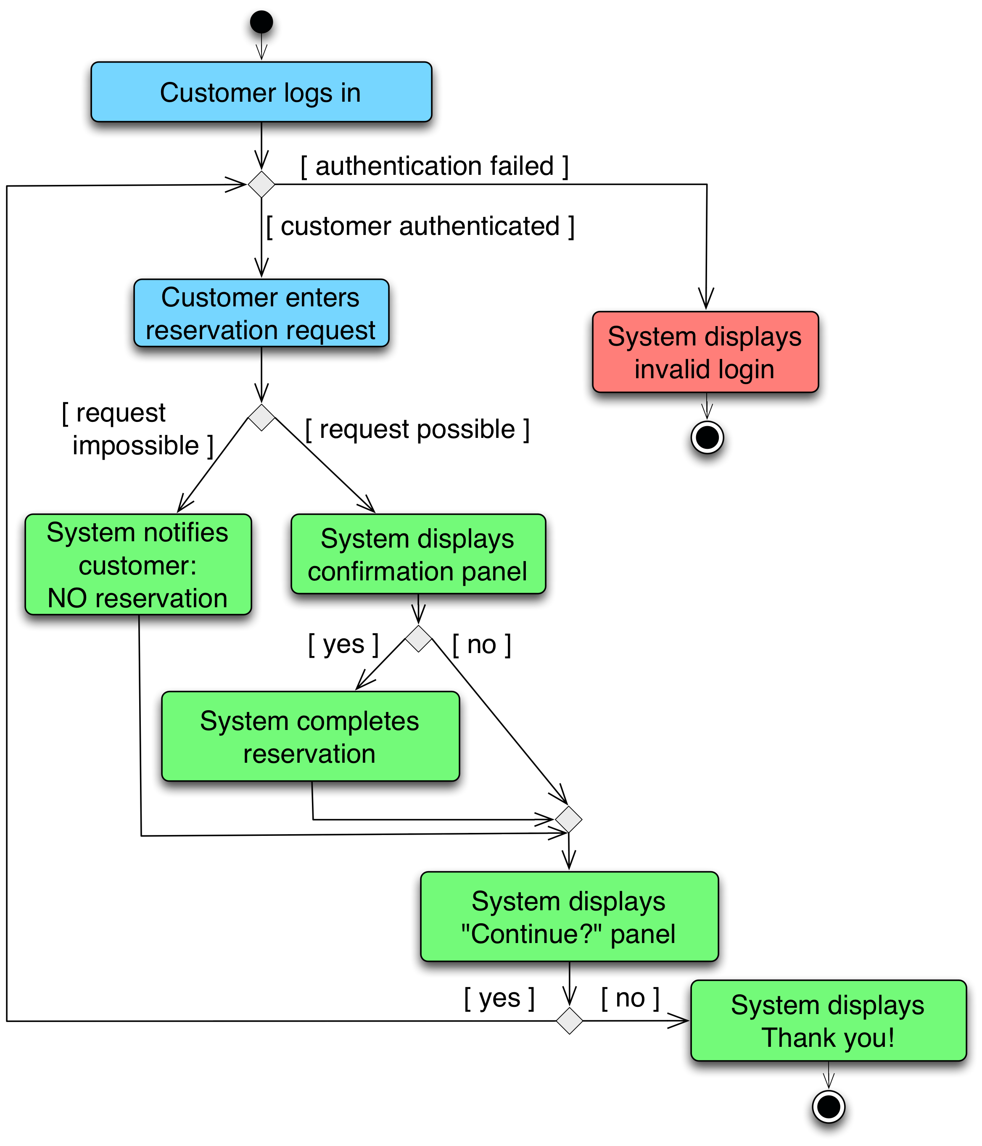
Flight Reservation Algorithm

Slide 13
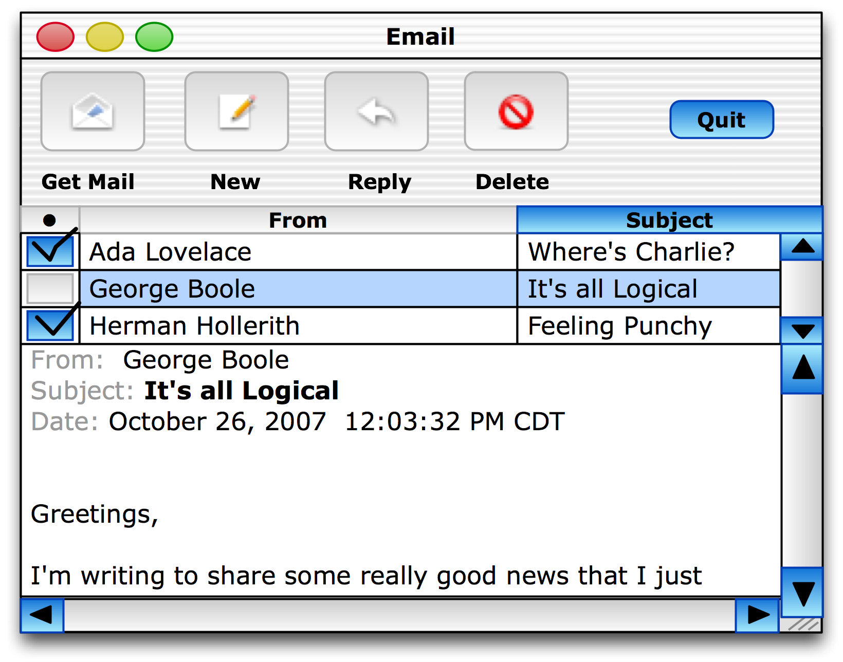
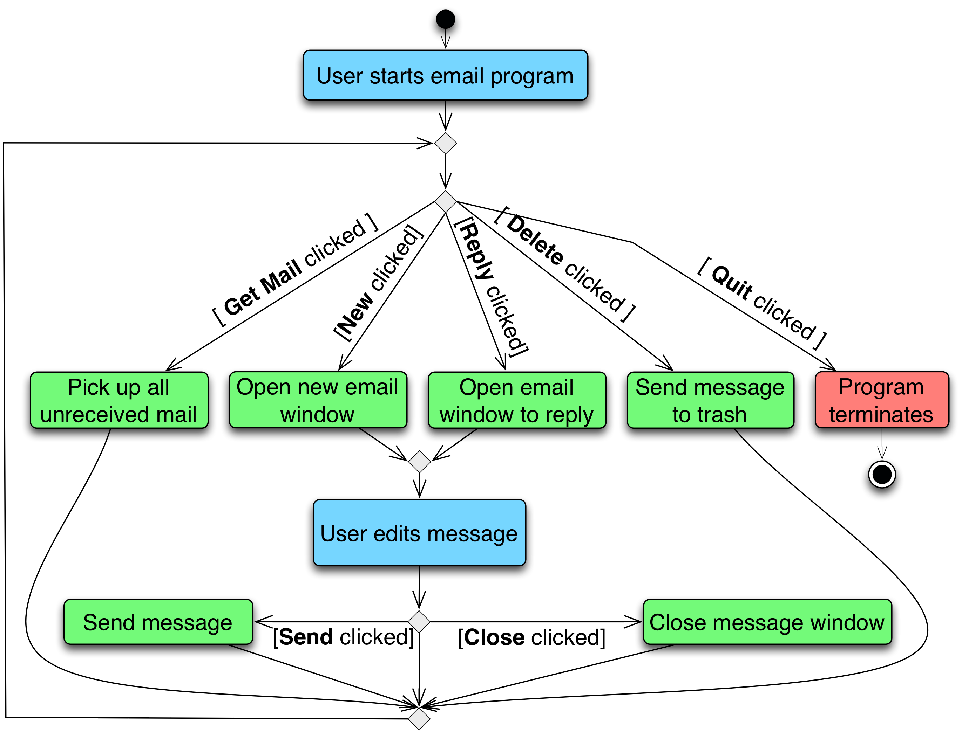
Email Client Algorithm
Notes:
Introduce assignment

Slide 14
Crazy Eights
Object of the Game: Be the first player to get rid of all the cards in her hand.
Setup: Deal each player 5 cards. Put remainder of cards face down in the draw pile. Start the discard pile by placing the top card of the draw pile face up next to the pile.
Game Play: You have to match the top card in the discard pile. If you have a match, you play it by placing it on top of the discard pile. If you do not have a match, you draw cards from the draw pile until you find a match. Your turn is over when you place a card in the discard pile. All eights are wild and can match anything. When an eight is played, the player specifies the suit that the next player must play.
Notes:
Object of the Game: Be the first player to get rid of all the cards in her hand.
Setup: Deal each player 5 cards. Put remainder of cards face down in the draw pile. Start the discard pile by placing the top card of the draw pile face up next to the pile.
Game Play: You have to match the top card in the discard pile. If you have a match, you play it by placing it on top of the discard pile. If you do not have a match, you draw cards from the draw pile until you find a match. Your turn is over when you place a card in the discard pile. All eights are wild and can match anything. When an eight is played, the player specifies the suit that the next player must play.

Slide 15
Deal cards
Make draw pile
Start discard pile
New turn
Cards left
Examine hand
Eight
No Match
Declare suit
Match
Draw a card
Play card
No cards left
Win the game!
Notes:
Break up the problem and think about what are the important pieces
- end condition
- setup
- I know I want to use some repetition, so I want to model only one turn, so I have a new turn activity to show where a new turn starts, and that is different from examining cards.
- Using all three problem solving skills – thinking about what I need to provide, breaking it into smaller pieces, and then focus on the level of detail and scope that I need to to solve the problem

Slide 16
Activity
Activity/Lesson Inspiration: https://curriculum.code.org/csp/unit3/2/
Break into groups and develop an algorithm for finding the minimum card. Once you have the algorithm, also draw the activity diagram for that activity.
Be sure to use the problem solving strategies:
Problem definition, decomposition, abstraction
Requirements, design, implementation/testing, refine…
Consider the sequence of events, what can happen at the same time, when are decisions made, where is there repetition.
Can you represent the algorithm more efficiently? Can you create a more efficient algorithm?

Slide 17
Discussion
What representation was easier to use to do the task? Which was easier to change? Which was easier to argue about?
How did you build the diagram?
How did you evaluate if it was correct? Did you need to change things as you built it?
How does this relate to developing software?
Notes:
talk about how diagrams like these are really used by software developers to lay out complex software to understand how they interact with each other, to model complex processes, and to identify problems with customers and stakeholders before building software.

Slide 18
Extending the Lesson
You can do this with pretty much any game or real-life activity you want.
Examples I have asked students to do in class or on an exam:
Morning routine – different for every person, but I ask them to include a certain number of activities
Grocery shopping – same as above
Baseball – a game they probably do know
Game of Pig – a game they probably don’t know so I give them the rules
Crazy Eights (see next slides for how I asked the question and the solution I walked them through)

