Slide 1
CS4HS October 15, 2016

Slide 2
Outline
Start-up Activities
Introductions
Goals
What is Computer Science?
Introduction to Scratch Programming
Computational Thinking Activity
Bringing Computational Thinking to K-12
Computer Science Curricula
Scratch Activity with Makey-makey devices
Introduction to Algorithms (time permitting)
Planning Future Activities

Slide 3
Start-up Activities
Pre-Course Survey
https://goo.gl/forms/yPKnJDguEb
Stipends and W-9 Forms
Course Credit
CS 503-700
1 Credit
$110

Slide 4
Resources
Computer Science Teachers Association
csta.acm.org
International Society for Technology in Education
www.iste.org
Code.org

Slide 5
Introductions

Slide 6
Goals
Develop a professional learning community of high school teachers interested in teaching computer science in CESA #4 area school districts.
Introduce teachers to the pedagogy and computer science content of the Exploring Computer Science and the AP Computer Science Principles curricula.
Provide any additional assistance CESA #4 schools need to implement ECS and/or AP CSP courses in their schools.

Slide 7
Long Term Goals
To have each CESA #4 high school offer either ECS or AP CSP
For every CESA #4 high school student to have access to AP CSP either locally or as part of a course offered cooperatively by a group of CESA #4 high schools.

Slide 8
What is Computer Science? What is Computational Thinking?
Individually create a definition of computer science, a definition of computational thinking and a list of skills associated with computational thinking
Share your definitions and list of skills with your group and develop common definitions and a common list of skills.
Each group writes their definitions and list of skills on poster paper.
Discussion

Slide 9
CSTA
“the study of computers and algorithmic processes, including their principles, their hardware and software designs, their applications, and their impact on society.”

Slide 10
Computational Thinking
"Computational Thinking is the thought processes involved in formulating problems and their solutions so that the solutions are represented in a form that can be effectively carried out by an information-processing agent.” (Cuny, Snyder, Wing)
“Computational thinking means the ability to apply mathematical concepts such as induction to develop more efficient, fair, and secure solutions.” (Center for Computational Thinking, Carnegie Mellon)

Slide 11
ITSE and CSTA Operational Definition of Computational Thinking (CT)
CT is a problem-solving process that includes (but is not limited to) the following characteristics:
Formulating problems in a way that enables us to use a computer and other tools to help solve them
Logically organizing and analyzing data
Representing data through abstractions such as models and simulations
Automating solutions through algorithmic thinking (a series of ordered steps)
Identifying, analyzing, and implementing possible solutions with the goal of achieving the most efficient and effective combination of steps and resources
Generalizing and transferring this problem-solving process to a wide variety of problems

Slide 12
ISTE and CSTA Dispositions and Attitudes Related to CT
Confidence in dealing with complexity
Persistence in working with difficult problems
Tolerance for ambiguity
The ability to deal with open-ended problems
The ability to communicate and work with others to achieve a common goal or solution

Slide 13
Introduction to Scratch
Scratch
Example Scratch Scripts
Live Demo

Slide 14
Basic Building Blocks of Programs
Variables
Sequencing
Selection
Iteration
Events

Slide 15
Scratch
Programming Language and Environment created by MIT to teach introductory programming
Programs are created by “gluing” together blocks

Slide 16
Scratch
Block
Instruction
Script
Sequences of instructions
Sprite
Object running scripts
Character on the stage
Stage
Display or graphics window
Events

Slide 17
Scratch Stage and Sprite

Slide 18
Scratch Block Categories

Slide 19
Guessing Game

Slide 20
Guessing Game Parts

Slide 21
Guessing Game Parts

Slide 22
Guessing Game Parts

Slide 23
Guessing Game Parts

Slide 24
Play Notes

Slide 25
Play Notes

Slide 26
Move to Corners

Slide 27
Move to Corners

Slide 28
Move to Center

Slide 29
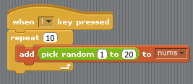
Initialize List

Slide 30
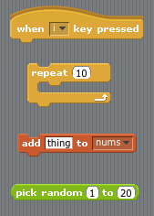
Initialize Parts

Slide 31
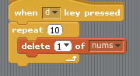
Delete Items from List

Slide 32
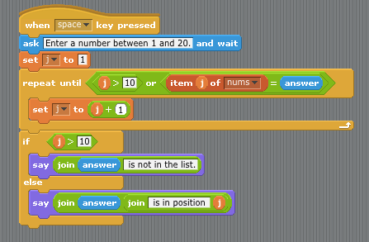
Linear Search

Slide 33

Linear Search Parts

Slide 34
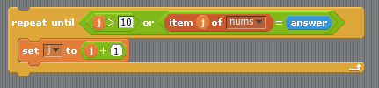
Linear Search Parts

Slide 35
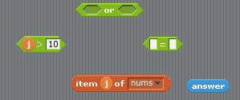
Repeat Condition Parts

Slide 36
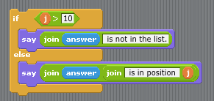
Linear Search Parts

Slide 37
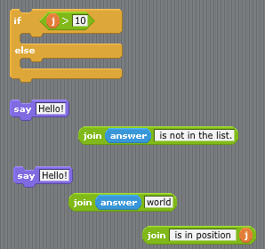
If Parts

Slide 38
Scratch Activity
Go to scratch.mit.edu. If you do not have a Scratch account Join Scratch
Sign-in to Scratch
Implement a guessing game like the one I showed with two additions.
Have the program ask the user for the range of values (lower and upper) from which a number will be chosen
Count the number of times it takes the user to guess the correct number and report the number to the user

Slide 39
Scratch Activity
If you want to write a more challenging program have the user think of a number from a range of numbers and have the program try to guess the number. For example the program could prompt the user to think of a number between 1 and 100. The user indicates when they have chosen a number and the program tries to guess the number. After each guess by the program the user indicates if the guess was too high, too low or correct.

Slide 40
Computational Thinking Activity

Slide 41
Bringing Computational Thinking to K-12

Slide 42
Challenges
Individually make a list of the challenges faced by you or your school to introducing computer science and computational thinking into the curriculum
Share your list with your group and develop common list.
Each group writes their list on poster paper.
Discussion

Slide 43
Computer Science Curricula
Exploring Computer Science (ECS)
http://www.exploringcs.org
AP Computer Science Principles (CSP)
https://advancesinap.collegeboard.org/stem/computer-science-principles
AP Computer Science A (Java)
http://apcentral.collegeboard.com/apc/public/courses/teachers_corner/4483.html

Slide 44
ECS
General introduction to computer science for “all” high school students
Increase and enhance computer science learning opportunities for high school students
Broaden participation by students from groups under represented in computer science

Slide 45
ECS
Human Computer Interaction
Problem Solving
Web Design
Programming
Computing and Data Analysis
Robotics

Slide 46
ECS
Inquiry Based Learning
Active Learning

Slide 47
Experience with ECS
Mary Byrns Black River Falls High School
John Crayton La Crosse Central High School

Slide 48
CSP
Similar in spirit to ECS but content and expectations were designed to be equivalent to first semester introductory computing course
Broaden Participation by students from groups under represented in computer science

Slide 49
CSP Big Ideas
Creativity
Abstraction
Data and Information
Algorithms
Programming
The Internet
Global Impact

Slide 50
CSP: Computational Thinking Practices
Connecting Computing
Creating Computation Artifacts
Abstracting
Analyzing Problems and Artifacts
Communicating
Collaborating

