Slide 1
Problem Solving

Slide 2
Problem Solving
Before we can explore programming, we need to first explore the methods of problem solving used by computer scientists
Problem solving techniques help us go from an idea for an application or a problem to solve, to a plan for how to solve it that can be translated into a computer program.
A plan for solving a problem is called an algorithm.

Slide 3
Problem Solving Using Computers
There are many problem solving strategies used by computational thinkers. The following strategies are central and common.
Problem definition
identify the tasks, data, and properties of the solution
Decomposition
break up the solution into smaller chunks
Abstraction
only look at the relevant details

Slide 4
Software Engineering
Software engineering is the study of designing and implementing software. A good deal of time is spent on the analysis or the problem and design of software architecture.
Step #1
Analyze the problem.
Step #2
Design the architecture of a solution.
Step #3
Implement the design as a computer program.
Notes:
The work of software design is much like the work of an architect.

Slide 5
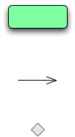
Activity Diagrams
The purpose:
a notation for depicting algorithms
captures the flow of an algorithm
activity diagrams are a kind of flow diagram / flowchart
part of the Unified Modeling Language (UML)
The notation
an action to be performed
a flow that determines the order of actions
a point at which flows merge or split (a choice)
starting and ending points (vertices)
Notes:
Flow can be thought of as the steps of an algorithm along with the order in which those steps are performed.

Slide 6
Setting the time of a Wristwatch
Pull crown out
Turn crown counterclockwise to desired time
Push crown in

Slide 7
Conditional Actions
Some actions are conditional. How would you say that you need to study if you have an exam tomorrow otherwise you would waste time on Facebook?
What are the actions?
What is the condition?
A diamond indicates points at which a flows split (a condition) or merge
[exam tomorrow]
[no exam tomorrow]
Study
Waste time on Facebook

Slide 8
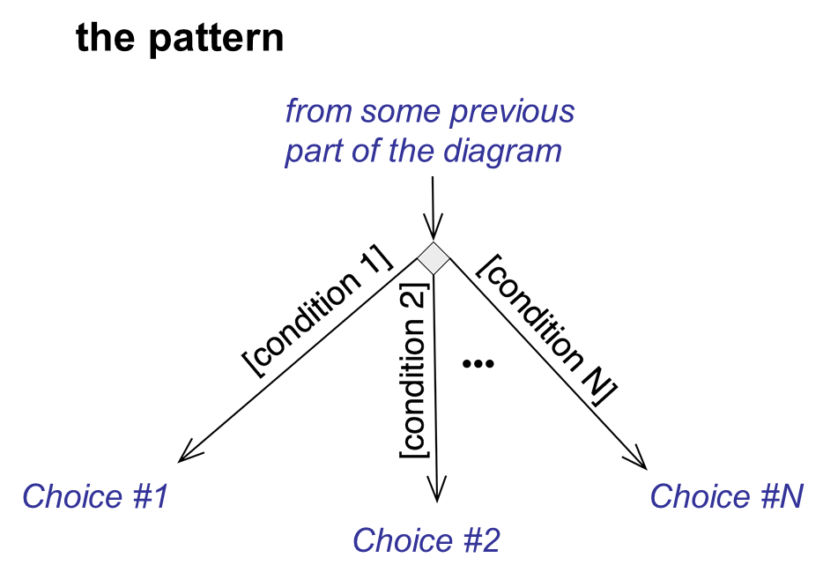
Can have more than two splits

Slide 9
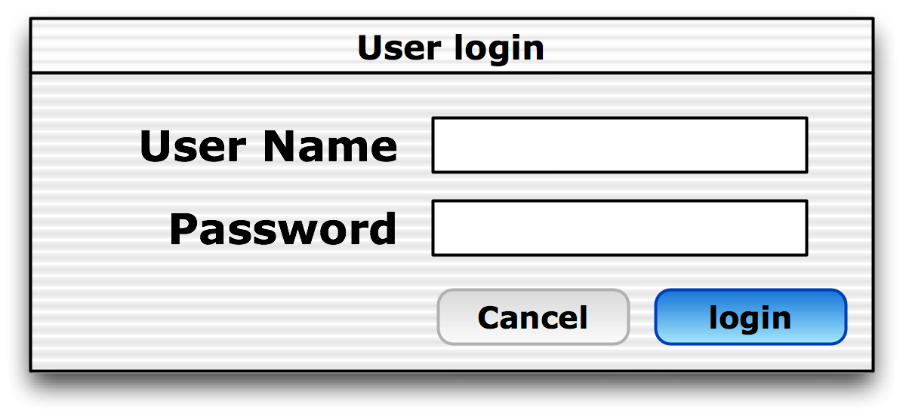
Logging In
enter user name
enter user password
[Cancel is clicked]
[Login is clicked]
cancel login
Check name/password
[name/password is valid]
Show desktop
Show Error msg
[name/password is invalid]

Slide 10
Repetition
Sometimes you would like to repeat some action. This doesn't require new diagram elements but can be expressed via actions, arcs, and conditionals.
[ending condition]
repeated action
[continue condition]
[continue condition]
repeated action
[ending condition]

Slide 11
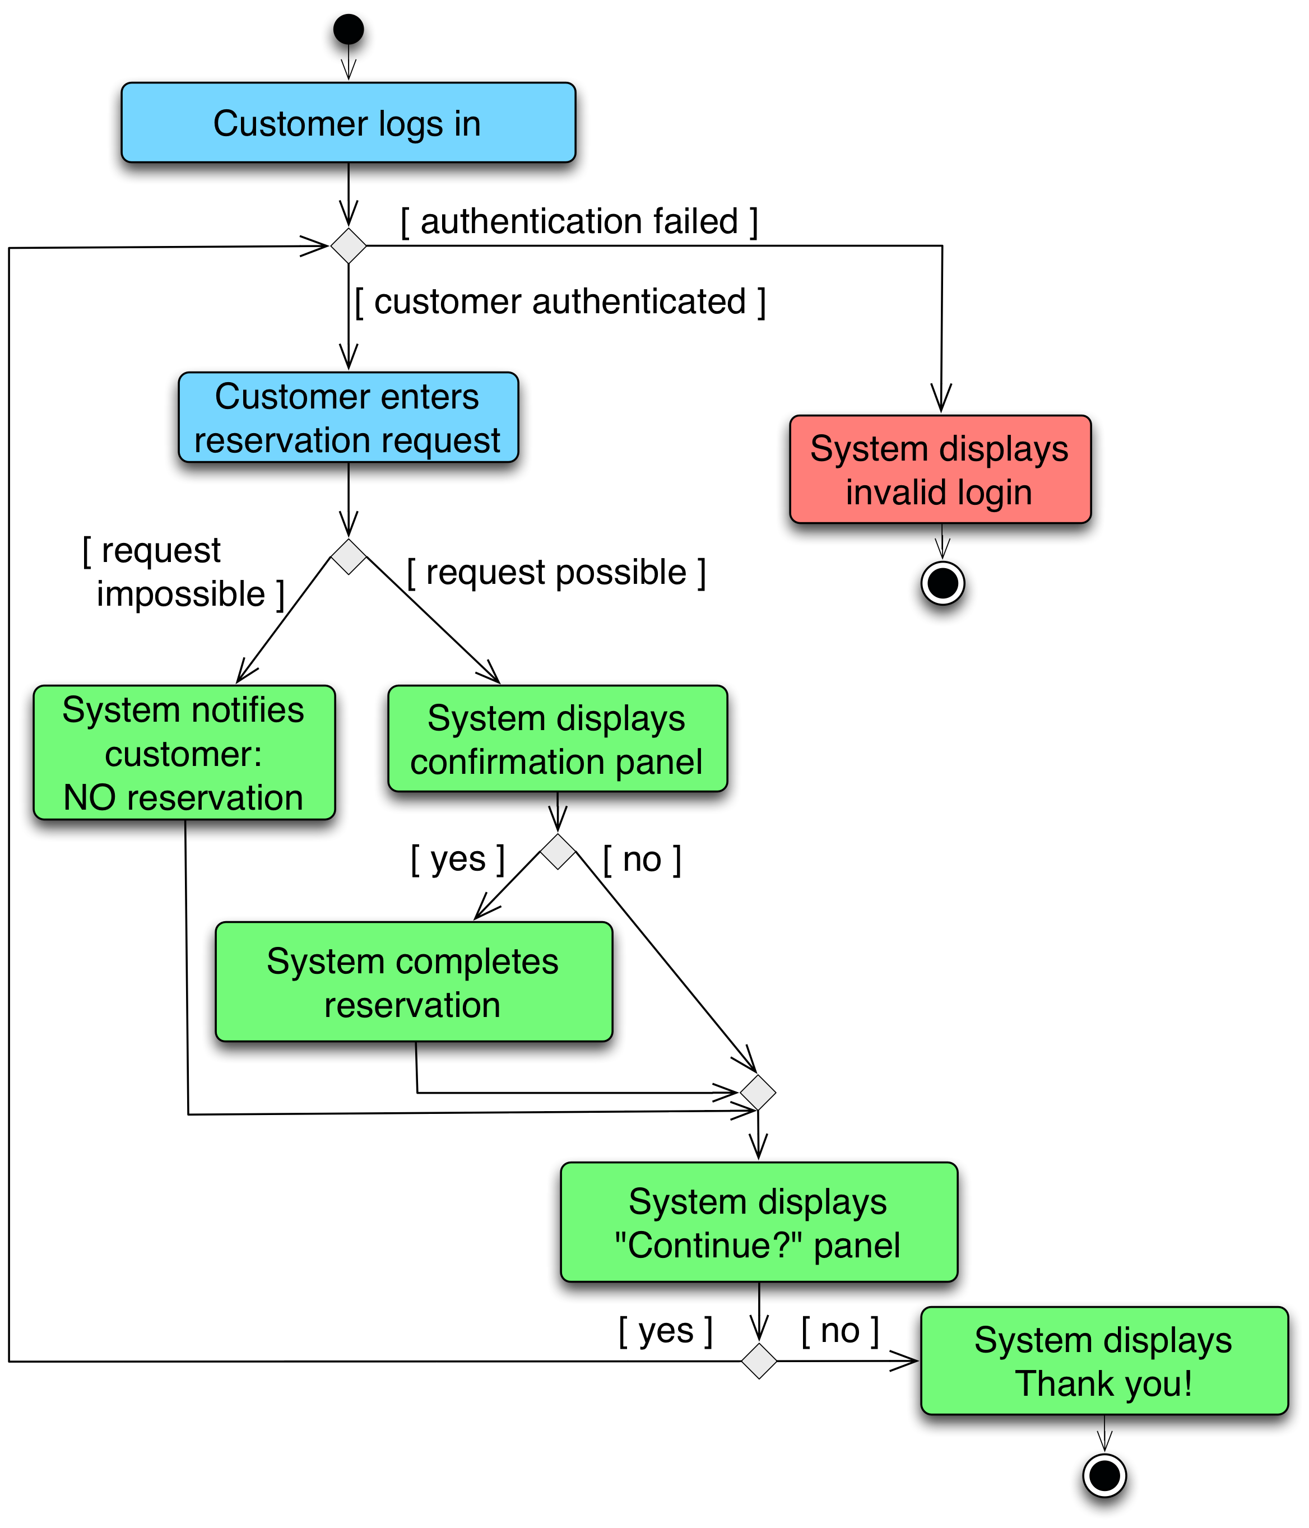
Flight Reservation Algorithm

Slide 12
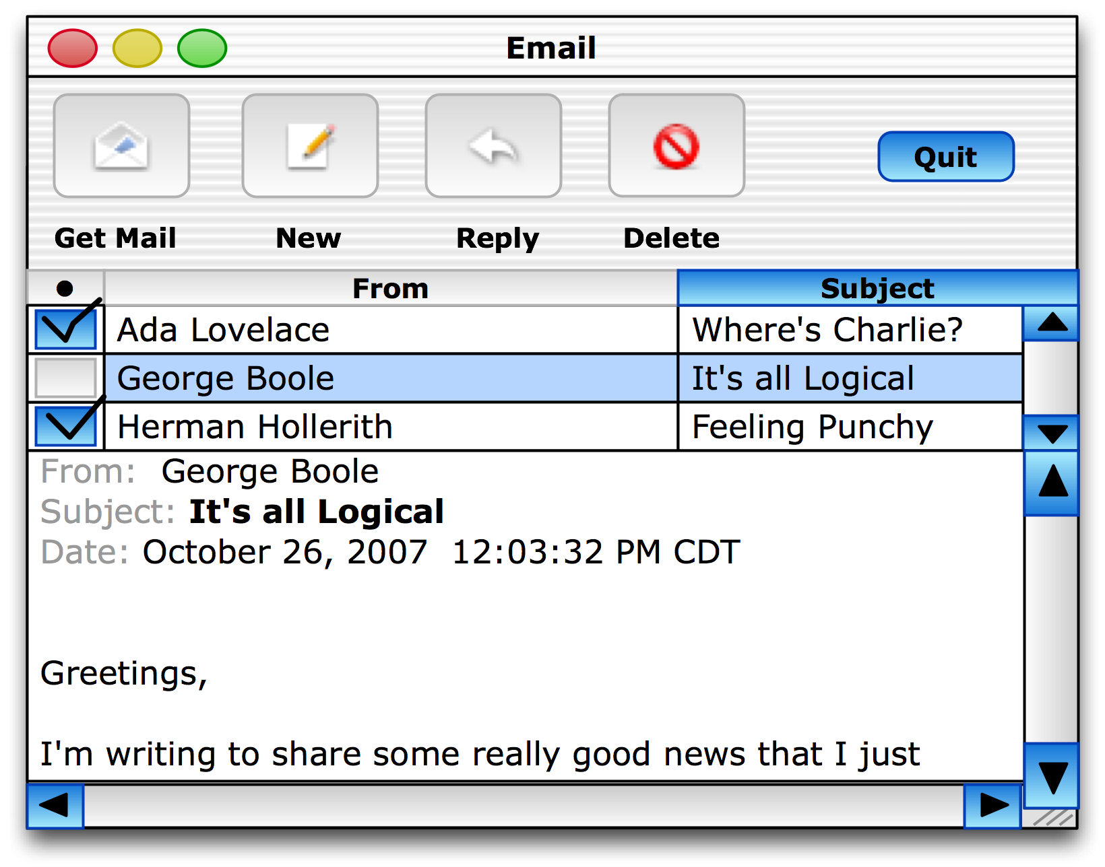
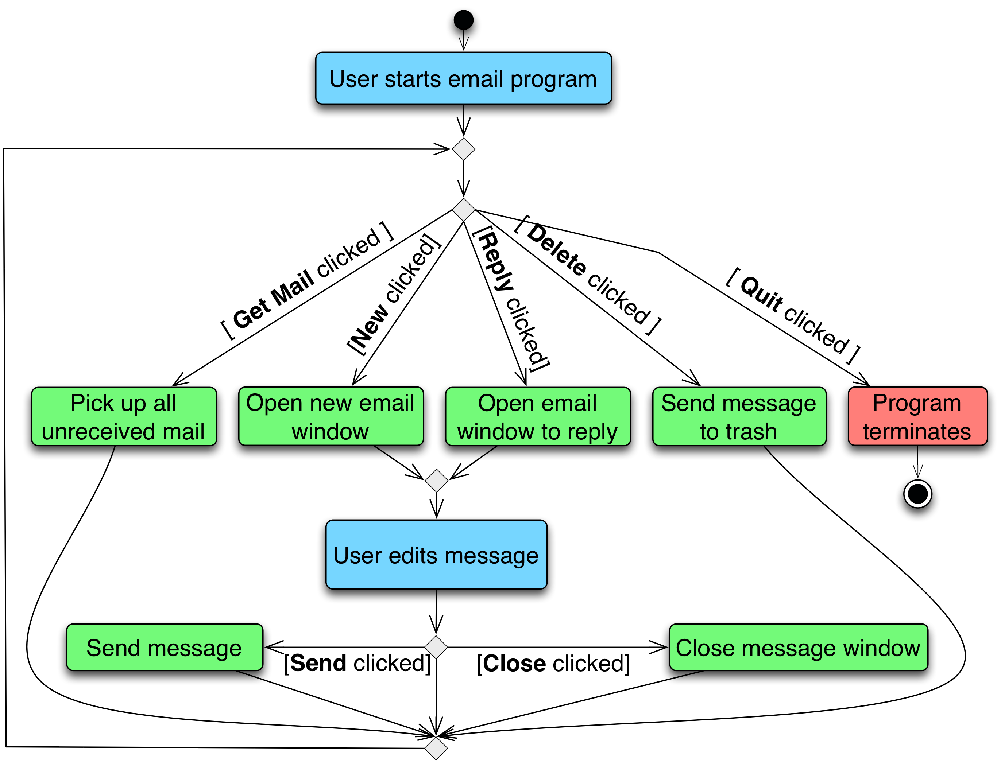
Email Client Algorithm
Notes:
Introduce assignment

Slide 13
Activity
Break into groups and draw an activity diagram for baseball (or the game of your choice).
Be sure to think about:
all the possible outcomes
identifying repetition and conditionals
Remember, there should only be one end to the game, all actions have something that follows.
Notes:
It is also good to remember that you will need to build it incrementally.
How does this help you develop software?

Slide 14
Discussion
How did you build the diagram?
How did you evaluate if it was correct? Did you need to change things as you built it?
How does this relate to developing software?
Notes:
talk about how diagrams like these are really used by software developers to lay out complex software to understand how they interact with each other, to model complex processes, and to identify problems with customers and stakeholders before building software.

