Slide 1
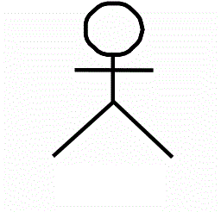
Use case Diagram – Sprint1
Buckchat – Sprint 1
Register
<<include>>
Validating
Credentials
user
Login
<<include>>

