Slide 1
Question Paper Generation System
Team2

Slide 2
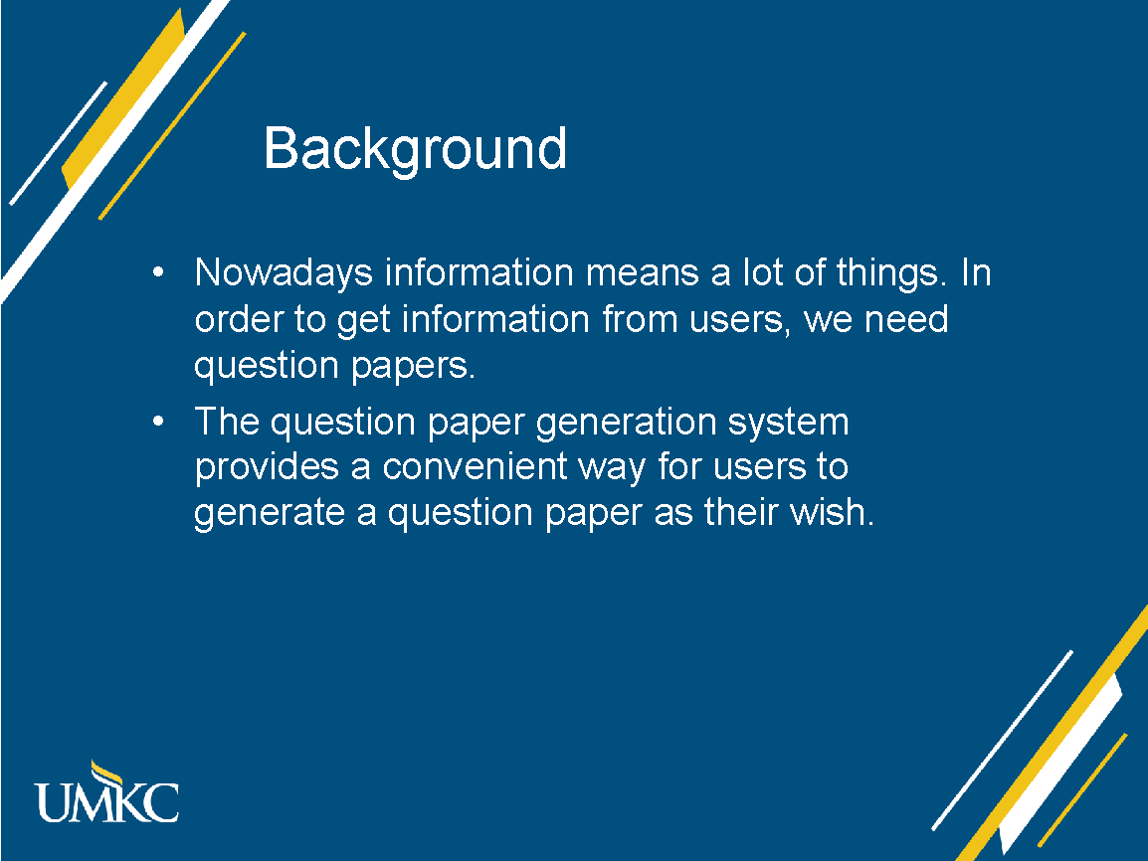
Background
Nowadays information means a lot of things. In order to get information from users, we need question papers.
The question paper generation system provides a convenient way for users to generate a question paper as their wish.

Slide 3
Project Overview
By using our system, you will be able to:
Register, Login and Logout
Create your own questions
Create your own question paper with your questions
Create your questions with picture of hand-written questions
Import/Export questions into json file
Get your paper as a PDF file
Automatically generate questions from text input

Slide 4
TimeLine
Increment 1
Register, Login and Logout
Database building
Simple UI design
Increment 2
Add/edit/delete questions
Add/edit/delete papers
Increment 3
Extract questions from picture (Using OCR)
Create and download PDF of paper
Import/Export question set from/to json file
Increment 4
Generate questions from text input
UI detailed design
Bug fixing

Slide 5
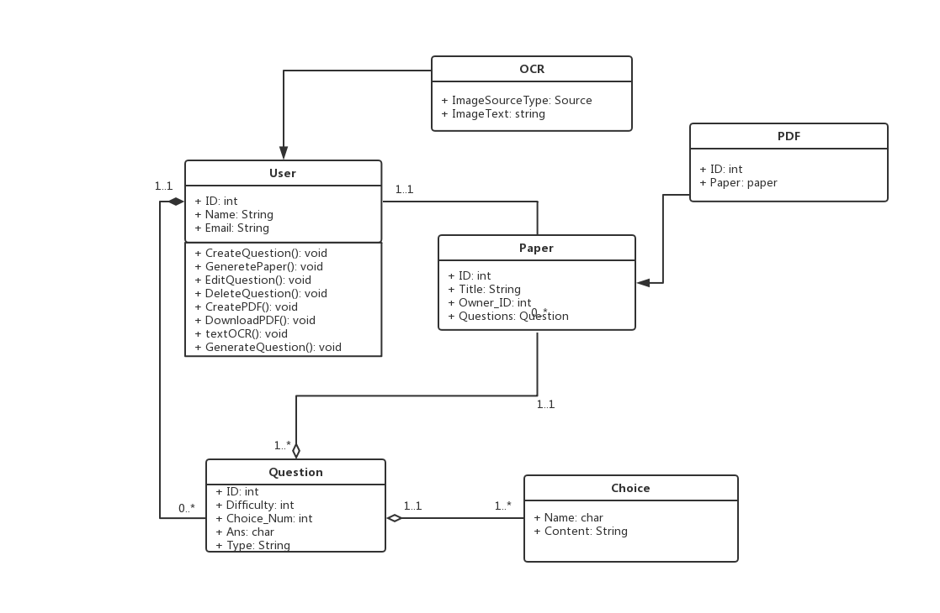
Class Diagram

Slide 6
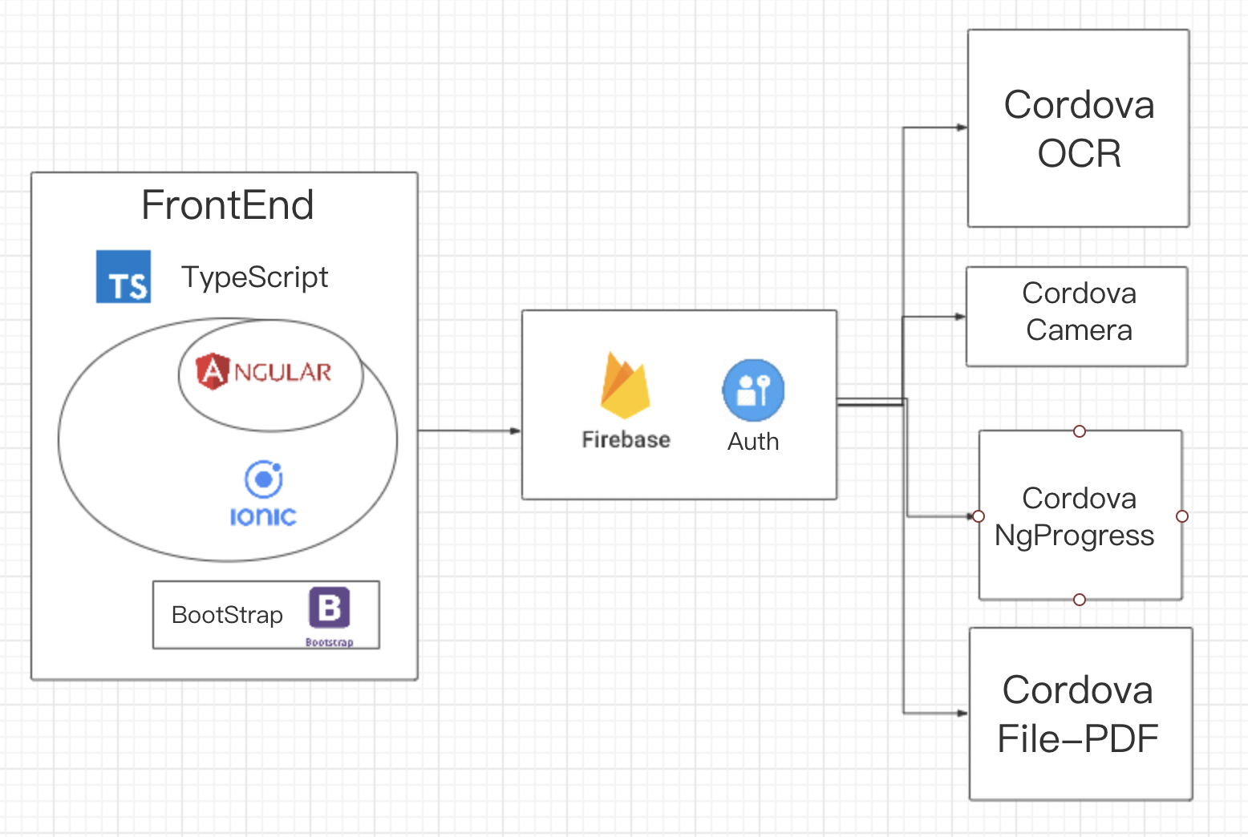

Technology

Slide 7

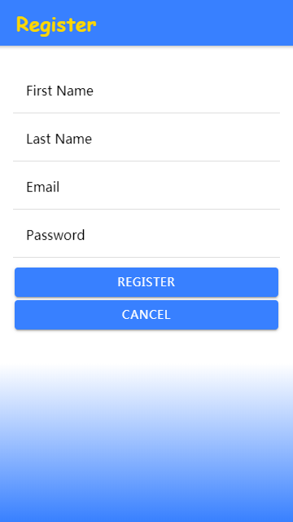
Usecase: Login/Register

Slide 8
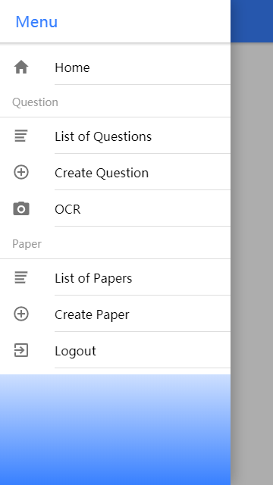
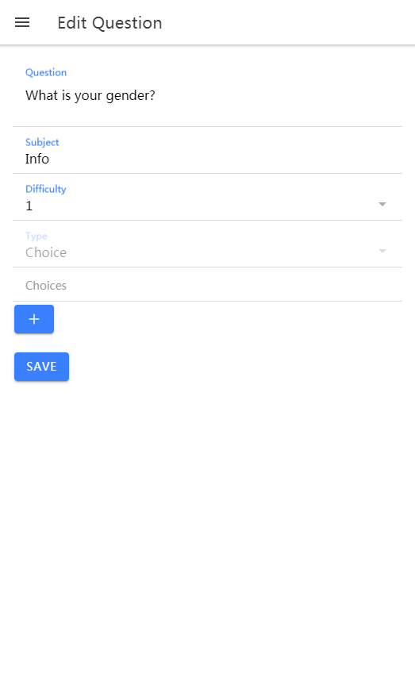
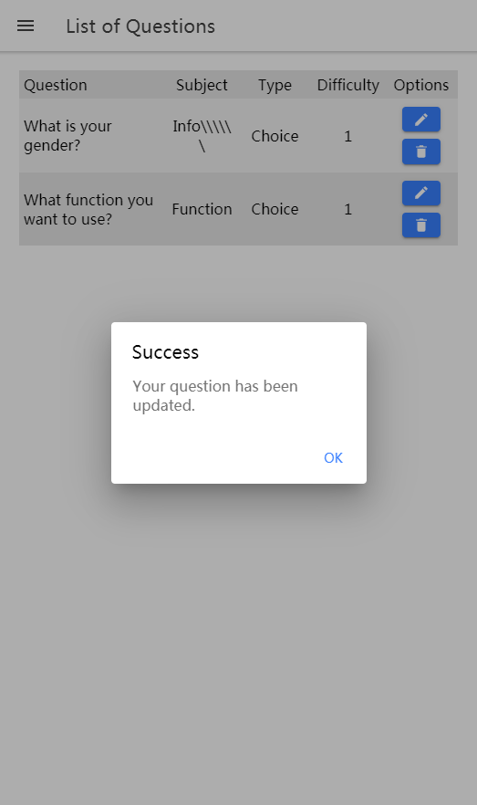
Usecase: Create/Edit question

Slide 9
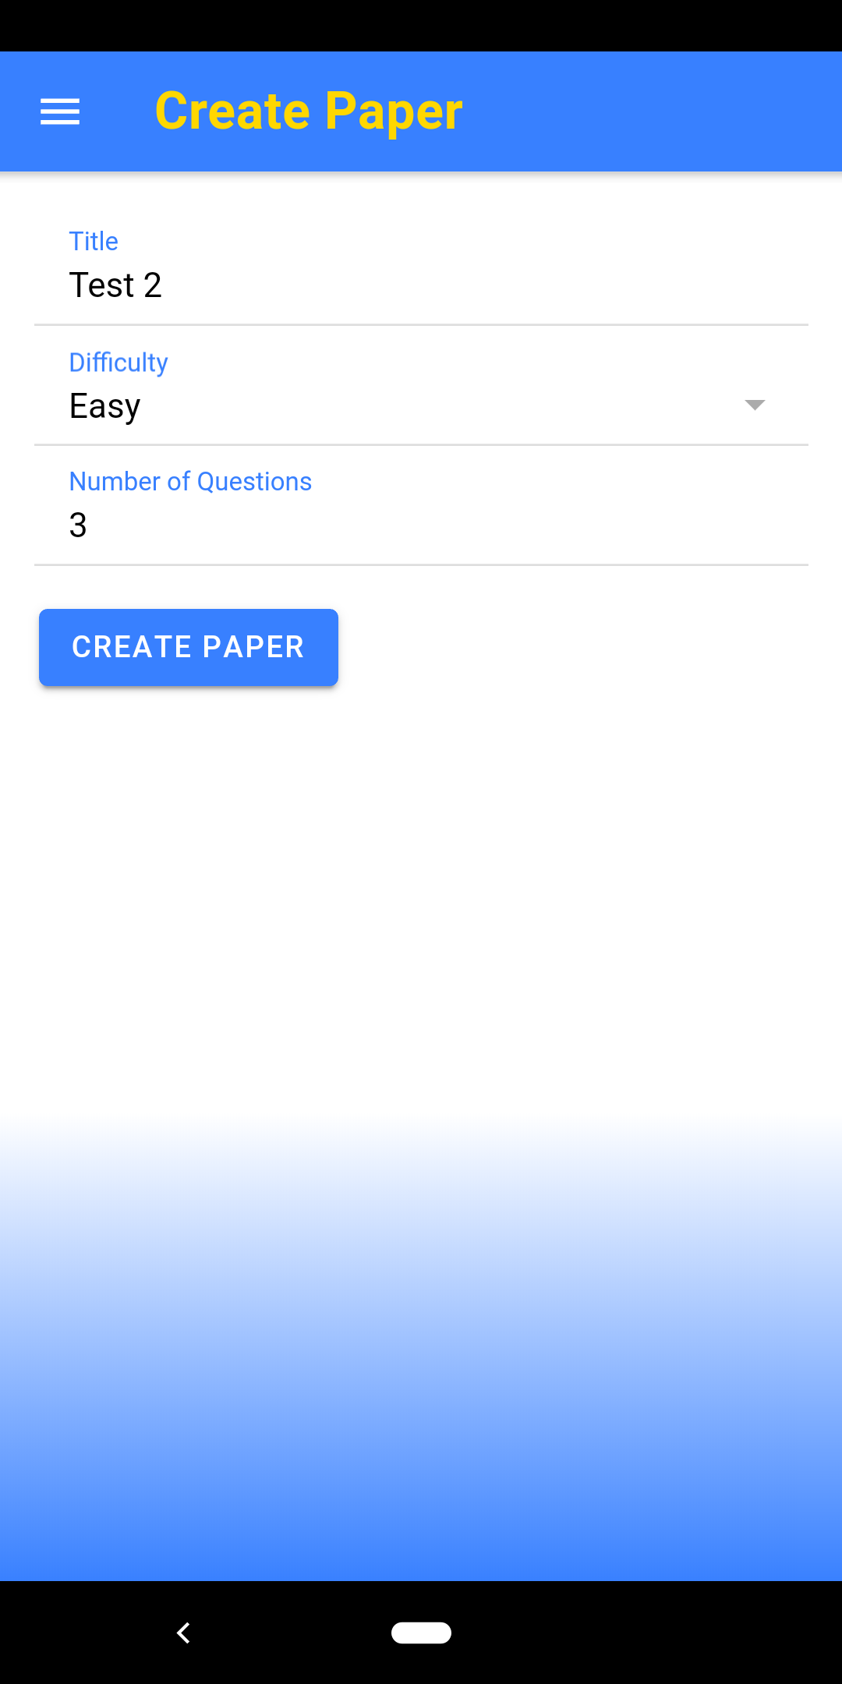
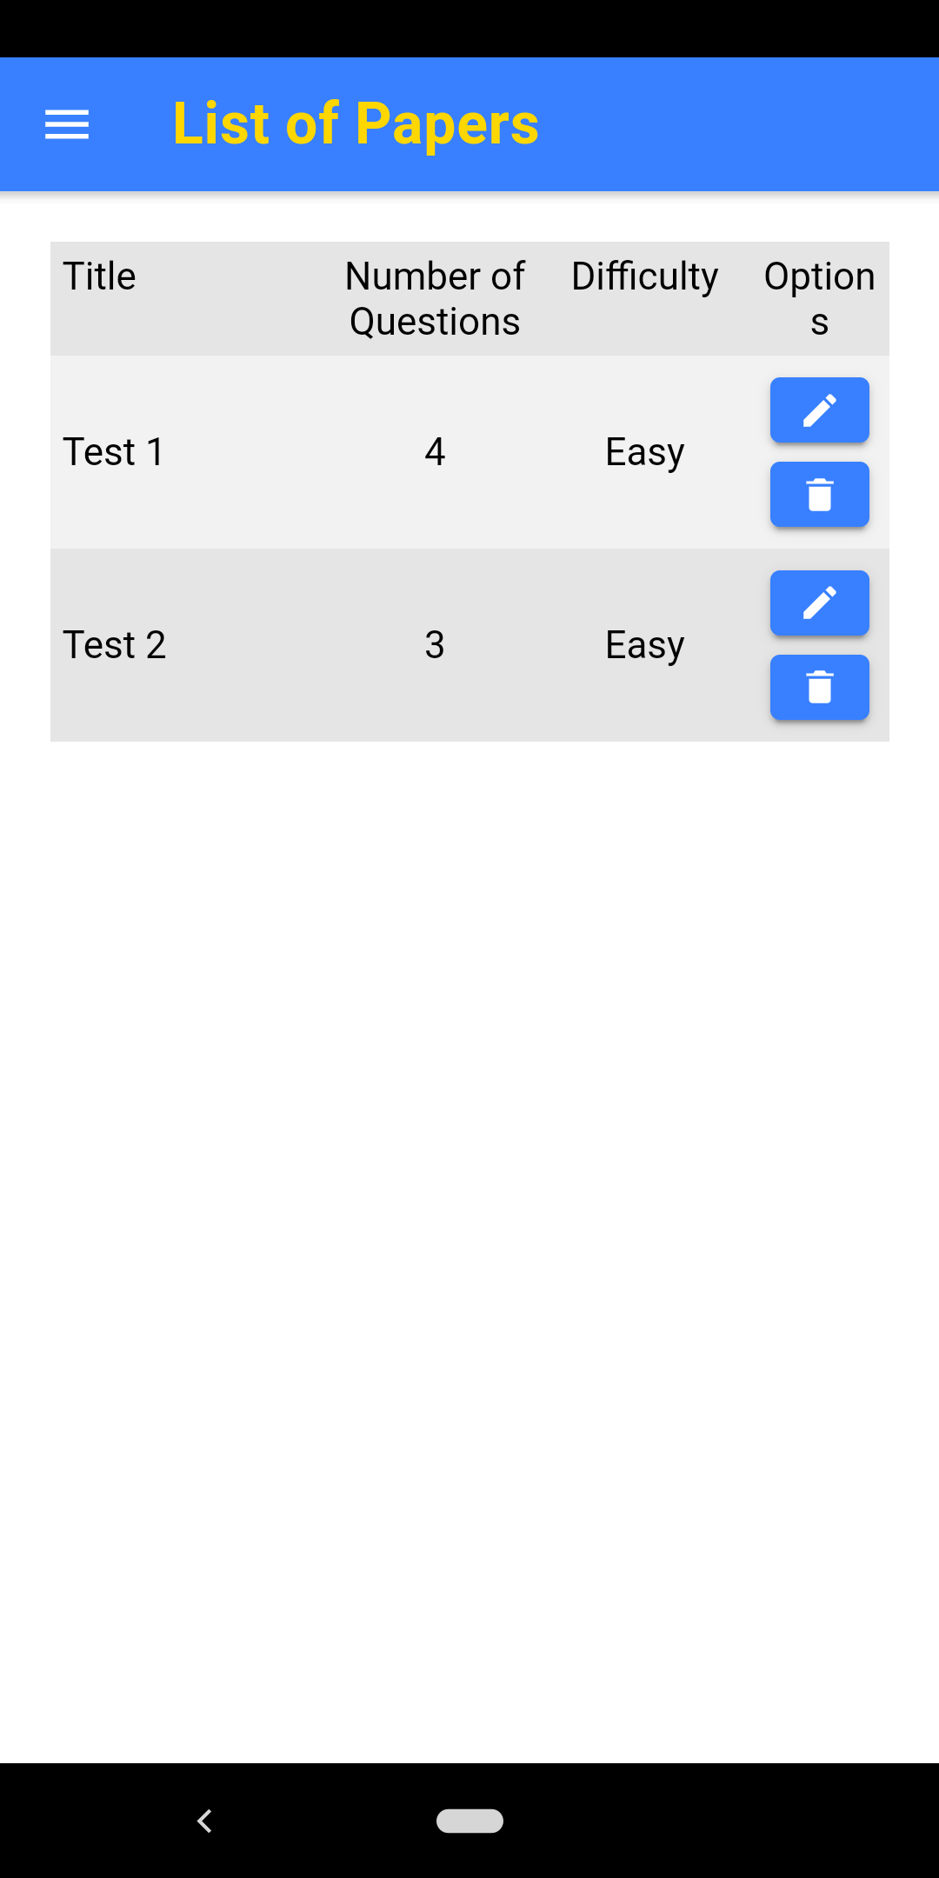
Usecase: Create paper

Slide 10

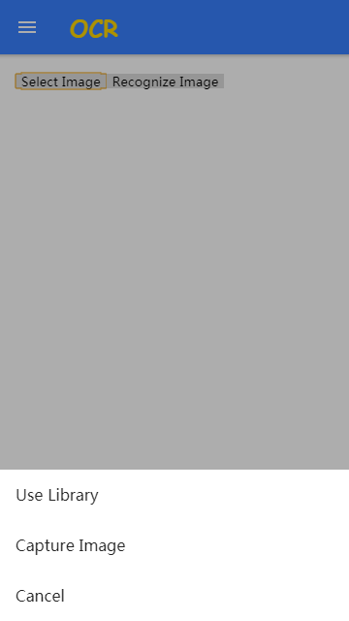

Usecase: Using OCR

Slide 11
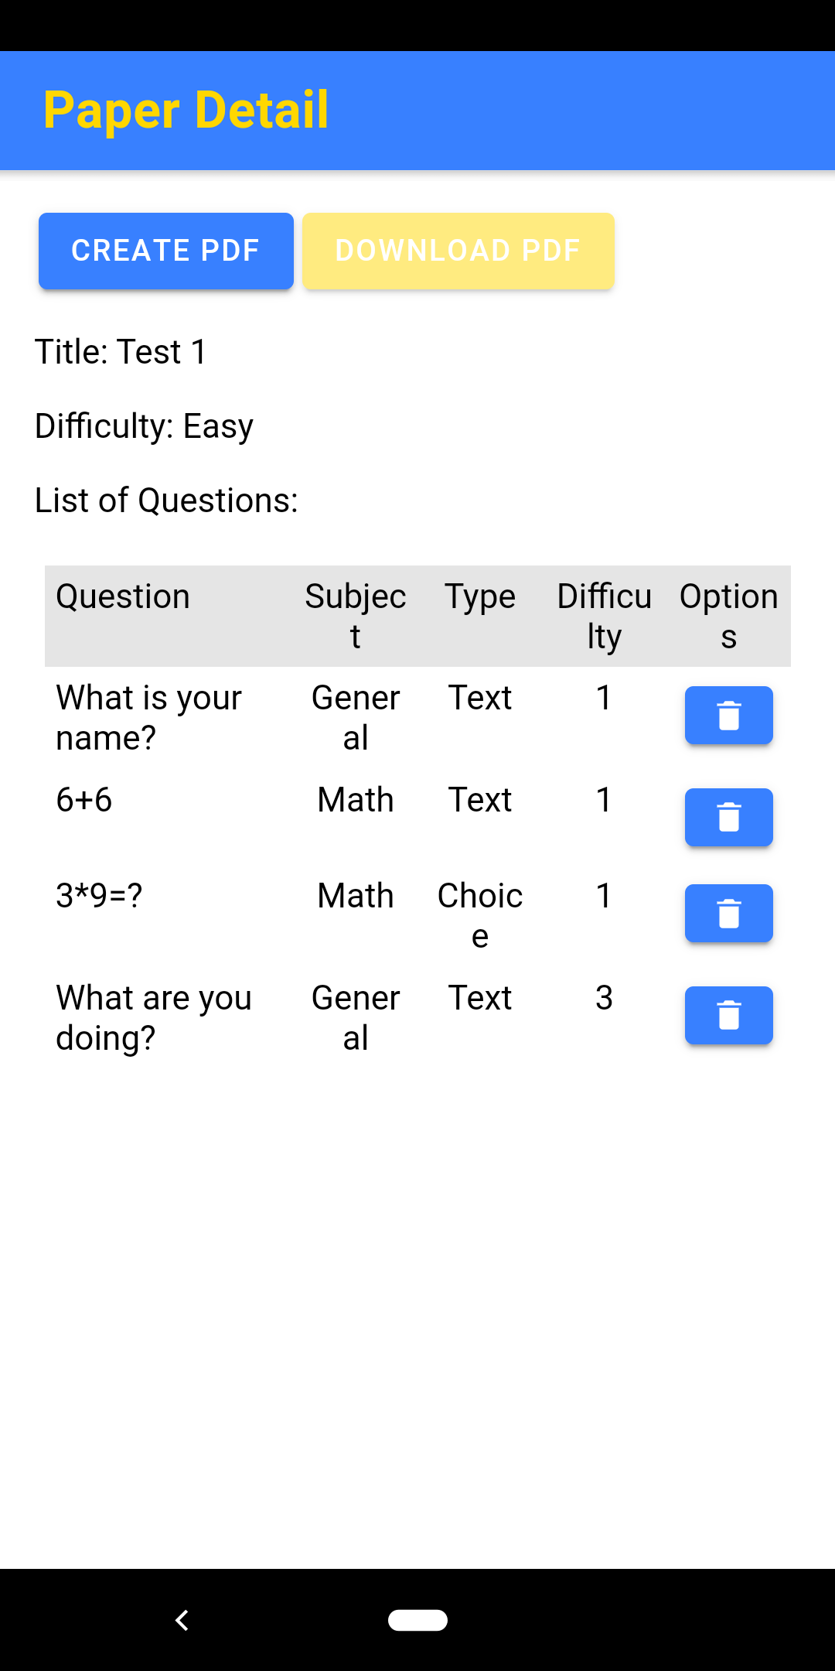
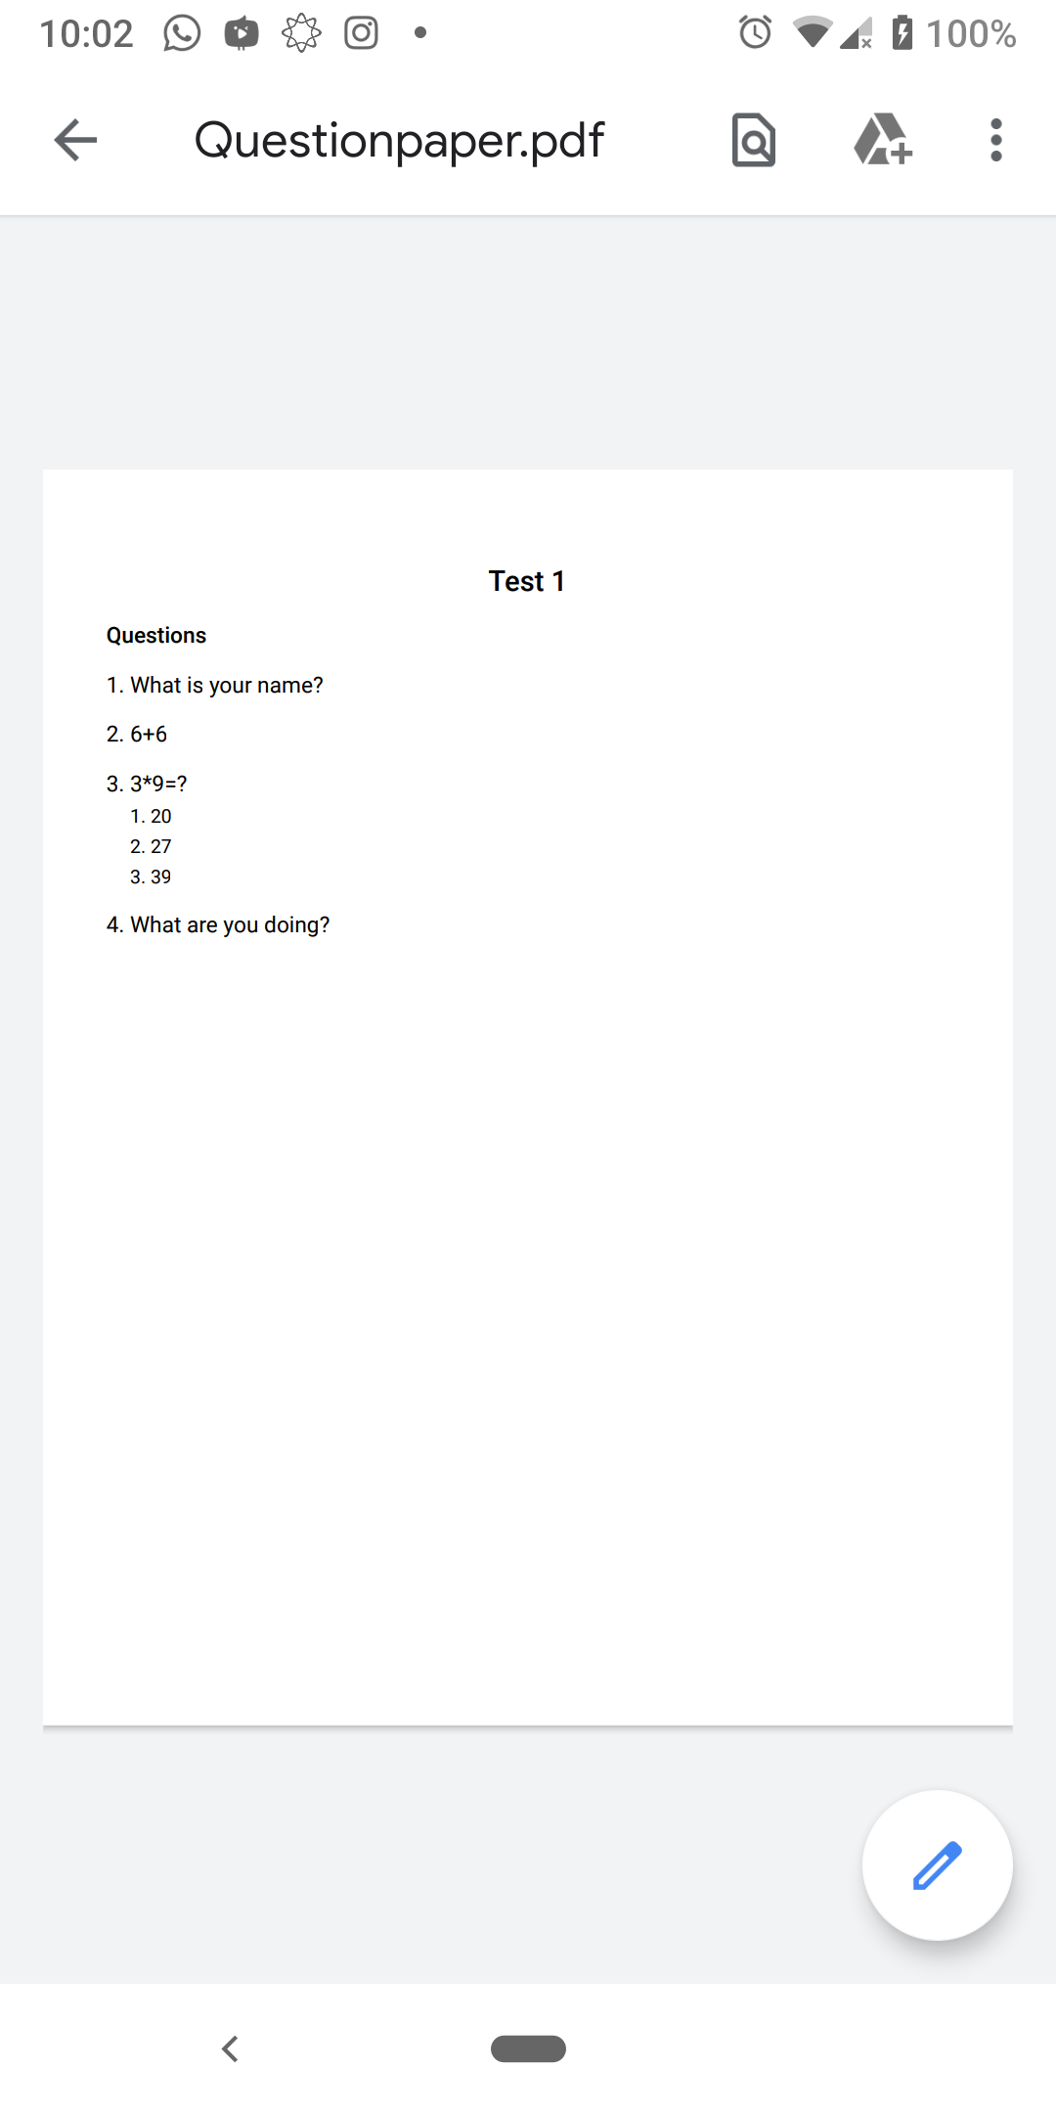
Usecase: Download PDF

Slide 12
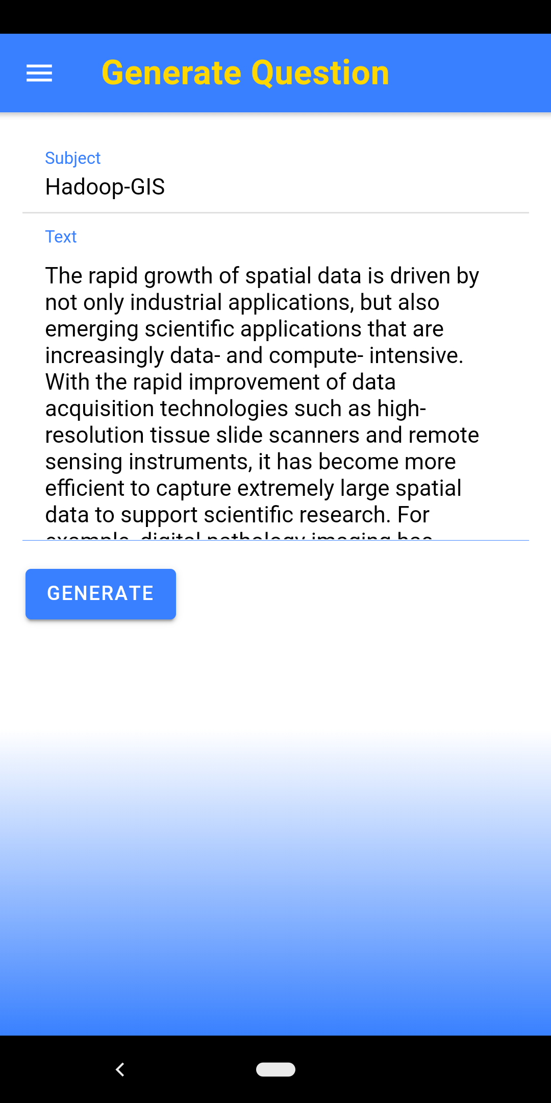
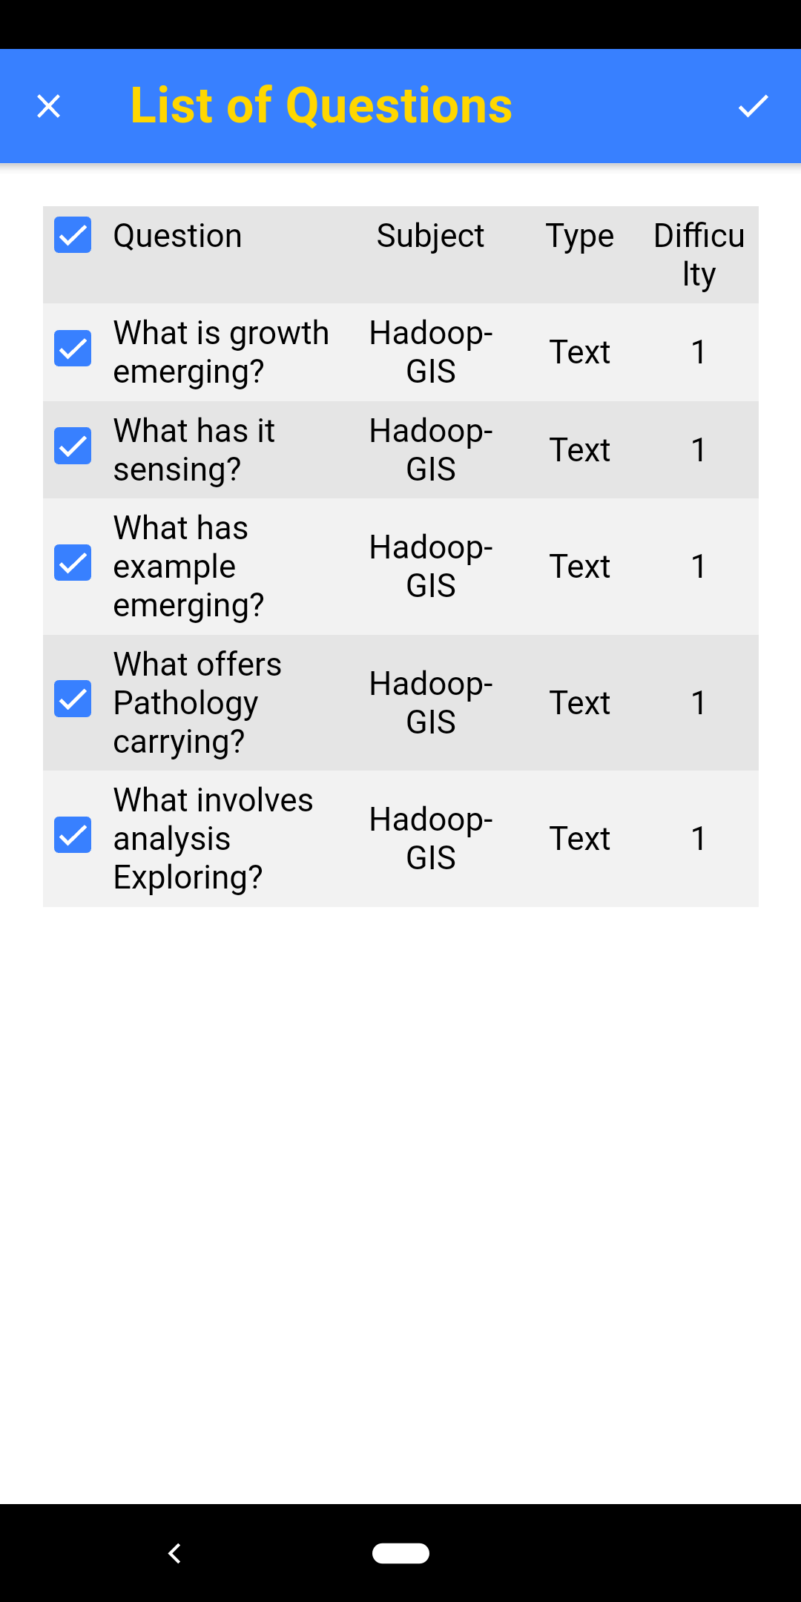
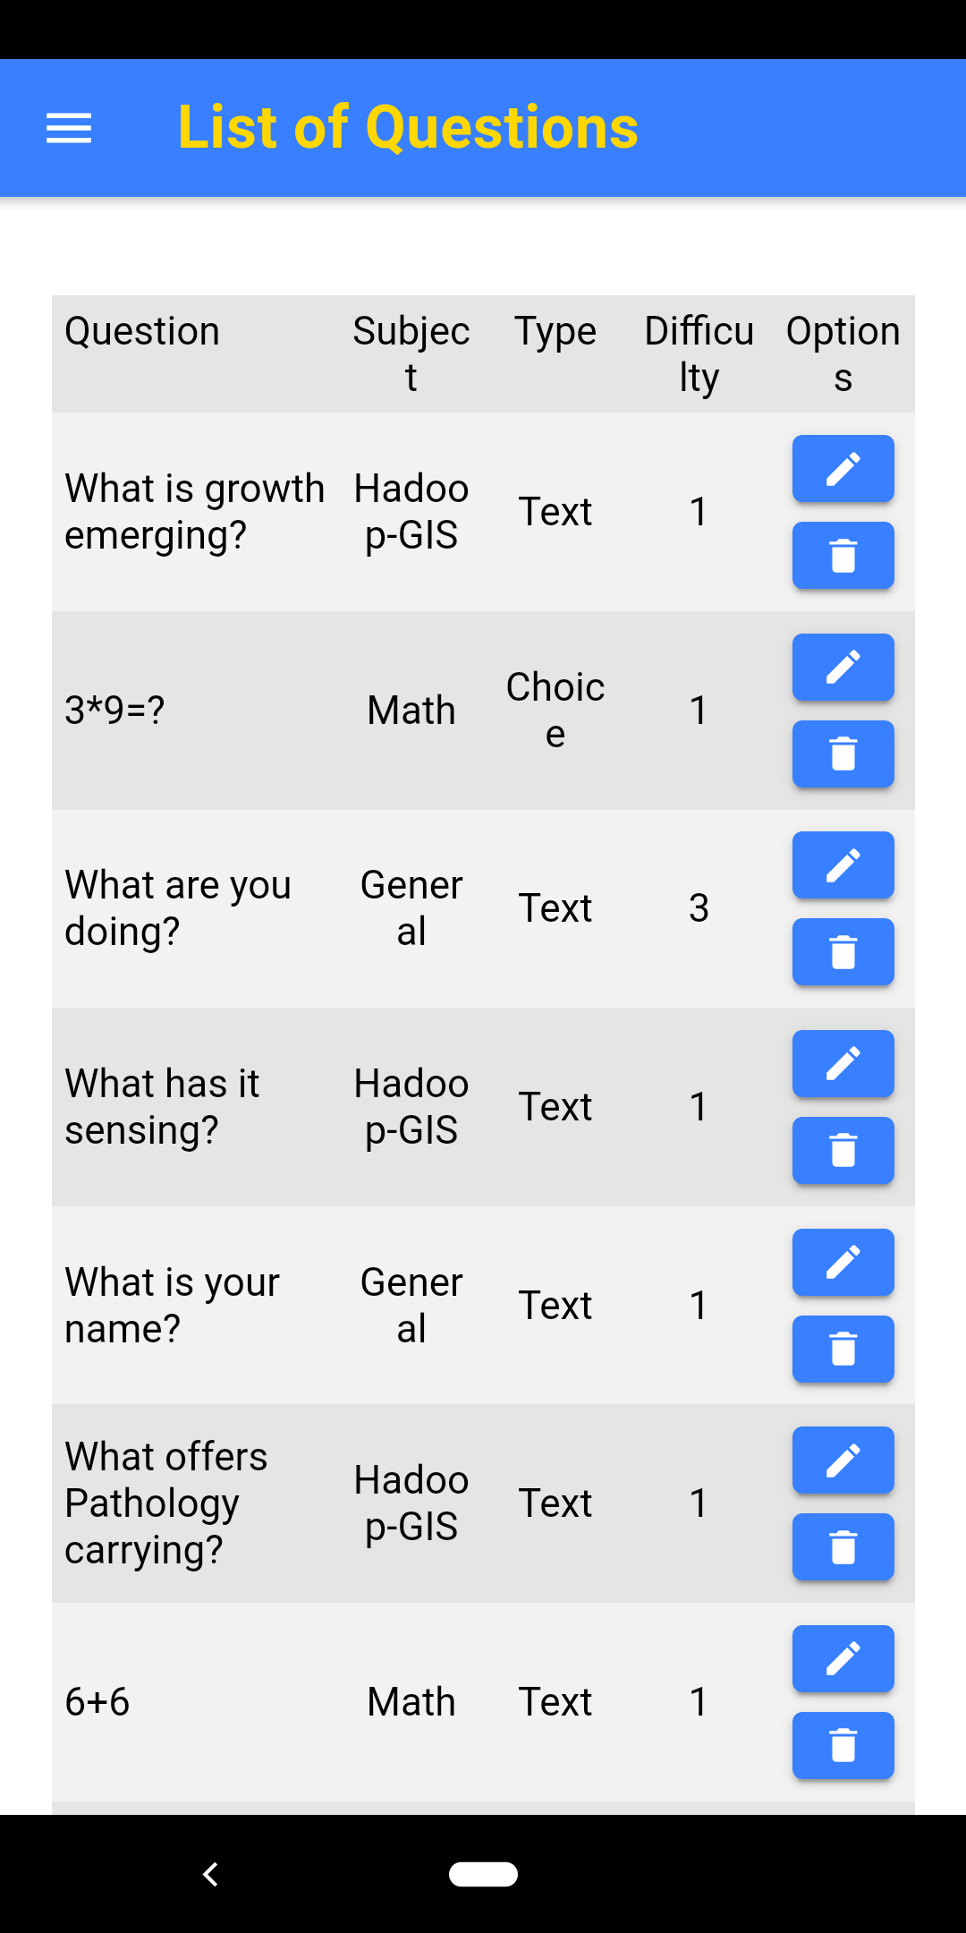
Usecase: Generate Questions from text input

Slide 13
Limitations
Lack of editing functions:
Select multiple questions or papers to delete
Filters
Not allow user edit the format of the paper before generating the PDF file

Slide 14
Pros and Cons
Pros:
Fundamental Functions
Firebase Authentication
Cons:
No forgot password
Need more auth providers

Slide 15
Future Work
Improvement of OCR
Use OCR to detect question papers from the internet, build a big set of questions
Automatically paper generation
User input a keyword and the paper will be generated automatically by using the related questions from the set
Improvement of paper format in PDF file

Slide 16
Thank You!

