Slide 1
CS590RA: Real Time Big Data Analytics Tutorial Lecture 1

Slide 2
Apache Hadoop?
Created by Doug Cutting and Mike Cafarella in 2005.
Open-source software framework that supports data-intensive distributed applications
Derived from Google's MapReduce & Google File System (GFS)

Slide 3
Hadoop’s Prominent Users
Yahoo!:
On February 19, 2008, launched the world's largest Hadoop production application.
The Yahoo! Search Webmap runs on a more than 10,000 core Linux cluster and used in every Yahoo! Web search query.
Facebook:
In 2010, the largest Hadoop cluster in the world with 21 PB of storage.
On July 27, 2011, the data had grown to 30 PB.
On June 13, 2012 the data had grown to 100 PB.
On November 8, 2012, the warehouse grows by roughly half a PB per day.

Slide 4
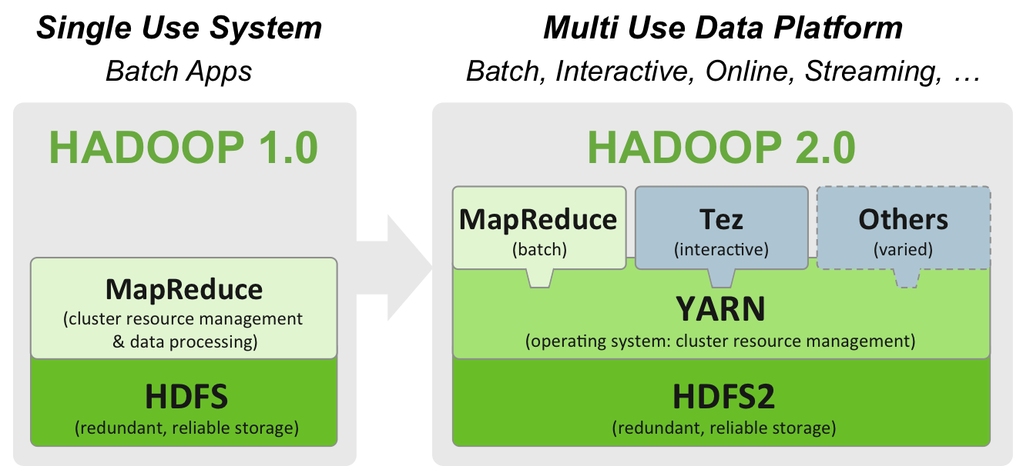
Hadoop System

Slide 5
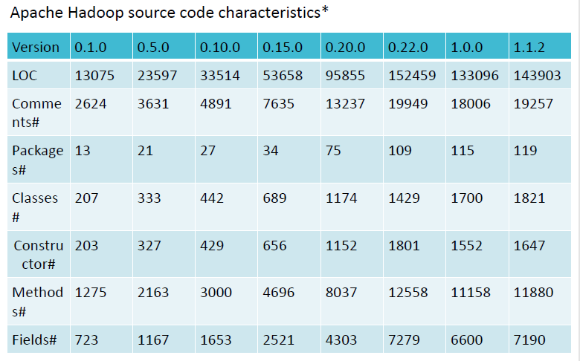
Apache Hadoop Source Code Statistics
10/2007
4/2009
12/2011
12/2011
2/2013
LATEST Version: 07 April, 2014: Release 2.4.0 available

Slide 6
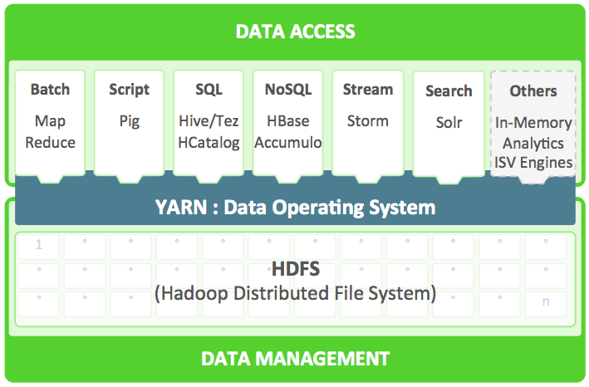
Hadoop 2.0
http://hortonworks.com/labs/yarn/

Slide 7
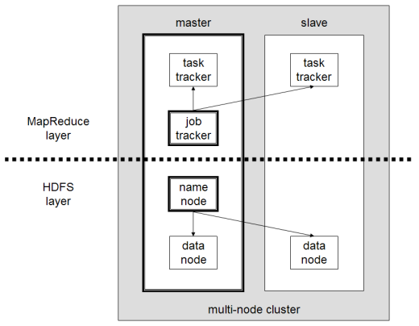
Hadoop Architecture
The file system uses the TCP/IP layer for communication.
Clients use Remote procedure call (RPC) to communicate between each other.

Slide 8
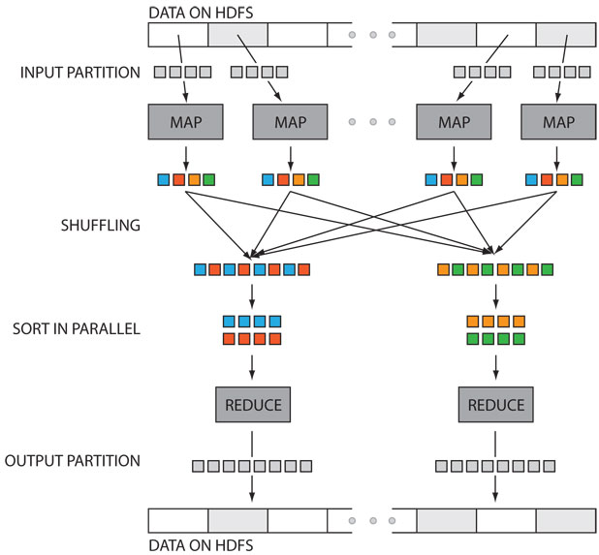
MapReduce Processing

Slide 9
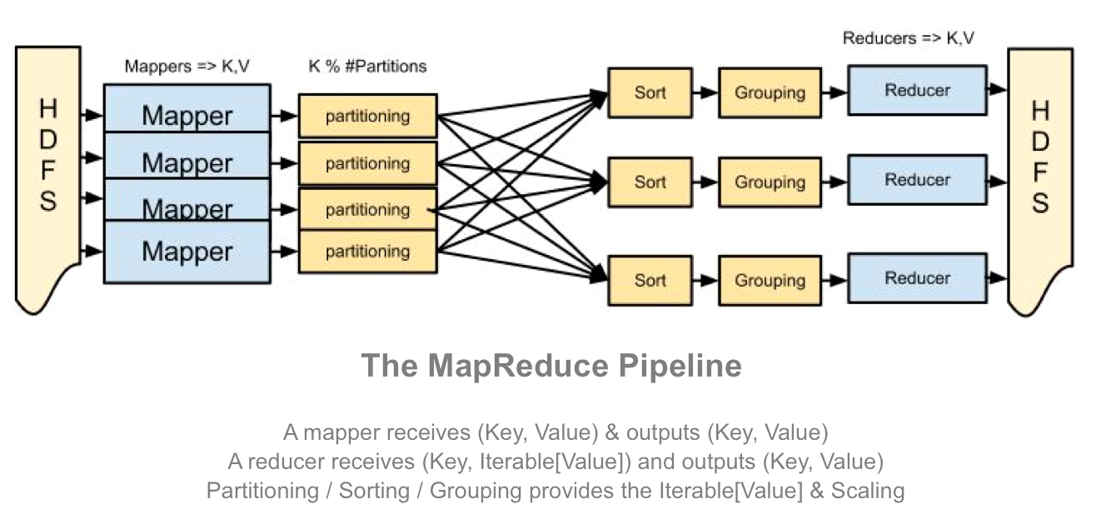
MapReduce Pipeline

Slide 10
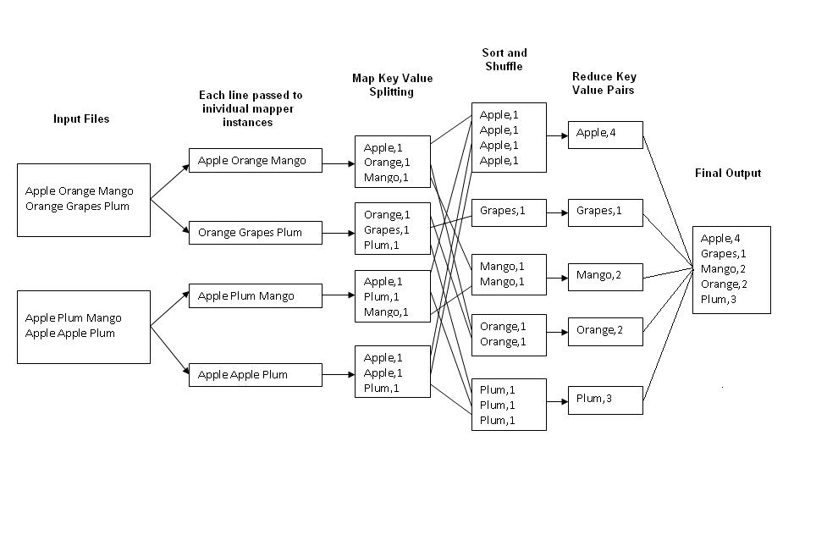
MapReduce Example

Slide 11
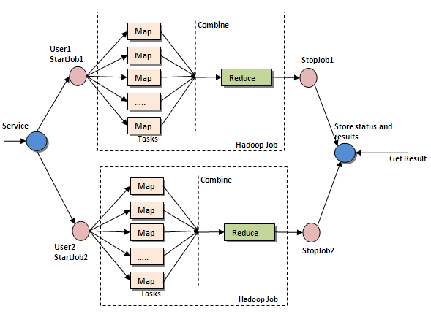
Hadoop Map/Reduce Processing
Map/Reduce is distributed
computing and parallel
processing framework where we have the advantage of
pushing the computation to data
• Distributed computing
• Parallel Computing
• Based on Map & Reduce
tasks
Image source: http://map-reduce.wikispaces.asu.edu/

Slide 12
Hadoop Eco-System
HDFS – Hadoop Distributed File System
Map/Reduce - Distributed computing framework
HBase – NoSQL data store (Non-relational distributed database)
Scoop - SQL-to-Hadoop database import and export tool
Hive – Hadoop Data Warehouse
Pig - Platform for creating Map/Reduce programs for analyzing large data sets
Mahout – Distributed Machine Learning/Data Mining System

Slide 13
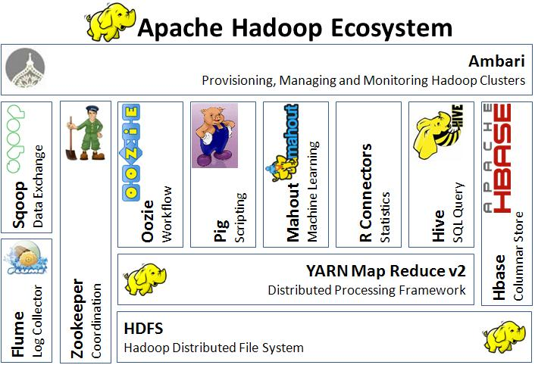
Source: http://techblog.baghel.com/

Slide 14
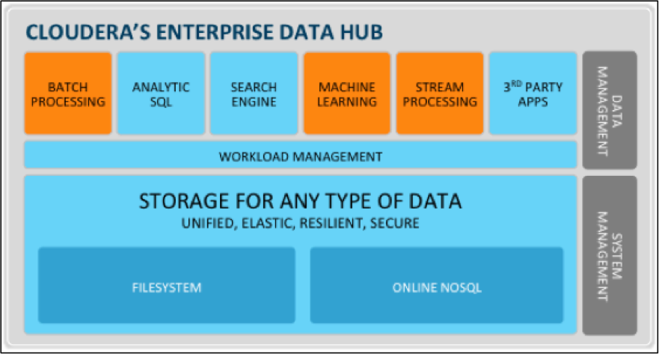
Cloudera Platform

