Slide 1
Web Technologies Overview/Servlets

Slide 2
Static Web Pages
Static files stored on disk (HTML, images, etc)
Web server
listen for HTTP requests
extract path
fetch and return contents of specified file
Limited use
most web applications you use are dynamic
facebook, twitter, news sites

Slide 3
Components
Development Platform
Storage
Web Server
Operating System

Slide 4
Amazon Web Services, etc
Development Platform
Server
Server
Server
Server

Slide 5
Dynamic Web Pages - Server Side
Client
Server
1. Request Page
LAMP
Linux, Apache, mySQL, PHP/Perl/Python
Note, the client sees only the HTML and/or Javascript
3. HTML Response
2. Execute Code

Slide 6
Components
PHP
mySQL
Apache
Linux

Slide 7
Python/PHP
Python
standard python code
use print statements to generate the HTML
Servlets will look like a Java version of this
PHP
inside out
HTML contains snippets of code
Java Server Pages (JSP) use a similar model

Slide 8
Dynamic Web Pages - Client Side
Client
Server
1. Request Page
3. HTML, Javascript, Applet, Flash Reponse
Server may still generate response dynamically
Client sees both HTML and code
code could be js, etc.
Client executes code
4. Code Executed
2. Response Generated

Slide 9
Web Frameworks
Django – python
Rails – ruby
Play – Java, Scala
Benefits
easy to reuse code
easy to adhere to standard models (MVC)
convenient configuration
database mapping
URL mapping

Slide 10
Servlets
Servlets are an API designed to make it easy to provide dynamic web applications in an object-oriented way.
jetty is a servlet container
provides a web server and implementation of the servlet API
Map a URL to a Servlet
HTTP parameters are parsed and packed into an object
Response code/headers are generated from response object

Slide 11
Overview
Servlet 1
Servlet 2
Servlet 3
doPost
doGet
doGet
ServletHandler
Connector

Slide 12
SimpleServletExample
/hello?name=<name>
returns a hello message customized with name
/goodbye?name=<name>
returns a goodbye message customized with name

Slide 13
Other Features
ResourceHandler - can be used to serve static pages
in example FileServer class
init method
called when Servlet is created, used to initialize state
Also see: http://java.sun.com/j2ee/tutorial/1_3-fcs/doc/Servlets.html

Slide 14
Embedding Jetty
Useful for development and/or single purpose applications
The application deploys jetty rather than the other way around
Alternative: deploy jetty and the deploy several applications using WAR files

Slide 15
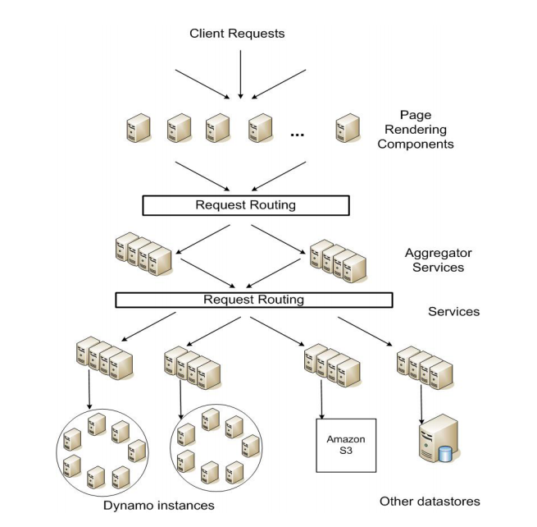
Amazon SOA

Slide 16
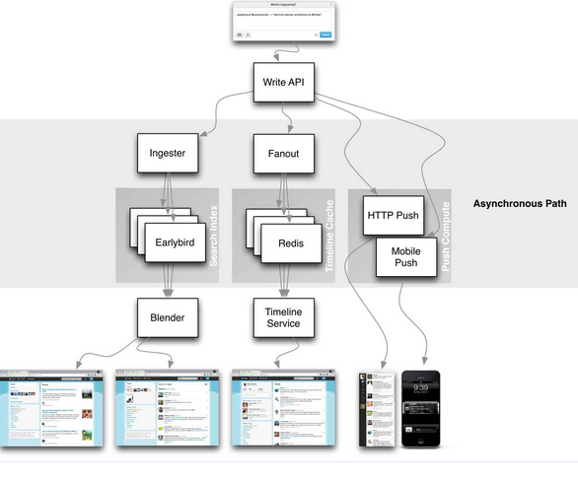
Twitter SOA

