Slide 1
Consistency in Distributed Systems
Sami Rollins

Slide 2
Replication
In cloud infrastructure services, replication is used ubiquitously to guarantee consistent performance and high availability
Vogel’s Eventually Consistent article
An early Google paper discussed their philosophy of using cheap/commodity hardware and building reliability in software
Assume failure is the norm and program the system to account for that failure

Slide 3
The C in CAP
R1
R2
R3
R4
Why maintain multiple copies of the data?

Slide 4
The C in CAP
R1
R2
R3
R4
Why maintain multiple copies of the data?
Recover from failure
For this case, could just have a “backup” copy
Decrease latency
How do we provide consistency?

Slide 5
Consistency Models
R1
R2
R3
R4
1. C1 writes A=5
2. C2 reads A
C1
C2

Slide 6
Strong Consistency
R1
R2
R3
R4
1. C1 writes A=5
2. C2 reads A
C1
C2
Strong consistency: C2 is guaranteed to see A=5

Slide 7
Strong Consistency
R1
R2
R3
R4
How would you implement strong consistency?

Slide 8
Strong Consistency
R1
R2
R3
R4
How would you implement strong consistency?
Passive replication
All requests go through a single, primary server and the primary copies to all secondaries before replying to the client
Active replication
Any replica can accept a write, however it must get all other replicas to reliably apply the write before replying to the client

Slide 9
Strong Consistency
Disadvantages?

Slide 10
Weak Consistency
R1
R2
R3
R4
1. C1 writes A=5
2. C2 reads A
C1
C2
Weak consistency: C2 may not see most up-to-date value for A

Slide 11
Weak Consistency
Good idea?
Appropriate applications?

Slide 12
Eventual Consistency
Eventually, all replicas will have the most up-to-date information
Often uses lazy replication
Any replica accepts the write
Writes are propagated asynchronously
A read may not see the most recent version of the data, but will eventually

Slide 13
Causal Consistency
Ensure that any read sees all writes that happened before

Slide 14
Logical Time
For many applications, the causal ordering of events is most important. The happened-before relation (→) is denoted as follows:
If two events occurred at the same process p_{i} then they occurred in the order in which p_{i} observes them.
For any message m send(m) →receive(m)
If e→e’ and e’ →e’’ then e→e’’
Events that are not ordered by → are concurrent – a || e

Slide 15
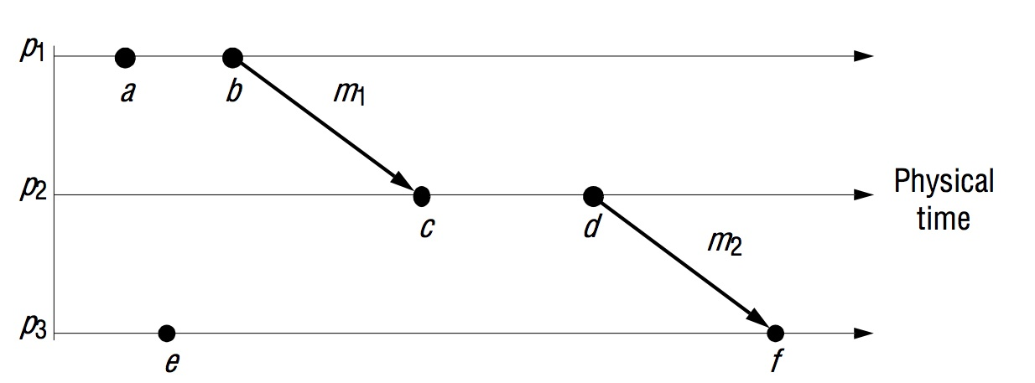
Logical Time
b→c, c→d, a||e
Any other → or || relationships?

Slide 16
Logical Clocks
Lamport timestamps
Monotonically increasing counter maintained at each process and updated according to the following rules:
LC1: L_{i} is incremented before each event is issued at process p
LC2:
When a process sends a message m it piggybacks its value of t = L_{i}
On receiving (m, t), a process computes L_{j} := max(L_{j}, t) and applies LC1 before timestamping the event receive(m)

Slide 17
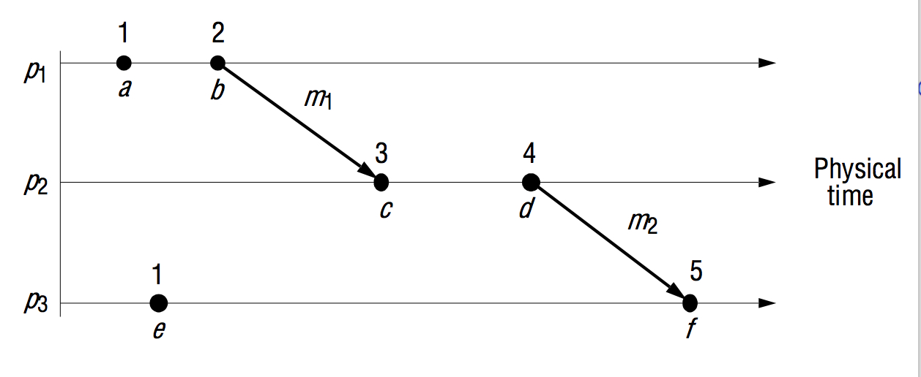
Logical Clocks
If e→e’ then L(e) < L(e’)
If L(e) < L(e’) then can we say e→e’?

Slide 18
Logical Clocks
If e→e’ then L(e) < L(e’)
If L(e) < L(e’) then can we say e→e’?
No! 1 < 3 but we can’t say anything about the relationship between e and c in the example above.

Slide 19
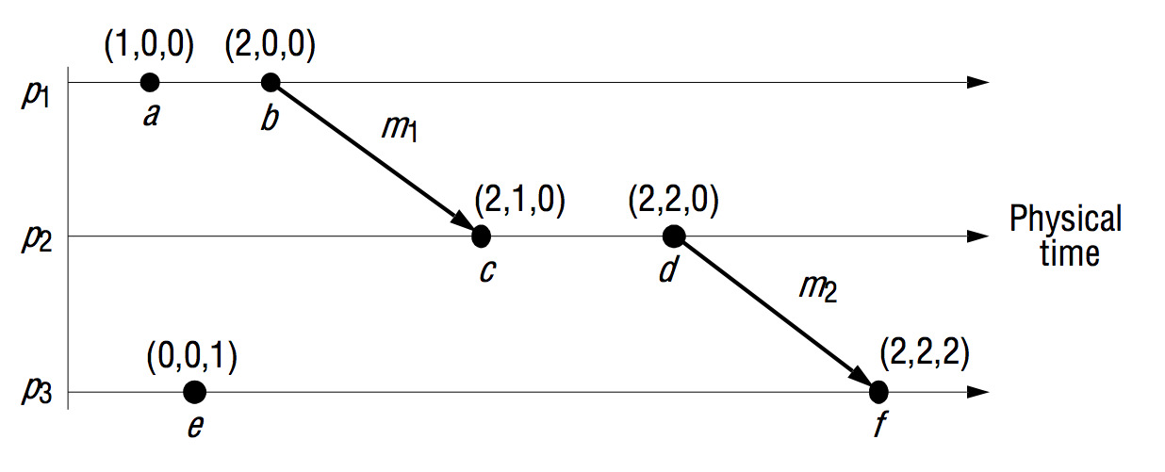
Vector Clocks

Slide 20
Causal Consistency
Client specifies the last timestamp seen
Replica provides data at timestamp that is concurrent with or happened after the last timestamp seen
Read-my-write consistency
Similar to causal consistency, but guarantees that the client sees its own writes

