Slide 1
DSD Overview
Sami Rollins

Slide 2
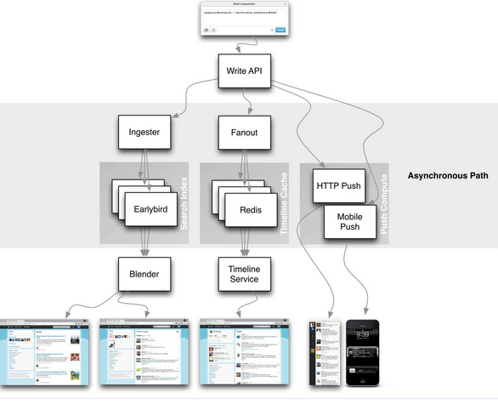
Why study distributed systems?
You use them everyday!
Scale is the name of the game
Distributed systems are complex
Understanding what is under the hood is important

Slide 3
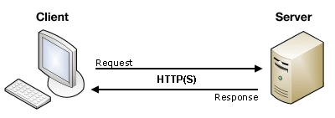
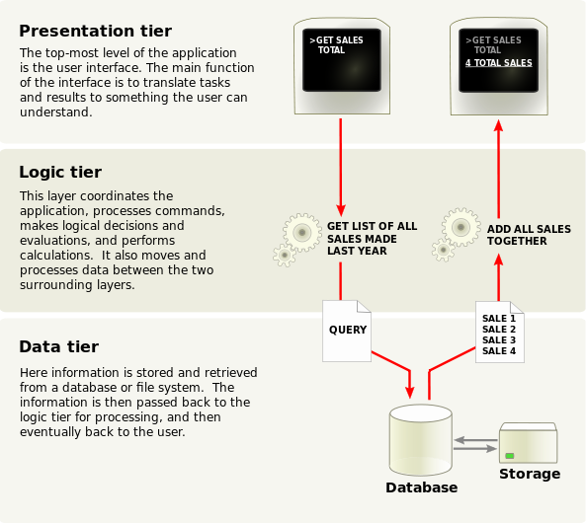
History lesson
Client/server or n-tier Architecture
Limited scalability
Database often a bottleneck

Slide 4
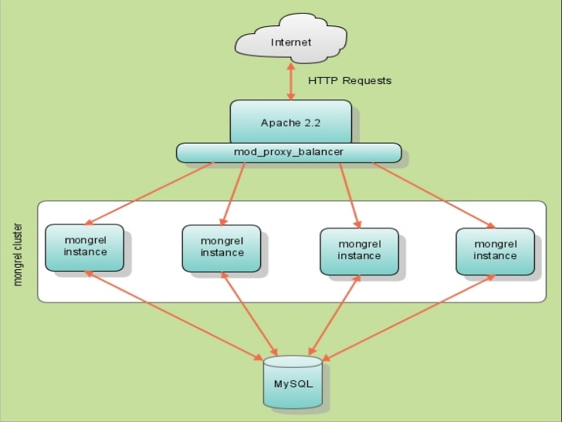
Twitter case study
Original Twitter architecture
Ruby on Rails
MySQL
1 server
2400 requests/second
Mongrel (web server)
Memcached

Slide 5
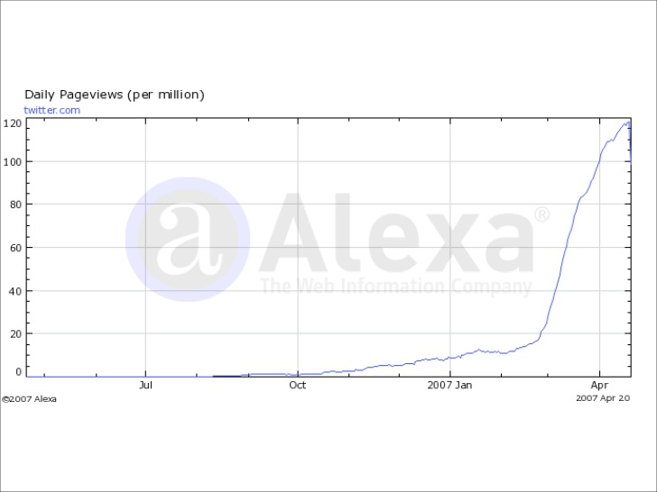
Twitter case study

Slide 6
Twitter case study
Optimize reads
insert
for each follower, insert new tweet in redis cache
Service-oriented architecture
System is a set of loosely coupled services

Slide 7
More history
Leslie Lamport
Turing Award winner 2013
http://research.microsoft.com/apps/video/default.aspx?id=210551
Common Object Request Broker Architecture (CORBA)
Java Remote Method Invocation (RMI)
Web Services
Simple Object Access Protocol (SOAP)
Representational State Transfer (REST)
Asynchronous Javascript and XML (AJAX)
JSON has become the more popular choice

Slide 8
Non-web distributed systems?
Twitter, Pinterest, Google, Etsy
All are web-based applications
What about other kinds of applications?
Characteristics
Concurrency
Independent failures
No global clock
Heterogeneity
High latency communication
System composed of computers spread over a large geographic area, maybe under different administrative domains

Slide 9
Other distributed systems
Peer-to-peer
File sharing/distribution
Gnutella?
Bit torrent
Others?
MMOG
DNS
CDNs
Akamai
Limelight
Netflix Open Connect

Slide 10
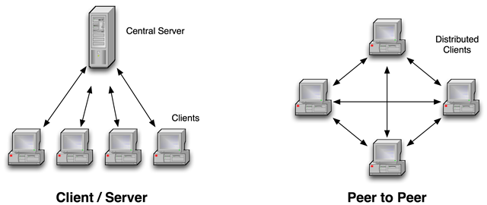
Architectures

Slide 11
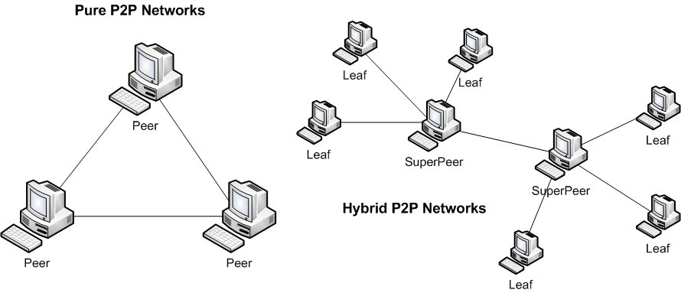
Architectures
Bit torrent - http://en.wikipedia.org/wiki/Peer-to-peer

Slide 12
Main challenges?
What do you think are the biggest challenges in building a distributed system?

Slide 13
Challenges
Heterogeneity
different networks, OSs, architectures
communication protocols must be carefully defined
Openness
Can new services/components be easily added?
Security
confidentiality, protection against corruption, resistant to attack
Scalability
tolerates increase in users and/or resources

Slide 14
Challenges
Failure handling
Can the system detect, mask, tolerate, recover from failures?
Concurrency
able to handle multiple requests simultaneously
Transparency
local and remote resources accessible in the same way

Slide 15
Principles
Availability
Enough resources to handle all traffic
Failure is handled gracefully
Performance
Fast response time
Sufficient hardware
Geographic placement

Slide 16
Principles
Reliability
Fault tolerance
Consistency
Eventual consistency
Strong consistency
Scalability
Increasing resources, supporting more users
Manageability
System updates, failures
Cost

Slide 17
CAP theorem – Pick two
Consistency
All nodes see the same data at the same time
Availability
A guarantee that every request receives a response about whether it was successful or failed
Partition tolerance
The system continues to operate despite arbitrary message loss or failure of part of the system

Slide 18
Pieces of the puzzle
Services
App
Server
Data
Client
Client
Services
Data
Client
Load balancing
App
Server
Client
Client
Data
App
Server
Services
Cache
Data
Queue

Slide 19
Design decisions
Load balancing algorithms
DNS round robin
Random
CPU/Memory utilization
Service-oriented Architecture (SOA)
Replication versus partitioning of functionality
Caching
Policies for populating cache and evicting data
Memcached
Redis

Slide 20
Design decisions
Data
Replicated versus partitioned
Asynchronous processing
Log requests for “big data” processing, transformation, etc
Kafka

