Slide 1
Principles of Software Development
Sami Rollins

Slide 2
Welcome to CS 601!
Learn to think like a software developer
Modular design
Reusable code
Problem solving
Mechanics
Concurrency
Networking
Web and HTTP
Distributed topics

Slide 3

A practical approach
Learn by doing – build a user review web application!
Labs – practice fundamentals
Project – get creative!

Slide 4
Lab 1
Practice with data structures
write
YelpStore
Real Yelp data
users
businesses
reviews

Slide 5
Lab 2
More practice with data structures
read
YelpStore

Slide 6
Lab 3
Concurrency and multithreaded programming
read
write
YelpStore

Slide 7
Lab 4
Yelp Site
Yelp Web Service
Web clients
Screen scraper
Web service client
Internet
Screen Scraper
Web Service Client

Slide 8
Lab 5
HTTP Server
Using raw sockets!
HTTP Server
Internet
Browser

Slide 9
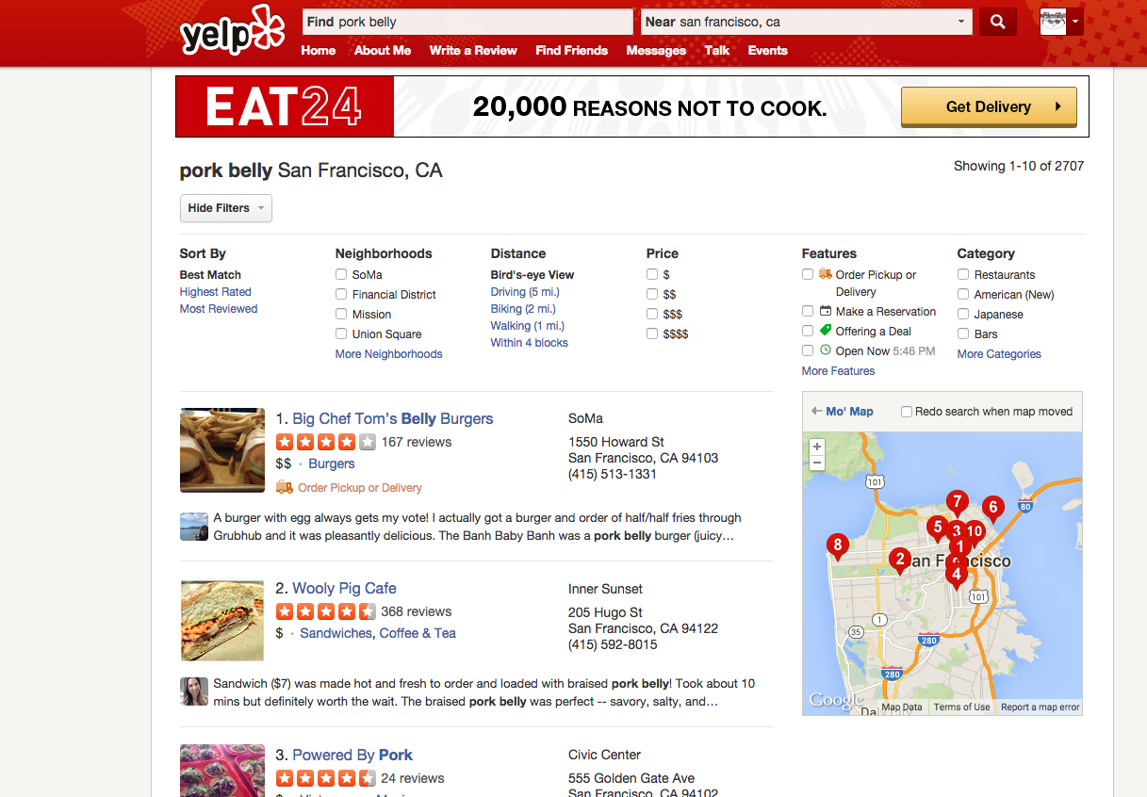
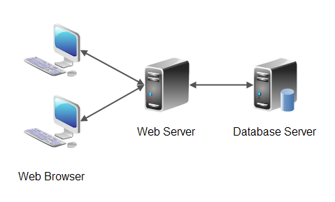
Project
Fully functional website

Slide 10
Scaling
Services
App
Server
Data
Client
Client
Services
Data
Client
Load balancing
App
Server
Client
Client
Data
App
Server
Services
Cache
Data
Queue

