Slide 1
DSD Overview
Sami Rollins

Slide 2
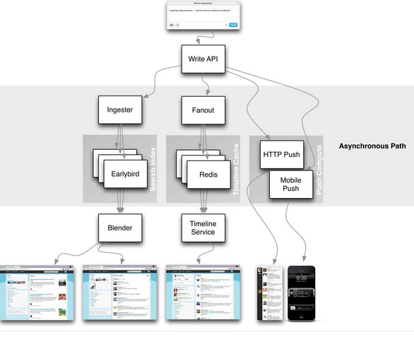
Why study distributed systems?
You use them everyday!
Scale is the name of the game
Distributed systems are complex
Understanding what is under the hood is important

Slide 3
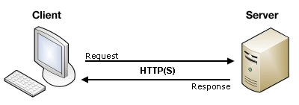
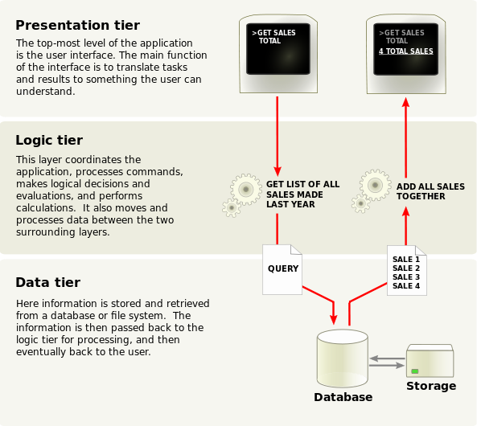
History lesson
Client/server or n-tier Architecture
Limited scalability
Database often a bottleneck

Slide 4
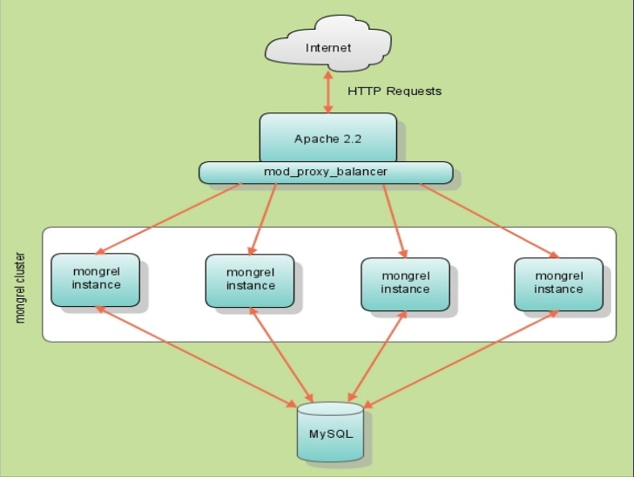
Twitter case study
Original Twitter architecture
Ruby on Rails
MySQL
1 server
2400 requests/second
Mongrel (web server)
Memcached

Slide 5
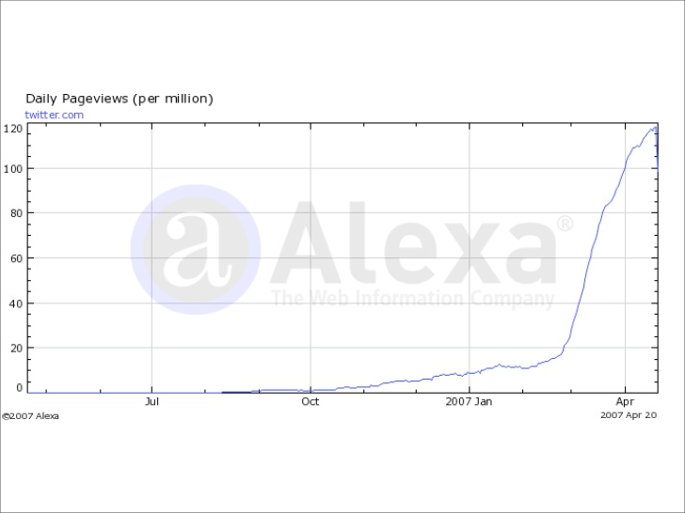
Twitter case study

Slide 6
Twitter case study
Optimize reads
insert
for each follower, insert new tweet in redis cache
Service-oriented architecture
System is a set of loosely coupled services

Slide 7
More history
Leslie Lamport
Turing Award winner 2013
http://research.microsoft.com/apps/video/default.aspx?id=210551
Common Object Request Broker Architecture (CORBA)
Java Remote Method Invocation (RMI)
Web Services
Simple Object Access Protocol (SOAP)
Representational State Transfer (REST)
Asynchronous Javascript and XML (AJAX)
JSON has become the more popular choice

Slide 8
Web services
Lab 1
Use Yelp and Twitter APIs
https://dev.twitter.com/docs/api/1.1
http://www.yelp.com/developers

Slide 9
Non-web distributed systems?
Twitter, Pinterest, Google, Etsy
All are web-based applications
What about other kinds of applications?
Characteristics
Concurrency
Independent failures
No global clock
Heterogeneity
High latency communication
System composed of computers spread over a large geographic area, maybe under different administrative domains

Slide 10
Other distributed systems
Peer-to-peer
File sharing/distribution
Gnutella?
Bit torrent
Others?
MMOG
DNS
CDNs
Akamai
Limelight
Netflix Open Connect

Slide 11
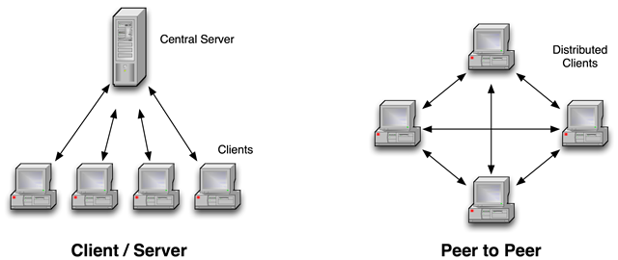
Architectures

Slide 12
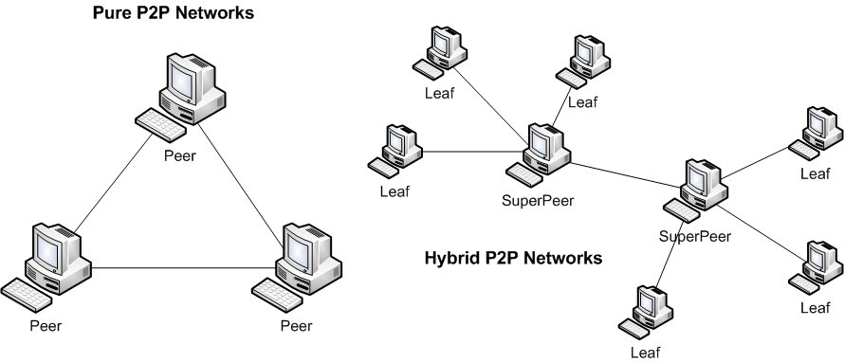
Architectures
Bit torrent - http://en.wikipedia.org/wiki/Peer-to-peer

Slide 13
Main challenges?
What do you think are the biggest challenges in building a distributed system?

Slide 14
Challenges
Heterogeneity
different networks, OSs, architectures
communication protocols must be carefully defined
Openness
Can new services/components be easily added?
Security
confidentiality, protection against corruption, resistant to attack
Scalability
tolerates increase in users and/or resources

Slide 15
Challenges
Failure handling
Can the system detect, mask, tolerate, recover from failures?
Concurrency
able to handle multiple requests simultaneously
Transparency
local and remote resources accessible in the same way

Slide 16
Some topics we’ll consider
Supporting concurrent operation
Time synchronization and event ordering
Coordination and coming to consensus
Replication
Transactions

