Slide 1
Principles of Software Development
Sami Rollins

Slide 2
Welcome to CS 601!
Learn to think like a software developer
Modular design
Reusable code
Problem solving
Foundations
Concurrency
Networking
Web and HTTP
Distributed topics

Slide 3

A practical approach
Learn by doing – build a user review web application!
Labs – practice fundamentals
Project – get creative!

Slide 4
Today
Introductions
Expectations
A bit of history
Java

Slide 5
Lab 1
Practice with data structures
write
YelpStore
Real Yelp data
users
businesses
reviews

Slide 6
Lab 2
More practice with data structures
read
YelpStore

Slide 7
Lab 3
Concurrency and multithreaded programming
read
write
YelpStore

Slide 8
Lab 4
Yelp Site
Yelp Web Service
Web clients
Screen scraper
Web service client
Internet
Screen Scraper
Web Service Client

Slide 9
Lab 5
HTTP Server
Using raw sockets!
HTTP Server
Internet
Browser

Slide 10
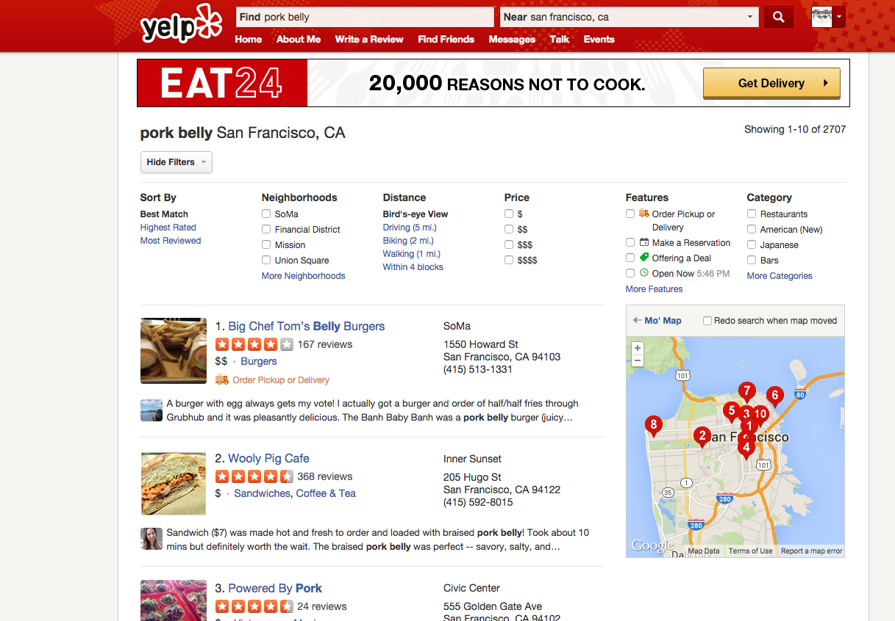
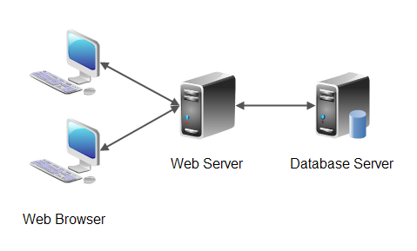
Project
Fully functional website

Slide 11
Scaling
Services
App
Server
Data
Client
Client
Services
Data
Client
Load balancing
App
Server
Client
Client
Data
App
Server
Services
Cache
Data
Queue

Slide 12
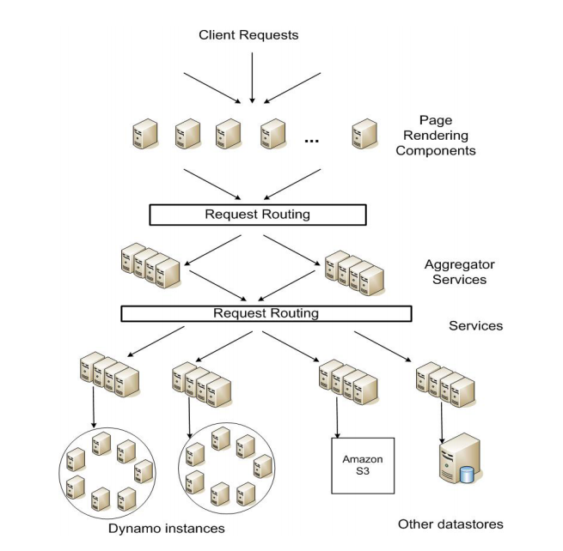
Amazon – Original SOA

Slide 13
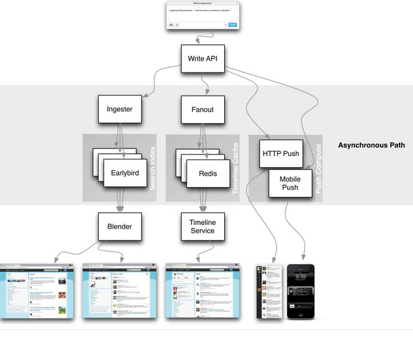
Twitter – Service Oriented Architecture (SOA)

Slide 14
Software Engineering
There are many examples of failed software projects
Affordable care act website
Therac-25 radiation therapy machine killed patients because of a bug
Software Engineering
Term coined in 1969. Discover more structured methods for building software.
Also see “Engineering Software as a Service: An Agile Approach Using Cloud Computing” by Fox and Patterson

Slide 15
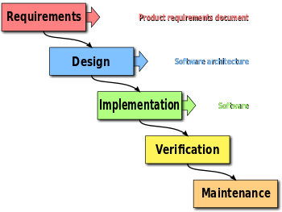
Waterfall – 1970s
Each phase happens once
Good for projects that require a lot of planning
NASA applications
“Plan to throw one [implementation] away; you will, anyhow.” -Fred Brooks, Jr.
Need user/client in the loop
Early prototypes

Slide 16
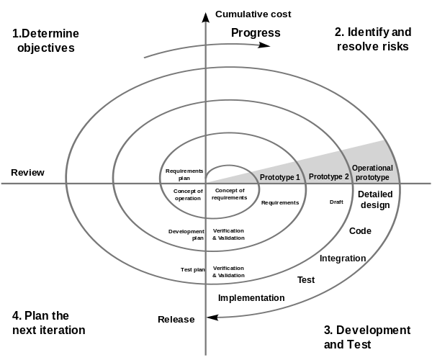
Spiral – 1980s
Develop prototypes
Consult client
Iterate
Iterations 6-24 months long

Slide 17
Rational Unified Process – 2003
Four phases
Inception
Elaboration
Construction
Transition
Each phase may have multiple iterations

Slide 18
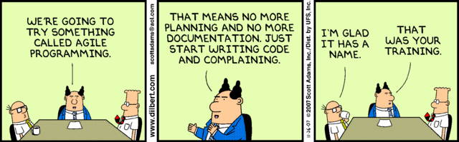
The Agile Manifesto – 2001
Individuals and interactions over processes and tools
Working software over comprehensive documentation
Customer collaboration over contract negotiation
Responding to change over following a plan

Slide 19
Exercise
Identify the ten applications you think are most important.
For each, do you think agile would be an appropriate software development methodology?

