Slide 1
Feb 07th 2013
Awesome Alphabet
BU Project – MET CS 673 W4
Professor Yuting Zhang
Team:
Vivek Goyal
Michael Grant
Mark Musante
Levi Puot Paul
Jaleel Kazi

Slide 2
Overview
Educational application designed to help 4-6 year old children learn the English alphabet.
Developed in stages following an Agile approach:
Feb 28th : Iteration 1
March 28th : Iteration 2
May 2nd : Iteration 3

Slide 3
Functional Requirements
Mandatory Features:
An alphabet page where the child can select a letter to learn about.
A picture will be shown and a sound will be played whenever a letter is shown. For example, for the letter ‘C’, an image of a cat may appear and the child will hear “Cat begins with a ‘C’”.
Multiple sounds and images for each letter. A child can click a button on the letter page to see and hear additional pictures and sounds for that letter.

Slide 4
Functional Requirements
Anticipated Features:
The ability for a parent to upload custom pictures and sounds to associate with letters.
Different themes when presenting letters (i.e. animals, transportation, etc.).
A game to test the child’s knowledge. In this game, the child will see a picture and hear a word and will need to select the letter that the word begins with. The game may use the currently selected theme (if available).

Slide 5
Functional Requirements
Desired Features:
A slideshow of the alphabet. Each letter will be shown for 5 seconds.
Monitoring of the child’s progress.
Multiple user accounts for multiple children.
A password system to prevent children from accessing parental features.
The ability for the parent to configure the application’s appearance.

Slide 6
Nonfunctional Requirements
Interface
Performance
Reliability
Constraints
Security
Portability
Error Handling

Slide 7
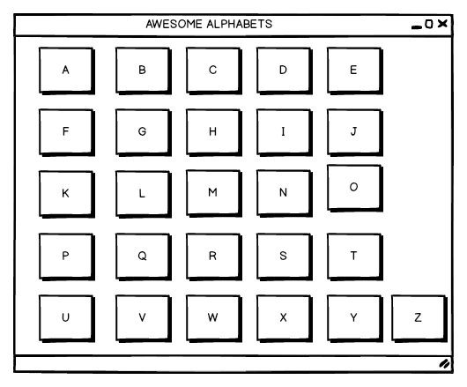
Sample Alphabet Page

Slide 8
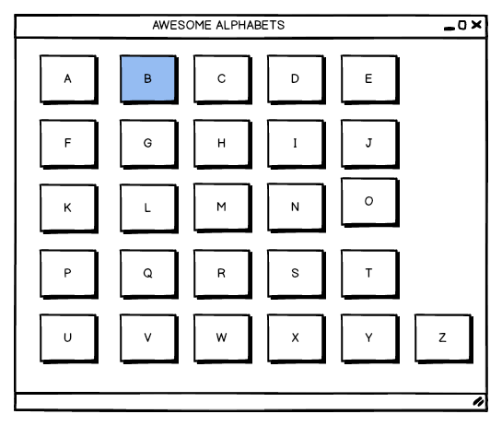
Selecting a Letter in the Alphabet Page

Slide 9
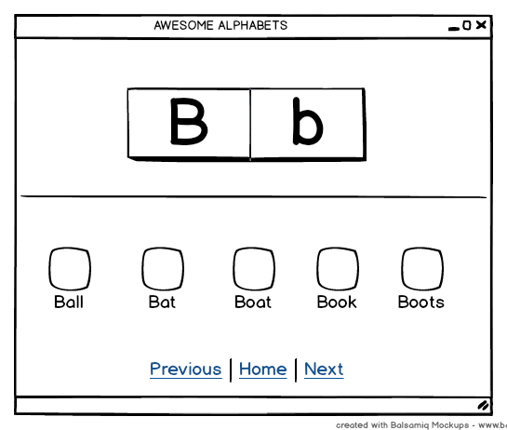
Sample Letter Page

Slide 10
Project Organization
Project Leader - Mark Musante
Backup Project Leader - Michael Grant
Configuration Leader - Michael Grant
Environment and Integration - Levi Paul
Requirements Leader - Vivek Goyal
Design Leader - Jaleel Kazi
Implementation Leader - Jaleel Kazi
Testing Leader - Levi Paul
Documentation - Mark Musante

Slide 11
Risk Management
# | Risk Title | Likelihood of occurrence (1-10) L | Impact (1-10) I | Retirement cost | Priority (11-L)* (11-I)*R | Mitigation plan | Responsible engineer | Target Completion date
1 | Sounds | 5 | 8 | 4 | (11-5)* (11-8)*4 = 72 | Learn Java Sound lib | Levi Paul | Feb 21
2 | Graphics | 4 | 8 | 3 | (11-4)* (11-8)*3 =63 | Learn Java Graphics lib | Jaleel Kazi | Feb 21
3 | Database | 3 | 8 | 2 | (11-3)* (11-8)*2 =48 | Learn Java DB | Levi Paul | Feb 21

Slide 12
Project Tools
PivotalTracker
Git, GitHub, EGit
Google Drive
Ant/Maven
Emma
PMD, FindBugs, CodePro AnalytiX
UML
JavaRefactor
JUnit
Log4J
MyBatis
JavaDoc
Skype

Slide 13
Deliverables
Source Code
Project Proposal
Software Quality Assurance Plan (SQAP)
Software Project Management Plan (SPMP)
Software Configuration Management Plan (SCMP)
Software Requirements Specification (SRS)
Software Design Document (SDD)
Software Test Document (STD)
User’s Manual
Maintenance Plan
Software Validation and Verification Plan (SVVP)
Project Presentations

Slide 14
Conclusion
Use Good Software Design Practices
Have On-time, Error-Free, and High-Quality Product Deliveries
Make Awesome Alphabet a Feature-Rich, Fun and Engaging Application

Slide 15
Thank You!

