Slide 1
March 6, 2013
Awesome Alphabet - Iteration 2
BU Project – MET CS 673 W4
Professor Yuting Zhang
Team:
Vivek Goyal
Michael Grant
Mark Musante
Levi Puot Paul
Jaleel Kazi

Slide 2
Overview
The Iteration 2 software developed between March 1st and March 27th.
Approximately 4 weeks in duration.

Slide 3
Requirements
Iteration 2 Requirements Included:
Adding ability to add, delete, and modify words.
Modifications include the ability change the sound, picture, theme, and word spelling.
Adding support for themes.
Adding, deleting, and modifying themes.
Associating words with themes.
Only show words based on currently selected theme.
Adding ability to configure application's behavior.
Show words on letter page randomly or in order.
Limit the number of different words shown for each letter.

Slide 4
Implementation Tasks
Added a Database class to create and provide communication with the database.
Created model classes for themes.
Updated existing Letter, WordPictureSound, and Alphabet model classes.
Added support for themes.
Added support for adding/modifying/deleting words.
Added new views to configure words, themes, and other options.
Added controllers to connect new views to models.
Updated existing controllers as necessary.
Added and updated unit tests.
Updated management of property files.

Slide 5
Design Patterns and Architectures
Continued use of Model-View-Controller architecture.
Observer pattern used as part of MVC setup and in other places where changes to the model need to be observed.
Singleton pattern is currently being used for the Database class.

Slide 6
UML Class Diagram
Diagram is on next slide.
To improve clarity, some lines have been consolidated and originate from parent classes instead of multiple subclasses. In addition, functions and member variables are not shown.

Slide 7
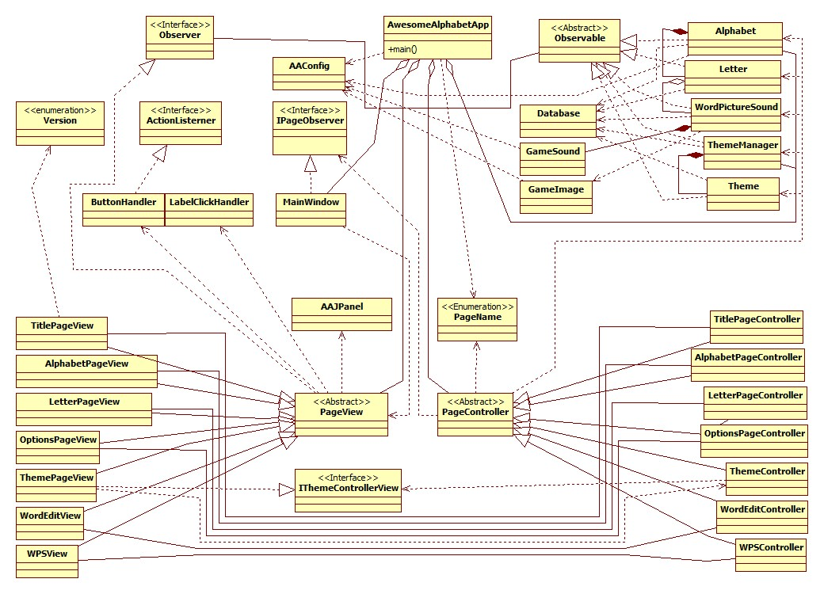

Slide 8
New Tools
EasyMock
Mocking framework to allow isolation to classes for unit testing.
SQLite
Lightweight Database Management System (DBMS) used to create and manage our database.

Slide 9
Documentation Updates
The following documents have been updated to reflect changes made in iterations 1 and 2:
Project Proposal
SQAP
SPMP
SDD
These changes include:
Updated tool and document lists.
Updated text discussing functionality, non-functional requirements, processes, and implementation.
Made other corrections and changes as needed.

Slide 10
Documentation Updates
In addition, the following documents were updated to match the Iteration 2 code implementation:
Javadoc
UML Diagram

Slide 11
Distribution of Major Tasks
Mike
Updated Project Proposal, SDD, and UML diagram.
Created theme models and controllers.
Created Database class, updated database schema, and created SQL queries.
Mark
Updated SPMP
Created Options, Theme Management, and Word Management views.
Created controllers for managing words and options.
Updated property file management.

Slide 12
Distribution of Major Tasks
Vivek
Updated classes related to words (i.e. Letter, Alphabet, WordPictureSound).
Created backup implementation of word management using properties file instead of database.
Prepared initial interface document for iteration 2.
Jaleel
Researched database and provided draft schema and example code that was used to help develop Database class.
Updated SQAP.
Levi
Updated test classes and added new tests.

Slide 13
Completed Functionality
Adding ability to add, delete, and modify words.
Modifications include the ability change the sound, picture, theme, and word spelling.
Adding support for themes.
Adding, deleting, and modifying themes.
Associating words with themes.
Only show words based on currently selected theme.

Slide 14
Tasks for Iteration 3
Adding ability to configure application's behavior.
Show words on letter page randomly or in order.
Limit the number of different words shown for each letter.
Improving user interface.
Cleaning up code.
New requirements to be determined.
Iteration 3 will end on April 25th, 2013 or May 2nd, 2013

Slide 15
Application Demonstration

Slide 16
The End

