Slide 1
COMPUTER SCIENCE PROJECT II-CS692
CLASS NAVIGATOR GUIDANCE BY-PROF HENRY WONG
Our GitHub Link-
https://github.com/CS691team3/CS691team3project
Our Wiki page link-
https://github.com/CS691team3/CS691team3project/wiki
Team Members
1. Shivam Mattoo
2. Ameya Kherodkar
3. Chinmay Joshi
4. Kenneth Okereke
5. Ashutosh Misar

Slide 2
Introduction
Class navigator is an app which will navigate students ,faculty, visitors to their respective destinations in university campus
It navigates users within the school facility using certain images
It will be the cross platform mobile application
This app will provide elegant, aesthetically pleasing panoramic tour to our university

Slide 3

Sprints
Sprint 1
UI development and Gathering images and Videos
Sprint 2
Extracting Images from Videos Training Image set, Application development
Sprint 3
Backend Implementation and User Experience
Integration testing and Project deployment
Sprint 4

Slide 4
SPRINT 2
Extracting Images from Videos for our Project to train dataset.
Start Application Development(Initial Phase) for both iOS and Android.

Slide 5

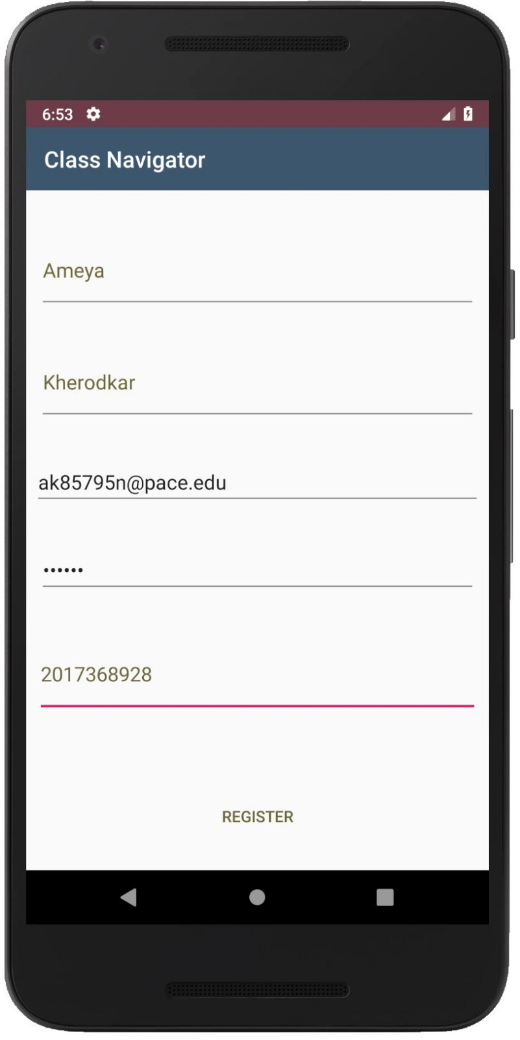
USER STORY USER STORY: 1 Sign-Up Module | Completed As a First time user I must be able to successfully signup for the application
ACCEPTANCE CRITERIA
Enter Valid Username Enter valid Email Enter valid Password Enter valid Contact Number

Slide 6
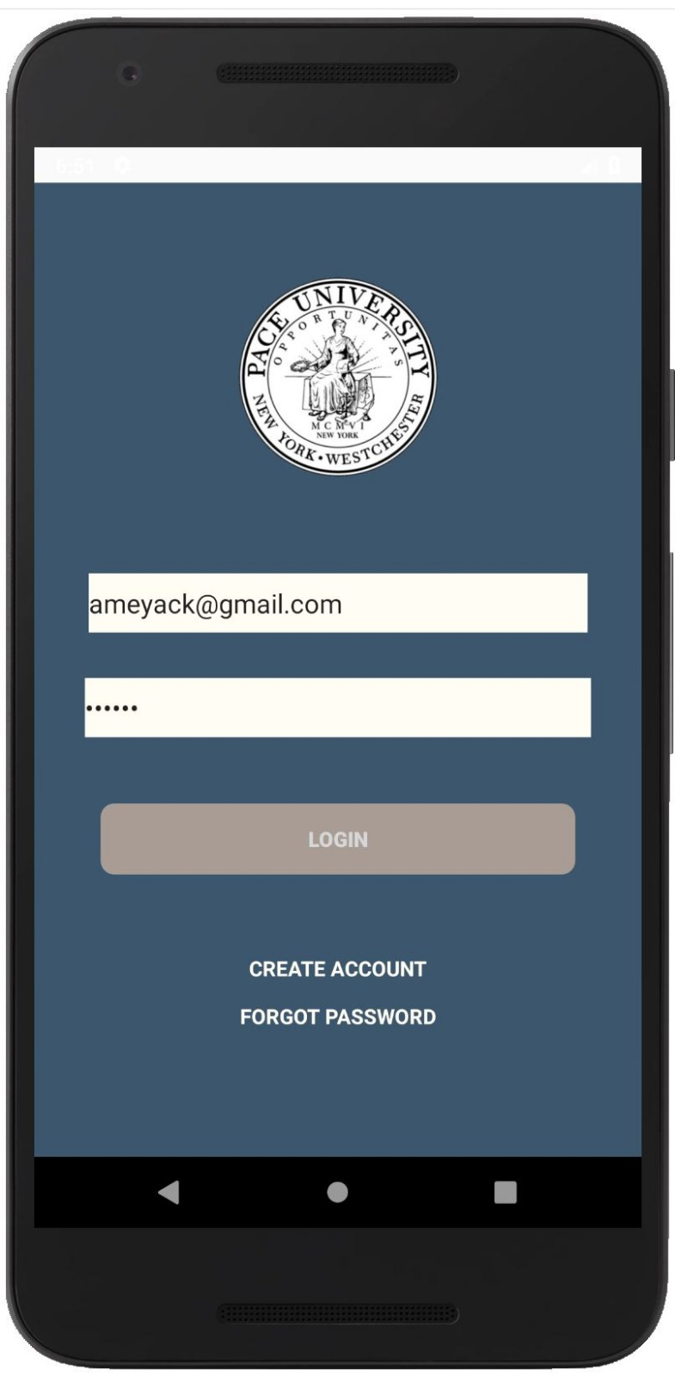
. User Story: 2 Login Module | Completed As a Valid user I must be able to successfully login into the Application
ACCEPTANCE CRITERIA
Login with valid Username/Email Enter valid Password Login

Slide 7
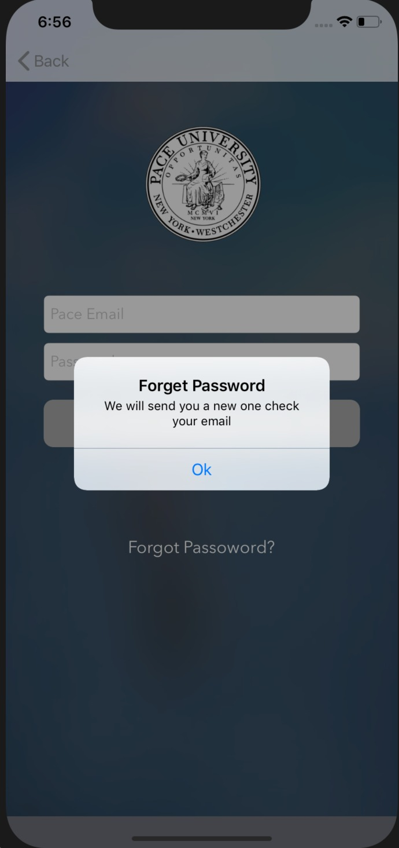
User Story: 3 Forgot password Module | Completed As a Valid user I must be able to successfully retrieve my password from forgot password menu.
ACCEPTANCE CRITERIA
Valid Username/Email Submit

Slide 8
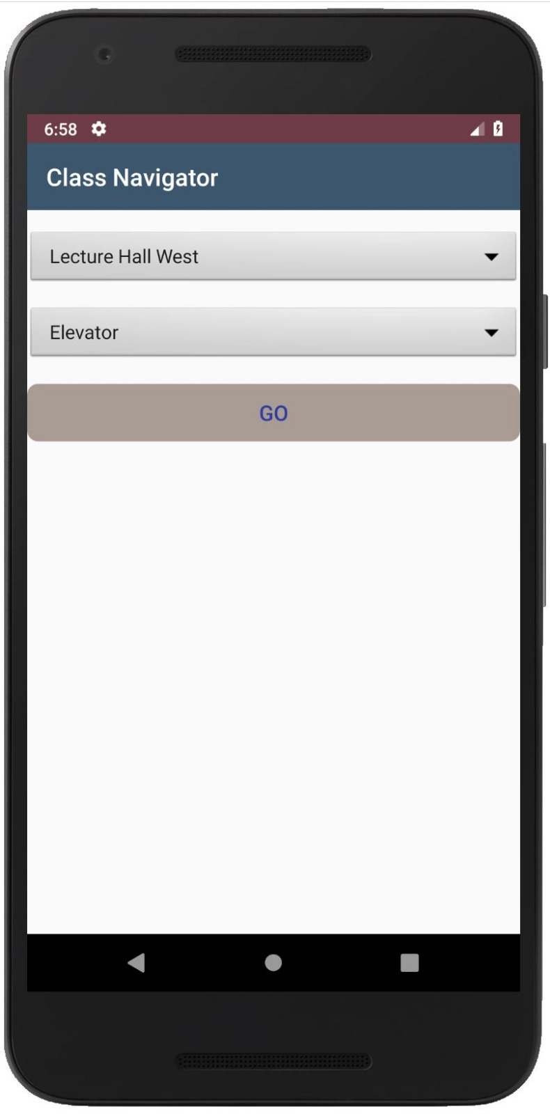
User Story: 4 Search Module | INComplete As a Valid user I must able to successfully reach to destination from source/ start location
ACCEPTANCE CRITERIA
Valid source location Valid destination location

Slide 9
Test Cases
Test Case Id | Test case Name | Test case description | Output
1. | User Registration/signup | New Users click on signup to be redirected to signup page | Users get redirected to signup page
2. | Creating Account | User enters account information like name, email, phone number, username and password | Signup complete
3. | Phone number | User enters numbers | Phone number accepted
4. | Phone number | User enters characters | Please enter a valid phone number
5. | Password | User enters a password less than 6 digits | Please enter a password 6 digits or greater
6. | Login | User enters correct username and password | Login successful user gets redirected to his account

Slide 10
Test Cases
Test Case Id | Test case Name | Test case description | Output
7. | Login | User enters incorrect username or password | Login failed please try again
8. | Search | User clicks on the search button | Camera Opens
9. | Log out | User selects log out | Successfully logged out redirected to login page

Slide 11
Steps we use to extract images from videos
Video fisheye distortion correction for all videos, and convert video format to 480p@30fps
Extract images from all frames of the video and rescale to 256×256;
Remove low quality images with blur indicator less than 0.45
Randomly split the dataset into two: 300 images from each category as validation dataset, and use the rest as training dataset

Slide 12
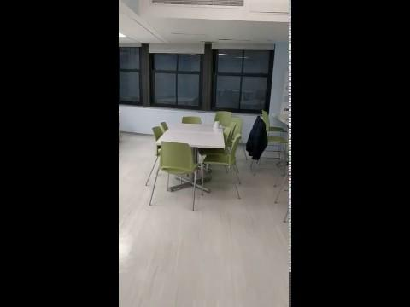
Sample Video to extract images

Slide 13
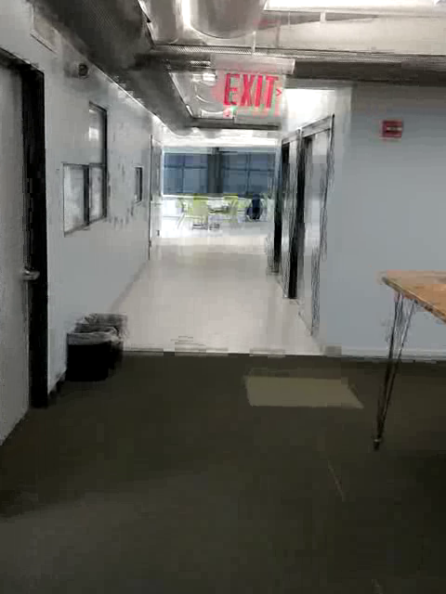
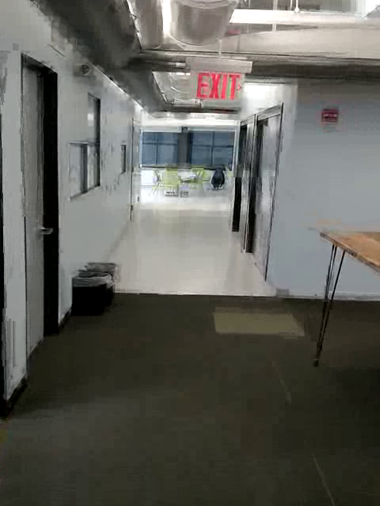
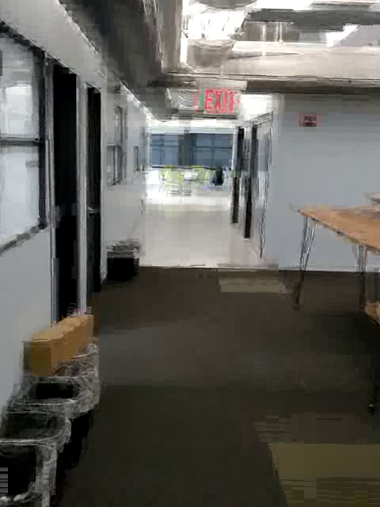
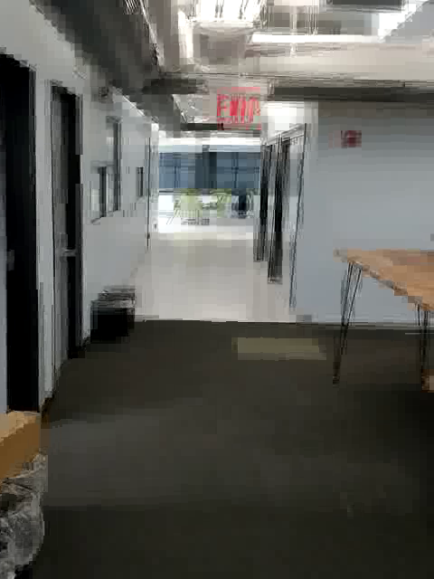
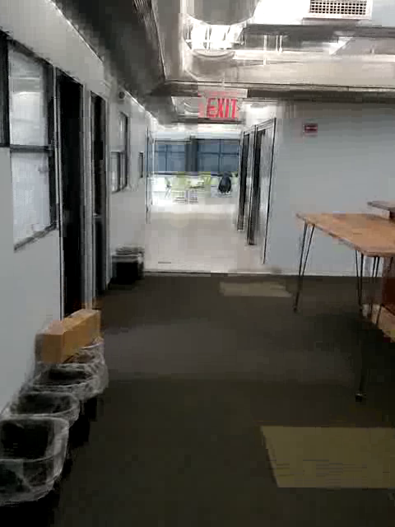
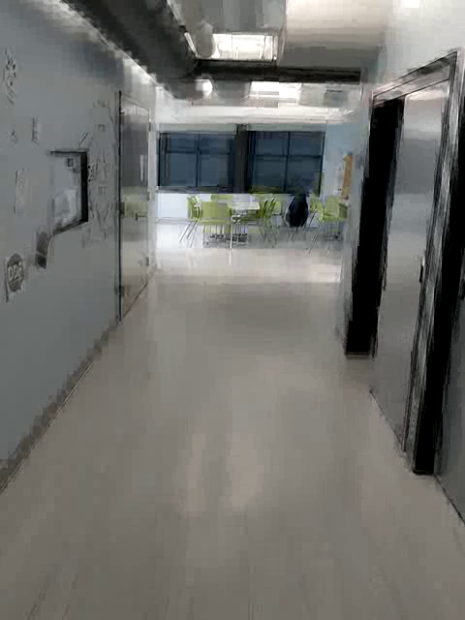
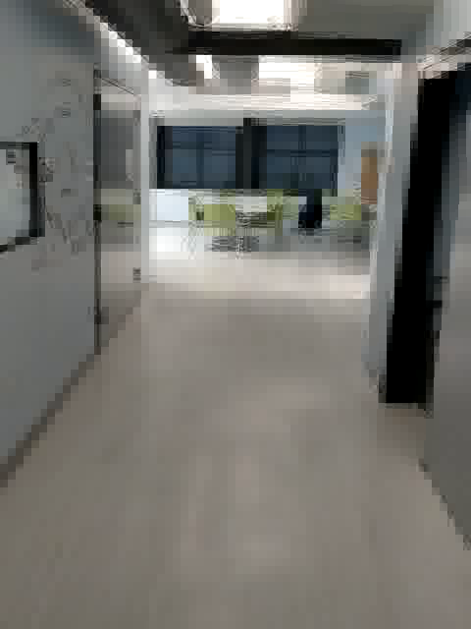
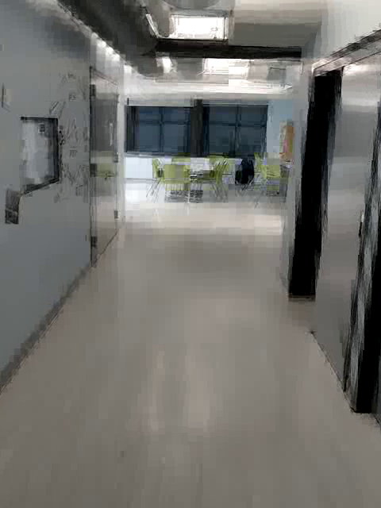
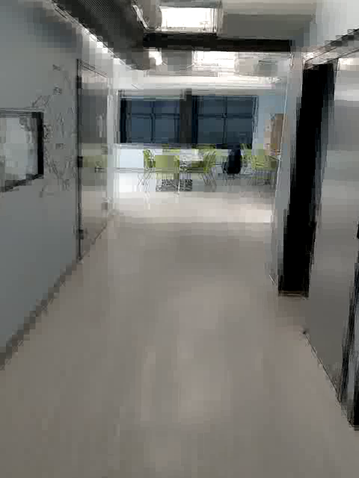
Sample Images Extracted and labeled
Kitchen 01 - 05
Kitchen 06- 09

Slide 14
Architecture Diagram
Training Phase
Deep Convolutional Neural Network
extract
Images with label
training
Videos
Service Phase
Room level model for level area recognition
Sent
Input Photo
to model

Slide 15
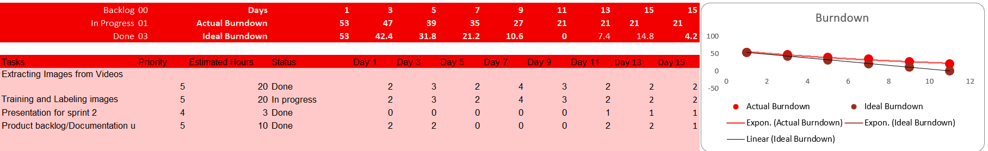
Burn Down Chart (SPRINT1)

Slide 16
Upcoming Implementation
Designing our DCNN model to interpret and recognize interior space.
Creating Backend for our Application
Integration Testing and project deployment

Slide 17
THANK YOU

