Slide 1
QuickPolls Poll Management Application
Final Project – Group 7
Surya Sreepada, CS7319, Off Campus, Team Leader
David G. Smith, CS7319, On Campus
Akhil Kumar Reddy Alavala, CS7319, Off Campus

Slide 2
Project Description - QuickPolls
Objective: The objective of the QuickPolls project is to develop an online poll management web application that allows users to create, participate in, and manage polls with real-time results. The project aims to deliver a user-friendly platform with features like simple email authentication, poll creation, and live results, catering to poll creators and participants for an interactive polling experience
Capabilities
User Authentication: A simple authentication system that allows users to log in by providing an email address, where a One-Time Passcode (OTP) is sent for verification.
Poll Creation: Users can create polls by defining a question, specifying multiple-choice options, and setting a duration for each poll.
Poll Participation: Users can browse through available polls and participate by selecting one of the provided options.
Real-Time Results Display: The application displays real-time poll results, showing the percentage of votes for each option, allowing users to see instant feedback after voting.
Poll Management: A poll management interface enables users to view, edit, or delete polls they have created, providing complete control over their polls
Operational Process
Security: Users can register and login using email and a passcode is generated for each login. No need to store or compare passwords.
Poll Participation and Management: Users can manage the polls (Create, Edit, Delete) and participate in any active poll.
Real-Time Results Display: The poll results are displayed to the users in real-time or near real-time based on the architectural style.

Slide 3
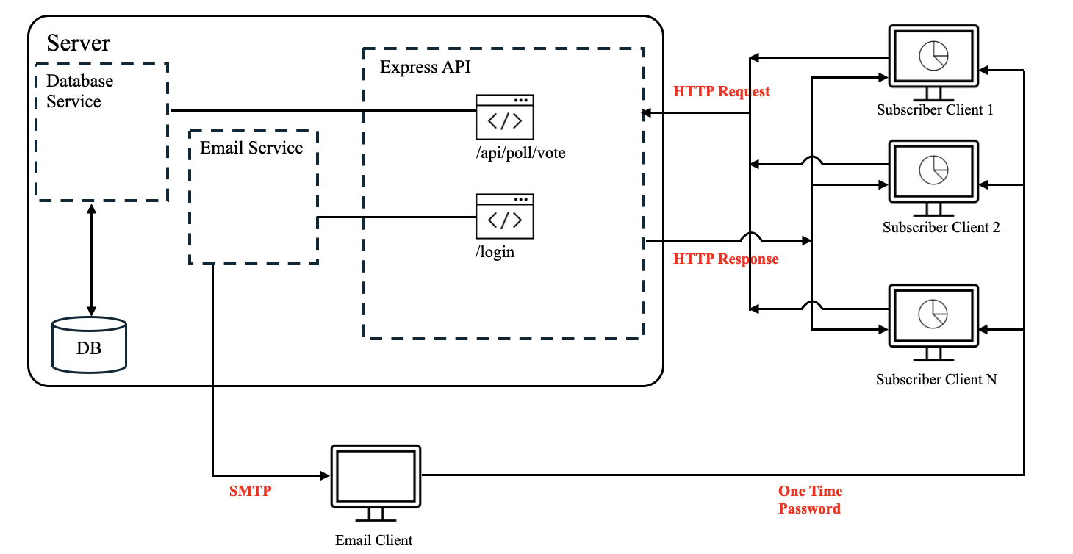
Architecture Option 1: Client-Server Level 2 Architecture

Slide 4
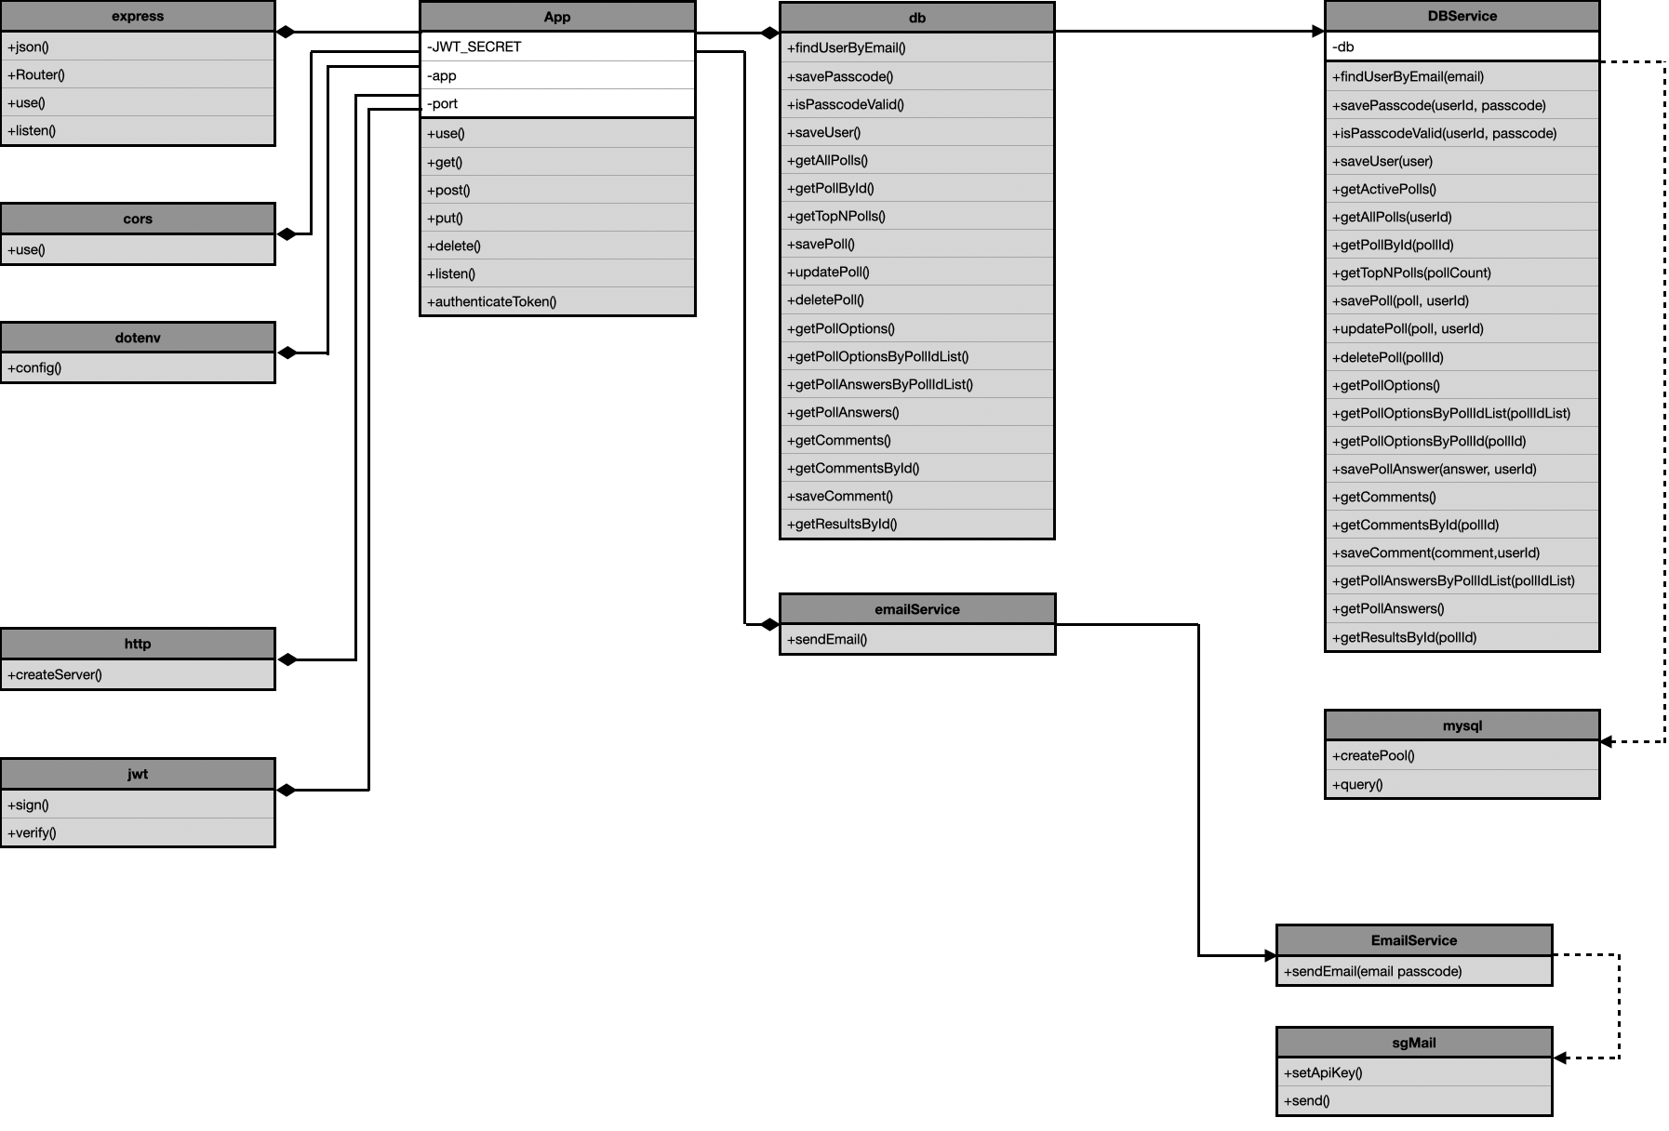
Architecture Option 1: Client-Server UML (Class)Diagram

Slide 5
Architecture Option 1: Client-Server Component-Connector Map
Components
Express API
Email Service
Database Service
sgMail
express
cors
dotenv
http
jwt
Connectors
db
emailService
Components
app.js
email-service.js
db.js
sgMail
express
cors
dotenv
http
jwt
Connectors
db
emailService

Slide 6




Architecture Option 2: Publisher-Subscriber Level 2 Architecture
Server
Notification Msg
Express API
RabbitMQ (Using AMQP)
Subscriber Client 1
Fanout Exchange
Notification Msg
Vote for a Poll
Publish
/api/poll/vote
Subscriber Queue
Subscriber Client 2
Client A
DB
Subscriber Queue
Notification Msg
Subscriber Client N

Slide 7
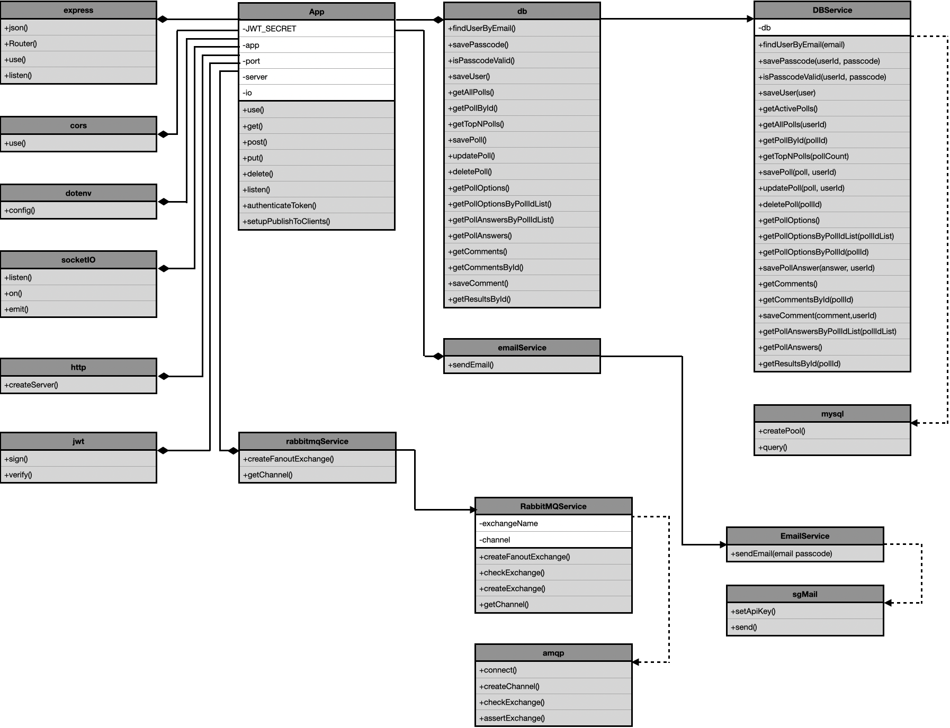
Architecture Option 2: Publisher-Subscriber UML (Class)Diagram

Slide 8
Architecture Option 2: Publisher-Subscriber Component-Connector Map
Components
Express API
Email Service
Database Service
RabbitMQService
sgMail
express
cors
dotenv
jwt
Connectors
http
socket
amqp
db
emailService
rabbitmqService
Components
app.js
email-service.js
db.js
rabbitmq.js
sgMail
express
cors
dotenv
jwt
Connectors
http
socket
amqp
db
emailService
rabbitmqService

Slide 9
Architecture Option 1: Client-Server Compare & Evaluate
Pros
Centralization: With a centralized server, as all essential data is managed in one place, data security and user authentication are streamlined making it easier to resolve network-wide issues from a single location.
Scalability: Client-server networks are highly scalable, allowing easy addition of servers, or PCs, which can expand without major downtime or disruptions.
Easy Management: Managing data is straightforward in a client-server setup since all data is stored centrally, providing efficient access and streamlined record-keeping.
Accessibility: In a client-server system, nodes function independently by requesting data from the server, simplifying upgrades, replacements, and relocations.
Data Security: The centralized architecture ensures robust data protection, allowing controlled access through credentials and easy data recovery from a single backup in case of loss.
Cons
Network Traffic Congestion: A primary drawback is the risk of system overload when resources are insufficient to handle all client requests, potentially leading to connection failures or slowdowns during high traffic or network outages, which could critically impact large businesses.
High Cost: Setting up and maintaining a client-server network can be costly, as powerful servers are often expensive to purchase and manage, making this model less affordable for all users.
Robustness: Client-server networks are centralized, meaning any failure or disruption to the primary server can halt the entire network, compromising overall resilience.
Maintenance Difficulty: Servers in a client-server network require continuous operation and immediate attention for any errors, necessitating skilled network managers to provide ongoing maintenance and rapid issue resolution.

Slide 10
Architecture Option 2: Publisher-Subscriber Compare & Evaluate
Pros
Loose Coupling: Publishers operate independently of subscribers, without needing to know their number, topics, or functionality, enabling separate development without concerns about state, ripple effects, or implementation.
Scalability: While PubSub systems can scale to support multiple components, they may struggle under high loads.
Cleaner Design: PubSub encourages thoughtful planning of component interactions, resulting in a cleaner design focused on decoupling and simplicity.
Flexibility: With PubSub, the only requirement is that components adhere to their designated roles (publisher or subscriber), without needing to consider their internal workings.
Easy Testing: Identifying if a publisher or subscriber receives incorrect messages is straightforward, simplifying testing and debugging.
Cons
Uncertain Message Delivery: Without feedback from the broker, there is no way to confirm if messages were successfully delivered or failed, making tighter coupling necessary to ensure reliability.
Lack of Mutual Awareness: Publishers and subscribers operate without knowledge of each other’s status, making it impossible to confirm the other party’s operational health.
Load Sensitivity: As the number of publishers and subscribers grows, the increased message traffic can strain the system, leading to potential instability under high loads.
Security Risks: Malicious publishers could infiltrate the system, publishing unauthorized messages that subscribers might access inappropriately.
Difficult Update Coordination: Managing updates between subscribers and publishers is challenging since they operate independently and lack direct knowledge of each other.

Slide 11
Selected: Publisher-Subscriber Architecture
Proposed Selection: Client-Server Architecture
Selected for its simplicity and centralized control, ensuring ease of implementation and maintenance.
Provided straightforward management of security through a centralized architecture.
Aligned well with initial requirements for a small-scale system with no need for real-time updates.
Final Selection: Publisher-Subscriber Architecture
Real-time updates for poll results became critical, which the Client-Server model could not handle efficiently.
The event-driven model of Pub-Sub provided instant updates, reducing traffic caused by constant polling.
Offered better scalability to support a growing user base by distributing workload through a message broker.
The loosely coupled nature of Pub-Sub improved flexibility and simplified management of complex components.
Delivered an enhanced user experience with seamless real-time interaction, making it the optimal choice.

Slide 12
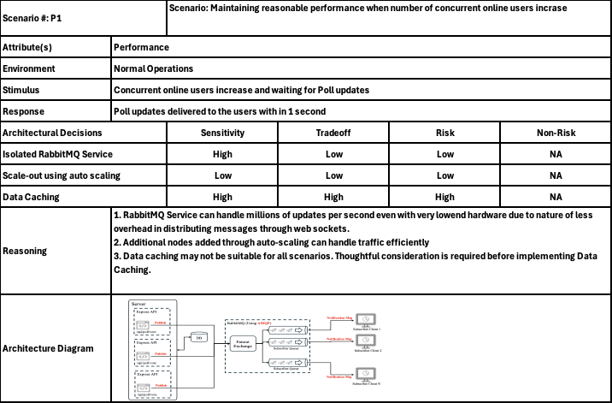
Risk Analysis - Performance Scenario Assessment (ATAM)

Slide 13
Risk Analysis - Performance Scenario Assessment (ATAM)
Architectural Risks
In Client-Server architecture, the server can become a bottleneck as it handles all client requests directly, leading to degraded performance during high traffic.
Pub-Sub architecture mitigates this risk by using a message broker to distribute workload, decoupling publishers from subscribers and reducing server strain.
Additionally, the loosely coupled nature of Pub-Sub allows for better fault tolerance and scalability, minimizing the impact of component failures.
The performance implications of Client-Service architecture with the unnecessary traffic to check for latest poll updates can be drastically reduced by the message broker in Publisher-Subscriber architecture
Quantitative Analysis
Performance observations show that Pub-Sub systems handle significantly higher throughput, as the broker efficiently routes messages to multiple subscribers simultaneously.
Latency in Pub-Sub is reduced since updates are pushed to clients in real-time, compared to frequent polling in Client-Server setups
In high-traffic scenarios, Pub-Sub systems exhibit better resource utilization and handle a larger number of concurrent users without performance degradation.
Qualitative Analysis
Pub-Sub architecture provides a more responsive user experience by ensuring instant updates, especially in real-time applications like QuickPolls.
The decoupled communication model in Pub-Sub makes the system more scalable and adaptable to dynamic load changes, which is critical for growing user bases.
It aligns better with modern, event-driven requirements, offering enhanced flexibility and maintainability compared to the rigid Client-Server approach.

Slide 14
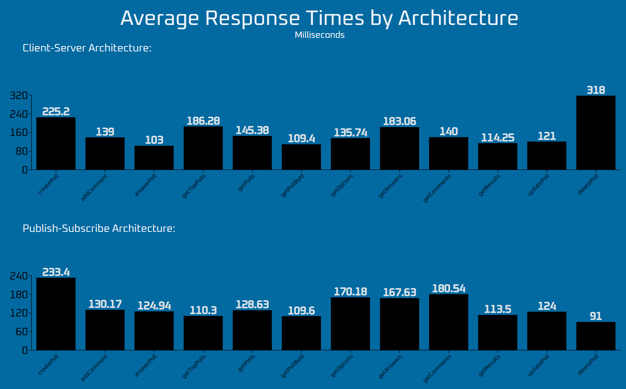
Risk Analysis - Performance More details

Slide 15
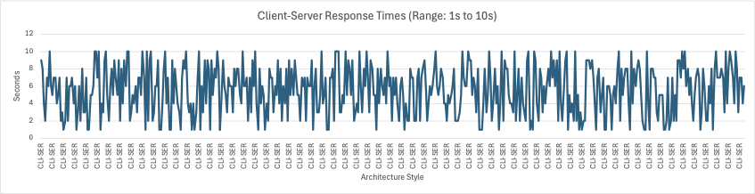
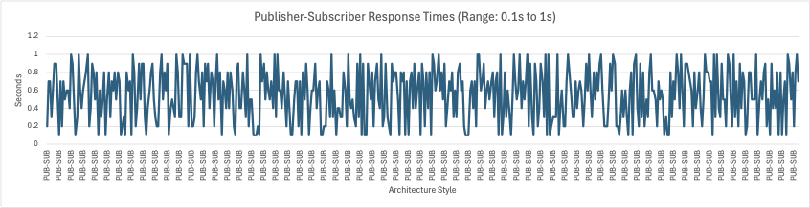
Risk Analysis - Performance More details

Slide 16
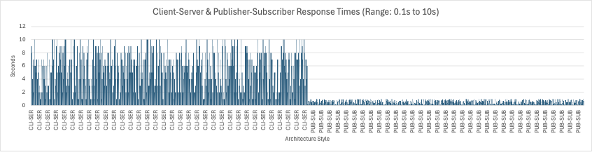
Risk Analysis - Performance More details

Slide 17
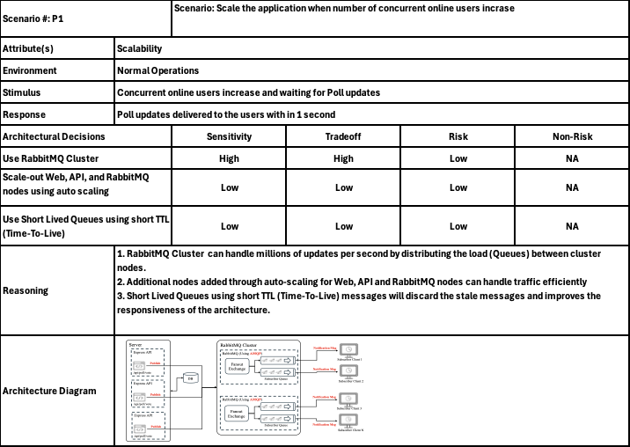
Risk Analysis - Scalability Scenario Assessment (ATAM)

Slide 18
Risk Analysis - Scalability Scenario Assessment (ATAM)
Architectural Risks
In Client-Server architecture, the server can quickly become overwhelmed as the number of concurrent users increases, leading to system failures or degraded performance
Pub-Sub architecture mitigates this risk by offloading message handling to a distributed message broker like RabbitMQ, which can efficiently manage increased traffic through clustering
The decoupled communication model in Pub-Sub ensures scalability by allowing independent scaling of publishers, subscribers, and the message broker
Pub-Sub reduces the risk of bottlenecks as messages are distributed to multiple subscribers without server overload
Using features like short-lived queues and auto-scaling further reduces the risk of stale data or performance bottlenecks in high-demand scenarios.
Quantitative Analysis
Though we were not able to perform scalability tests, Pub-Sub system with RabbitMQ can handle millions of messages per second by distributing the load across multiple cluster nodes.
Auto-scaling Web, API, and RabbitMQ nodes in a Pub-Sub system ensures linear scalability, maintaining performance as the user base grows
With short-lived queues, stale messages are automatically discarded, improving system responsiveness even with increased concurrent users
Qualitative Analysis
Pub-Sub architecture is inherently more scalable as it decouples communication, enabling each component to be scaled independently based on load
RabbitMQ clusters ensure efficient distribution of tasks, making it easier to handle spikes in user activity without performance degradation
Even though scaling the Client-Server architecture is much easier,
the unnecessary traffic for poll update checks can still be a bottleneck.

Slide 19
Risk analysis
Pros
Making Informed Decisions: By being aware of possible hazards businesses can balance opportunities and related risks to make well-informed decisions.
Better Planning: Being aware of possible hazards enables the creation of backup plans and risk-reaction techniques, which boost readiness and adaptability.
Resource optimization makes the best use of time and money by identifying and prioritizing risks, which makes it possible to allocate resources to areas that need the most attention.
Business Growth: Organizations can more boldly pursue opportunities by incorporating risk management into strategic planning and business development when they have a clear understanding of potential risks
Cons
Resource-intensive: It may take a lot of time and money to do thorough risk analysis, as well as a large number of human resources.
Complexity: Risk management is a multifaceted process that includes identifying, evaluating, and reducing risks across the board for a business. This intricacy can be too much for management to handle and be resource-intensive.
Possibility of Bias: Subjectivity and biases can affect the development of a Risk Breakdown Structure (RBS), which could change how hazards are perceived. Because it may affect the precision and efficacy of the risk management plan, this potential for bias is a serious drawback.
Some risk assessment methods may oversimplify complicated problems, which could result in a lack of comprehension and effective mitigation techniques.

Slide 20
References
[1] Client-server architecture. (n.d.-a). https://cs.uwaterloo.ca/~m2nagapp/courses/CS446/1195/Arch_Design_Activity/ClientServer.pdf
[2] Google. (n.d.). Architectural overview of pub/sub | Pub/Sub Documentation | google cloud. Google. https://cloud.google.com/pubsub/architecture
[3] Olamendy, J. (2011, August 12). Evaluate the software architecture using Atam. JC Olamendy’s Thoughts. https://johnolamendy.wordpress.com/2011/08/12/evaluate-the-software-architecture-using-atam/
[4] RobBagby. (n.d.). Publisher-subscriber pattern - azure architecture center. Azure Architecture Center | Microsoft Learn. https://learn.microsoft.com/en-us/azure/architecture/patterns/publisher-subscriber
[5] Terra, J. (2024, July 23). What is client-server architecture? everything you should know: Simplilearn. Simplilearn.com. https://www.simplilearn.com/what-is-client-server-architecture-article
[6] What is pub sub? - pub/sub messaging explained - AWS. (n.d.-b). https://aws.amazon.com/what-is/pub-sub-messaging/
[7] What is pub/sub? the publish/subscribe model explained. Ably Realtime. (n.d.). https://ably.com/topic/pub-sub
[8] Wikimedia Foundation. (2024a, October 2). Publish–subscribe pattern. Wikipedia. https://en.wikipedia.org/wiki/Publish%E2%80%93subscribe_pattern
[9] Wikimedia Foundation. (2024b, November 8). Client–server model. Wikipedia. https://en.wikipedia.org/wiki/Client%E2%80%93server_model
[10] R. N. Taylor, N. Medvidovic, E. M. Dashofy, Software Architecture Foundation, Theory, and Practice, 10th Edition., Hoboken, New Jersey: John Wiley & Sons, Inc.2010, pp. 108-109, 118-120. (course textbook)

Slide 21
Demo

Slide 22
Thank You

