Slide 1

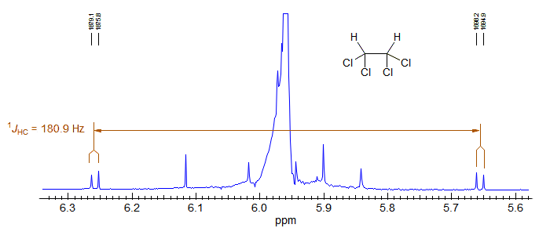
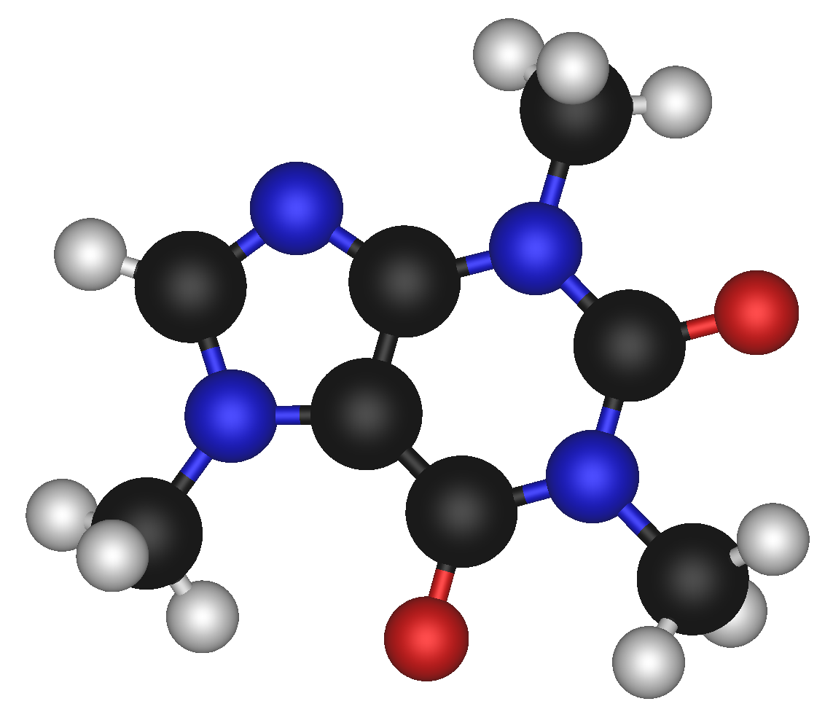



Prediction of One Bond Coupling Constants
1JCH
V Chandrasekhar Nainala

Slide 2
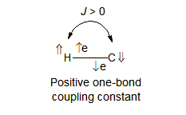
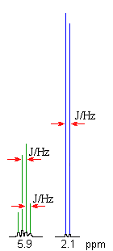
Coupling Constants
Magnetic interaction (coupling) between nuclei (A and X) with a non-zero spin perturbs (polarizes) the spins of the intervening electrons, and the energy levels of neighboring magnetic nuclei are in turn perturbed by the polarized electrons.
Spin–Spin splitting :
Splitting of the NMR peaks in to 2, 3, 4, 5, etc. (doublet, triplet, quartet, quintet, etc.)
Distance between peaks in a multiplet is called the Coupling Constant, J.
Coupling between ¹³C and ¹H, are separated from each other by 100-300 Hz.
(i.e., separated from the central peak by 50-150 Hz).
Notes:
This leads to a lowering of the energy of the neighboring nucleus when the perturbing nucleus has one spin, and a raising of the energy when it has the other spin. Hence frequency of nearby nuclei as they resonate this is known as Spin-Spin coupling.

Slide 3
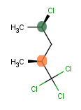
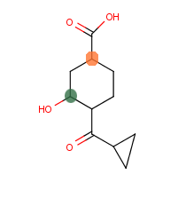
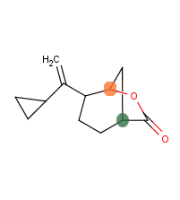
Motivation
Chlorinated Carbons
Strained Rings
Hetero Cycles
Solvent Effect
165 Hz
134 Hz
162 Hz
148 Hz

Slide 4

Structural features
that influence
1JCH
Experimental
1J 13C-H
Accessing the accuracy of
NWChem
1JCH Calculations
Literature
NWChem JCH Calculations
Predictive Model based
on the above study

Slide 5
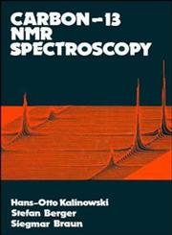

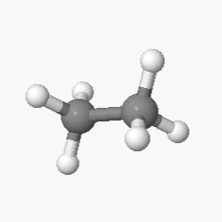
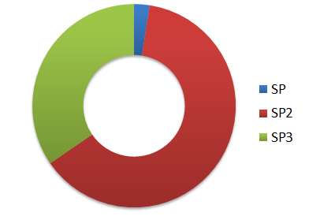
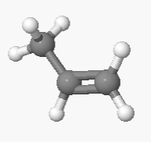
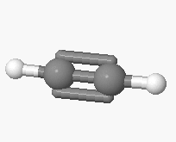
Experimental Data Set
13C-NMR- Spektroskopie
Hans – Otto Kalinowski
Stefan Berger
Siegmar Braun
Structure Determination Using Spectroscopic Methods
Hans J. Reich
Online Resource
C(SP3) - H
140 Data Points
C(SP2) - H
Raw Data
188 Structures
255 Data Points
C(SP) - H
9 Data Points

Slide 6
NWChem
ab initio Computational chemistry software package
Developers : Pacific Northwest National Laboratory
Optimization & J-Calc
Basis Set: B3LYP / TZVP ( DFT Orbital)
Max iterations: 90
Raw Output
188 Structures
CDK (1.5.4)
Experimental Data

Slide 7
NWChem Predictions

