Slide 1

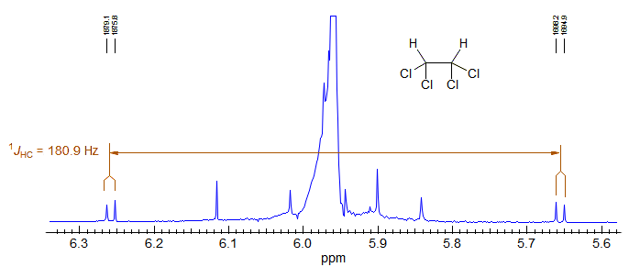
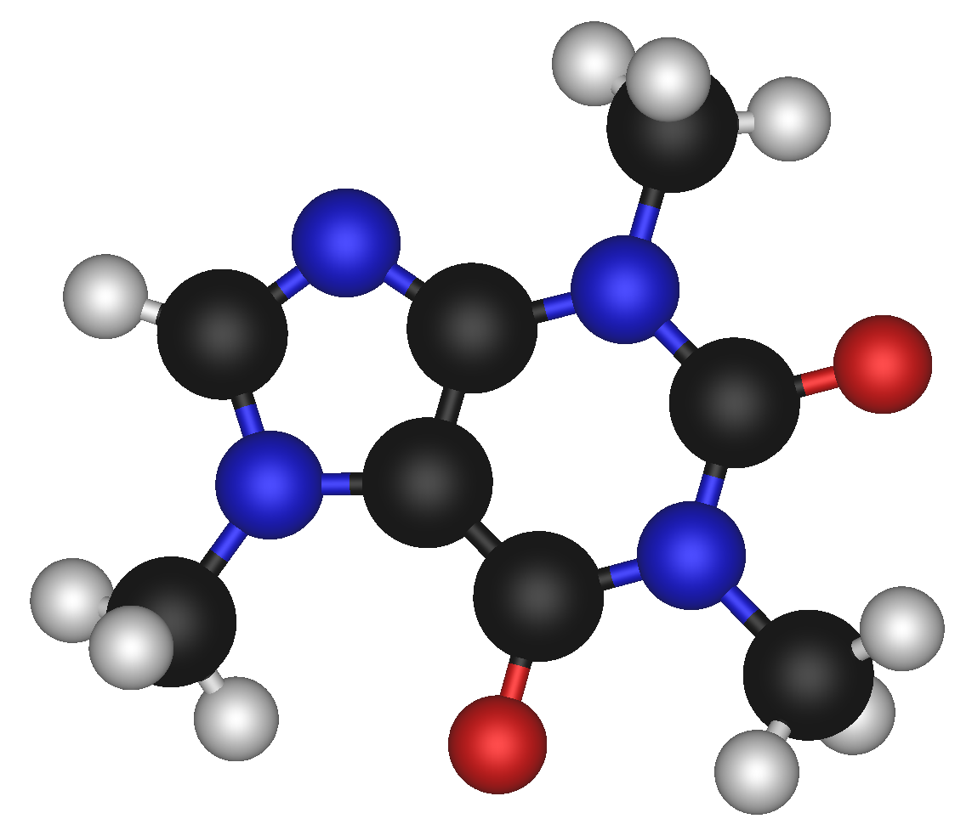



Prediction of One Bond Coupling Constants
1JCH
V Chandrasekhar Nainala

Slide 2
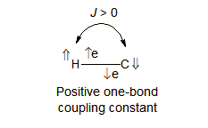
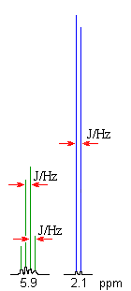
Coupling Constants
Magnetic interaction (coupling) between nuclei (A and X) with a non-zero spin perturbs (polarizes) the spins of the intervening electrons, and the energy levels of neighboring magnetic nuclei are in turn perturbed by the polarized electrons.
Spin–Spin splitting :
Splitting of the NMR peaks in to 2, 3, 4, 5, etc. (doublet, triplet, quartet, quintet, etc.)
Distance between peaks in a multiplet is called the Coupling Constant, J.
Coupling between ¹³C and ¹H, are separated from each other by 100-300 Hz.
(i.e., separated from the central peak by 50-150 Hz).
Notes:
This leads to a lowering of the energy of the neighboring nucleus when the perturbing nucleus has one spin, and a raising of the energy when it has the other spin. Hence frequency of nearby nuclei as they resonate this is known as Spin-Spin coupling.

Slide 3
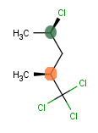
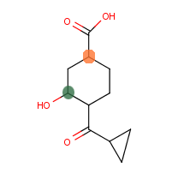
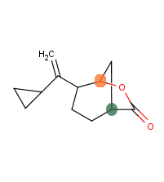
Motivation
Chlorinated Carbons
Strained Rings
Hetero Cycles
Solvent Effect
165 Hz
134 Hz
162 Hz
148 Hz

Slide 4

Structural features
that influence
1JCH
Experimental
1J 13C-H
Accessing the accuracy of
NWChem
1JCH Calculations
Literature
NWChem JCH Calculations
Predictive Model based
on the above study

Slide 5
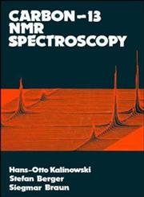

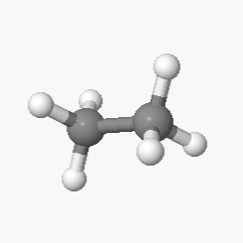
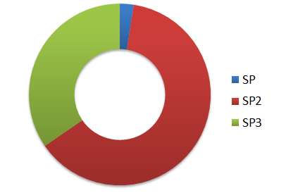
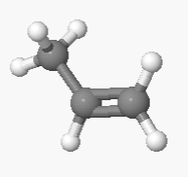
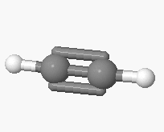
Experimental Data Set
13C-NMR- Spektroskopie
Hans – Otto Kalinowski
Stefan Berger
Siegmar Braun
Structure Determination Using Spectroscopic Methods
Hans J. Reich
Online Resource
C(SP3) - H
140 Data Points
C(SP2) - H
Raw Data
188 Structures
255 Data Points
C(SP) - H
10 Data Points

Slide 6
NWChem
ab initio Computational chemistry software package
Developers : Pacific Northwest National Laboratory
Optimization & J-Calc
Basis Set: B3LYP / TZVP ( DFT Orbital)
Max iterations: 90
Raw Output
188 Structures
CDK (1.5.4)
Experimental Data

Slide 7
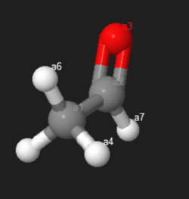
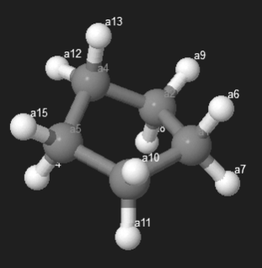
NWChem Predictions
S.No | C | Hybridization | Exp 1JCH (Hz) | NWChem 1JCH (Hz) | Error (Hz)
1 | a4 | SP3 | 127 | 123.5402 | 3.4598
2 | a5 | SP3 | 127 | 123.5447 | 3.4553
3 | a6 | SP3 | 127 | 134.2279 | -7.2279
Avg : (381.3128) / 3 = 127.1043
S.No | C | Hybridization | Exp 1JCH (Hz) | NWChem 1JCH (Hz) | Error (Hz)
1 | a6 | SP3 | 128.5 | 126.2034 | 2.2966
2 | a7 | SP3 | 128.5 | 130.1403 | -1.6403
3 | a8 | SP3 | 128.5 | 124.9537 | 3.5463
4 | a9 | SP3 | 128.5 | 130.5677 | -2.0677
5 | a10 | SP3 | 128.5 | 128.535 | -0.035
6 | a11 | SP3 | 128.5 | 128.4248 | 0.0752
7 | a12 | SP3 | 128.5 | 130.526 | -2.026
8 | a13 | SP3 | 128.5 | 124.9716 | 3.5284
9 | a14 | SP3 | 128.5 | 126.2767 | 2.2233
10 | a15 | SP3 | 128.5 | 130.0776 | -1.5776
Avg : (1280.677 ) / 10 = 128.0677
Similar Mol ID: 33, 30, 35, 36, 37, 39, 45, 46, 47, 48, 49, 60, 62, 64, 65, 68, 71, 72, 74, 73, 75,76 ..

Slide 8
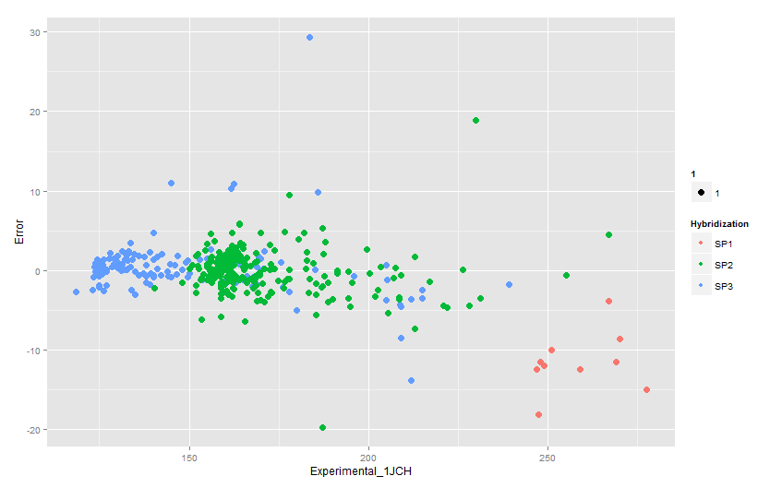
NWChem Predictions

Slide 9
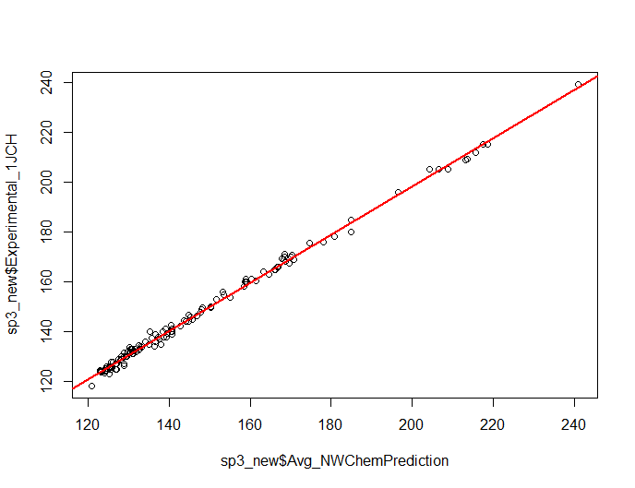
SP3
NWChem ~ Experimental 1JCH Fit
Experimental_1JCH = 4.386090 + (0.970114) * NWChem_Avg_1JCH
Cross Validation
K | 2 | 3 | 4 | 5 | 6 | 7 | 8 | 9 | 10
MSE (Avg) | 2.28 | 2.27 | 2.26 | 2.25 | 2.26 | 2.25 | 2.25 | 2.25 | 2.25

Slide 10
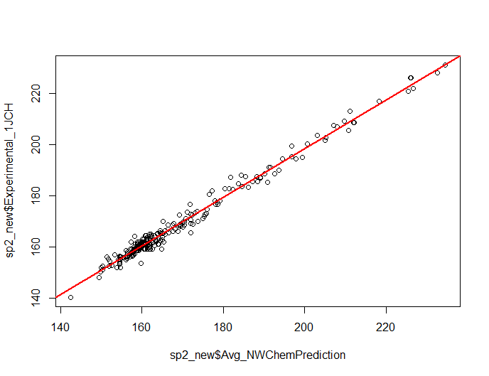
SP2
NWChem ~ Experimental 1JCH Fit
Experimental_1JCH = 7.955546 + (0.952302) * NWChem_Avg_1JCH
Cross Validation
K | 2 | 3 | 4 | 5 | 6 | 7 | 8 | 9 | 10
MSE (Avg) | 4.13 | 4.12 | 4.11 | 4.12 | 4.11 | 4.11 | 4.11 | 4.1 | 4.11

Slide 11
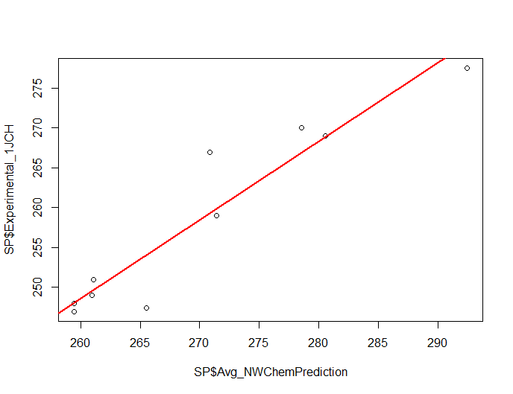
SP
NWChem ~ Experimental 1JCH Fit
Experimental_1JCH = -7.223 + (0.984) * NWChem_Avg_1JCH
Cross Validation
K | 2 | 3 | 4 | 5 | 6 | 7 | 8 | 9 | 10
MSE (Avg) | 25.6 | 21.7 | 19.9 | 20.2 | 20.3 | 19.9 | 19.8 | 19.8 | 19.8

Slide 12
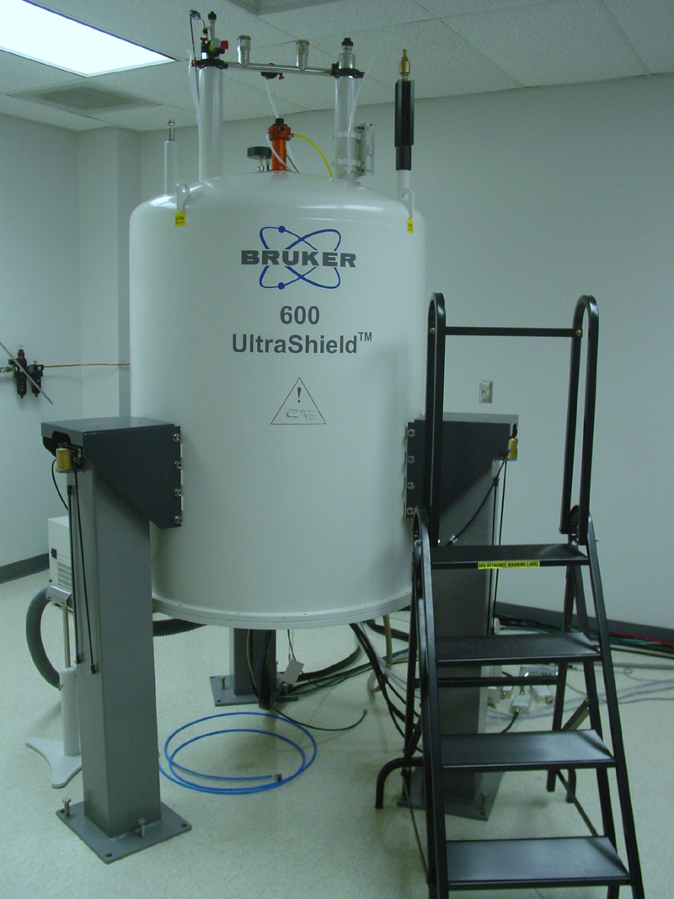
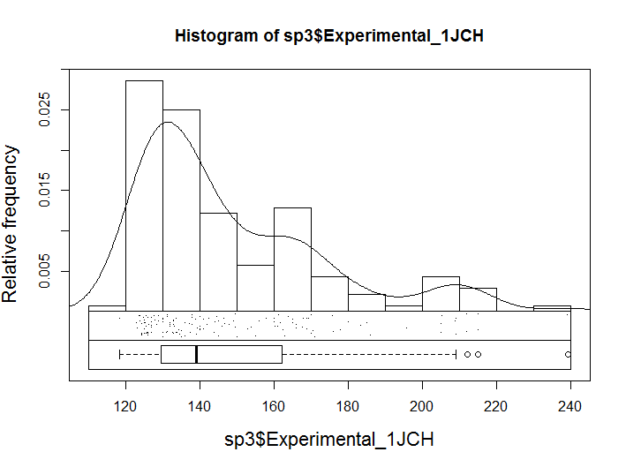
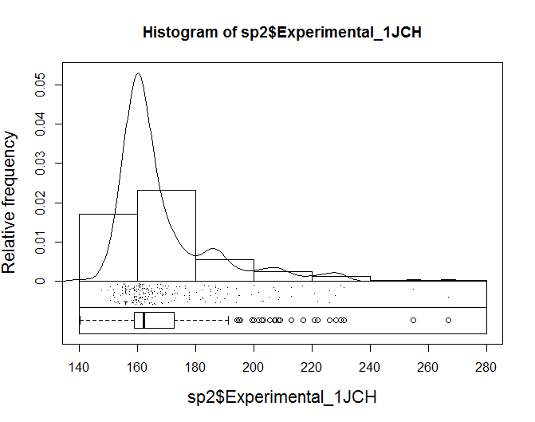
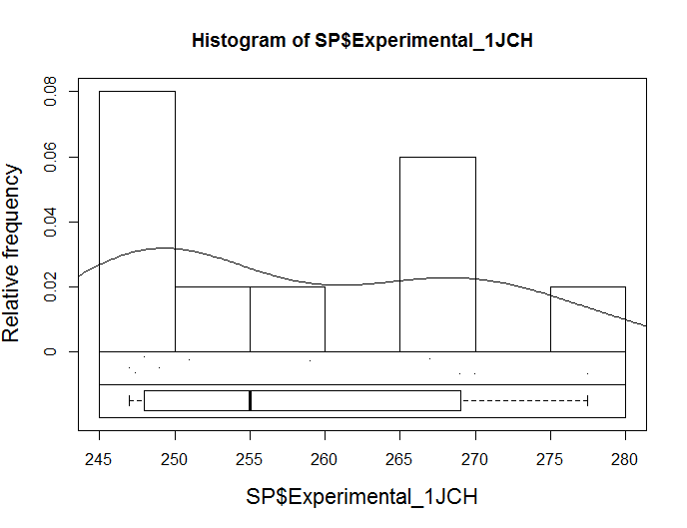
SP3: Experimental_1JCH = 4.386090 + (0.970114) * NWChem_Avg_1JCH
SP2: Experimental_1JCH = 7.955546 + (0.952302) * NWChem_Avg_1JCH
SP1: Experimental_1JCH = -7.223 + (0.984) * NWChem_Avg_1JCH
Fitting NWChem Predictions ~ Experimental Data
NWChem Predictions
Experimental Data
Large
DataSet
Data Fitted
to Experimental Values
Model
NWChem Predictions

Slide 13
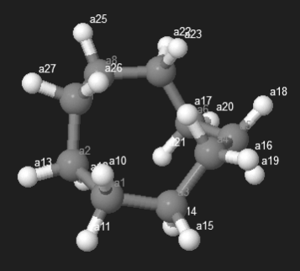
Prediction of NWChem_1JCH
MolID | NWChem_Pred | EXP_1JCH | SigmaDeltaTheta | SigmaAbsDelthaTheta | Omega | MaxDeltaTheta
12 | 122.9596 | 124 | -3.244792746 | 6.966371737 | 120.2077 | 1.50376037
12 | 122.9596 | 124 | -3.244792746 | 6.966371737 | 120.2077 | 1.50376037
12 | 123.0339 | 124 | -8.215054262 | 9.032672 | 117.6293 | 0.408808869
12 | 123.0339 | 124 | -8.215054262 | 9.032672 | 117.6293 | 0.408808869
12 | 123.3359 | 124 | -6.523522895 | 8.67277853 | 118.1695 | 1.074627817
12 | 123.3359 | 124 | -6.523522895 | 8.67277853 | 118.1695 | 1.074627817
12 | 123.611 | 124 | -4.389417514 | 7.014699192 | 120.3796 | 0.803400275
12 | 123.611 | 124 | -4.389417514 | 7.014699192 | 120.3796 | 0.803400275
12 | 123.7765 | 124 | -3.395572313 | 12.3702848 | 120.0722 | 2.436489967
12 | 123.7765 | 124 | -3.395572313 | 12.3702848 | 120.0722 | 2.436489967
12 | 124.3416 | 124 | -5.66865319 | 5.752354641 | 119.1843 | 0.041850726
12 | 124.3416 | 124 | -5.66865319 | 5.752354641 | 119.1843 | 0.041850726

Slide 14
Multivariate Linear Regression
(Principal component regression)
Structural Features
Aromatic
Strained
C_Mulliken Charge
AtomDegree
C_Effective Atom Polarizability
C_Partial Pi Charge
C_Pi Electronegativity
C_SigmaElectonegativity
Hybridization
H_mulliken_charge
H_Effective Atom Polarizability
H_sigmaElectroNegativityDescriptor
SigmaDeltaTheta
SigmaAbsDelthaTheta
Omega
MaxDeltaTheta
BondLength

Slide 15
Work Flow
Test set predictivity
MAD / RMSE
Complete Data
CV - MSE
SP1
SP2
SP3
381
MVLR model
PC1,….PCn
(98 % variance)
Test Set
Training Set
Dimension reduction
(PCA)
Descriptor Calculation

Slide 16
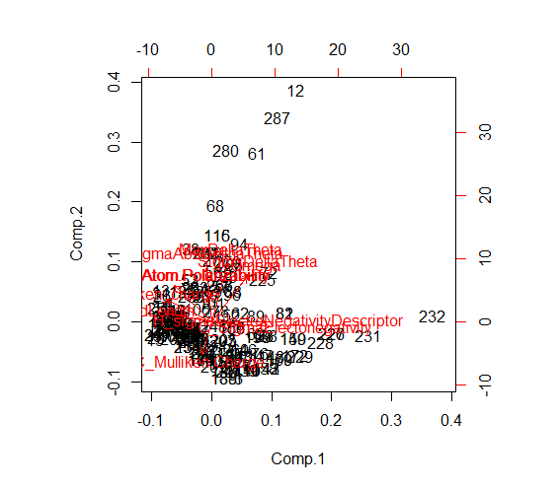
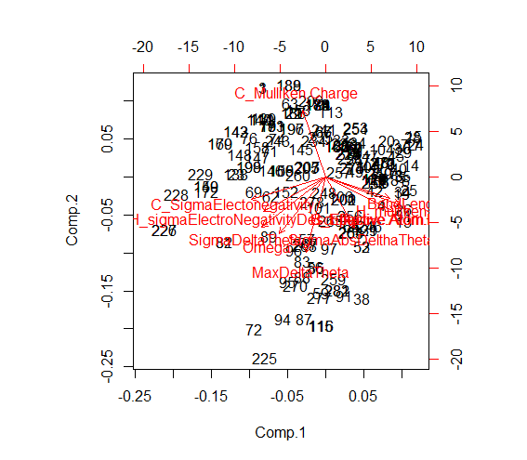
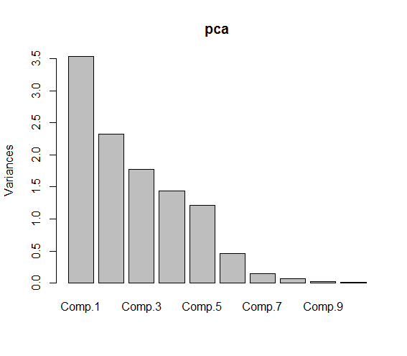
SP3
Non-Strained Carbon (287)
Strained Carbon (94)

Slide 17
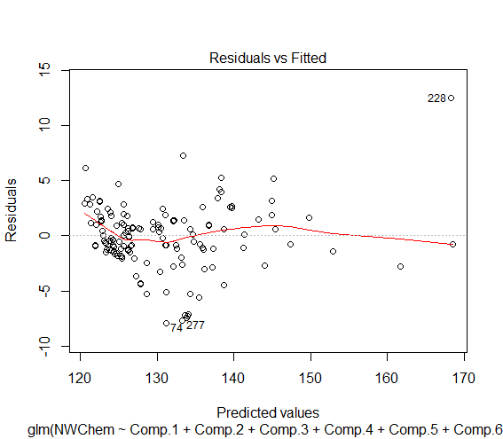
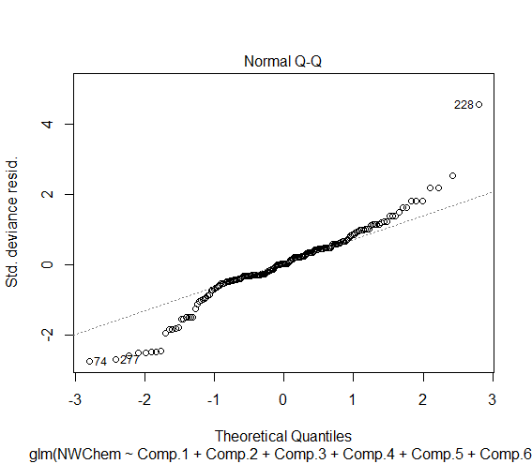
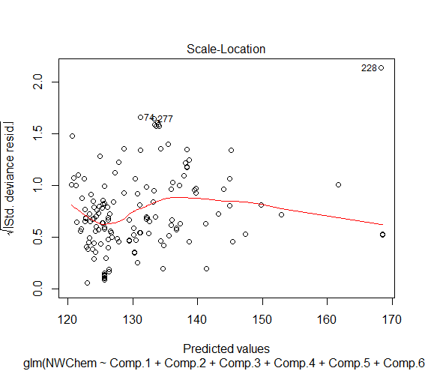
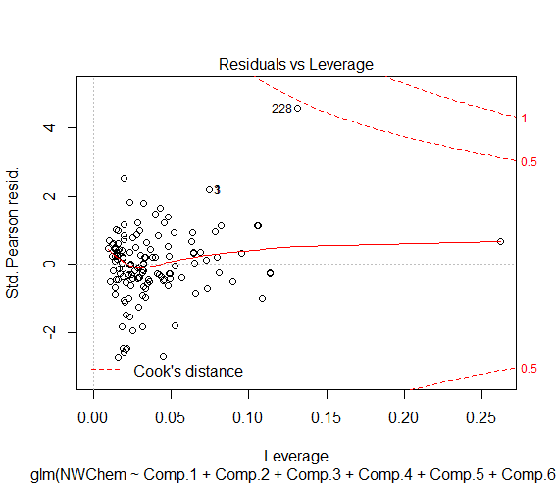
SP3 - Non-Strained
NWChem = (Intercept) 129.9327 + (Comp.1) -3.4336 + (Comp.2) -1.7915 + (Comp.3) 3.2235
+ (Comp.4) 1.6155

Slide 18
SP3 - Non-Strained
Training Set Cross Validation
K | 2 | 3 | 4 | 5 | 6 | 7 | 8 | 9 | 10
MSE (Avg) | 7.58633 | 7.508503 | 7.388523 | 7.354757 | 7.331774 | 7.321991 | 7.295648 | 7.316933 | 7.307532
Test Set Prediction Error:
MAE : 2.880516 RMSE : 4.964659

Slide 19
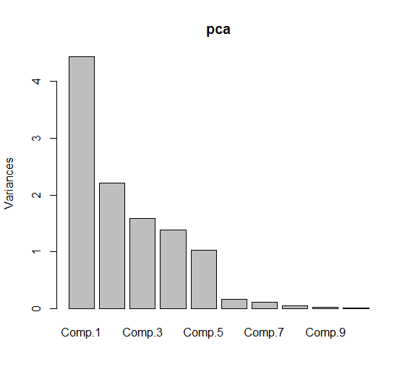
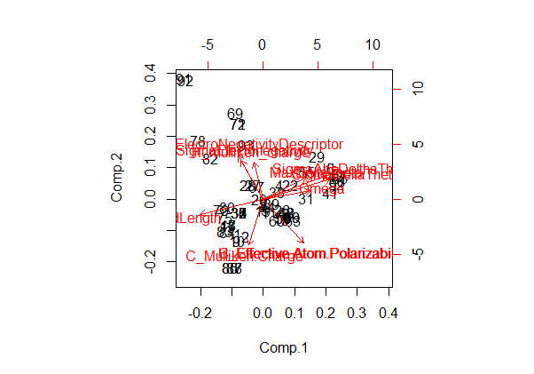
SP3 - Strained
Strained Carbon: 94
Training Set: 67
Test Set: 27

Slide 20
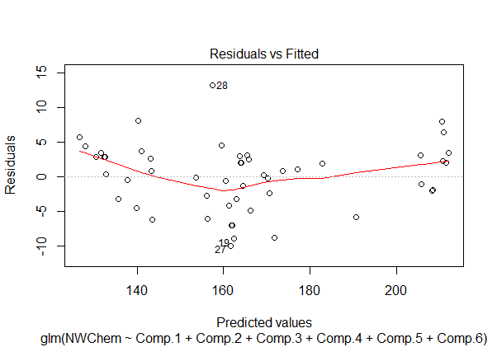
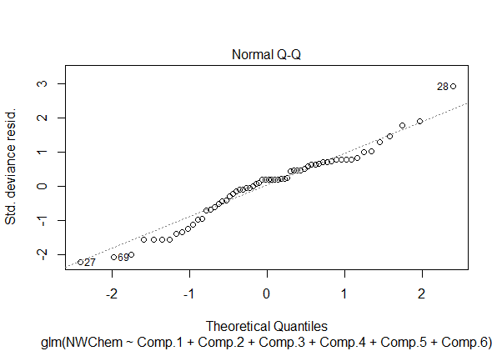
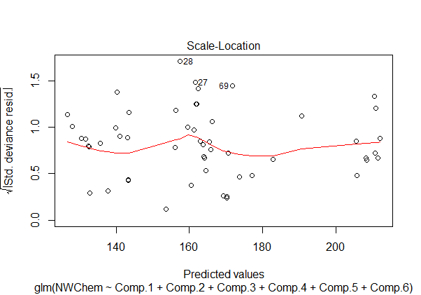
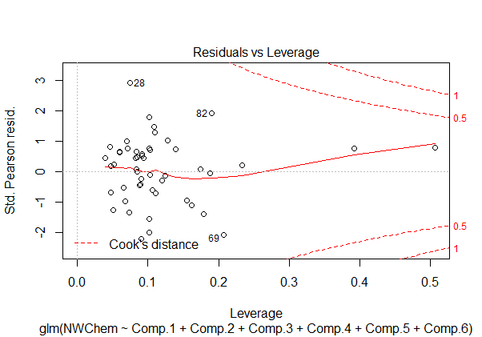
SP3 - Strained

Slide 21
SP3 - Strained
NWChem = (Intercept) 162.8351 + (Comp.1) -10.8071 + (Comp.2) 3.9722
+ (Comp.3) -4.9472 + (Comp.4) 0.8035 + (Comp.5) -3.3748
+ (Comp.6) 1.6627
Training Set Cross Validation
K | 2 | 3 | 4 | 5 | 6 | 7 | 8 | 9 | 10
MSE (Avg) | 23.38988 | 19.98881 | 20.06375 | 19.64266 | 19.40256 | 19.30656 | 19.25153 | 19.1496 | 19.0322
Test Set Prediction Error
MAE: 5.177795
RMSE: 5.649851

Slide 22
SP2
NWChem = (Intercept) 169.61413 + (Comp.1 )*-5.90978 + (Comp.2)*-1.19516 +(Comp.3 )*8.39194+ (Comp.5 )*-3.33556+(Comp.6 )*-6.48190
Training Set Cross Validation
K | 2 | 3 | 4 | 5 | 6 | 7 | 8 | 9 | 10
MSE (Avg) | 14.9205 | 14.41373 | 14.32834 | 14.28692 | 14.22549 | 14.18884 | 14.18959 | 14.17043 | 14.13174
Test Set Prediction Error
MAE : 5.05435
RMSE: 6.344694

Slide 23
NWChem Calculations @ Large Data Set
6661802 (5.9 M commercially available unique)
Number of Processes - 10
(2.4 GHz Intel Core 2 Duo, 4GB 1067 MHz DDR3)
Preliminary Screening
Include Charged : False
Exclude Elements : .
Include Elements : H C N O F Al Si P S Cl Ar c s n o
Molecular Weight : 10-500 Daltons
Passed : 5083021
Failed : 1578781
Execution Time: 1240680 ms ~ 20.678 min

Slide 24
e Molecules
SP
IncludeElements #
ExcludeElements =
IncludeSMARTS C#C C#C)
SPHydrogens true
Passed : 2649
Failed : 5080372
Execution Time: 38717 ms
SP2
IncludeElements =
ExcludeElements #
SP2Hydrogens true
Passed : 4237244
Failed : 845777
Execution Time: 897101 ms
SP3
ExcludeElements # =
Passed : 472361
Failed : 4610660
Execution Time: 34179 ms
SP2_SP
IncludeElements = #
SP2Hydrogens true SPHydrogens true
Passed : 10456
Failed : 5072565
Execution Time: 94378 ms

Slide 25
Diversity Based Sub Set Selection
Algorithm: OptiSim
K-Sub Set Size: 10
Diversity Threshold: 0.5
Screen: MaxMin
Diverse Subset Size: 2000
SP3
SP2
SP1
SP2_SP
472361
4237244
2649
10456
580
598
111
130

Slide 26
NWChem Calculations
1419
281
26
1112
Done
Killed
In Queue

Slide 27
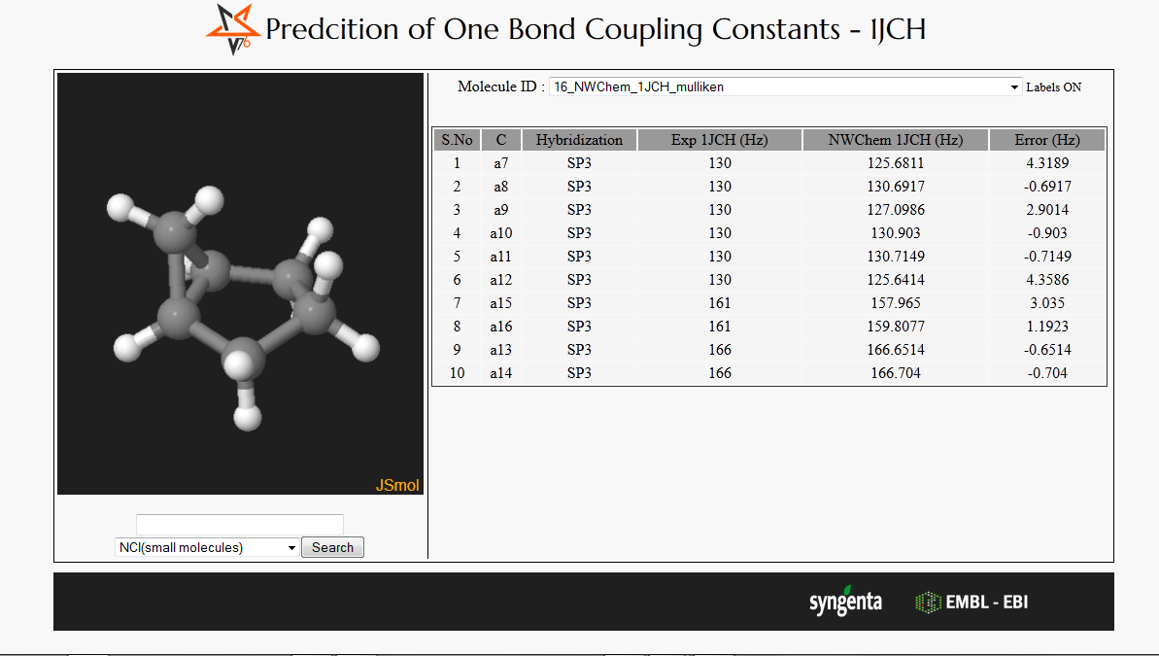
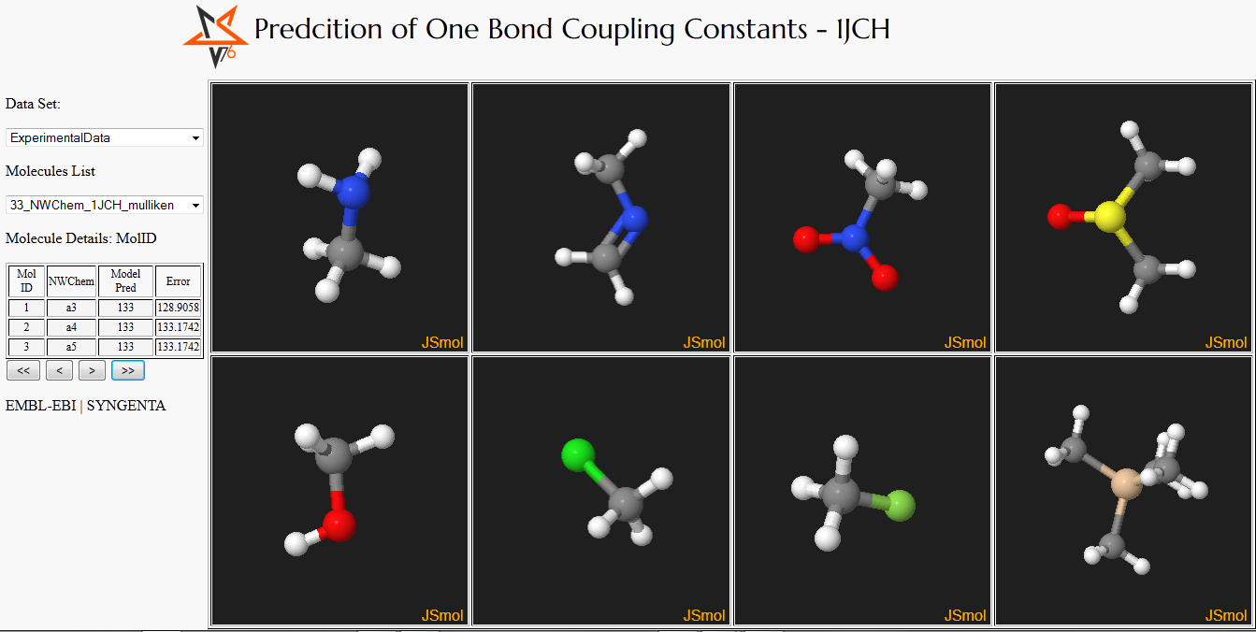
To Do !!

Slide 28
Thank you

