Slide 1
Azure – Customer Success Framework for Partner
Sample Slides – commit phase

Slide 2
commitment on the goals
commit

Slide 3
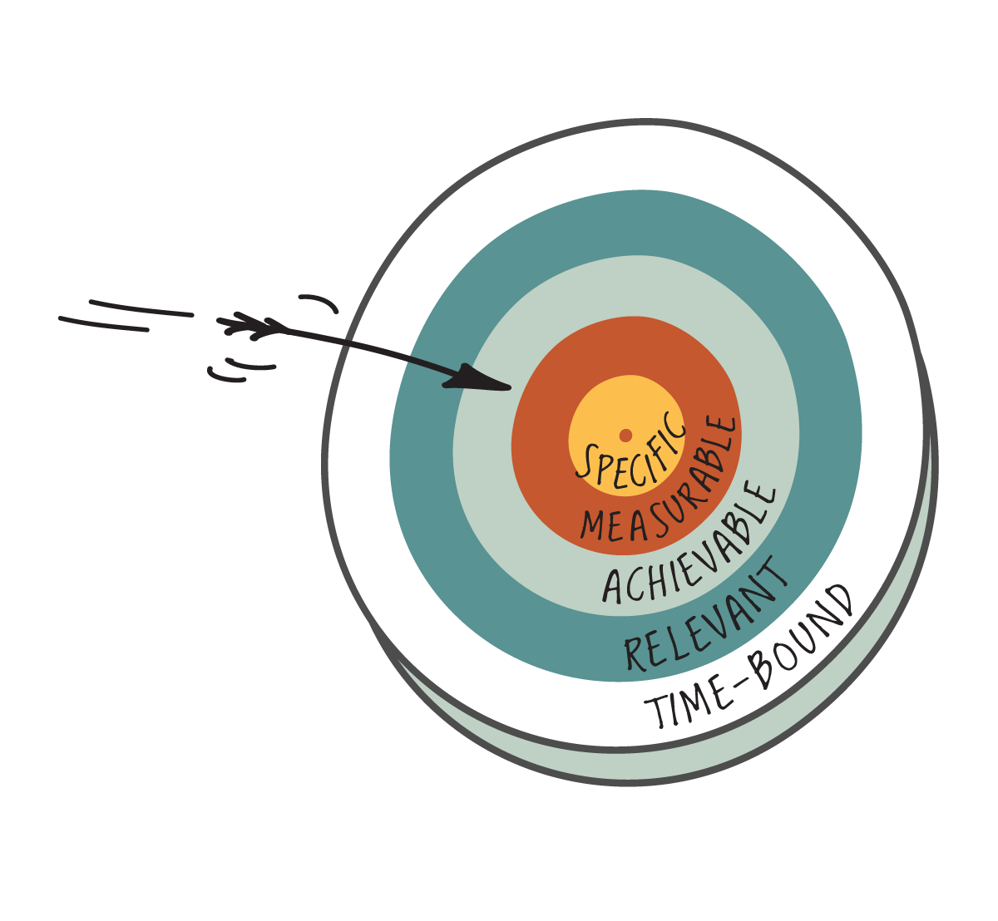
Define a proof able target with the customer
Think about SMART defined targets:
A SMART goal should be
Specific,
Measurable,
Achievable,
Realistic and
Time-bound

Slide 4
Define a statement of work (SoW)
example
Project
Eckwerte
Parameters
Situation
Project Goal (Target State)
Project manager:
xx
xx
….
Next Phase
Total project
Time
Start:
01.01.13
01.01.13
Project Benefit/Value
End:
31.01.13
31.12.13
xx
Budget (cash-out)
kEUR:
100
1.100
Tolerance:
20%
10%
Risks
Notes
Expenses, in Days
xx
Internally:
78 + PM
External:
5 *
*Depending on internal Availability

Slide 5
Objectives
example
Objectiv
Success criteria
Responsible
xx
xx
..
xx
xx
..
xx
xx
..
Delimitation
xx

Slide 6
Conditions
example
Condition
Detail
1
xx
xx
2
xx
xx
3
xx
xx
4
xx
xx

Slide 7
Work packages
Work package
Date
Responsible
1
xx
xx
xx
2
xx
xx
xx
3
xx
xx
xx
4
xx
xx
xx

Slide 8
Work package
example
Titel WP:
Feinkonzept Optimum erstellen
Responsable:
n.n.
Start:
DD.MM.
End:
DD.MM.
Effort:
6 PT
Duration:
10 Days
Specifications:
Resources required/material:
xx
xx
Input:
Results / Products:
Impact / Dependency:
xx
xx
xx

