Slide 1
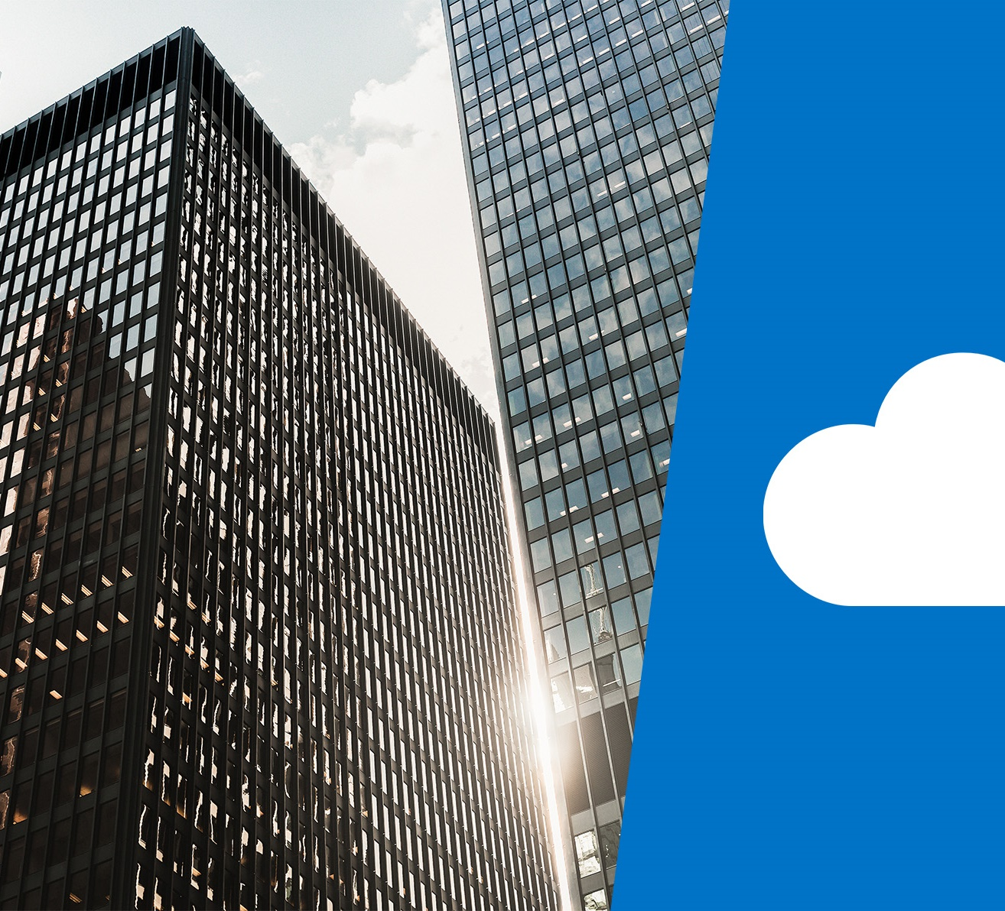
Security, privacy, compliance, and trust

Slide 2
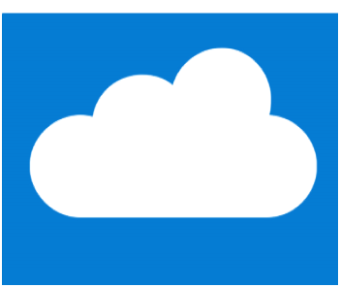
Learning objectives

Slide 3
Module 3 – Learning objectives
Understand and describe how to secure network connectivity in Microsoft Azure.
Understand and describe core Azure identity services.
Understand and describe security tools and features.
Understand and describe Azure governance methodologies.
Understand and describe monitoring and reporting in Azure.
Understand and describe privacy, compliance, and data protection standards in Azure.

Slide 4
Securing network connectivity in Azure

Slide 5
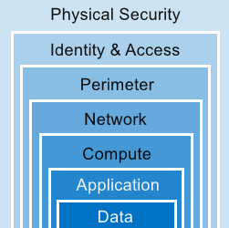
Defense in Depth
A layered approach to securing computer systems.
Provides multiple levels of protection.
Attacks against one layer are isolated from subsequent layers.
Notes:
This is conceptual, to be kept high level, explaining how security options can be targeted at each layer. We will discuss two layers in more depth in the next slide.

Slide 6
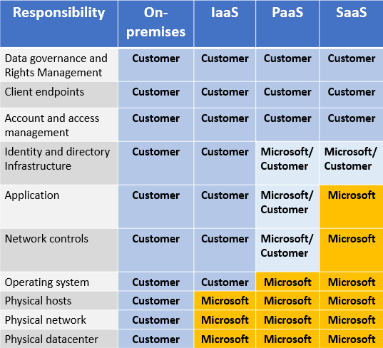
Choosing Azure network security solutions - layers
Shared responsibility
As computing environments move from customer-controlled datacenters to cloud datacenters, the responsibility for security also shifts. Security is now a concern shared by cloud providers and customers.
Notes:
Again it is conceptual, to be kept high level, the graphic shows the shared responsibility split between provider (Microsoft), customer and both, for on-premises and different cloud service types.

Slide 7
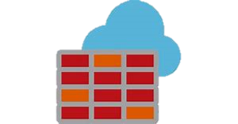
Azure Firewall
A firewall is a service that grants server access based on the originating IP address of each request
Azure Firewall is a managed, cloud-based network security service that protects your Azure Virtual Network resources. It is a fully stateful firewall as a service with built-in high availability and unrestricted cloud scalability.
Azure Firewall includes many features, including:
Built-in high availability
Unrestricted cloud scalability
Inbound and outbound filtering rules
Azure Monitor logging
Notes:
Common Usage Scenarios
You typically deploy Azure Firewall on a central virtual network to control general network access. With Azure Firewall you can configure:
Application rules that define fully qualified domain names (FQDNs) that can be accessed from a subnet.
Network rules that define source address, protocol, destination port, and destination address.
Application Gateway also provides a firewall, the web application firewall (WAF). This is different to Azure Firewall. WAF provides centralized inbound protection of your web applications from common exploits and vulnerabilities, whereas Azure Firewall provides:
Inbound protection for non-HTTP/S protocols (for example,
Remote Desktop Protocol (RDP), Secure Shell (SSH),
File Transfer Protocol (FTP)),
Outbound network-level protection for all ports and protocols
Application-level protection for outbound HTTP/S.
Because Azure Firewall has more functionality available to it, it is intended for different use cases.
For more details, see https://azure.microsoft.com/en-us/services/azure-firewall/ page.

Slide 8

Azure DDoS protection
Distributed denial of service (DDoS) attacks attempt to overwhelm and exhaust an application’s resources, making the application slow or unresponsive to legitimate users.
Azure DDoS Protection service protects your Azure applications by scrubbing traffic at the Azure network edge before it can impact your service's availability.
Azure DDoS Protection provides the following service tiers:
Basic. The Basic service tier is automatically enabled as part of the Azure platform.
Standard. The Standard service tier provides additional mitigation capabilities that are tuned specifically to Microsoft Azure Virtual Network resources.
Notes:
DDoS standard protection can mitigate the following types of attacks:
Volumetric attacks. The attack's goal is to flood the network layer with a substantial amount of seemingly legitimate traffic.
Protocol attacks. These attacks render a target inaccessible, by exploiting a weakness in the layer 3 and layer 4 protocol stack.
Resource (application) layer attacks. These attacks target web application packets to disrupt the transmission of data between hosts.
Note: You can read more about Azure DDoS Protection from the page https://azure.microsoft.com/en-us/services/ddos-protection/

Slide 9

Network security groups
Network Security Groups (NSGs) allow you to filter network traffic to and from Azure resources in an Azure virtual network. An NSG can contain multiple inbound and outbound security rules that enable you to filter traffic to and from resources by source and destination IP address, port, and protocol.
Network security rule properties:
A network security group can contain as many rules as you want within Azure subscription limits.
When you create a network security group, Azure creates a series of default rules to provide a baseline level of security. You cannot remove the default rules, but you can override them by creating new rules with higher priorities.
Notes:
Each rule specifies the following properties:
Property Explanation
Name > > Unique name of the NSG.
Priority > A number between 100 and 4096. Rules are processed in priority order, with lower numbers processed before higher numbers.
Source or Destination > Individual IP address or IP address range, service tag, or application security group.
Protocol > TCP, UDP, or Any
Direction > Whether the rule applies to inbound or outbound traffic. Port Range An individual or range of ports. Action Allow or deny
You can read more about NSGs on the https://docs.microsoft.com/en-us/azure/virtual-network/security-overview#network-security-groups
page.

Slide 10

Application Security Groups
Provides for the grouping of servers with similar port filtering requirements, and group together servers with similar functions, such as web servers
Application security group features :
Allows you to reuse your security policy at scale without manual maintenance of explicit IP addresses
handles the complexity of explicit IP addresses and multiple rule sets, allowing you to focus on your business logic
Notes:
For details about ASG, see : https://docs.microsoft.com/en-us/azure/virtual-network/security-overview#application-security-groups

Slide 11
Choosing Azure network security solutions - layers
Perimeter layer. The network perimeter layer is about protecting organizations from network-based attacks against your resources. Some options are to use Azure DDoS Protection and Azure Firewall.
Networking layer. At this layer, the focus is on limiting network connectivity across all your resources and only allowing what is required. Some options are deny by default, restrict inbound internet access, and limit outbound.
Combining services. You can also combine multiple Azure networking and security services. Some examples are:
Network security groups and Azure Firewall
Application Gateway WAF and Azure Firewall.
Notes:
This is to be kept high level, general concepts.

Slide 12
Core Azure identity services

Slide 13
Authentication and authorization
Two concepts are fundamental to understanding identity and access.
Authentication
identifies the person or service seeking access to a resource.
requests legitimate access credentials.
basis for creating secure identity and access control principles.
Authorization
determines an authenticated person’s or service’s level of access.
defines which data they can access, and what they can do with it.
Notes:
Note : Authentication is sometimes shortened to AuthN, and authorization is sometimes shortened to AuthZ.

Slide 14
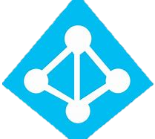
Azure Active Directory
Azure Active Directory (Azure AD) is a Microsoft cloud-based identity and access management service. Azure AD helps employees of an organization sign in and access resources.
Azure AD provides services such as:
Authentication
Single sign-on (SSO)
Application management
Business to business (B2B) identity services
Business-to-Customer (B2C) identity services
Notes:
Azure AD provides services such as:
Authentication. providing functionality such as self-service password reset, multi-factor authentication (MFA), a custom banned password list, and smart lockout services.
Single-Sign-On (SSO). SSO enables users to remember only one ID and one password to access multiple applications.
Application management. You can manage your cloud and on-premises apps using Azure AD Application Proxy, SSO, the My apps portal (also referred to as Access panel), and SaaS apps.
Business to business (B2B) identity services. Manage your guest users and external partners while maintaining control over your own corporate data
Business-to-Customer (B2C) identity services. Customize and control how users sign up, sign in, and manage their profiles when using your apps with services, including when using your applications and a social identity sign in experience.
Device Management.
Note: You can read more about Azure Active Directory on the https://azure.microsoft.com/en-us/services/active-directory/ webpage.

Slide 15
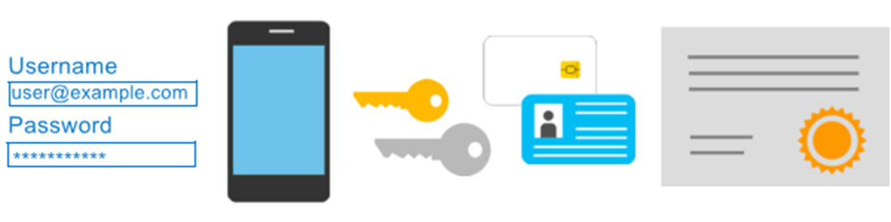
Azure Multi-Factor Authentication
Provides additional security for your identities by requiring two or more elements for full authentication.
Something you know.
Something you possess.
Something you are.
Notes:
Discuss what could qualify for each of the items listed
Something you know: This could be a password or the answer to a security question.
Something you possess: This might be a mobile app that receives a notification, or a token-generating device.
Something you are: This is typically some sort of biometric property, such as a fingerprint or face scan used on many mobile devices.
MFA - https://docs.microsoft.com/en-us/azure/active-directory/authentication/concept-mfa-howitworks

Slide 16
Security tools and features

Slide 17
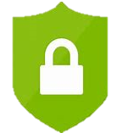
Azure Security Center
Azure Security Center is a monitoring service that provides threat protection across all of your services both in Azure, and on-premises.
Azure Security Center can:
Provide security recommendations based on your configurations, resources, and networks.
Monitor security settings across on-premises and cloud workloads, and automatically apply required security to new services as they come online.
Notes:
Azure Security Center is part of the https://www.cisecurity.org/cis-benchmarks/ (CIS) recommendations.
Azure Security Center Versions
Azure Security Center is available in two tiers:
Free. Available as part of your Azure subscription, this tier is limited to assessments and recommendations of Azure resources only.
Standard. This tier provides a full suite of security-related services including continuous monitoring, threat detection, just-in-time access control for ports, and more.
To access the full suite of Azure Security Center services you will need to upgrade to a Standard tier subscription. You can access the 60-day free trial from within the Azure Security Center dashboard in the Azure Portal.
You can read more about Azure Security Center at https://azure.microsoft.com/en-us/services/security-center/

Slide 18
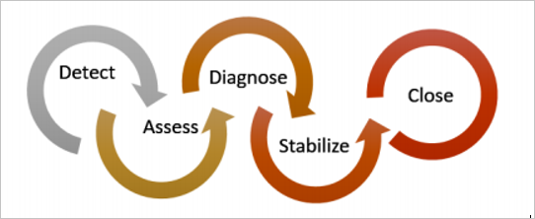
Azure Security Center usage scenarios
You can use Security Center in the detect, assess, and diagnose stages of an incident response.
Use Security Center recommendations to enhance security.
Notes:
You can use Security Center during the detect, assess, and diagnose stages. Here are examples of how Security Center can be useful during the three initial incident response stages:
Detect. Review the first indication of an event investigation. Example: Use the Security Center dashboard to review the initial verification that a high-priority security alert was raised.
Assess. Perform the initial assessment to obtain more information about the suspicious activity. Example: Obtain more information about the security alert.
Diagnose. Conduct a technical investigation and identify containment, mitigation, and workaround strategies. Example: Follow the remediation steps described by Security Center in that particular security alert.
2. Another usage example is to Use Security Center recommendations to enhance security.
You can reduce the chances of a significant security event by configuring a security policy, and then implementing the recommendations provided by Azure Security Center.
A security policy defines the set of controls that are recommended for resources within that specified subscription or resource group. In Security Center, you define policies according to your company's security requirements.
Security Center analyzes the security state of your Azure resources. When Security Center identifies potential security vulnerabilities, it creates recommendations based on the controls set in the security policy. The recommendations guide you through the process of configuring the needed security controls. For example, if you have workloads that do not require the Azure SQL Database Transparent Data Encryption (TDE) policy, turn off the policy at the subscription level and enable it only in the resources groups where SQL TDE is required.
You can read more about Azure Security Center at https://azure.microsoft.com/en-us/services/security-center/

Slide 19

Azure Key Vault
Azure Key Vault is a centralized cloud service that you use for storing application secrets. Key Vault helps you control your applications' secrets by keeping them in a single, central location and providing secure access, permissions control, and access logging.
Key Vault usage scenarios:
Secrets management
Key management
Certificate management
Store secrets backed by hardware security modules (HSMs)
Notes:
The benefits of using Key Vault include:
Centralized application secrets. Centralizing storage for application secrets allows you to control their distribution, and reduces the chances that secrets may be accidentally leaked.
Securely stored secrets and keys. Azure uses industry-standard algorithms, key lengths, and HSMs, and access requires proper authentication and authorization.
Monitor access and use. Using Key Vault, you can monitor and control access to company secrets.
Simplified administration of application secrets. The ability to enroll and renew certificates from public certificate authorities (CAs). Furthermore, you can scale up and replicate content within regions, and manage using standard management tools.
Integrate with other Azure services. You can integrate Key Vault with storage accounts, container registries, event hubs and many more Azure services.
Note: You can read more about Key Vault on the https://azure.microsoft.com/en-us/services/key-vault/ webpage.

Slide 20
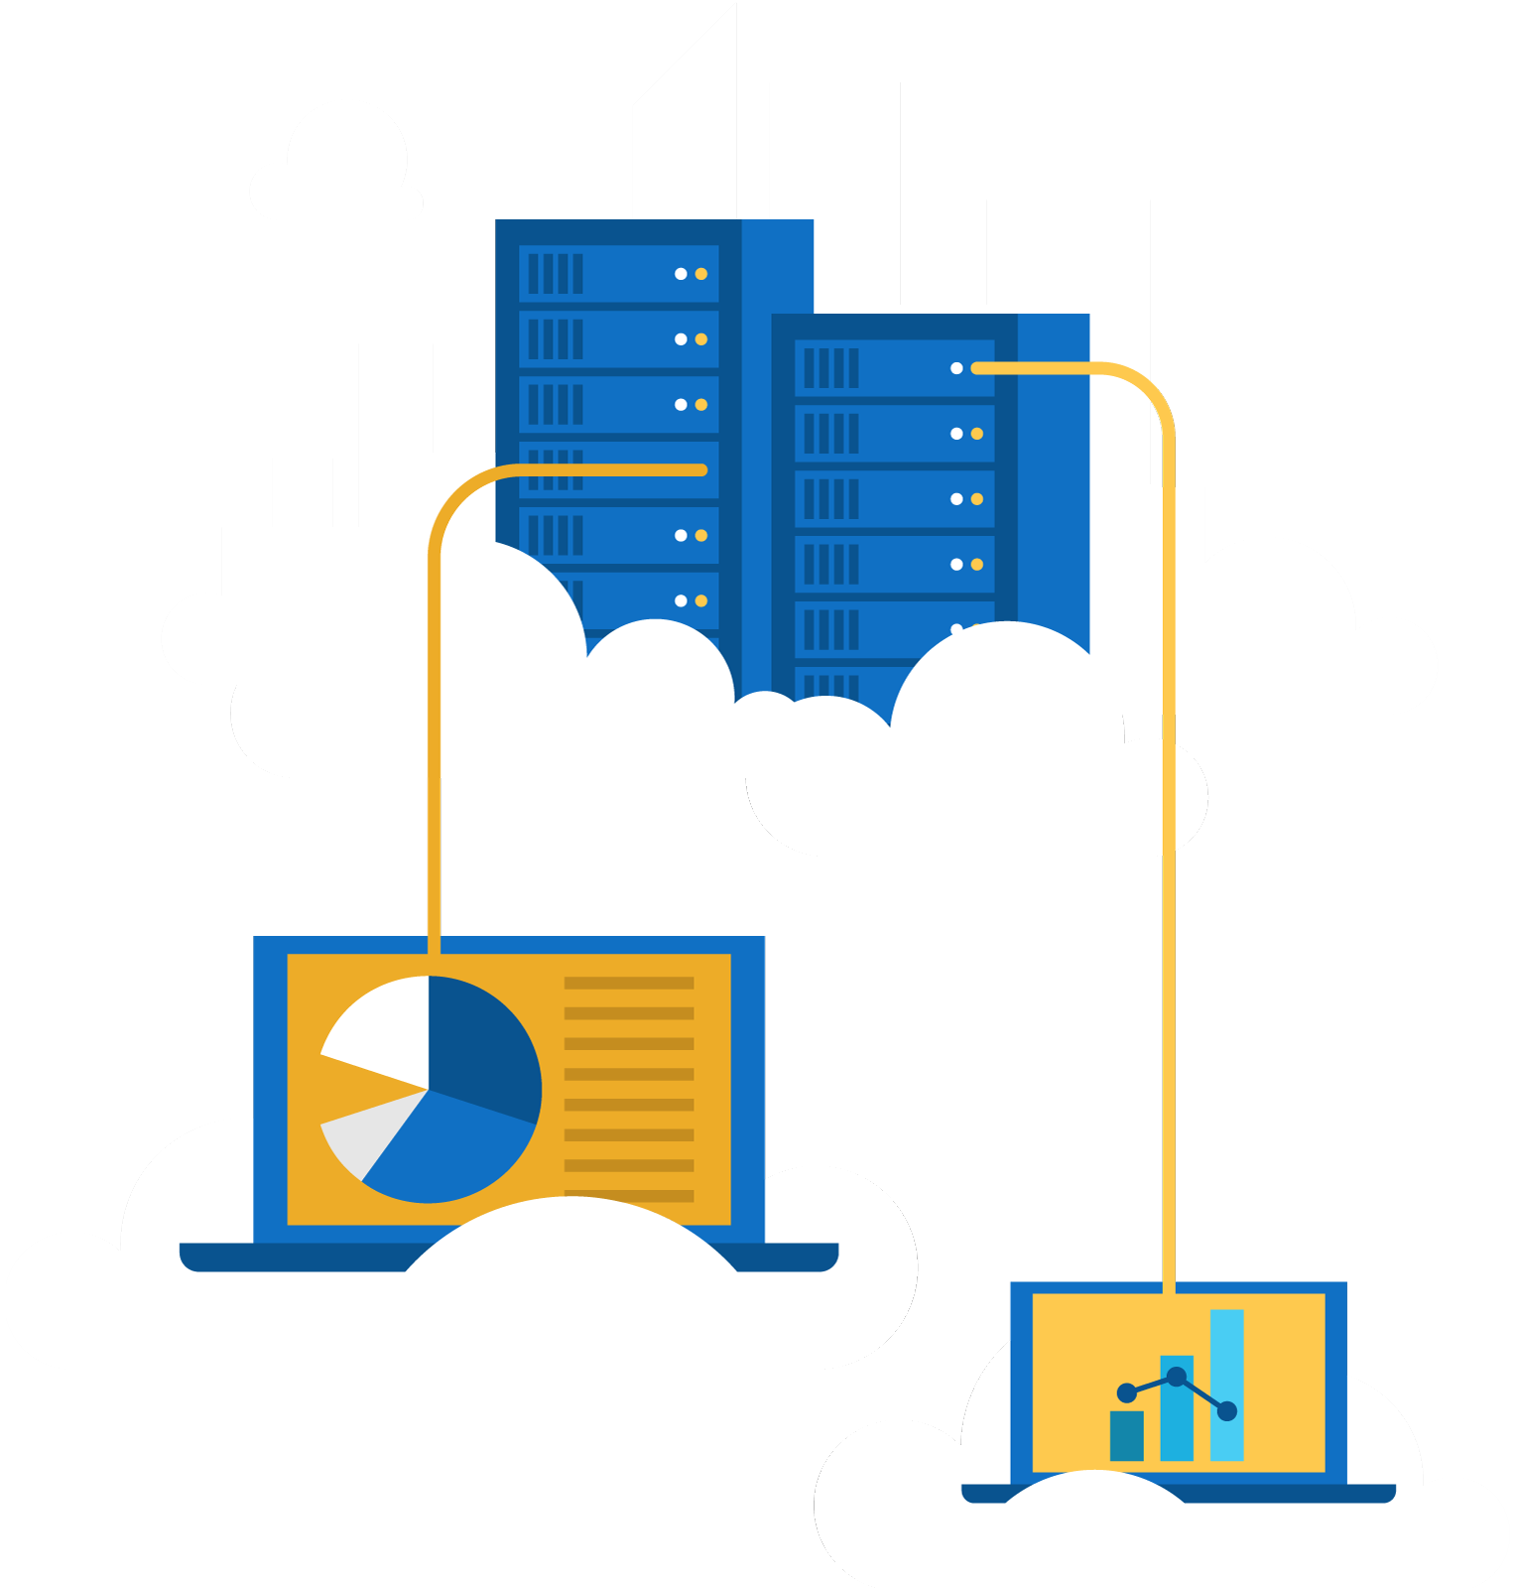
Exercise 1

Slide 21
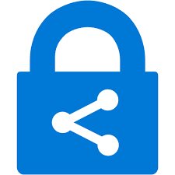
Azure Information Protection
Microsoft Azure Information Protection is a cloud-based solution that helps organizations classify and optionally help protect its documents and emails by applying labels. Labels can be applied:
Automatically by administrators who define rules and conditions
Manually by users
A combination of the two, where users are given recommendations
Usage scenario:
A user saves a Microsoft Word document containing a credit card number.
A custom tooltip displays recommending that the file be labelled Confidential\All Employees, which is the label that the administrator has configured.
This label classifies the document and protects it.
Notes:
Note: You can purchase Microsoft AIP either standalone, or through one of the following Microsoft licensing suites: Enterprise Mobility + Security, or Microsoft 365 Enterprise. Purchasing details are available on the https://azure.microsoft.com/en-us/pricing/details/information-protection/ webpage.
Note: You can read more about Microsoft AIP on the https://docs.microsoft.com/en-us/azure/virtual-network/ webpage.

Slide 22
Azure Advanced Threat Protection
Azure Advanced Threat Protection (Azure ATP) is a cloud-based security solution that identifies, detects, and helps you investigate advanced threats, compromised identities, and malicious insider actions directed at your organization.
Azure ATP consists of the following components:
Azure ATP portal. Azure ATP has it's own portal through which you monitor and respond to suspicious activity
Azure ATP sensor: Azure ATP sensors are installed directly on your domain controllers.
Azure ATP cloud service. Azure ATP cloud service runs on Azure infrastructure.
Notes:
Purchasing
Azure ATP is available as part of Enterprise Mobility + Security 5 suite (EMS E5), and as a standalone license. You can acquire a license directly from the https://www.microsoft.com/en-ie/cloud-platform/enterprise-mobility-security-pricing or through the Cloud Solution Provider (CSP) licensing model. It is not available to purchase via the Azure portal.
You can enter the Azure ATP portal either by logging in to the portal https://portal.atp.azure.com and selecting your instance, or browsing to the instance URL: https://instancename.atp.azure.com.
Note: To successfully log in to the Azure ATP portal, you have to log in with a user assigned to an Azure Active Directory security group with access to the Azure ATP portal
Note: You can read more about Azure Advanced Threat Protection on the https://azure.microsoft.com/en-us/features/azure-advanced-threat-protection/ webpage

Slide 23
Lesson 05: Azure governance methodologies

Slide 24

Azure Policy
Azure Policy is a service in Azure that you use to create, assign, and, manage policies. These policies enforce different rules and effects over your resources, so those resources stay compliant with your corporate standards and service-level agreements (SLAs).
With Azure Policy, provides the following:
Azure Policy uses policies and initiatives to run evaluations of your resources and scans for those not compliant with the policies you have created.
Azure Policy comes with a number of built-in policy and initiative definitions that you can use, under categories such as Storage, Networking , Compute, Security Center, and Monitoring.
Notes:
Azure Policy can also integrate with Azure DevOps and apply policies for your continuous integration and delivery pipelines for pre-deployment and post-deployment of your applications.
Azure Policy also has the ability to automatically remediate resources and configurations that are deemed non-compliant, thus ensuring the integrity of the state of the resources.
Note: You can read more about Azure Policy on the https://azure.microsoft.com/en-us/services/azure-policy/webpage. https://azure.microsoft.com/en-us/services/azure-policy/

Slide 25
Policies : Example policy definitions
Allowed Storage Account size
conditions and rules define acceptable sizes for new storage accounts.
requests to create storage accounts outside the defined sizes are denied.
Allowed Locations
defines the Azure locations where your organization can deploy resources, to enforce geographic compliance requirements.
requests to deploy resources outside the defined locations are denied.
More Azure Policy examples :
docs.microsoft.com/azure/governance/policy/samples/
Notes:
Apply a policy to your resources in three steps:
Create the policy definition.
Assign the definition to a scope of resources.
View the policy evaluation results.
Additional policy definition example : Allowed Virtual Machine (VM) SKUs - This policy specifies a set of VM SKUs that your organization can deploy.
Consider browsing to the Azure Policy examples page, and scrolling through some of the sample policies.
Policy assignment : To implement a policy definition, you must assign them first. A policy assignment is a policy definition that has been assigned to a specific scope. This scope could range over a management group or a resource group. Policy assignments are inherited by all child resources.
For details about Azure Policy, see : https://azure.microsoft.com/en-us/services/azure-policy/

Slide 26
Initiatives
Initiatives work alongside policies in Azure Policy.
Initiative definitions : Group multiple policy definitions into a single unit, to track compliance at greater/ macro-level scope.
For example, one initiative can monitor all of your Azure Security Center recommendations.
Initiative assignments : Initiative definitions that are assigned to a specific scope. Initiative assignments reduce the need to make an initiative definition for each scope.
Notes:
Even if you have a single policy, we recommend using initiatives if you anticipate adding more policies over time.
Initiative definitions - Simplify the process of managing and assigning policy definitions, by grouping a set of policies into one single item. For example, you could create an initiative named Enable Monitoring in Azure Security Center, for the purpose of monitoring all the available security recommendations in your Azure Security Center.
Under this initiative, you would have the following policy definitions:
Monitor unencrypted SQL Database in Security Center – For monitoring unencrypted SQL databases and servers.
Monitor OS vulnerabilities in Security Center – For monitoring servers that do not satisfy the configured baseline.
Monitor missing Endpoint Protection in Security Center – For monitoring servers without an installed endpoint protection agent.
Initiative assignments - Like a policy assignment, an initiative assignment is an initiative definition assigned to a specific scope. Initiative assignments reduce the need to make several initiative definitions for each scope. Scope could also range from a Management Group to a Resource Group.

Slide 27





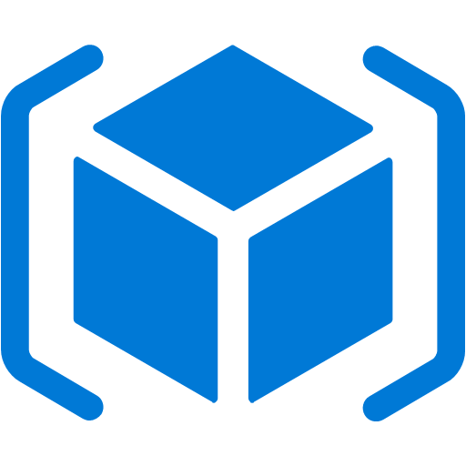
Role-based access control (RBAC)
Fine-grained access management
Segregate duties within your team and grant only the amount of access to users that they need to perform their jobs.
Enables allowing or disallowing access to the Azure portal, and controlling access to resources.
Azure
Active Directory
Azure
subscription
User
Apps
User groups
Resource group
Resource group
Notes:
Azure RBAC - https://docs.microsoft.com/en-us/azure/role-based-access-control/overview

Slide 28
Exercise 2

Slide 29
Locks
Protect your Azure resources from accidental deletion or modification .
Manage locks at subscription, resource group, or individual resource levels within Azure Portal.
 | User Actions
Lock Types | Read | Update | Delete
CanNotDelete | Yes | Yes | No
ReadOnly | Yes | No | No
Notes:
Consider showing students “Locks” in Azure Portal.
In Azure portal, the lock types are called Delete and Read-only.
For details about Locks, see : https://docs.microsoft.com/en-us/azure/azure-resource-manager/resource-group-lock-resources

Slide 30
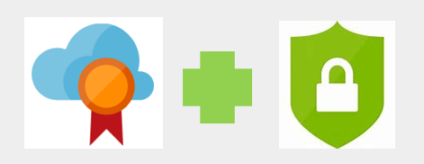
Azure Advisor security assistance
Azure Advisor provides security recommendation by integrating with Azure Security Center.
View the security recommendations on the Security tab of the Advisor dashboard.
Click deeper into the Security Center recommendations to improve and enhance your security governance.
Notes:
Azure Advisor provides security recommendation by integrating with Azure Security Center. You can view the security recommendations on the Security tab of the Advisor dashboard. You can then click deeper into the Security Center recommendations.

Slide 31
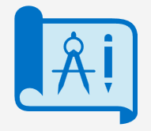
Azure Blueprints
Azure Blueprints enable cloud architects to define a repeatable set of Azure resources that implement and adhere to an organization's standards, patterns, and requirements.
Usage Scenarios:
Use Azure Blueprints’ artifacts and tools to help with auditing, traceability, and compliance with your deployments.
Use with Azure DevOps scenarios, where blueprints are associated with specific build artifacts and release pipelines, and require more rigorous tracking.
Notes:
The process of implementing Azure Blueprints, consists of the following high-level steps:
Create an Azure Blueprint.
Assign the blueprint.
Track the blueprint assignments.
Usage Scenario
Adhering to security or compliance requirements, whether government or industry requirements, can be difficult and time-consuming. To help you with auditing, traceability, and compliance with your deployments, use Azure Blueprint artifacts and tools. Time-consuming paperwork is no longer needed, and your path to certification is expedited.
Azure Blueprints are also useful in Azure DevOps scenarios, where blueprints are associated with specific build artifacts and release pipelines, and can be tracked more rigorously.
NOTE: At the time of writing this course, Azure Blueprints is in preview and has not been released generally.
Note: You can read more about Azure Blueprints at https://azure.microsoft.com/en-us/services/blueprints/

Slide 32
Subscription governance
There are mainly three aspects to consider in relation to creating and managing subscriptions:
Billing: Reports and chargeback can be generated per subscriptions
Access Control: A subscription is a deployment boundary for Azure resources and has the ability to set up role-based access control (RBAC
Subscription Limits: Subscriptions are also bound to some hard limitations. If there is a need to go over those limits in particular scenarios, then additional subscriptions may be needed. If you hit a hard limit, there is no flexibility.
Notes:
We will discuss and define subscriptions in more detail later in the course, however we will briefly mention subscriptions here in the context of governance.
There are mainly three aspects to consider in relation to creating and managing subscriptions: Billing, Access Control and Subscription limits.
Billing: Reports can be generated by subscriptions, if you have multiple internal departments and need to do “chargeback”, a possible scenario is to create subscriptions by department or project.
Access Control: A subscription is a deployment boundary for Azure resources and every subscription is associated with an Azure AD tenant that provides administrators the ability to set up role-based access control (RBAC). When designing a subscription model, one should consider the deployment boundary factor, some customers have separate subscriptions for Development and Production, each one is completely isolated from each other from a resource perspective and managed using RBAC.
Subscription Limits: Subscriptions are also bound to some hard limitations. For example, the maximum number of Express Route circuits per subscription is 10. Those limits should be considered during the design phase, if there is a need to go over those limits in particular scenarios, then additional subscriptions may be needed. If you hit a hard limit, there is no flexibility.
Also available to assist with managing subscriptions are management groups, which manage access, policies, and compliance across multiple Azure subscription. We will discuss these in more detail later.

Slide 33
Monitoring and reporting in Azure

Slide 34

Tags
You can apply tags to your Azure resources providing metadata to logically organize them into a taxonomy such as an organization structure, workload, geography or any other logical grouping.
Each tag consists of a name and a value pair
Name | Value
Environment | Production
Department | IT
Tags are useful when you need to organize resources for billing or management.
Notes:
After you apply tags, you can retrieve all the resources in your subscription with that tag name and value. Tags enable you to retrieve related resources from different resource groups
You can use Azure Policy to enforce tagging values and rules on resources.
Tag Limitations
There are some limitations with using Tags, such as:
Not all resource types support tags. To determine if you can apply a tag to a resource type, see Tag support for Azure resources. Tag support for Azure resources
Each resource or resource group can have a maximum of 15 tag name/value pairs. This limitation applies only to tags directly applied to the resource group or resource. A resource group can contain many resources that each have 15 tag name/value pairs. If you have more than 15 values that you need to associate with a resource, use a JSON string for the tag value. The JSON string can contain many values that are applied to a single tag name.
The tag name is limited to 512 characters, and the tag value is limited to 256 characters. For storage accounts, the tag name is limited to 128 characters, and the tag value is limited to 256 characters.
Virtual Machines and Virtual Machine Scale Sets are limited to a total of 2048 characters for all tag names and values.
Tags applied to the resource group are not inherited by the resources in that resource group.
Tags can't be applied to classic resources such as Cloud Services.
Tag names can't contain these characters: <, >, %, &, \, ?, /

Slide 35
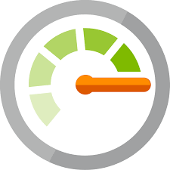
Azure Monitor
Azure Monitor maximizes the availability and performance of applications by delivering a comprehensive solution for collecting, analyzing, and acting on telemetry from cloud and on-premises environments.
As soon as you create an Azure subscription and start adding resources, Azure Monitor starts collecting data:
Activity Logs. Record when resources are created or modified.
Metrics tell. Show how the resource is performing and the resources that it's consuming.
You can extend the data you're collecting into the actual operation of the resources by enabling Diagnostics under the resource settings, and adding an agent to compute resources.
Notes:
What data does Azure Monitor collect?
Azure Monitor can collect data from a variety of sources. Azure Monitor collects data from the following tiers, this is not a full list:
Application monitoring data: Data about the performance and functionality of the code you have written, regardless of its platform.
Azure resource monitoring data: Data about the operation of an Azure resource.
Azure subscription monitoring data: Data about the operation and management of an Azure subscription, as well as data about the health and operation of Azure itself.
Diagnostic settings
As soon as you create an Azure subscription and start adding resources such as virtual machines and web apps, Azure Monitor starts collecting data.
Activity Logs record when resources are created or modified.
Metrics tell you how the resource is performing and the resources that it's consuming.
You can extend the data you're collecting into the actual operation of the resources by enabling diagnostics and adding an agent to compute resources.
Note: You can read more about Azure Monitor the page https://azure.microsoft.com/en-us/services/monitor/

Slide 36

Azure Service health
Azure Service Health is a suite of experiences that provide personalized guidance and support when issues with Azure services arise. It can notify you, help you understand the impact of issues, and keep you updated as the issue is resolved.
Azure Service Health is composed of:
Azure Status. Provides a global view of the health state of Azure services.
Service Health. A customizable dashboard that tracks the state of Azure services in the regions where you use them.
Azure Resource Health: Diagnose and obtain support when an Azure service issue affects your resources.
Notes:
Together, these experiences provide you with a comprehensive view into the health of Azure, at the granularity that is most relevant to you.
Note: You can read more about Azure Service Health on the https://azure.microsoft.com/en-us/services/monitor/ webpage

Slide 37
Monitoring applications and services
Integrate Azure Monitor with other Azure services to improve your data monitoring capabilities, and gain better insights into your operations.
Analyze | Use variants of Azure Monitor for resources (containers, virtual machines, etc.), with Azure Application Insights for applications.
Respond | Azure Alerts can respond proactively to critical conditions identified in your monitor data, and use Auto-scale with Azure Monitor Metrics.
Visualize | Use Azure Monitor data to create interactive visualizations, charts, and tables with Power BI.
Integrate | Integrate Azure Monitor with other systems to build customized solutions to suit your needs and requirements.
Notes:
Analyze
Application Insights. This service monitors the availability, performance, and usage of your web applications whether they're hosted in the cloud or on-premises.
Azure Monitor for containers. This service is designed to monitor the performance of container workloads that are deployed to managed Kubernetes clusters hosted on Azure Kubernetes Service (AKS).
Azure Monitor for VMs. This service monitors your Azure VMs at scale by analyzing the performance and health of your Windows and Linux VMs, including their different processes and interconnected dependencies on other resources and external processes.
Integrating any and all of these monitoring services with Azure Service Health can add value.
Respond
In addition to allowing you to interactively analyze monitoring data, an effective monitoring solution must also be able to proactively respond to critical conditions identified in the data that it collects. This might be sending a text or email to an administrator responsible for investigating an issue, or launching an automated process that attempts to correct an error condition.
Alerts. Alerts in Azure Monitor proactively notify you of critical conditions, and potentially can attempt to take corrective action.
Autoscale. Autoscale ensures you have the right amount of resources running to manage the load on your application.
Visualize
Visualizations, such as charts and tables, are effective tools for summarizing monitoring data and presenting it to different audiences. Other tools you may use to visualize data in particular scenarios may include:
Dashboards
Views
Power BI
Integrate
You'll often need to integrate Azure Monitor with other systems, and build custom solutions that use your monitoring data. Other Azure services work with Azure Monitor to provide this integration.

Slide 38
Privacy, compliance and data protection standards in Azure

Slide 39
Compliance Terms and Requirements
Microsoft provides the most comprehensive set of compliance offerings (including certifications and attestations) of any cloud service provider. Some compliance offering include:
CJIS (Criminal Justice Information Services ) | HIPAA (Health Insurance Portability and Accountability Act)
CSA STAR Certification | ISO/IEC 27018
General Data Protection Regulation (GDPR) | National Institute of Standards and Technology (NIST)
You can view all the Microsoft compliance offerings at Microsoft Compliance Center - Compliance Offerings.
Notes:
Should discuss the questions below with students. When selecting a cloud provider to host your solutions, you should understand how that provider can help you comply with regulations and standards. Some questions to ask about a potential provider include:
How compliant is the cloud provider when it comes to handling sensitive data?
How compliant are the services offered by the cloud provider?
How can I deploy my own cloud-based solutions to scenarios that have accreditation or compliance requirements?
Microsoft invests heavily in the development of robust and innovative compliance processes.
Should go to the URL on the slide and briefly scroll through the compliance offerings.

Slide 40
Microsoft privacy statement
Explains what personal data Microsoft processes, how Microsoft processes it, and for what purposes.
Applies to the interactions Microsoft has with users and Microsoft products such as Microsoft services, websites, apps, software, servers, and devices.
Is intended to provide openness and honesty about how Microsoft deals with personal data in its products and services.
For more information, review the privacy statement at Microsoft Privacy Statement.

Slide 41
Trust Center
Trust Center is a website resource containing information and details about how Microsoft implements and supports security, privacy, compliance, and transparency in all our cloud products and services.
The Trust Center site provides:
In-depth information about security, privacy, compliance offerings, policies, features, and practices across Microsoft cloud products.
Recommended resources in the form of a curated list of the most applicable and widely-used resources for each topic.
Information specific to key organizational roles, including business managers, tenant admins or data security teams, risk assessment and privacy officers, and legal compliance teams.
Notes:
You may want to show students the Trust Center
For more information, visit the https://www.microsoft.com/en-us/trustcenter webpage.

Slide 42
Service Trust Portal
The Service Trust Portal (STP) is the Microsoft public site for publishing audit reports and other compliance-related information related to Microsoft’s cloud services.
It also hosts the Compliance Manager service.
STP is a companion feature to the Trust Center, and allows you to:
Access audit reports across Microsoft cloud services on a single page.
Access compliance guides to help you understand how can you use Microsoft cloud service features to manage compliance with various regulations.
Access trust documents to help you understand how Microsoft cloud services help protect your data.
Notes:
Accessing the STP
To access some STP materials, you must sign in as an authenticated user with your Microsoft cloud services account (either an Azure AD organization account or a Microsoft account), and then review and accept the Microsoft Non-Disclosure Agreement for Compliance Materials.
Existing customers can access the STP at the https://servicetrust.microsoft.com/ https://servicetrust.microsoft.com/webpage, with one of the following online subscriptions (trial or paid):
Office 365
Dynamics 365
Azure

Slide 43
Compliance Manager
Compliance Manager is a workflow-based risk assessment in the Trust Portal that enables you to track, assign, and verify your organization's regulatory compliance activities
It provide details related to Microsoft professional services and Microsoft cloud services such as Microsoft Office 365, Microsoft Dynamics 365, and Azure.
Compliance Manager provides the following features:
Enables you to assign, track, and record compliance and assessment-related activities.
Provides a compliance score to help you track your progress and prioritize auditing.
Provides a secure repository in which to upload and manage evidence and other artifacts related to compliance activities.
Notes:
Compliance Manager provides the following features:
Enables you to assign, track, and record compliance and assessment-related activities, which can help your organization cross team barriers to achieve your organization's compliance goals.
Provides a Compliance Score to help you track your progress and prioritize auditing controls that will help reduce your organization's exposure to risk.
Provides a secure repository in which to upload and manage evidence and other artifacts related to compliance activities.
Produces richly detailed reports in Microsoft Excel that document the compliance activities performed by Microsoft and your organization, which can be provided to auditors, regulators, and other compliance stakeholders.
Compliance Manager provides ongoing risk assessments with a risk-based scores reference displayed in a dashboard view for regulations and standards.
As part of the risk assessment, Compliance Manager also provides recommended actions you can take to improve your regulatory compliance.
IMPORTANT NOTE: Compliance Manager is a dashboard that provides a summary of your data protection and compliance stature, and recommendations to improve data protection and compliance. The Customer Actions provided in Compliance Manager are recommendations only; it is up to each organization to evaluate the effectiveness of these recommendations in their respective regulatory environment prior to implementation. Recommendations found in Compliance Manager should not be interpreted as a guarantee of compliance.

Slide 44
Azure Government services
Microsoft Azure Government addresses the security and compliance needs of US federal agencies, state and local governments, and their solution providers.
Azure Government:
Is a separate instance of the Microsoft Azure service.
Offers physical isolation from non-US government deployments, and provides screened US personnel.
Handles data that is subject to certain government regulations and requirements, such as FedRAMP, NIST 800.171 (DIB), ITAR, IRS 1075, DoD L4, and CJIS.
Notes:
You can read more about Azure Government on the https://azure.microsoft.com/en-us/global-infrastructure/government/ webpage.

Slide 45
Azure Germany services
Microsoft Azure Germany is built on the Microsoft trusted cloud principles of security, privacy, compliance, and transparency.
It brings data residency in transit and at rest in Germany, and data replication across German datacenters for business continuity.
Customer data in the two datacenters is managed under the control of a data trustee, T-Systems International. This trustee is an independent German company and a subsidiary of Deutsche Telekom.
Anyone who requires data to reside in Germany can use this service.
Notes:
You may want to show Students the Microsoft Azure Germany home page, the link is provided below
https://azure.microsoft.com/en-us/global-infrastructure/germany/
You can read more about Microsoft Azure Germany on the https://azure.microsoft.com/en-us/global-infrastructure/germany/ webpage.

Slide 46
Azure China 21Vianet
Microsoft Azure operated by 21Vianet (Azure China 21Vianet) is a physically separated instance of cloud services located in China.
As the first foreign public cloud service provider offered in China in compliance with government regulations, Azure China 21Vianet provides world-class security as discussed in the Trust Center topic, as required by Chinese regulations for all systems and applications built on its architecture.
Notes:
According to the China Telecommunication Regulation (in Chinese), providers of cloud services (IaaS and PaaS) must have value-added telecom permits. Only locally-registered companies with less than 50-percent foreign investment qualify for these permits. To comply with this regulation, the Azure service in China is operated by 21Vianet, based on the technologies licensed from Microsoft.
You can read more about Azure China on the https://docs.microsoft.com/en-us/azure/china/ webpage.

Slide 47
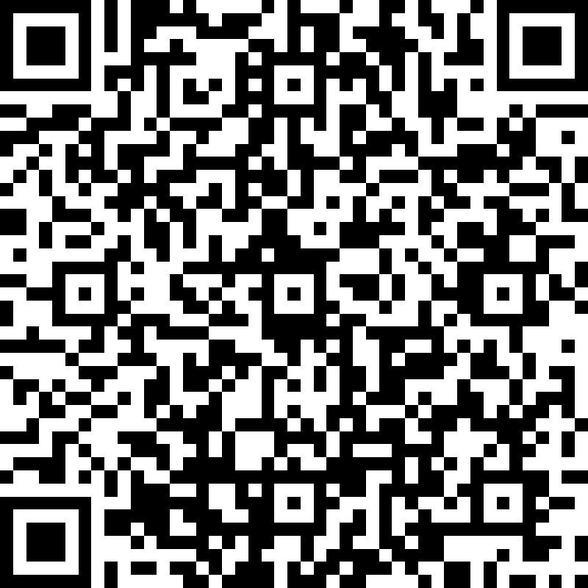
Quiz

