Slide 1
Azure Fundamentals Bootcamp
Niels Ophey

Slide 2
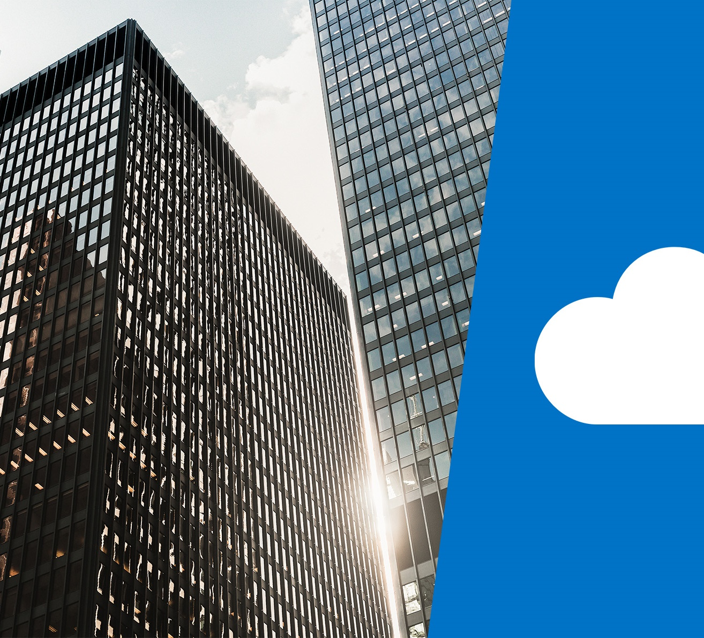
Cloud concepts

Slide 3
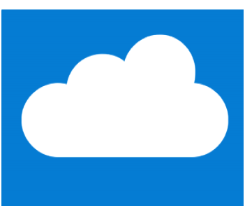
Learning objectives

Slide 4
Module 1 – Learning objectives
Describe and understand cloud services and their benefits
Understand key terms you will encounter when working with cloud services
Understand public, private, and hybrid cloud models
Understand infrastructure as a service (IaaS)
Understand platform as a service (PaaS)
Understand software as a service (SaaS)

Slide 5
Why cloud services?

Slide 6
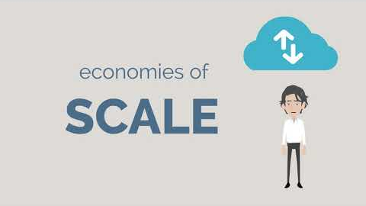
Video: Cloud Services

Slide 7
Key concepts and terms
Cloud services have certain characteristics and considerations, such as:
High availability
Scalability
Elasticity
Agility
Fault tolerance
Disaster recovery
Global reach
Customer latency capabilities
Predictive cost considerations
Security
Notes:
Provide descriptions of each characteristic.
For more conceptual detail about cloud computing, open What is cloud computing?
There is also a term reference guide available at Cloud computing terms.

Slide 8
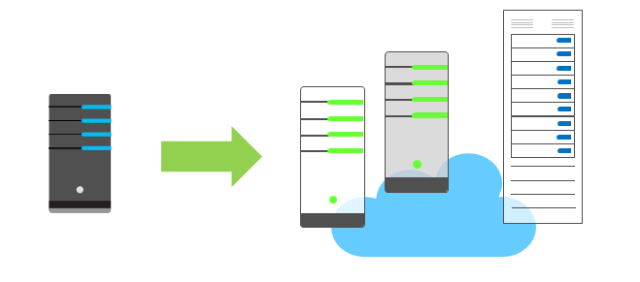
Economies of scale
The concept of economies of scale is the ability to do things less expensively and more efficiently when operating at a larger scale in comparison to operating at a smaller scale.
Cloud providers such as Microsoft, Google, and Amazon Web Services (AWS) are very large businesses, and thus can leverage the benefits of economies of scale and then pass those benefits on to their customers.
Notes:
Economies of scale are apparent to end users in a number of ways, one of which is the ability to acquire hardware at a lower cost than if a single user or smaller business were purchasing it.
Storage costs, for example, have decreased significantly over the last decade due in part to cloud providers' ability to purchase larger amounts of storage at significant discounts. They are then able to use that storage more efficiently, and pass on those benefits to end users in the form of lower prices.
However, there are limits to the benefits large organizations can realize through economies of scale. A product will inevitably have an underlying core cost as it becomes more of a commodity, based on what it costs to produce. Competition is also another factor which has an effect on costs of cloud services.

Slide 9
CapEx vs. OpEx
Capital Expenditure (CapEx) is the spending of money on physical infrastructure up front, and then deducting that expense from your tax bill over time. CapEx is an upfront cost which has a value that reduces over time.
Operational Expenditure (OpEx) is spending money on services or products and being billed for them immediately. You can deduct this expense from your tax bill in the same year. There is no upfront cost, you pay for a service or product as you use it.
Notes:
Today, organizations can sign up for a service from a cloud provider to get up and running. This enables them to begin selling or providing services to their customers more quickly, without the need for significant upfront costs
If your service is busy and you consume a lot of resources in a month, then you receive a large bill. If those services are minimal and don't use a lot of resources, then you will receive a smaller bill.
A business can still use the CapEx expenditure strategy if they want, but it is no longer a requirement that they do so.

Slide 10
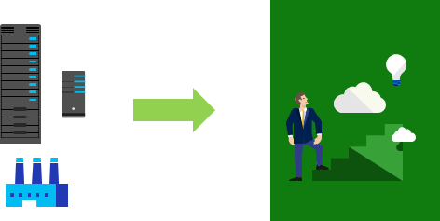
Consumption- based model
Users only pay for the resources they use
Notes:
The graphic represents physical infrastructure, which would have an associated cost to acquire it. The arrow indicates a transition to the cloud where there is no physical infrastructure. The user shows progression with their idea in the cloud, consuming only the resources that they need.
This consumption-based model brings with it many benefits, including:
No upfront costs
No need to purchase and manage costly infrastructure that they may or may not use to its fullest
The ability to pay for additional resources if and when they are needed
The ability to stop paying for resources that are no longer needed

Slide 11
Types of cloud models

Slide 12
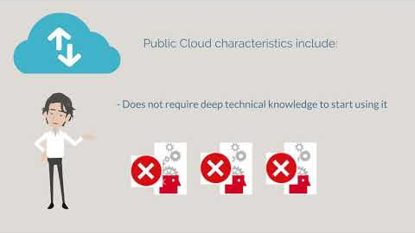
Video: Cloud Models

Slide 13
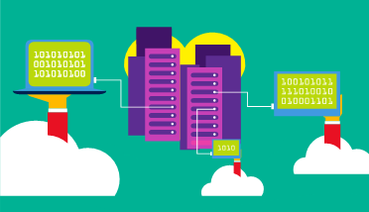
Public cloud
A public cloud is owned by a cloud services provider (also known as a hosting provider). It provides resources and services to multiple organizations and users who connect to the cloud service via a secure network connection, typically over the internet
Notes:
Public cloud models have the following characteristics:
Multiple end users. Public cloud modes may make their resources available to multiple organizations.
Public access. Public clouds provide access to the public.
Availability. This is the most common cloud-type deployment model.
Connectivity. Users and organizations are typically connected to the public cloud over the internet using a web browser.
Skills. Public clouds do not require deep technical knowledge to set up and use
Businesses can use multiple public cloud service provider companies of varying scale. Microsoft Azure is an example of a public cloud provider.

Slide 14
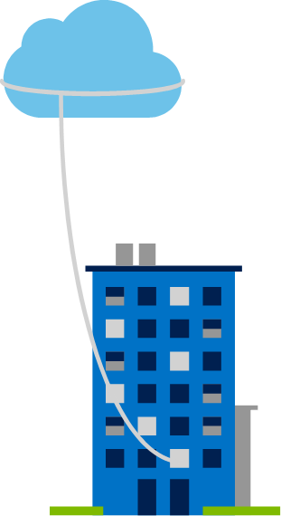
Private cloud
A private cloud is owned and operated by the organization that uses the resources from that cloud. They create a cloud environment in their own datacenter and provide self-service access to compute resources to users within their organization. The organization remains the owner, entirely responsible for the operation of the services they provide.
Notes:
Private cloud models have the following characteristics:
Ownership. The owner and user of the cloud services are the same.
Hardware. The owner is entirely responsible for the purchase, maintenance, and management of the cloud hardware.
Users. A private cloud operates only within one organization and cloud computing resources are used exclusively by a single business or organization.
Connectivity. A connection to a private cloud is typically made over a private network that is highly secure.
Public access. A private cloud does not provide access to the public.
Skills. Deep technical knowledge is required to set up, manage, and maintain the private cloud.

Slide 15
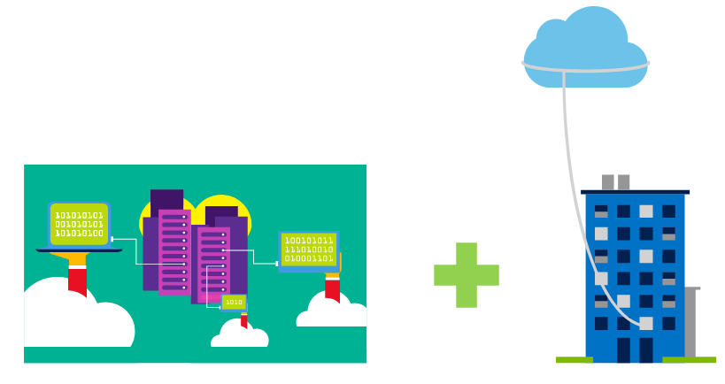
Hybrid cloud
A hybrid cloud combines both public and private clouds, allowing you to run your applications in the most appropriate location
Notes:
Hybrid cloud models have the following characteristics:
Resource location. Specific resources run or are used in a public cloud, and others run or are used in a private cloud.
Cost and efficiency. Hybrid cloud models allow an organization to leverage some of the benefits of cost, efficiency, and scale that are available with a public cloud model.
Control. Organizations retain management control in private clouds.
Skills. Technical skills are still required to maintain the private cloud and ensure both cloud models can operate together.
An example of a hybrid cloud usage scenario would be hosting a website in the public cloud and linking it to a highly secure database hosted in a private cloud.
Hybrid cloud scenarios can be useful when organizations have some information that cannot be put in a public cloud, possibly for legal reasons. For example, you may have medical data that cannot be exposed publicly.
You can read more about Microsoft Azure Hybrid cloud options at Hybrid Cloud.

Slide 16
Cloud model comparison
Public cloud:
No CapEx. You don’t have to buy a new server to scale up.
Agility. Applications can be made accessible quickly, and deprovisioned whenever needed.
Consumption-based model. Organizations pay only for what they use, and operate under an OpEx model.
Private cloud:
Control. Organizations have complete control over resources.
Security. Organizations have complete control over security.
Hybrid cloud:
Flexibility. The most flexible scenario. With a hybrid cloud setup, an organization can determine whether to run their applications in a private cloud or in a public cloud.
Compliance. Organizations maintain the ability to comply with strict security, compliance, or legal requirements as needed.
Notes:
The slide contains only some cloud comparison discussion points. Depending on time, you may want to consider broadening out the discussion and asking for more comparison details, some answers may include
Public cloud:
Skills. No deep technical skills are required to deploy, use, and gain the benefits of a public cloud. Organizations can leverage the skills and expertise of the cloud provider to ensure workloads are secure, safe, and highly available
Skills. Private clouds requires in-house IT skills and expertise that may be hard to get or be costly
Specific scenarios. If organizations have a unique business requirement, such as having to maintain a legacy application, it may be hard to meet that requirement with public cloud services.
Costs. Purchasing and maintaining a private cloud to use alongside the public cloud can be more expensive than selecting a single deployment model.

Slide 17
Types of cloud services

Slide 18
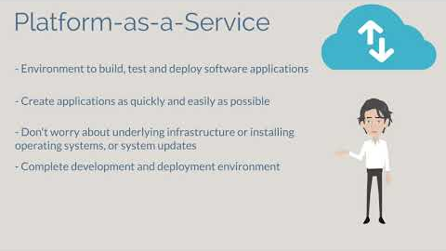
Video: Cloud Services

Slide 19
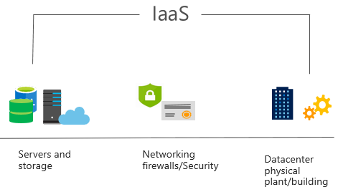
IaaS
IaaS is the most basic category of cloud computing services. With IaaS, you rent IT infrastructure servers, and virtual machines (VMs), storage, networks, and operating systems from a cloud provider on a pay-as-you-go basis. It's an instant computing infrastructure, provisioned and managed over the internet.
Notes:
For more information on IaaS, visit What is IaaS?

Slide 20
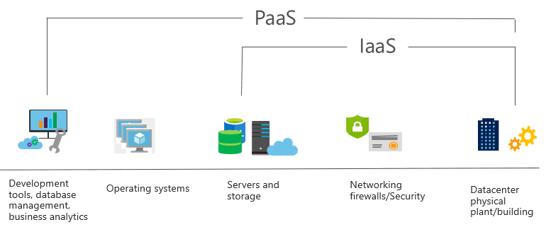
PaaS
PaaS provides an environment for building, testing, and deploying software applications. The goal of PaaS is to help create an application as quickly as possible without having to focus on managing the underlying infrastructure.
Notes:
Common usage scenarios:
Development framework. PaaS provides a framework that developers can build upon to develop or customize cloud-based applications. Similar to the way you create a Microsoft Excel macro, PaaS lets developers create applications using built-in software components. Cloud features such as scalability, high-availability, and multi-tenant capability are included, reducing the amount of coding that developers must do.
Analytics or business intelligence. Tools provided as a service with PaaS allow organizations to analyze and mine their data. They can find insights and patterns, and predict outcomes to improve business decisions such as forecasting, product design, and investment returns.
For more information on IaaS see What is PaaS?

Slide 21
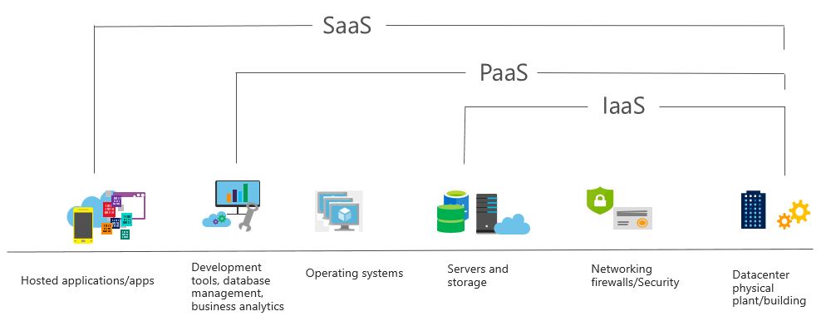
SaaS
SaaS is software that is centrally hosted and managed for the end customer. It allows users to connect to and use cloud-based apps over the internet. Common examples are email, calendars, and office tools such as Microsoft Office 365.
Notes:
Common usage scenarios:
Examples of Microsoft SaaS services include Microsoft Office 365, Skype, and Microsoft Dynamics CRM Online.
For more information on IaaS, see What is SaaS?

Slide 22
Cloud service comparison
IaaS: Flexibility. IaaS is the most flexible cloud service as you have control to configure and manage the hardware running your application.
PaaS: Productivity. Users can focus on application development only, as all platform management is handled by the cloud provider. Working with distributed teams as services is easier, as the platform is accessed over the internet and can be made globally available more easily.
SaaS: Pay-as-you-go pricing model. Users pay for the software they use on a subscription model, typically monthly or yearly, regardless of how much they use the software.
Notes:
The slide contains only some of the cloud service comparison discussion points. Depending on time, you may want to consider broadening out the discussion using some of the points from below.
IaaS
IaaS is the most flexible category of cloud services. It aims to give you complete control over the hardware that runs your application. Instead of buying hardware, with IaaS, you rent it.
IaaS Advantages:
No CapEx. Users have no upfront costs.
Agility. Applications can be made accessible quickly, and deprovisioned whenever needed.
Skills. No deep technical skills are required to deploy, use, and gain the benefits of a public cloud. Organizations can leverage the skills and expertise of the cloud provider to ensure workloads are secure, safe, and highly available.
PaaS
PaaS provides the same benefits and considerations as IaaS, with some additional benefits.
PaaS Advantages:
No CapEx. Users have no upfront costs.
Agility. PaaS is more agile than IaaS, and users do not need to configure servers for running applications.
Productivity. Users can focus on application development only, as all platform management is handled by the cloud provider. Working with distributed teams as services is easier, as the platform is accessed over the internet and can be made globally available more easily.
SaaS
SaaS provides the same benefits as IaaS, but again there some additional benefits.
SaaS Advantages:
No CapEx. Users don’t have any upfront costs.
Agility. Users can provide staff with access to the latest software quickly and easily.
Pay-as-you-go pricing model: Users pay for the software they use on a subscription model, typically monthly or yearly, regardless of how much they use the software.

Slide 23
Begriffsklärung.
Unternehmen kontrolliert
Daten/Prozesse
Geteilte Kontrolle
Anwendung/DB
Direkte Kontrolle durchs Unternehmen nimmt ab
Inhouse
Dienstleister kontrolliert
Virtualisierung
Daten/Prozesse
RZ/Server
Anwendung/DB
Daten/Prozesse
RZ/Speicher
Virtualisierung
Anwendung/DB
Daten/Prozesse
Inhouse
Hosting
IaaS
PaaS
SaaS
Internet/Netzwerk
RZ/Server
Virtualisierung
Anwendung/DB
Daten/Prozesse
RZ/Speicher
RZ/Server
Virtualisierung
Anwendung/DB
Cloud/Outsourcing
Internet/Netzwerk
RZ/Speicher
RZ/Server
Virtualisierung
Internet/Netzwerk
RZ/Speicher
RZ/Server
Zunehmender Grad an Auslagerung
Internet/Netzwerk
RZ/Speicher
Internet/Netzwerk

Slide 24
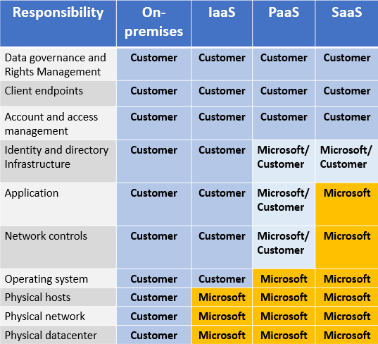
Management responsibilities
IaaS requires the most user management of all the cloud services. The user is responsible for managing the operating systems, data, and applications.
PaaS requires less user management. The cloud provider manages the operating systems, and the user is responsible for the applications and data they run and store.
SaaS requires the least amount of management. The cloud provider is responsible for managing everything, and the end user just uses the software.
Notes:
It is important that users understand what they are responsible for when using cloud services, to ensure their workloads are managed correctly and don't suffer any down time.
There is a shared responsibility model for ensuring cloud workloads are run securely and in a well-managed way. Depending on the service you are using, the cloud provider is responsible for some aspects of the workload management, and the customer or end user is responsible for other aspects of the workload management, and in some cases both share a responsibility.

Slide 25

Quiz

