Slide 1
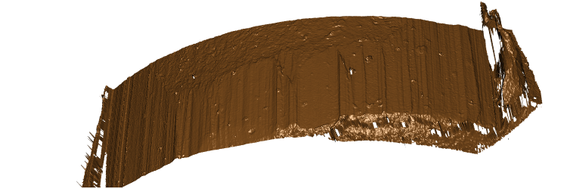
right shoulder
breakoff
left shoulder

