Slide 1
Introduction

Slide 2
Who are we?
Andr01d
Red Team Captain
Pwnstar/gamemista
Red Team Co-Captain

Slide 3
What is Red Team?
Teams:
Red: Offensive Penetration Testing
Blue: Defensive Security Training/CCDC team
What does Red Team do?
Performs penetration tests against a specific network of vm’s
Train the Blue Team/CCDC team for national and collegiate competitions
Compete in multiple CTF’s (capture the flag), including several DEFCON Quals
Prior knowledge
No specific prior knowledge needed, though familiarity of linux/unix operating systems is a good base

Slide 4
Survey
Complete the survey
Answer everything to the best of your ability

Slide 5
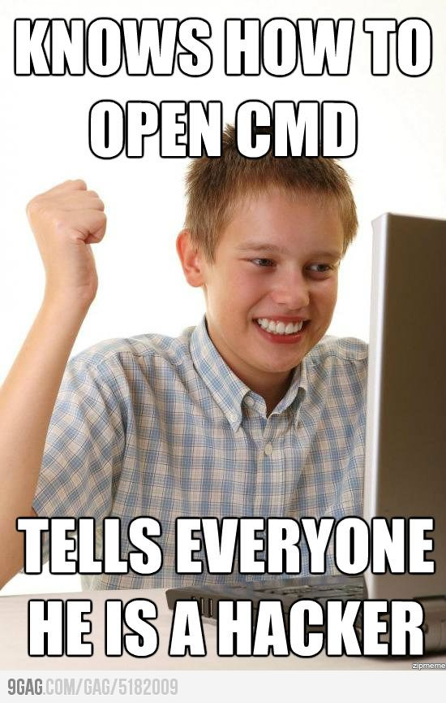
The “Ball Sack” Curve
“1337’ness”
Time

Slide 6
How do I keep from being a “script kiddie”?
Learn to program!
Scripting languages
Perl
Python
Bash
Low level languages
C
Assembly
TAKE NOTES
Do your assigned homework
If you have trouble, don’t be afraid to ask for help!
andr01d@tutanota.com
Message me on slack - andr01d
Learn to google
Google is your new best friend
Don’t try to learn a whole programming language over homework to create a simple script
Don’t get lost in google, it’s very easy
Most answers can be found in 1-2 Google searches

Slide 7
What you need
Laptop with hypervisor capabilities
VMware Workstation/Fusion
If you are a CS student, Workstation is free
Fusion is free for all
Binder/paper
Empty binder is fine if you are taking notes on the computer
Drive

Slide 8
Tools that will be used
Armitage/Metasploit
Exploit database/framework
Nmap
Tool for scanning networks/target computers for open ports and services
Nikto
Website vulnerability scanner
Vega/Burp Suite
Website scanner/proxy for multiple attacks
Many more to come.

Slide 9
Documentation
Cutycapt
Dradis
Use scripts off the github
github.com/CSARedTeam
Armitage for mapping network and logging attacks

Slide 10
Linux setup

