Slide 1

Hacking Tools 4 n00bs
By andr01d

Slide 2
Topics to be covered:
Operating Systems
Basic enumeration
Network discovery/scanning
Pwning the boxes
Post-exploitation/maintaining access
Covering your tracks
DOS

Slide 3
Operating Systems
Kali linux
Black Arch
BackBox
Any linux

Slide 4
Basic enumeration: A little bit of intel goes a long way
Whois
Nslookup
GOOGLE

Slide 5

Scan all the networks
Nmap
Nmap
Nmap
Nessus
Openvas
Wireshark
Tcpdump
Aircrack-ng

Slide 6
Scan all the networks: Web
Nmap
Nikto
Burp Suite
Subgraph Vega
Sqlmap
Sqlninja
BEEF
Xsser
SET

Slide 7
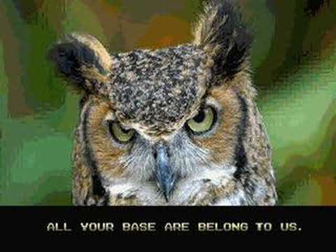
Pwning the boxes
Metasploit
Bruteforce:
Hydra
Medussa
Passwords:
John the Ripper
Cane and Able
SSH, SSH, SSH
Armitage

Slide 8
Post exploitatin...persistance
NETCAT
SSH
VNC
Meterpreter
Webshells
Rootkits
Keyloggers

Slide 9
DOS
Torshammer
Slobhammer
Andsmash
Hping3
Scapy
http://map.norsecorp.com/#/

