Slide 1
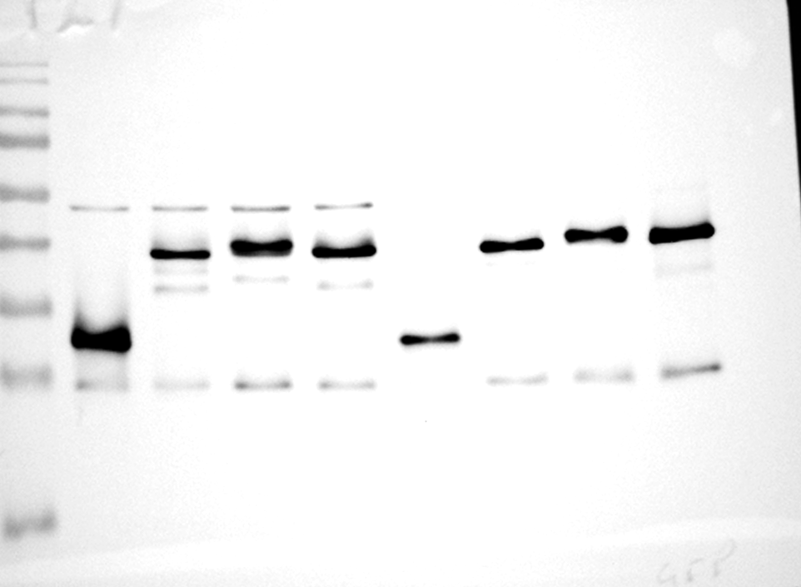
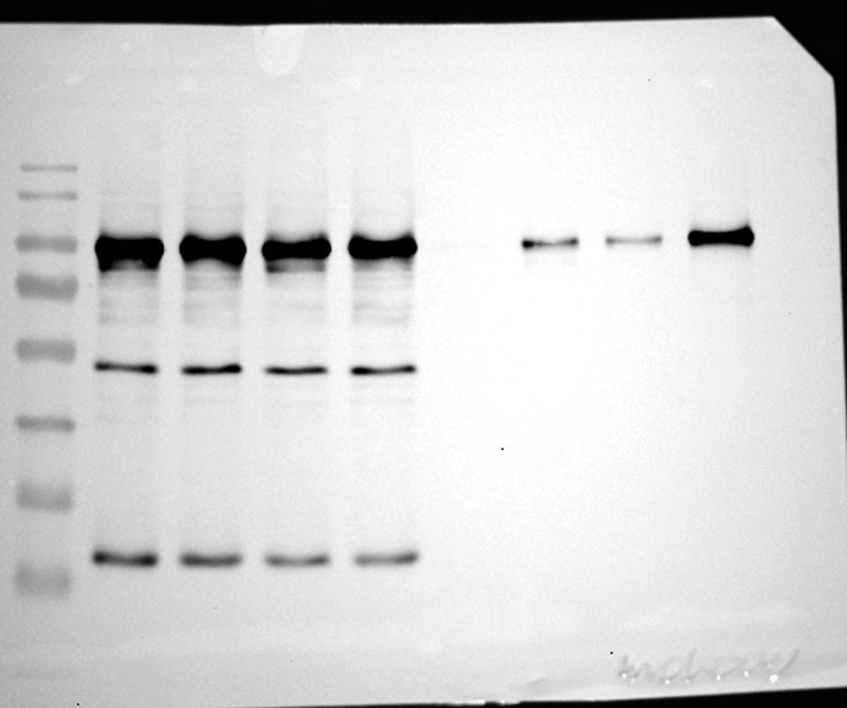
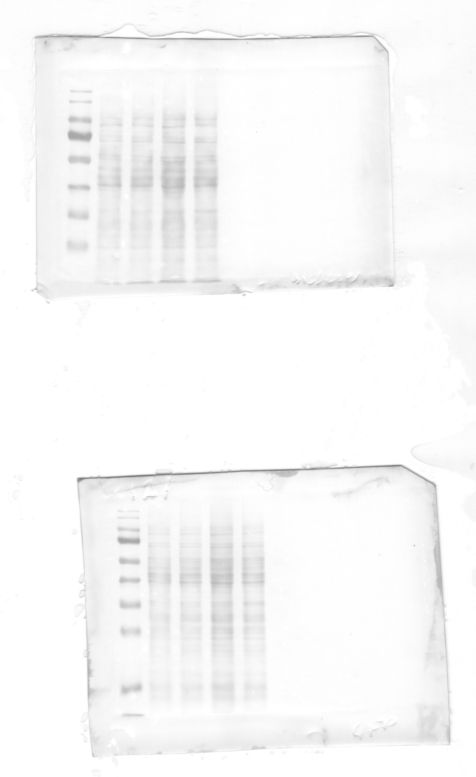
Figure 5b
eGFP-LC3^{AS_Mutant2}
eGFP-LC3^{AS_Mutant2}
eGFP-LC3^{AS_Mutant1}
eGFP-LC3^{AS_Mutant1}
eGFP-LC3B-WT
eGFP-LC3B-WT
eGFP
eGFP
KDa
Input (10%)
IP
Starve (6 h)
180
70
55
40
eGFP-LC3B
35
25
15
KDa
180
70
mCherry-P62
55
40
35
25
KDa
180
70
55
Ponceau
40
35
25

Slide 2
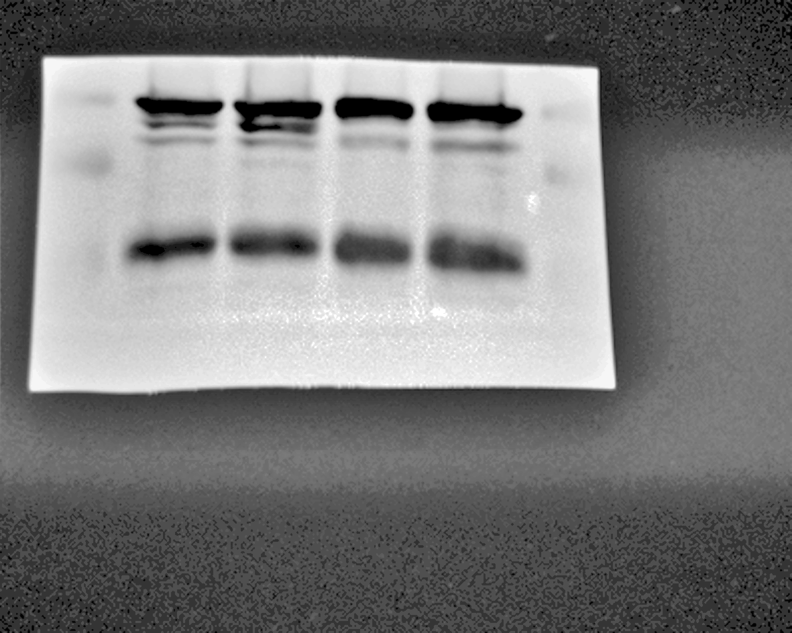
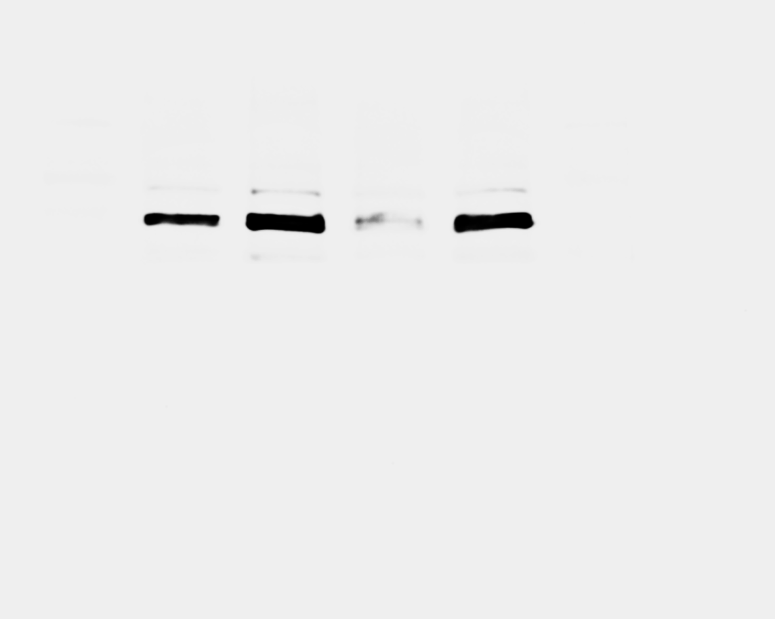
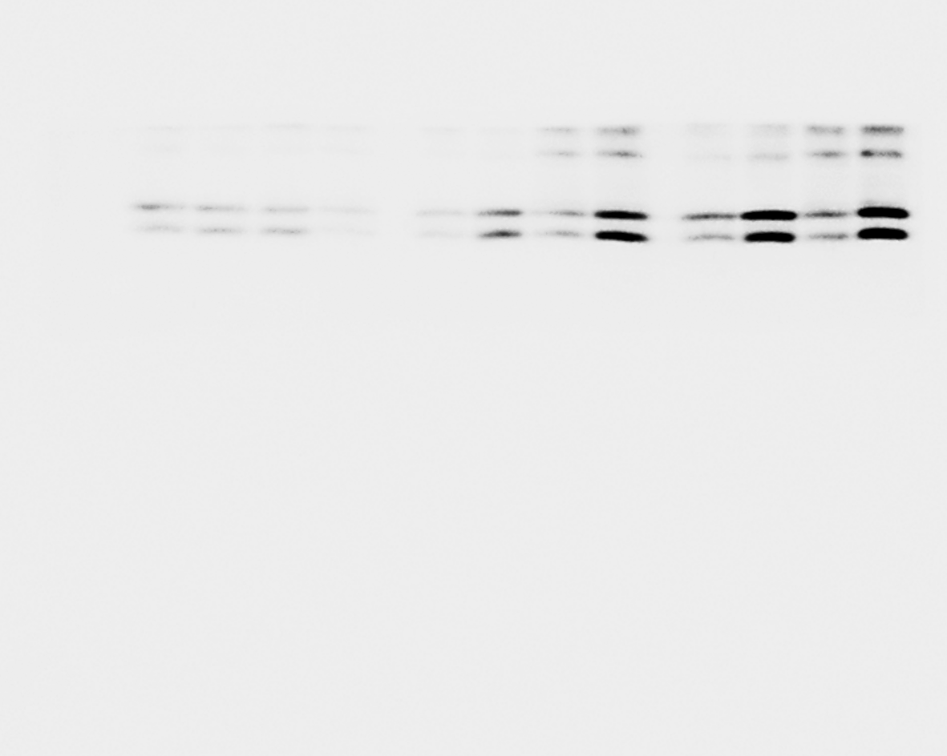
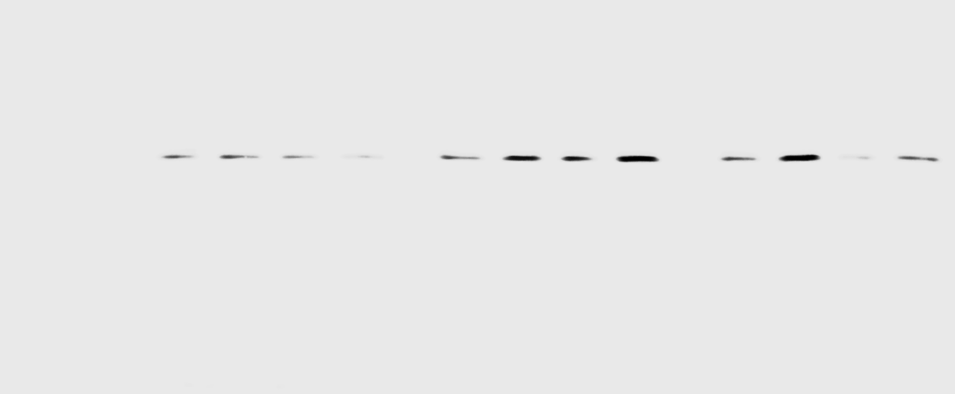
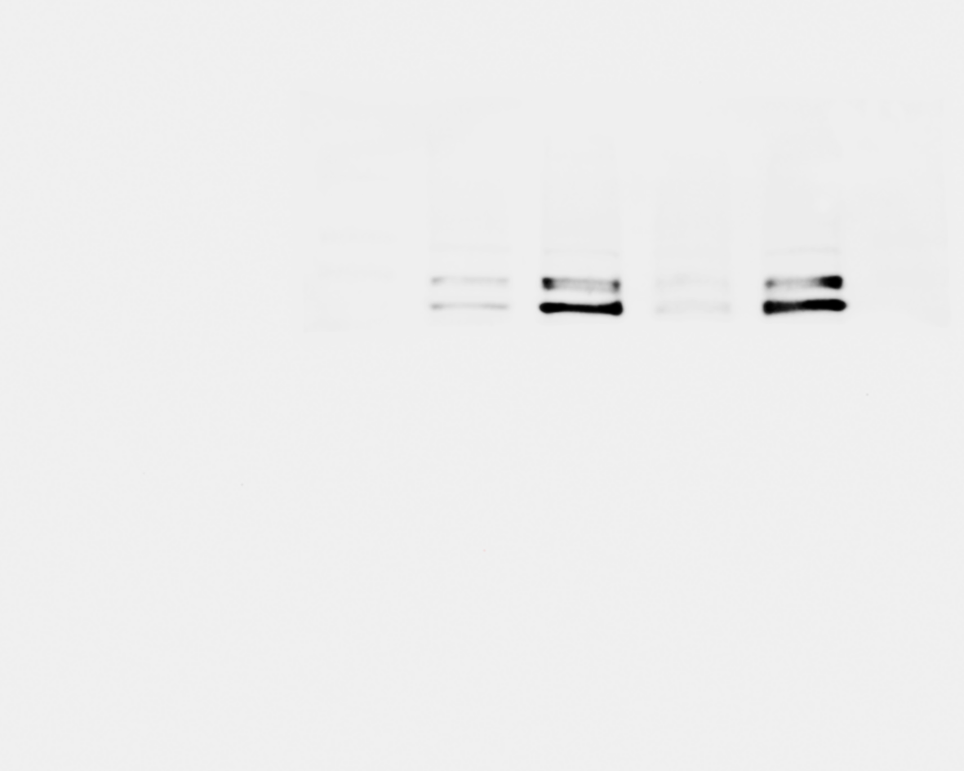

Figure 5e
WT^{LC3B}
WT^{LC3B}
LC3B^{AS_Mutant1}
LC3B^{AS_Mutant1}
Lysosomal Inhibitor
- + - +
Lysosomal Inhibitor
- + - +
EGFP
70 KDa
FAM134B
40 KDa
VPS4A
LC3B I
II
55 KDa
40 KDa
Ponceau
70 KDa
P62
40 KDa

