Slide 1
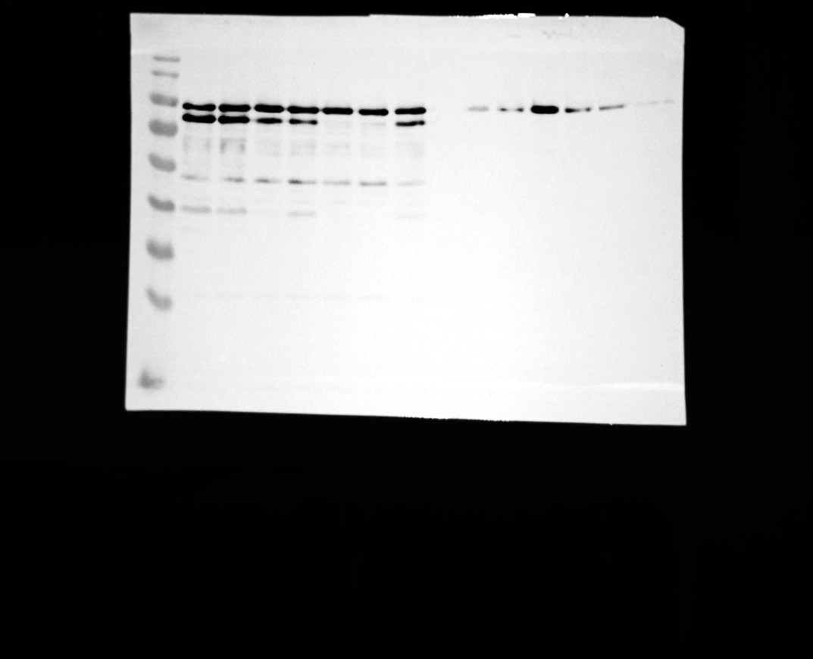
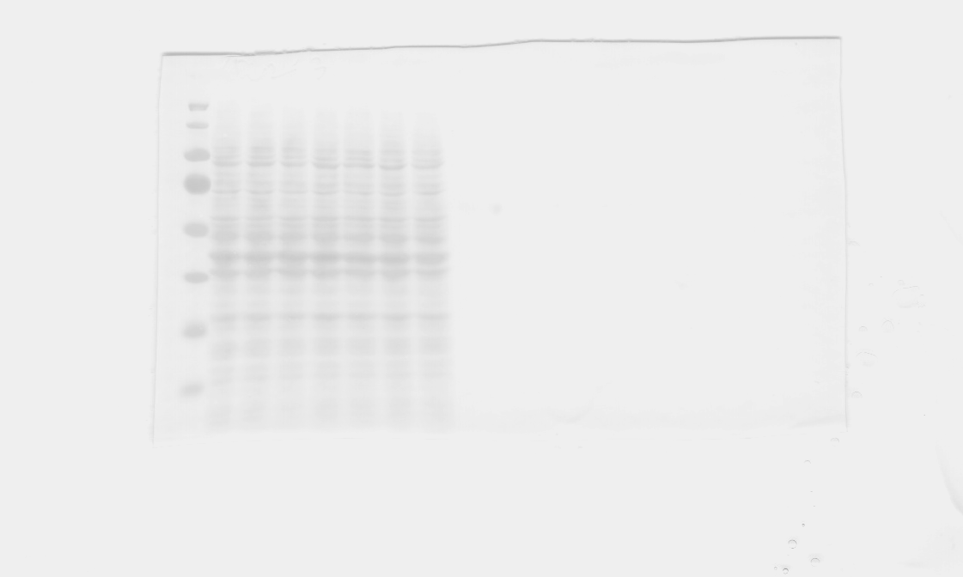
Supplementary Figure 27a
eGFP- _{∆G}LC3^{AS_Mutant 1}
eGFP- _{∆G}LC3^{AS_Mutant 2}
eGFP- _{∆G}LC3^{AS_Mutant 1}
eGFP- LC3^{AS_Mutant 2}
eGFP- _{∆G}LC3^{AS_Mutant 2}
eGFP- LC3^{AS_Mutant 1}
eGFP- LC3^{AS_Mutant 2}
eGFP- _{∆G}LC3^{AS_Mutant 1}
eGFP- LC3^{AS_Mutant 1}
eGFP- _{∆G}LC3^{AS_Mutant 2}
eGFP- _{∆G}LC3^{AS_Mutant 1}
eGFP- LC3^{AS_Mutant 2}
eGFP- _{∆G}LC3^{AS_Mutant 2}
eGFP- LC3^{AS_Mutant 1}
eGFP- LC3^{AS_Mutant 2}
eGFP- LC3^{AS_Mutant 1}
eGFP- _{∆G}LC3^{WT}
eGFP- _{∆G}LC3^{WT}
eGFP- _{∆G}LC3^{WT}
eGFP- _{∆G}LC3^{WT}
eGFP- LC3^{WT}
eGFP- LC3^{WT}
eGFP- LC3^{WT}
eGFP- LC3^{WT}
eGFP
eGFP
eGFP
eGFP
Starve (6 hrs) ➤
Input (10%)
IP
Starve (6 hrs) ➤
Input (10%)
IP
180
KDa
180
70
mCherry-p62 ➤
70
55
55
eGFP-LC3B ➤
40
40
35
35
eGFP ➤
25
25
15
15
Ponceau

