Slide 1
CaDRReS2
An attempt to improve drug-response prediction
Progress
-Aanchal Mongia
September 11, 2019

Slide 2
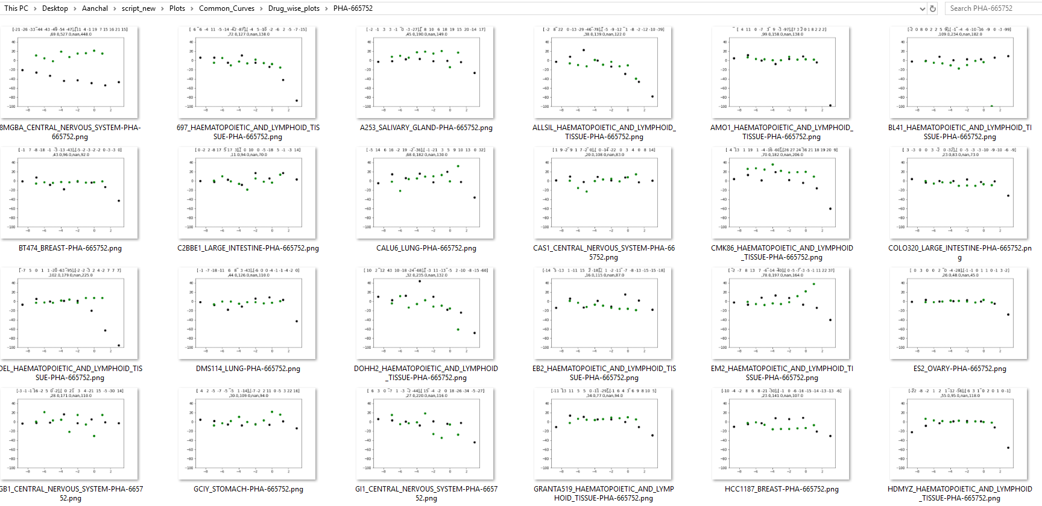
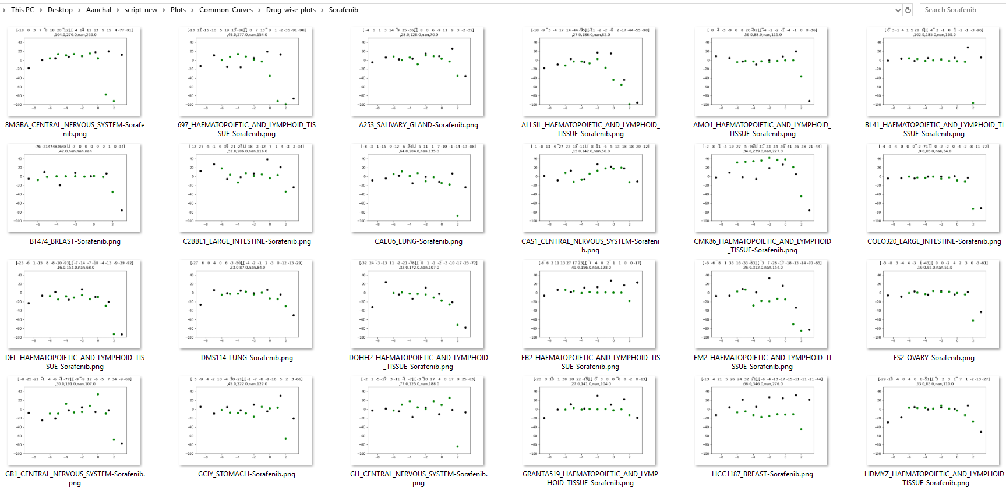
Pair segregation (Drug wise) observations
PHA-665752
PHA-665752, Sorafenib (MOTIVATION for merging: combining the datasets would help interpret the drug response better)
Inactive and highly selective compounds/
Either works on high dosage or on some specific cell lines
GDSC never shows response on the tested dosage, CCLE shows the drug working on very few cell lines
Sorafenib

Slide 3
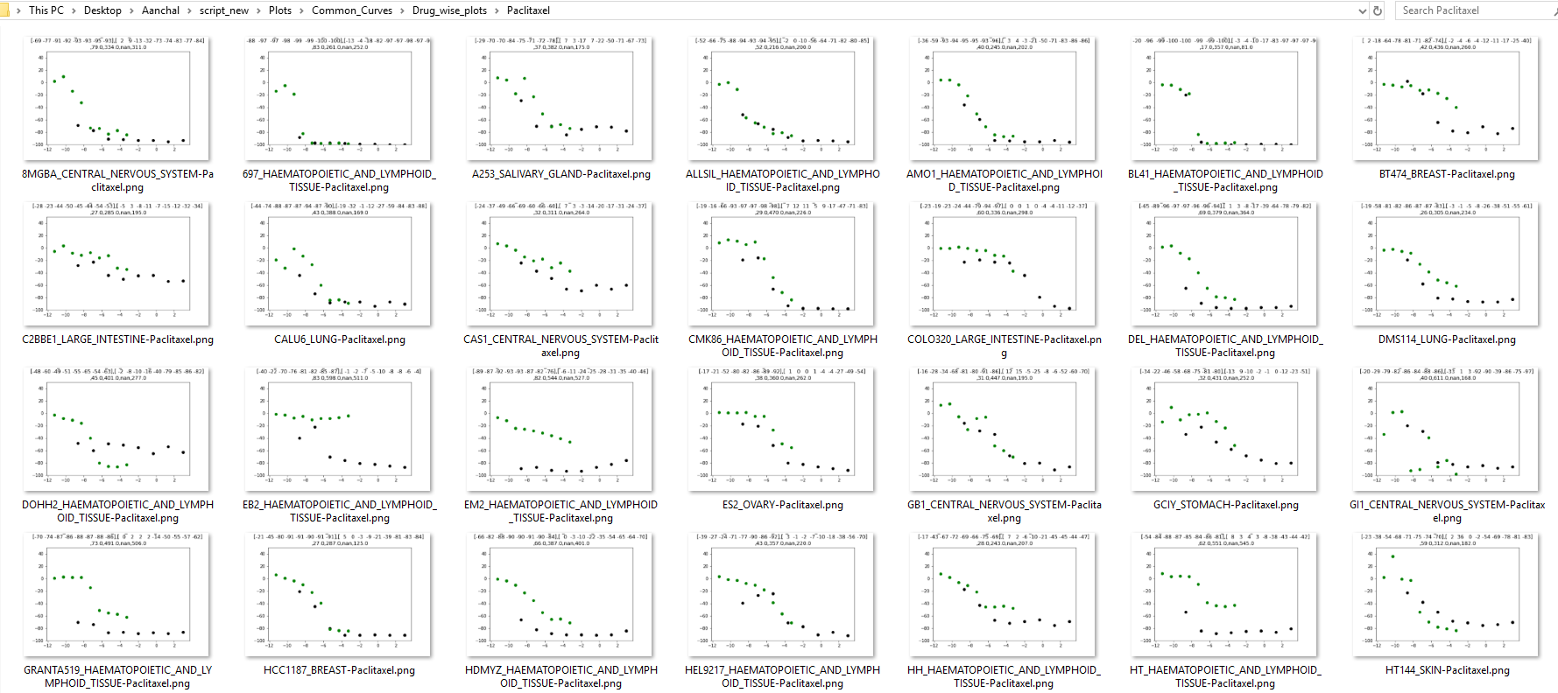
2. Drugs showing mostly consistent drug response across datasets:
AZD0530, lapatinib, Erlotinib, PHA-665752
3. PACLITAXEL: CCLE drug response is mostly lower than that of GDSC CCLE dose range: ( 0.0025-8 ) uM GDSC dose range; (0.0004-0.1024) uM
PACLITAXEL

Slide 4
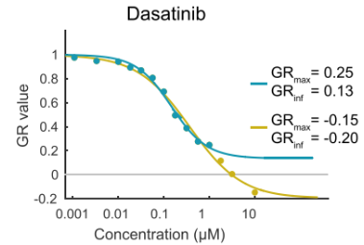
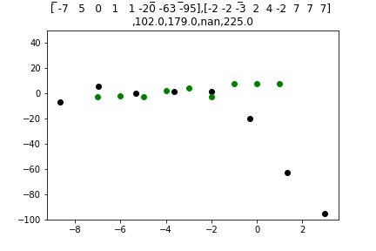
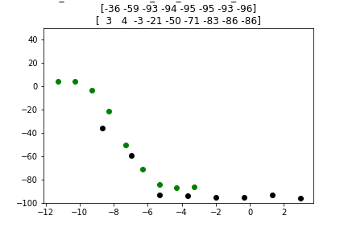
Possible explanations of the following 3 types of inconsistencies
Outlier behaviour(Hump/Rising) which is actually DNW- experimental bias (curve fitting on merged data resolves it i.e. DNW and outliers have same fitted curve)
Our Concordant_diffRange class) - DIFFERENT DRUG DOSAGE (sheer combing resolves it) Motivation: a dose range that is adequate for analysis of 1 drug may not be adequate for another.

Slide 5
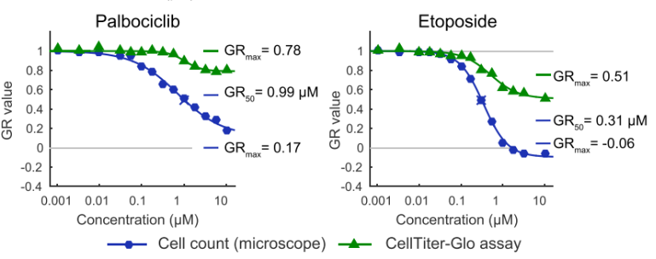
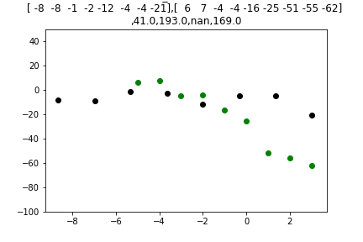
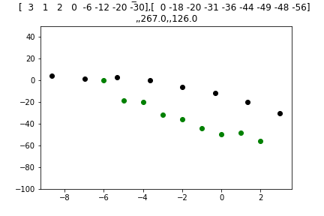
3. Open-ended - DIFFERENT CELL COUNTING METHOD Motivation: It is known that CellTiter-Glo and direct cell counts are poorly correlated when drugs cause large changes in cell size or alter ATP metabolism, thereby changing the relationship between ATP level in a cell extract and viable cell number

Slide 6
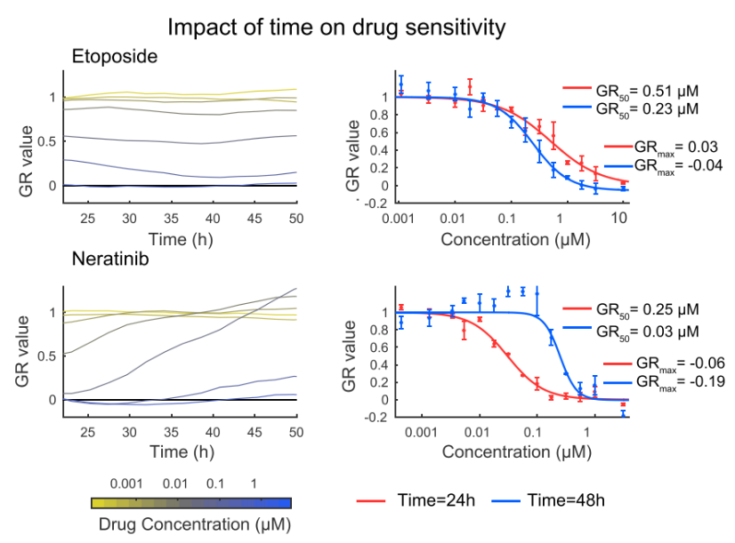
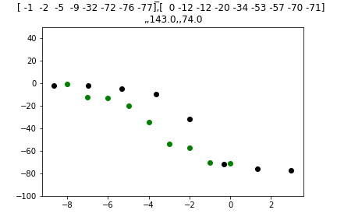
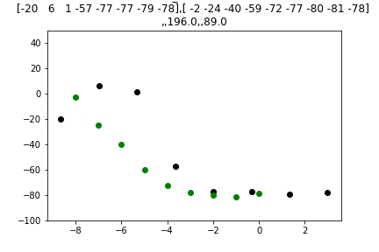
4. Closed -DIFFERENT TIME DURATIONS
Motivation: IC50 values can be strongly time-dependent and we might therefore expect data for some drugs to be sensitive to small variations in procedure.

Slide 7
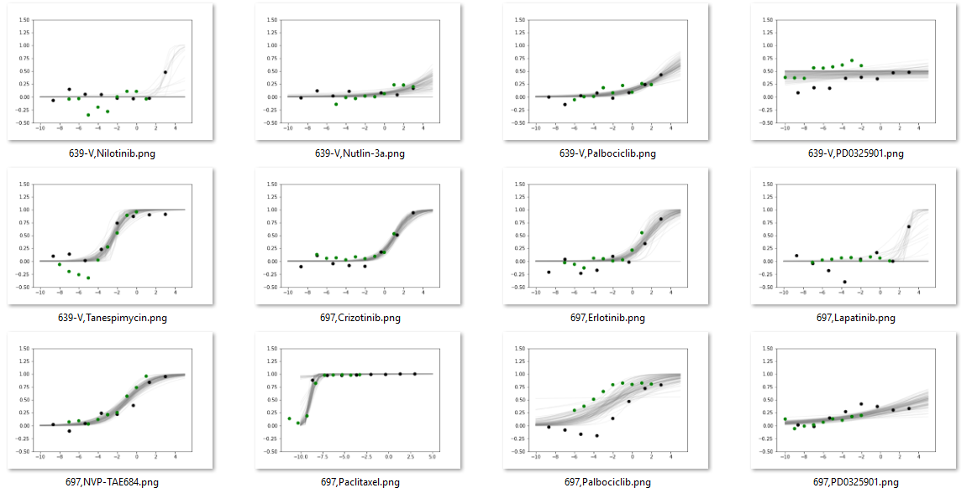
Curve fitting results
Bayesian sigmoid model was fitted on each cell line-drug pair and the ic50 and slope (m) distribution for each pair of curves was used to plot the learnt curves

Slide 8
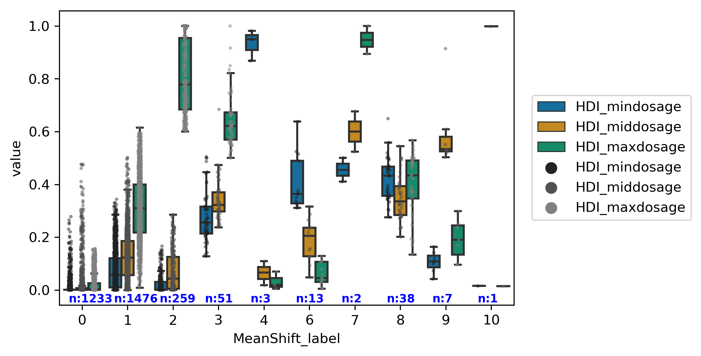
Pair classification results using MS clustering

Slide 9
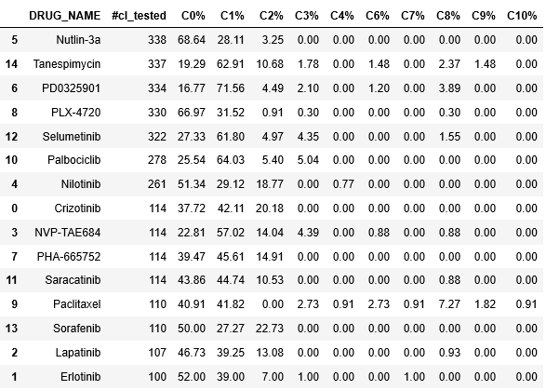
Drug and cell line composition for each cluster

Slide 10
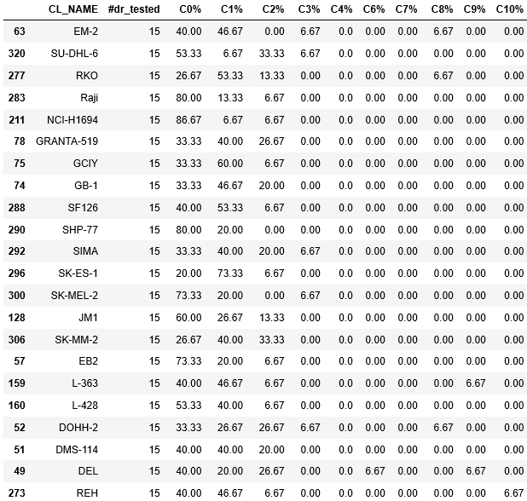
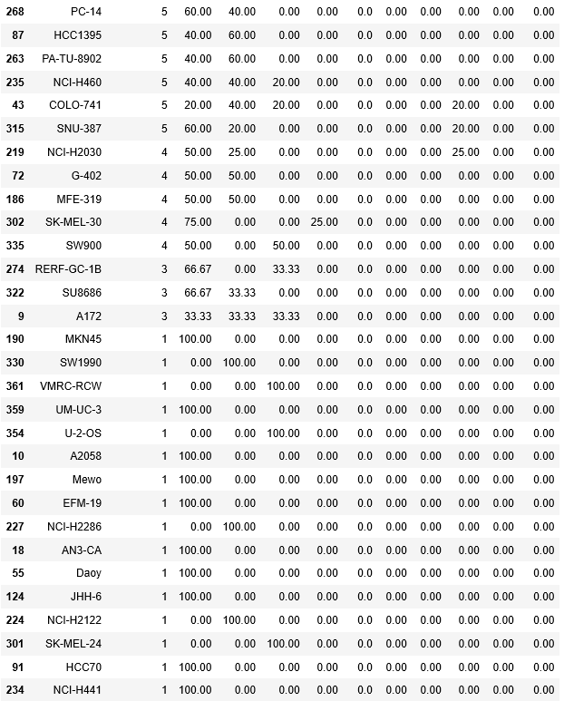

Slide 11
Drugs to look upon/analyze:
Paclitaxel
Tanespimycin
PD-0325901
Selumetinib

Slide 12
Future plan
1) Handling data inconsistency: To find a reasonable way to merge the dose response information from 2 different experiments (CCLE and GDSE)
Outlier detection and filtering (done)
Common Pair separation/classification (done)
Analysing the difference (shift, outlier behaviour) in response behaviour (in progress)
Correct them
Merge the datasets for a more reliable database
2) Quantification of Drug response: Find an alternative metric to capture the drug response behaviour / quantify the Dose-response curve in the best way possible

Slide 13
Appendix
-Aanchal Mongia
August 1, 2019

Slide 14

Queries from last presentation..
How large the correlation can be? -> Find corr between IC50 from concordant pairs
Is the number of H-H and R-R pairs depleted (low by chance) ? -> chi-square test

Slide 15
Other work
*2a* Project 400 files update
*2b* Literature review for FUTURE ROADMAP

